Slide 1
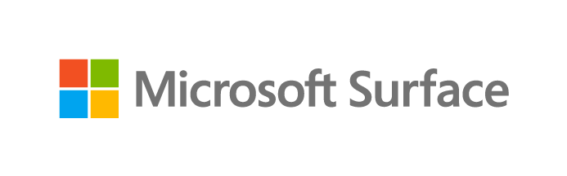
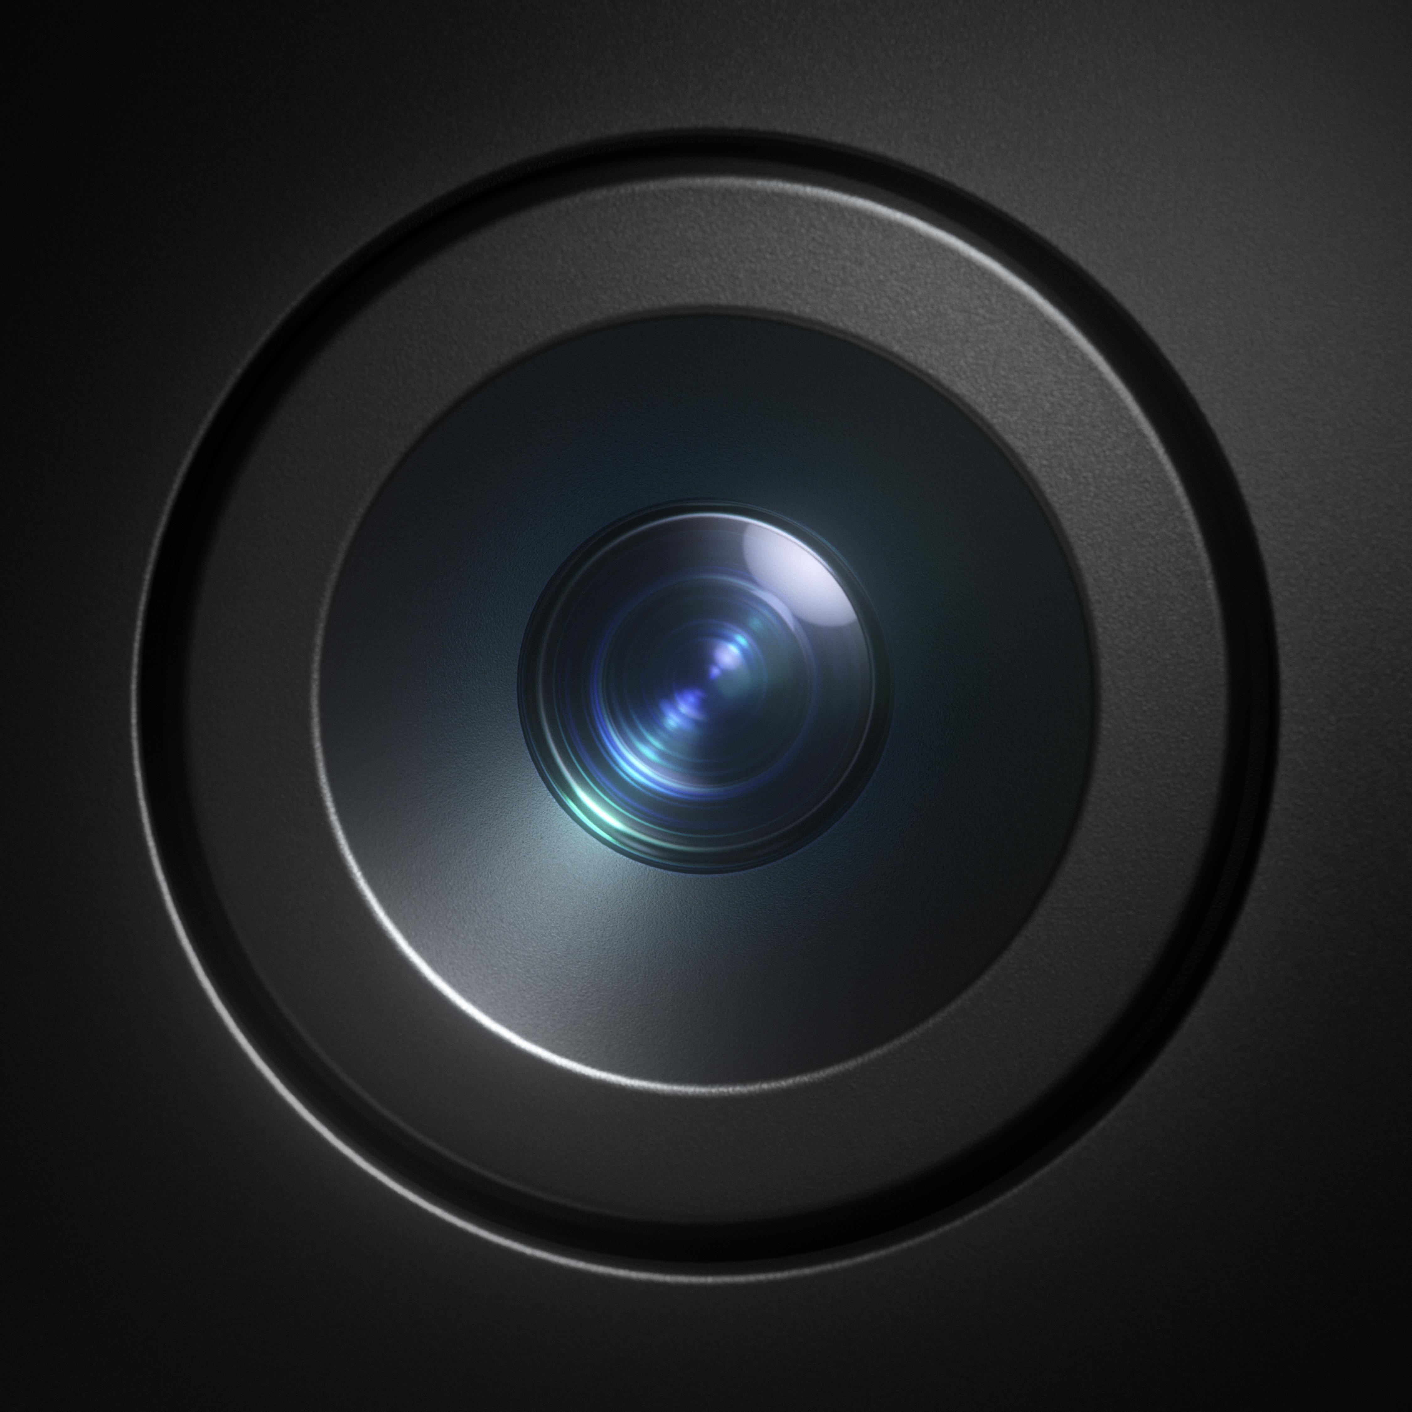
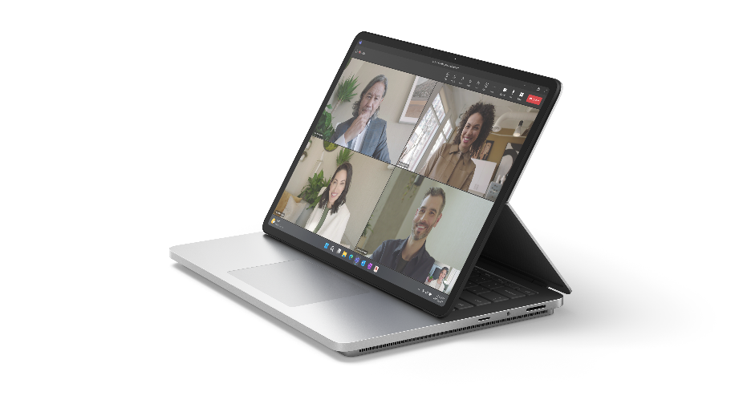
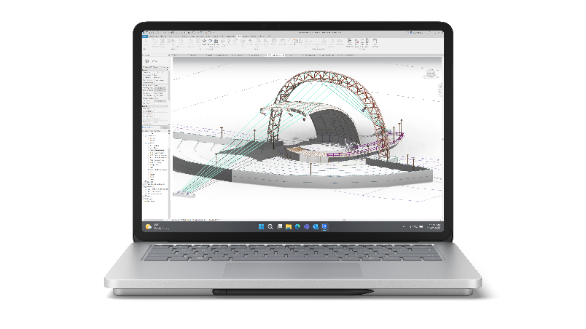
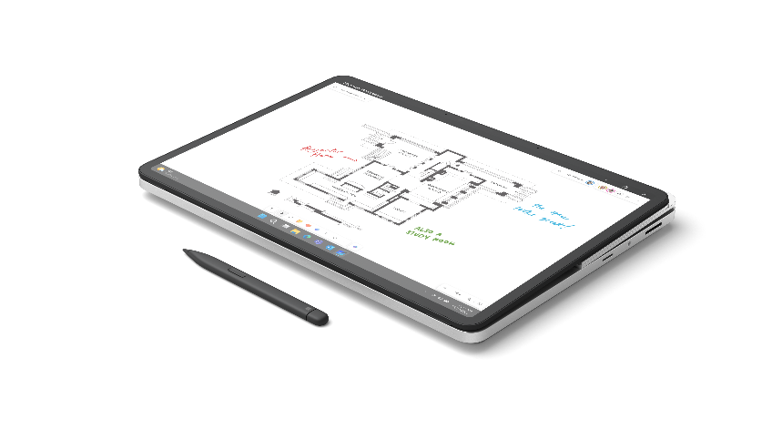

Microsoft Surface Laptop Studio 2
The versatility to create. The power to perform.
Reimagine how your team gets work done with the most powerful Surface ever. Surface Laptop Studio 2 delivers enterprise-level performance in a revolutionary design that seamlessly transitions between modes.
Go from a touchscreen laptop to the perfect angle for collaboration to a portable canvas, all at the fast pace of the modern workplace. With Microsoft security and innovative Windows 11 features enabled out of the box, Surface Laptop Studio 2 is the ultimate powerhouse laptop.
DESIGNED FOR PERFORMANCE
VERSATILITY FOR ANY CHALLENGE
The most powerful Surface delivers over 2x more computing power and up to twice the graphics performance for demanding jobs or multitasking.¹
Give your teams the power to tackle any challenge, whether they’re compiling data, multitasking across 4K displays, jumping between calls, or sketching ideas.
EMPOWER CREATIVITY AND COLLABORATION
DEPLOY, MANAGE, AND STAY SECURED ANYWHERE
Elevate productivity through with Microsoft 365² through a high-quality touchscreen, Studio Camera, speakers, mics, and all the ports your workers need.
Protect your organization’s data with Secured-core PCs and chip-to-cloud security³ as IT saves time and money through modern deployment and management.
Vibrant 14.4”⁴ PixelSense™ Flow touchscreen with a refresh rate up to 120hz
A more serviceable design that minimizes downtime⁵
New Studio Camera with a wide field of view and
AI-powered features
Omnisonic® speakers and far-field Studio Mics featuring Voice Clarity⁶
Seamless transitions between three different modes through the dynamic woven hinge
All-day productivity with all-day battery life⁸
Inking like pen on paper
with Surface Slim Pen 2⁷
Disclaimers
¹Available as an option on certain of Surface Laptop Studio 2.
²Sold separately. Software license required for some features.
³Some cloud-enabled features and functionality require paid subscription and/or qualifying license.
⁴Surface Laptop Studio 2 display has rounded corners within a standard rectangle. When measured as a standard rectangular shape the screen is 14.36” diagonally (actual viewable area is less).
⁵Customer Replaceable Units (CRUs) are components available for purchase through your Surface Commercial Authorized Device Reseller. Components can be replaced on-site by a skilled technician following Microsoft’s Service Guide. Opening and/or repairing your device can present electric shock, fire and personal injury risks and other hazards. Use caution if undertaking do-it-yourself repairs. Device damage caused during repair will not be covered under Microsoft’s Hardware Warranty or protection plans. Components will be available shortly after initial launch; timing of availability varies by component and market.
⁶Voice Clarity requires Windows 11 and is available in apps which use integrated device microphones and use certain Windows audio processing modes.
⁷Sold separately.
⁸Battery life varies significantly based on device configuration, usage, network and feature configuration, signal strength, settings and other factors. See aka.ms/SurfaceBatteryPerformance for details.

Slide 2
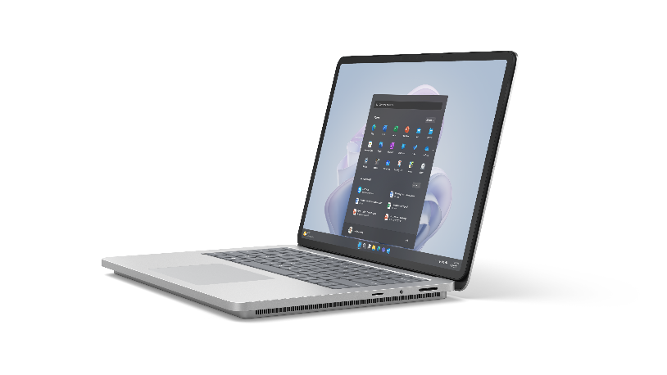
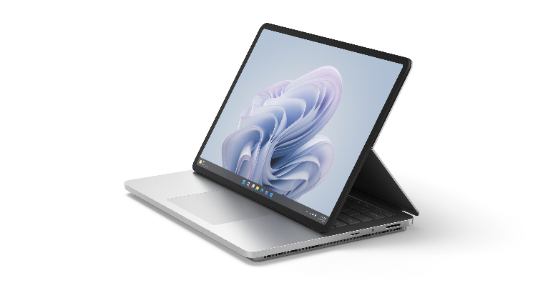
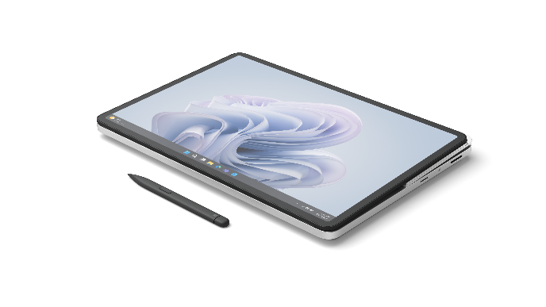
Microsoft Surface Laptop Studio 2
PROCESSOR
13th Gen Intel® Core™ i7-13800H Processor
Built on the Intel® Evo™ platform Intel® Gen3 Movidius 3700VC VPU AI Accelerator
MEMORY AND
STORAGE¹
Memory options:
16GB, 32GB or 64GB LPDDR5x RAM
Storage options:
Removable² solid-state drive (Gen 4 SSD) options: 512 GB, 1TB or 2TB
GRAPHICS
Graphics options:
NVIDIA® GeForce RTX™ 4050 Laptop GPU with 6GB GDDR6 vRAM
2130 MHz boost clock speed, 80W maximum graphics power NVIDIA® GeForce RTX™ 4060 Laptop GPU with 8GB GDDR6 vRAM
2010 MHz boost clock speed, 80W maximum graphics power NVIDIA® RTX™ 2000 Ada
Generation Laptop GPU with 8GB GDDR6 vRAM
2115 MHz boost clock speed, 80W maximum graphics power
Intel® Iris® Xe Graphics
DISPLAY
HDR Touchscreen: 14.4”³ PixelSense™ Flow Display Resolution: 2400 x 1600 (200 PPI) Refresh rate: up to 120Hz
Aspect ratio: 3:2
Contrast ratio 1500:1
Color profile: sRGB and Vivid Individually color-calibrated display
VESA DisplayHDR 400 certified Dolby Vision IQ^{®4} support Touch: 10-point multi-touch Corning® Gorilla® Glass 5 display Brightness:
SDR: 500 nits maximum (typical) HDR: 650 nits peak luminance⁵
Disclaimers
¹System software uses significant storage space. Available storage is subject to change based on system software updates and apps usage. 1 GB = 1 billion bytes. 1 TB = 1,000 GB. See Surface.com/Storage for more details.
²Customer Replaceable Units (CRUs) are components available for purchase through your Surface Commercial Authorized Device Reseller. Components can be replaced on-site by a skilled technician following Microsoft’s Service Guide. Opening and/or repairing your device can present electric shock, fire and personal injury risks and other hazards. Use caution if undertaking do-it-yourself repairs. Device damage caused during repair will not be covered under Microsoft’s Hardware Warranty or protection plans. Availability of replaceable components and service options may vary by market and/or at initial product launch.
³Surface Laptop Studio 2 display has rounded corners within a standard rectangle. When measured as a standard rectangular shape the screen is 14.36” diagonally (actual viewable area is less).
⁴Requires Dolby Vision® encoded content and video.
⁵HDR requires HDR content and enabling HDR in device settings.

Slide 3
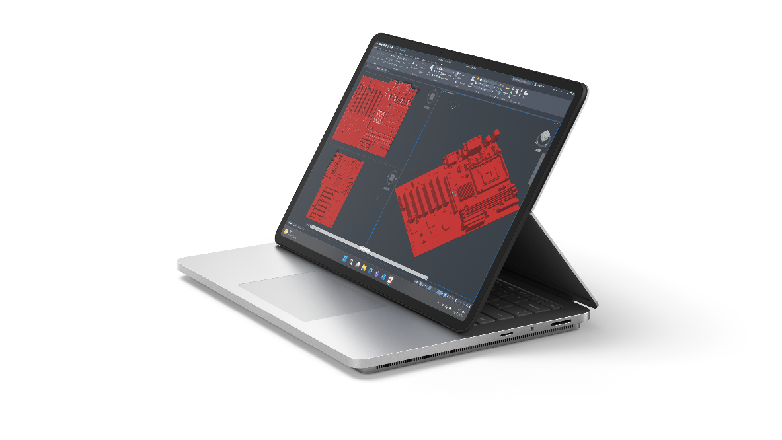
Microsoft Surface Laptop Studio 2
SIZE AND WEIGHT⁶
Length: 12.72 inch (323 mm)
Width: 9.06 inch (230 mm)
Height: 0.86 inch (22 mm)
AUDIO
Dual far-field Studio Mics with Voice Clarity⁸
Quad Omnisonic® speakers with Dolby® Atmos^{®9}
Weight:
Intel® Iris® Xe graphics model: 4.18 lbs (1.89 kg)
NVIDIA® graphics models: 4.37 lbs (1.98 kg)
PORTS
2 x USB-C® with USB4®/ Thunderbolt™ 4 (with DisplayPort and Power Delivery)
USB-A 3.1
MicroSDXC card reader
3.5 mm headphone jack Surface Connect port
BATTERY
LIFE⁷
Intel® Iris® Xe graphics model: up to 19 hours of typical device usage NVIDIA® graphics models (except 2 TB SSD): up to 18 hours of typical device usage
2 TB SSD NVIDIA® graphics models: up to 16 hours of typical device usage
NETWORK AND CONNECTIVITY
Wi-Fi 6E: 802.11ax compatible Bluetooth® Wireless 5.3 technology
PEN AND ACCESSORIES
COMPATIBILITY
Designed for Surface Slim Pen 2¹⁰ and supports tactile signals Integrated Surface Slim Pen 2¹⁰ storage for charging under the keyboard
Supports Microsoft Pen Protocol (MPP)
SECURITY
Hardware TPM 2.0 chip for enterprise-grade security and BitLocker support
Enterprise-grade protection with Windows Hello 2.0 face sign-in Windows 11 Secured-core PC
CAMERAS
Full HD front-facing Surface Studio Camera
1080p Full HD camera with wide field of view
Windows Studio Effects with Auto Framing, Eye Contact, and Background Blur
Windows Hello 2.0 face authentication camera
Disclaimers
⁶Might vary depending on manufacturing processes.
⁷Up to 19.0 hours of battery life based on typical Surface device usage on Surface Laptop Studio 2 with Intel® Core™ i7-13700H Processor, 512GB, 16 GB RAM - Testing conducted by Microsoft in July-August 2023 using preproduction Windows 11 software and preproduction Surface Laptop Studio 2 Intel® Core™ i7-13700H Processor, 512GB, 16GB RAM devices. Testing consisted of full battery discharge with a mixture of active use and modern standby. The active use portion consists of (1) a web browsing test accessing eight popular websites over multiple open tabs, (2) a productivity test utilizing Microsoft Word, PowerPoint, Excel, OneNote and Outlook, and (3) a portion of time with the device in use with idle applications. All settings were default except screen brightness was set to 150 nits with Auto-Brightness, Adaptive Color, and Smart Charging disabled. Wi-Fi was connected to a network. Tested with Windows 11 Version 10.0.22621 (22H2). Battery life varies significantly with settings, usage, and other factors.
Up to 18.0 hours of battery life based on typical Surface device usage on Surface Laptop Studio 2 with Intel® Core™ i7-13700H Processor, NVIDIA® GeForce™ RTX 4050 Laptop GPU, 512GB, 16GB RAM. Testing conducted by Microsoft in July-August 2023 using preproduction Windows 11 software and preproduction Surface Laptop Studio 2 Intel® Core™ i7-13700H Processor, NVIDIA® GeForce™ RTX 4050 Laptop GPU, 512GB, 16GB RAM devices. Testing consisted of full battery discharge with a mixture of active use and modern standby. The active use portion consists of (1) a web browsing test accessing eight popular websites over multiple open tabs, (2) a productivity test utilizing Microsoft Word, PowerPoint, Excel, OneNote and Outlook, and (3) a portion of time with the device in use with idle applications. All settings were default except screen brightness was set to 150nits with Auto-Brightness, Adaptive Color, and Smart Charging disabled. Wi-Fi was connected to a network. Tested with Windows 11 Version 10.0.22621 (22H2). Battery life varies significantly with settings, usage, and other factors.
Surface Laptop Studio 2 with Intel® Core™ i7-13700H Processor, NVIDIA® GeForce™ RTX 4060 Laptop GPU, 2TB, 64GB RAM Testing conducted by Microsoft in July-August 2023 using preproduction Windows 11 software and preproduction Surface Laptop Studio 2 Intel® Core™ i7-13800H Processor, NVIDIA® GeForce™ RTX 4060 Laptop GPU, 2TB, 64GB RAM devices. Testing consisted of full battery discharge with a mixture of active use and modern standby. The active use portion consists of (1) a web browsing test accessing eight popular websites over multiple open tabs, (2) a productivity test utilizing Microsoft Word, PowerPoint, Excel, OneNote and Outlook, and (3) a portion of time with the device in use with idle applications. All settings were default except screen brightness was set to 150nits with Auto-Brightness, Adaptive Color, and Smart Charging disabled. Wi-Fi was connected to a network. Tested with Windows 11 Version 10.0.22621 (22H2). Battery life varies significantly with settings, usage, and other factors.
⁸Voice Clarity requires Windows 11 and is available in apps which use integrated device microphones and use certain Windows audio processing modes.
⁹Requires Dolby Atmos® encoded content and audio.
¹⁰Sold separately.

Slide 4
Microsoft Surface Laptop Studio 2
SOFTWARE
Windows 11 Pro
Preloaded Microsoft 365 Apps¹¹ Microsoft 365 Business Standard, Microsoft 365 Business Premium, or Microsoft 365 Apps 30-day trial¹²
EXTERIOR
Casing: Anodized aluminum Color: Platinum
HINGE
Dynamic Woven Hinge made of woven fabric
SENSORS
Auto brightness via Ambient Color Sensor
Accelerometer Gyroscope
ACCESSIBILITY
Surface Precision Haptic touchpad with adjustable click sensitivity, right click area, and adaptive touch mode
Compatible with Surface Adaptive Kit
Compatible with Microsoft Adaptive Accessories
Includes Windows Accessibility Features – Learn More Accessibility Features | Microsoft Accessibility Discover more Microsoft Accessible Devices & Products
– Accessible Devices & Products for PC & Gaming | Assistive Tech Accessories - Microsoft Store
WHAT'S IN THE BOX
Surface Laptop Studio 2 Power supply:
Intel® Iris® Xe graphics model: 102W
NVIDIA® graphics models: 120W Quick start guide
Safety and warranty documents
KEYBOARD LAYOUT
Activation: Moving (mechanical) keys
Layout: QWERTY, full row of function keys (F1-F12)
Windows key and dedicated buttons for media controls, screen brightness and mute
Backlight
Precision Haptic touchpad
SUSTAINABILITY
Sustainable Products & Solutions | Microsoft CSR
SERVICEABILITY
Replaceable components include:² SSD
AB cover module (display)
C cover (including: keyboard, touchpad and pen charger) D-Plate + battery Motherboard
Cosmetic plate
Charging Port (Surface Connect connector)
MicroSDXC card reader USB-C® and USB-A ports connectors
Audio jack
WARRANTY¹³
1-year limited hardware warranty
BATTERY CAPACITIES⁶
Battery capacity Nominal (WH) 58 Battery capacity Min (WH) 56
Disclaimers
²Customer Replaceable Units (CRUs) are components available for purchase through your Surface Commercial Authorized Device Reseller. Components can be replaced on-site by a skilled technician following Microsoft’s Service Guide. Opening and/or repairing your device can present electric shock, fire and personal injury risks and other hazards. Use caution if undertaking do-it-yourself repairs. Device damage caused during repair will not be covered under Microsoft’s Hardware Warranty or protection plans. Availability of replaceable components and service options may vary by market and/or at initial product launch.
⁶Might vary depending on manufacturing processes.
¹¹Sold separately. Software license required for some features.
¹²Activation required. If your device is managed by your organization’s IT department, contact your IT administrator for activation. If you activate your trial outside your organization, after 30 days, you will be charged the applicable monthly or annual subscription fee. Credit card required. Cancel any time to stop future charges.
See https://aka.ms/m365businesstrialinfo.
¹³Microsoft’s Limited Warranty is in addition to your consumer law rights.

