Slide 1
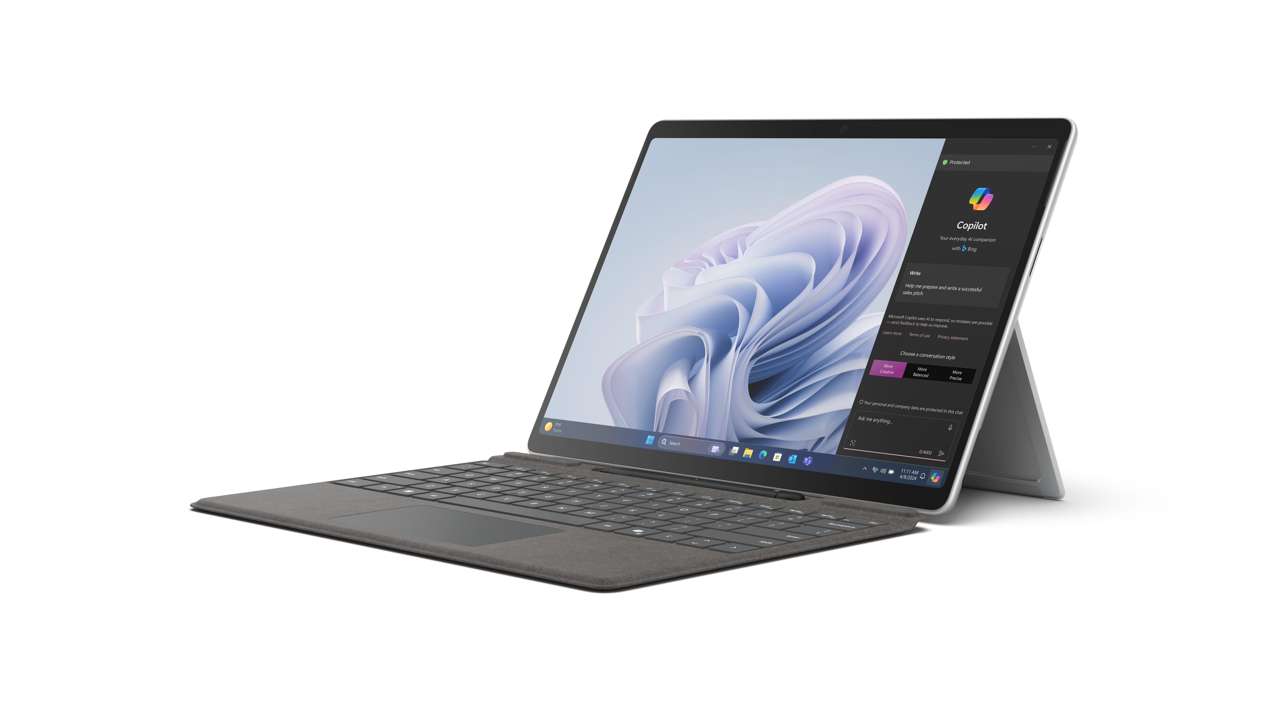
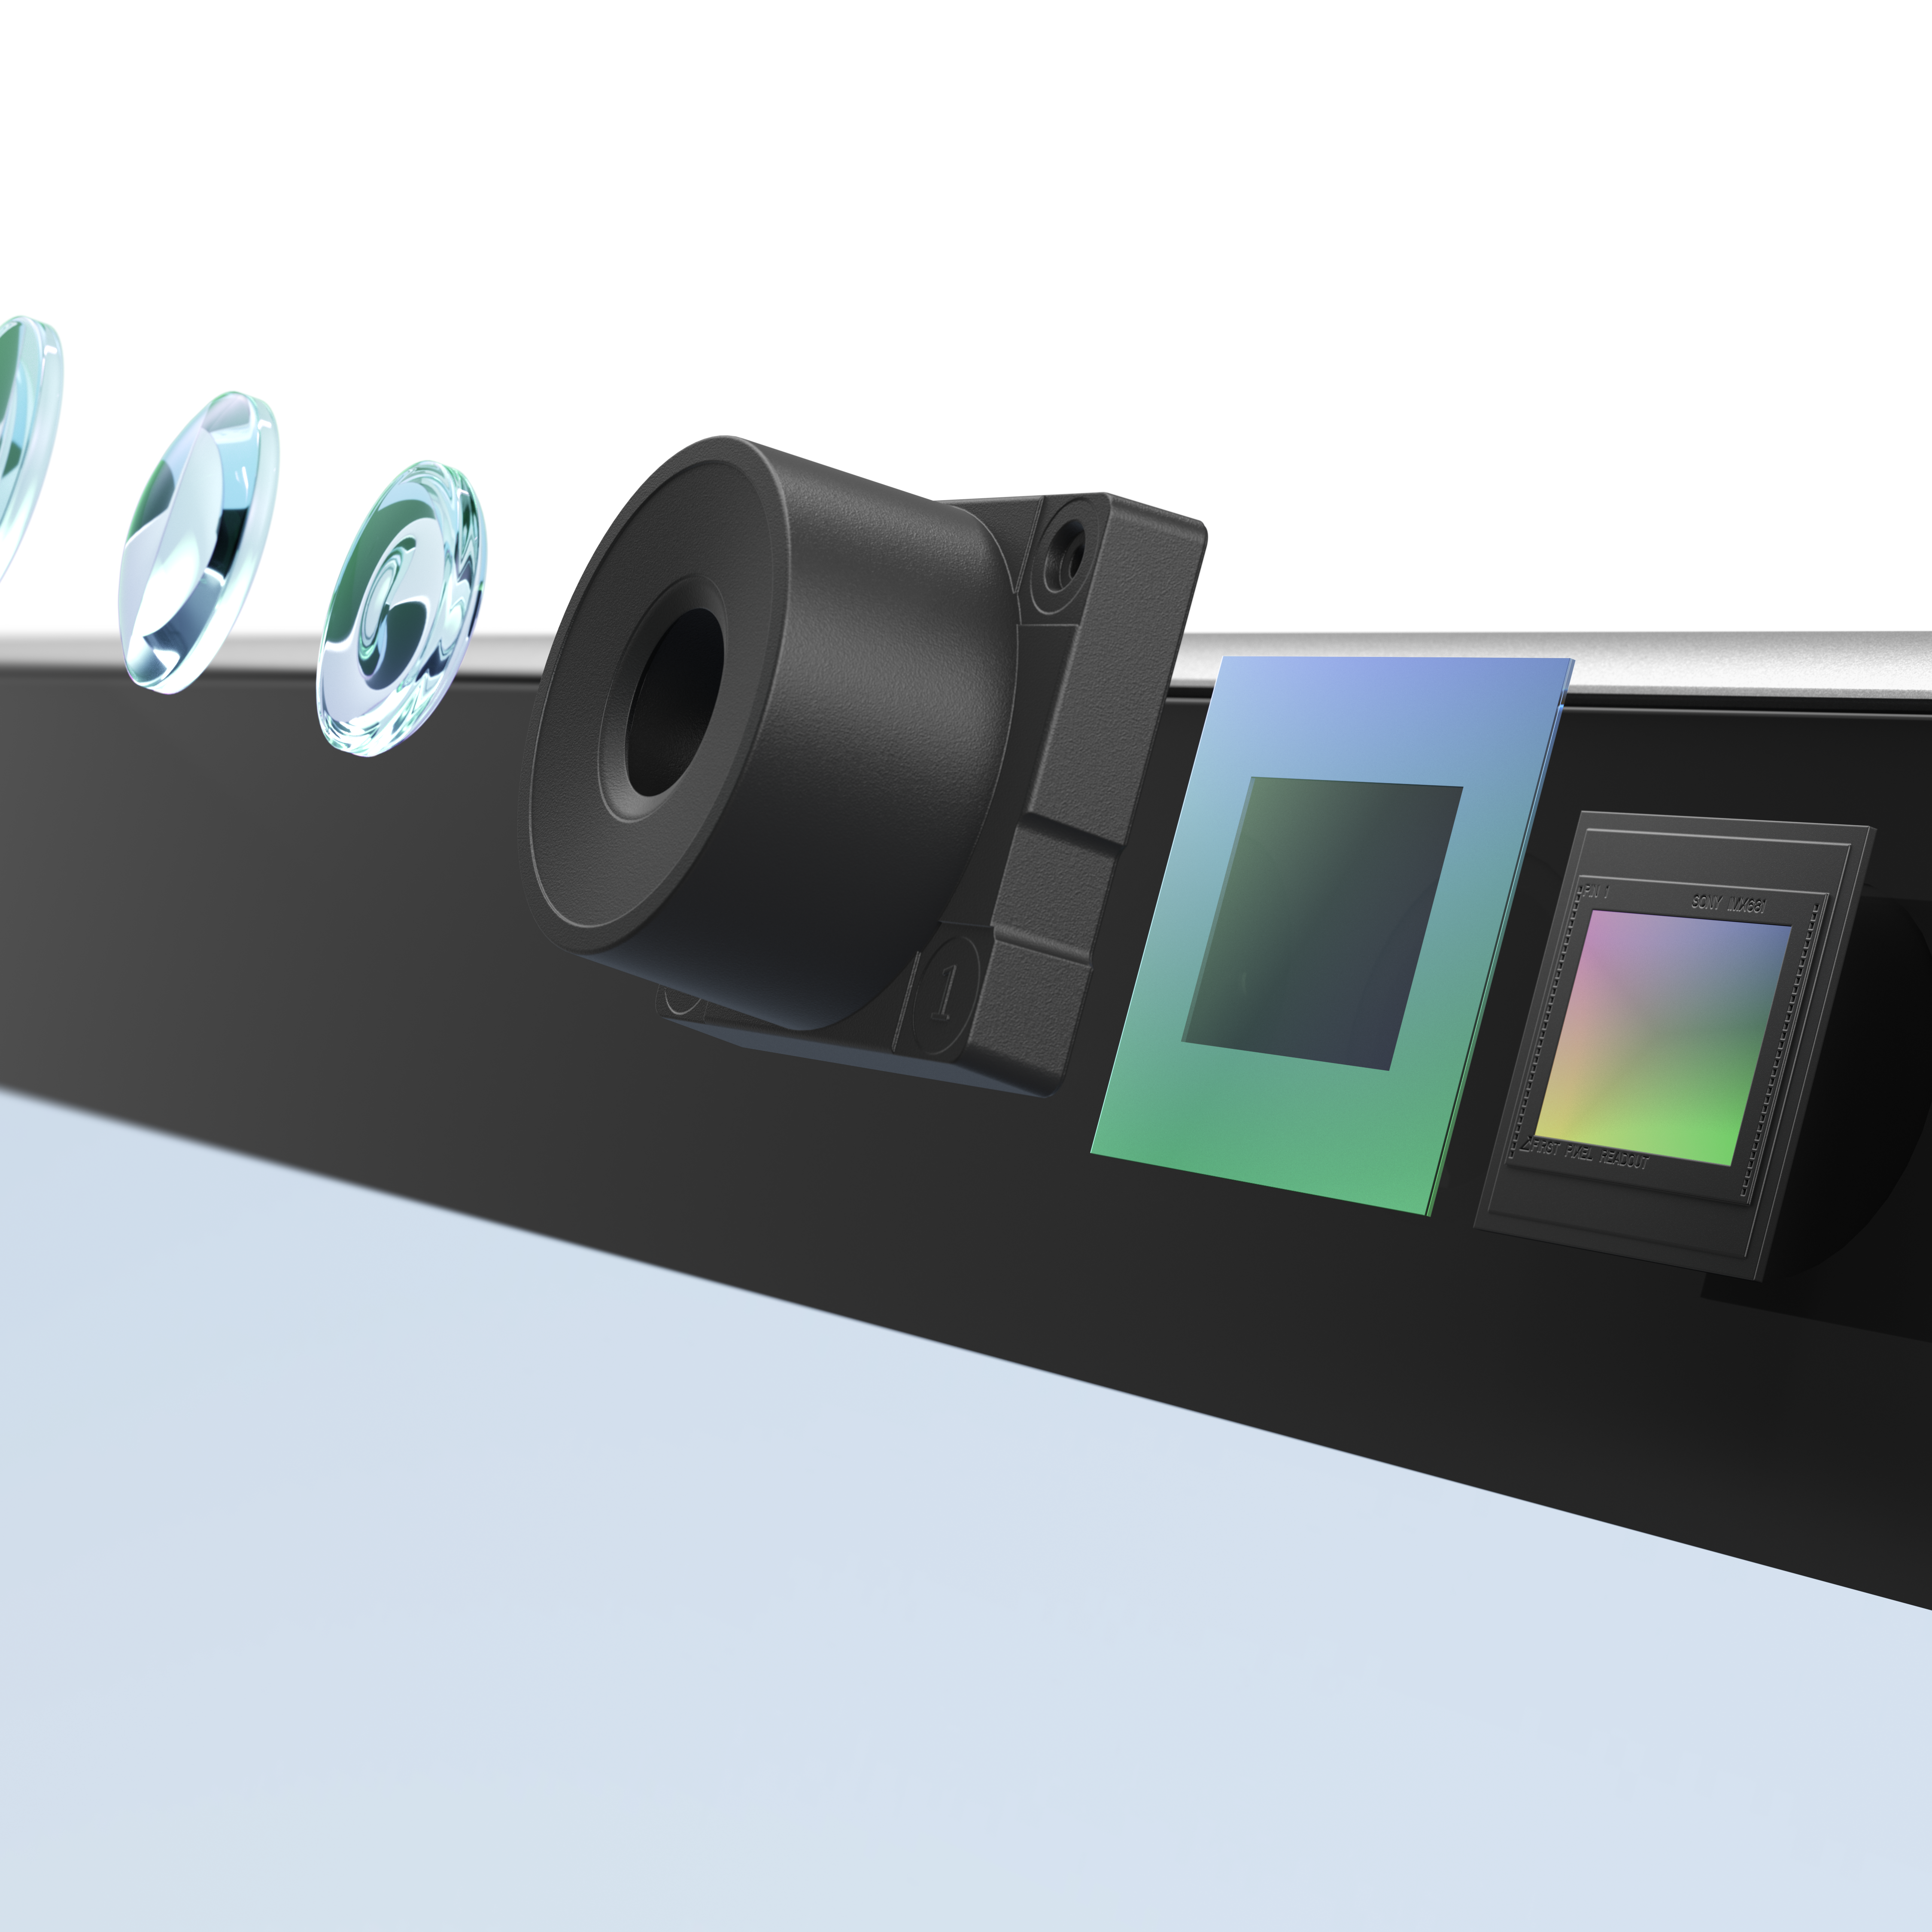

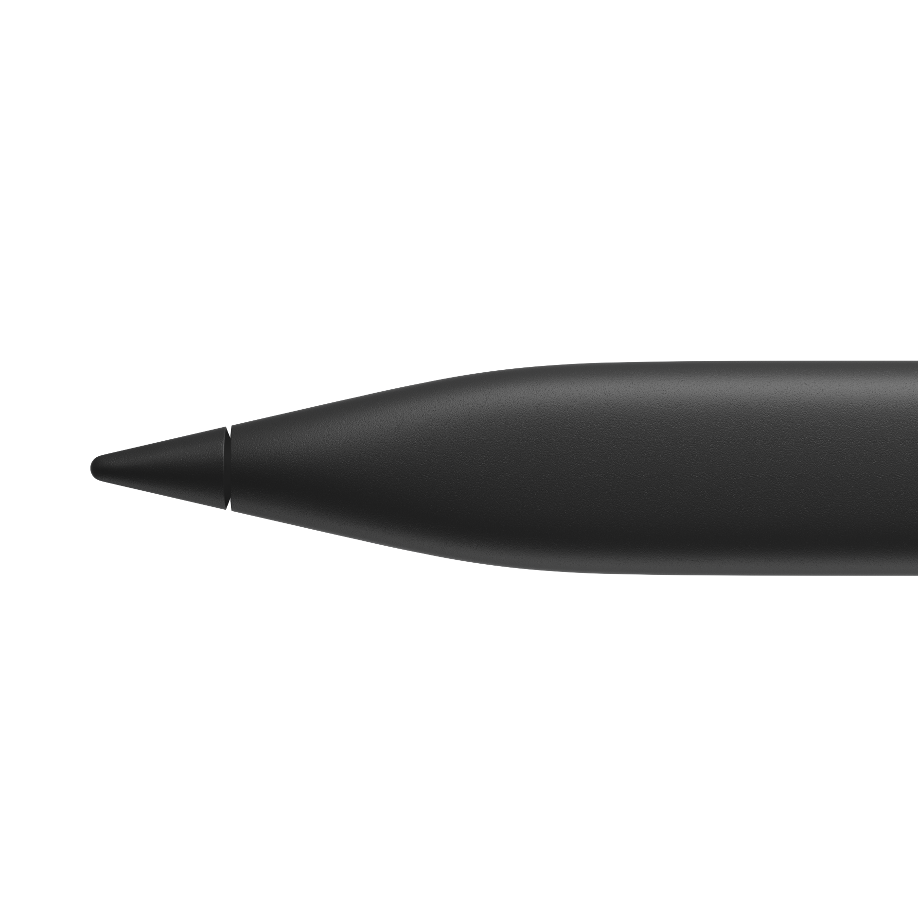
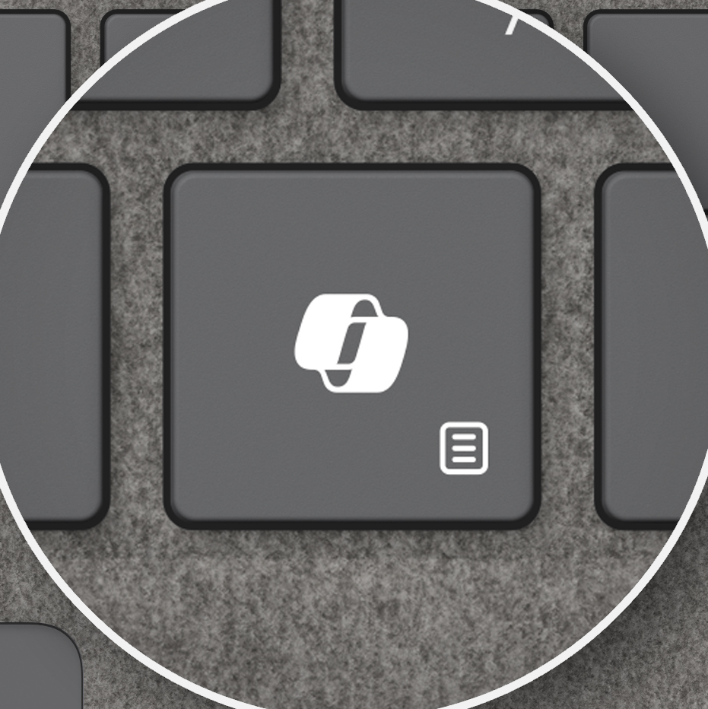

Surface Pro 10
A new era of workplace collaboration | Never-ending, on-the-go impact
Take advantage of seamless hardware and software symmetry with features that remove boundaries around how work happens. | Keep pace with the flow of business through relentless performance, durability, and portability.
An AI PC built for business, designed for versatility
Productivity realized with Microsoft Copilot | Multi-layered security and manageability
Experience the productivity of Copilot in Windows 11 Pro* and Microsoft Copilot for Microsoft 365¹ with inclusive features only Surface can deliver through effortless touch gestures, voice commands, and Surface Slim Pen² inking. | Safeguard your sensitive data with industry-leading security and remote management that maintains control of sensitive data.
Surface Pro 10 blurs the boundary between hardware and software for peak performance in a secured, lightweight device that adapts to any work style. Employees get the benefits of an AI PC that accelerates Microsoft Copilot* experiences and offers integrated AI engines that enable the next wave of business features.
Secure sign-in and authentication with Windows Hello for Business or the built-in NFC reader³
AI-enhanced 1440p ultrawide Surface Studio Camera that supports Windows Studio Effects and has a 114-degree field of view, the widest ever put into a Windows PC⁹
Anti-reflective technology and adaptive color on the PixelSense™ Flow touchscreen shifts the balance of color based on your environment, making your screen look vivid in almost any lighting condition
Up to 19 hours of battery life⁷ and supported fast charging⁸
Inking that feels like pen on paper with Surface Slim Pen²
New Copilot key⁶ for quick access to Copilot in Windows 11 Pro*
Simplified repairs with instructional QR codes built into the device. Clear icons inside identify the number of screws and driver types needed for key components⁴
Intel® Core™ Ultra processor with Intel® AI Boost and up to 64GB of RAM⁵
*Copilot in Windows (in preview) is available in select global markets and will be rolled out to additional markets over time. Learn more. Copilot with commercial data protection is available at no additional cost for users with an Entra ID with an enabled, eligible Microsoft 365 license. ¹Copilot for Microsoft 365 sold separately and requires a qualifying volume license or subscription - Microsoft Copilot for Microsoft 365 | Microsoft 365. ²Sold separately. Software license required for some features. ³NFC is available on Wi-Fi configurations of Surface Pro 10. ⁴Replacement components available through Surface Commercial authorized device resellers. Components can be replaced on-site by a skilled technician following Microsoft’s Service Guide. Microsoft tools (sold separately) may also be required. Availability of replacement components and service options may vary by product, market and over time. See Surface service options - Surface | Microsoft Learn. Opening and/or repairing your device can present electric shock, fire and personal injury risks and other hazards. Use caution if undertaking do-it-yourself repairs. Unless required by law, device damage caused during repair will not be covered under Microsoft’s Hardware Warranty or protection plans. ⁵System software uses significant storage space. Available storage is subject to change based on system software updates and apps usage. 1GB = 1 billion bytes. 1TB = 1,000 GB. Surface.com/Storage more details. ⁶Feature availability varies by market, see aka.ms/WindowsAIFeatures. When Copilot for Windows is not available or enabled on the device, pressing the Copilot key will launch Windows Search. ⁷Battery life varies significantly based on usage, network and feature configuration, signal strength, settings and other factors. See aka.ms/SurfaceBatteryPerformance for details. ⁸In select markets, only specific configurations come with 39W Surface power supply. Fast charging is supported with minimum 45W Surface power supply or USB Type-C PD charger rated at 45W or higher, sold separately. Testing conducted by Microsoft in February 2024. For details on Fast Charging see - USB-C and Fast Charging for Surface - Microsoft Support ⁹Based on a comparison of published tech specs for Windows laptops and 2:1s as of 2/20/24.

Slide 2
| Surface Pro 10
PROCESSOR Intel® Core™ Ultra 5 processor 135U Intel® Core™ Ultra 7 processor 165U NPU: Intel® AI Boost
MEMORY AND STORAGE¹ Memory options: 8GB, 16GB, 32GB, 64GB LPDDR5x Storage options: Removable² solid-state drive (Gen 4 SSD): 256GB, 512GB, 1TB
SECURITY Hardware TPM 2.0 chip for enterprise-grade security and BitLocker support Windows Hello facial recognition with Enhanced Sign-in Security NFC authentication Windows 11 Secured-core PC
BATTERY LIFE Up to 19 hours of typical device usage³
PORTS AND CHARGING 2 x USB-C® with USB4®/Thunderbolt™ 4 with support for: Charging Data transfer DisplayPort 2.1 with support up to 1 x 8K monitor Supports fast charging with minimum 45W power supply via Surface Connect or USB-C®⁴ Surface Connect port Surface Pro Keyboard port
CAMERAS Quad HD front-facing Surface Studio Camera 1440p Quad HD camera with ultrawide field of view Windows Studio Effects with automatic framing, eye contact, and background blur 10.5 MP Ultra HD rear-facing camera Windows Hello face authentication camera
SIZE AND WEIGHT^{5, 6} Length: 11.3 inch (287 mm) Width: 8.2 inch (208.6 mm) Height: 0.37 inch (9.3 mm) Weight: 1.94 lbs (879 g)
SOFTWARE Windows 11 Pro or Windows 10 Pro⁷ Preloaded Microsoft 365 Apps⁸ Microsoft 365 Business Standard, Microsoft 365 Business Premium, or Microsoft 365 Apps 30-day trial⁹
AUDIO Dual Studio Mics with voice focus¹⁰ 2 W stereo speakers with Dolby® Atmos^{®11} Support for Bluetooth® LE Audio
DISPLAY Touchscreen: 13” PixelSense™ Flow display¹² Resolution: 2880 x 1920 (267 PPI) Aspect ratio: 3:2 Contrast ratio: 1300:1 Refresh rate: up to 120Hz (Dynamic refresh rate supported) Color profile: sRGB and Vivid Individually color-calibrated display Adaptive color Touch: 10-point multi-touch Dolby Vision IQ™ support¹³ Touch: 10-point multi-touch Corning® Gorilla® Glass 5 Anti-reflective Brightness: SDR 600 nits maximum (typical)
SERVICEABILITY Replacement components:¹⁴ Display module Removable solid-state drive Battery Motherboard (including main processor and main memory) Surface Connect Thermal module Microphone module Solid-state drive door Speakers Enclosure (bucket) Front camera Rear camera Power and volume buttons Kickstand Device entry kit
ACCESSIBILITY Compatible with the Surface Pro Keyboard with bold keyset¹⁵ Compatible with Surface Adaptive Kit Compatible with Microsoft Adaptive Accessories Includes Windows Accessibility Features – Learn More Accessibility Features | Microsoft Accessibility Discover more Microsoft Accessible Devices & Products – Accessible Devices & Products for PC & Gaming | Assistive Tech Accessories - Microsoft Store
SENSORS Ambient color sensor Accelerometer Gyroscope Magnetometer NFC
WHAT'S IN THE BOX Surface Pro 10 39W Power Supply (In select markets, available only with specific configurations) Quick Start Guide Safety and warranty documents
BATTERY CAPACITIES⁵ Battery Capacity Nominal (Wh) 48 Battery Capacity Min (Wh) 47
EXTERIOR Casing: Anodized aluminum Colors:¹⁶ Platinum, Black Physical buttons: Volume, Power
SUSTAINABILITY More recycled materials Enclosure is made with a minimum of 72% recycled content, including 100% recycled aluminum alloy and 100% recycled rare earth metals¹⁷ More energy efficient ENERGY STAR® certified
WARRANTY¹⁸ 1-year limited hardware warranty
PEN AND ACCESSORIES COMPATIBILITY Pen compatibility: Designed for Surface Slim Pen¹⁹ Integrated storage and wireless charging for Surface Slim Pen with Surface Pro Keyboard with pen storage¹⁹ Supports tactile signals with Surface Slim Pen¹⁹ Supports Microsoft Pen Protocol (MPP) Keyboard compatibility: Surface Pro Keyboard Surface Pro Signature Keyboard Surface Pro X Signature Keyboard Surface Pro X Keyboard
KICKSTAND Kickstand with 165 degrees full friction hinge
NETWORK AND CONNECTIVITY Wi-Fi 6E: 802.11ax compatible²⁰ Bluetooth® Wireless 5.3 technology
GRAPHICS Intel® Graphics
¹System software uses significant storage space. Available storage is subject to change based on system software updates and apps usage. 1GB = 1 billion bytes. 1TB = 1,000 GB. Surface.com/Storage more details. ²Solid State Drive (SSD) Retention is only available on Microsoft Surface devices in which the SSD is marketed as removable per the Technical Specifications. Solid State Drive (SSD) Retention is included in both Extended Hardware Service Plus and Microsoft Complete for Business Plus and is also available as an Optional Add-on when purchasing Microsoft Extended Hardware Service and Microsoft Complete for Business. Devices returned to Microsoft with a missing Solid State Drive (SSD) are subject to a Solid State Drive (SSD) replacement fee unless the device is enrolled in the Drive (SSD) Retention offer. ³Battery life varies significantly based on usage, network and feature configuration, signal strength, settings and other factors. See aka.ms/SurfaceBatteryPerformance for details. Testing conducted by Microsoft in February 2024 using preproduction Windows 11 software and preproduction Surface Pro 10 Intel® Core™ Ultra 7 processor 165U, 512GB,16GB RAM devices. Testing consisted of full battery discharge with a mixture of active use and modern standby. The active use portion consists of (1) a web browsing test accessing eight popular websites over multiple open tabs, (2) a productivity test utilizing Microsoft Word, PowerPoint, Excel, OneNote and Outlook, and (3) a portion of time with the device in use with idle applications. Personalization colors set to Light mode for Windows and apps. All settings were default except screen brightness was set to 150 nits with auto-brightness and adaptive color disabled. Wi-Fi was connected to a network. Tested with Windows 11 Version 22631.3085. Battery life varies significantly with settings, usage, and other factors. ⁴In select markets, only specific configurations come with 39 W Surface power supply. Fast Charging (from 5% to 80%) is supported with minimum 45W Surface power supply or USB-C® PD charger, sold separately. Testing was conducted at Microsoft in February 2024, using pre-production devices, software, and minimum of 45W USB-C® charger under controlled conditions. The device was powered on to the desktop screen with default display brightness settings. Actual charge time will vary based on operating conditions. Measured at typical office ambient temperature of 23C. ⁵Might vary depending on manufacturing processes. ⁶Weight not including Keyboard. ⁷Windows 10 is not available for purchase but is supported by Surface Pro 10. Visit https://aka.ms/SurfaceSupportedOperatingSystems for more information. ⁸Requires license or subscription (sold separately) to activate and use. ⁹Activation required. If your device is managed by your organization’s IT department, contact your IT administrator for activation. After 30 days, you will be charged the applicable monthly or annual subscription fee. Credit card required. Cancel any time to stop future charges. See https://aka.ms/m365businesstrialinfo. ¹⁰Voice focus requires activation, Windows 11 and is available in apps which use integrated device microphones and use certain Windows audio processing modes. ¹¹Requires Dolby® Atmos® encoded content/audio. ¹²Surface Pro 10 display has rounded corners within a standard rectangle. When measured as a standard rectangular shape the screen is 13” diagonally (actual viewable area is less). ¹³Requires Dolby Vision® encoded content and video. ¹⁴Replacement components available through Surface Commercial authorized device resellers. Components can be replaced on-site by a skilled technician following Microsoft’s Service Guide. Microsoft tools (sold separately) may also be required. Availability of replacement components and service options may vary by product, market and over time. See Surface service options - Surface | Microsoft Learn. Opening and/or repairing your device can present electric shock, fire and personal injury risks and other hazards. Use caution if undertaking do-it-yourself repairs. Unless required by law, device damage caused during repair will not be covered under Microsoft’s Hardware Warranty or protection plans. ¹⁵Surface Pro Keyboard with bold keyset is only in US English. ¹⁶Colors available on selected models only. Available colors, sizes, finishes, and processors may vary by store, market, and configuration. ¹⁷Enclosure includes Bucket and Kickstand. 100% recycled aluminum alloy in Bucket and Kickstand. 100% recycled rare earth metals in magnets. Based on validation performed by Underwriter Laboratories, Inc. using Environmental Claim Validation Procedure, UL 2809-2, Second Edition, November 7, 2023. ¹⁸Microsoft’s Limited Warranty is in addition to your consumer law rights. ¹⁹Sold separately. ²⁰Wi-Fi 6E not available in all areas.

