Slide 1
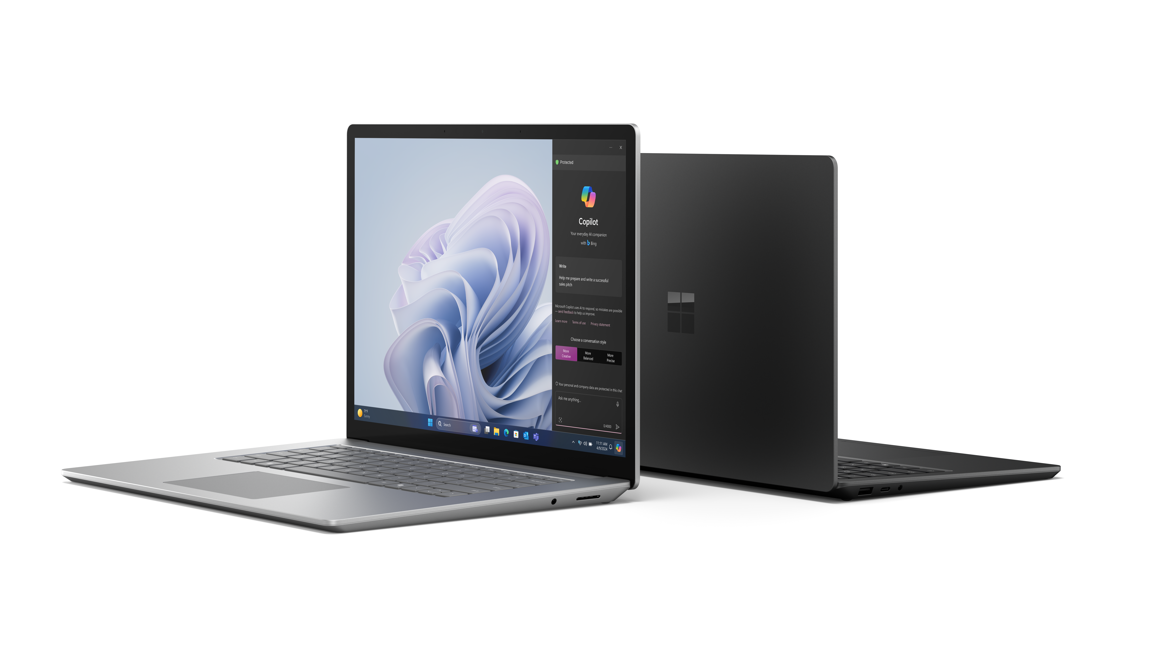
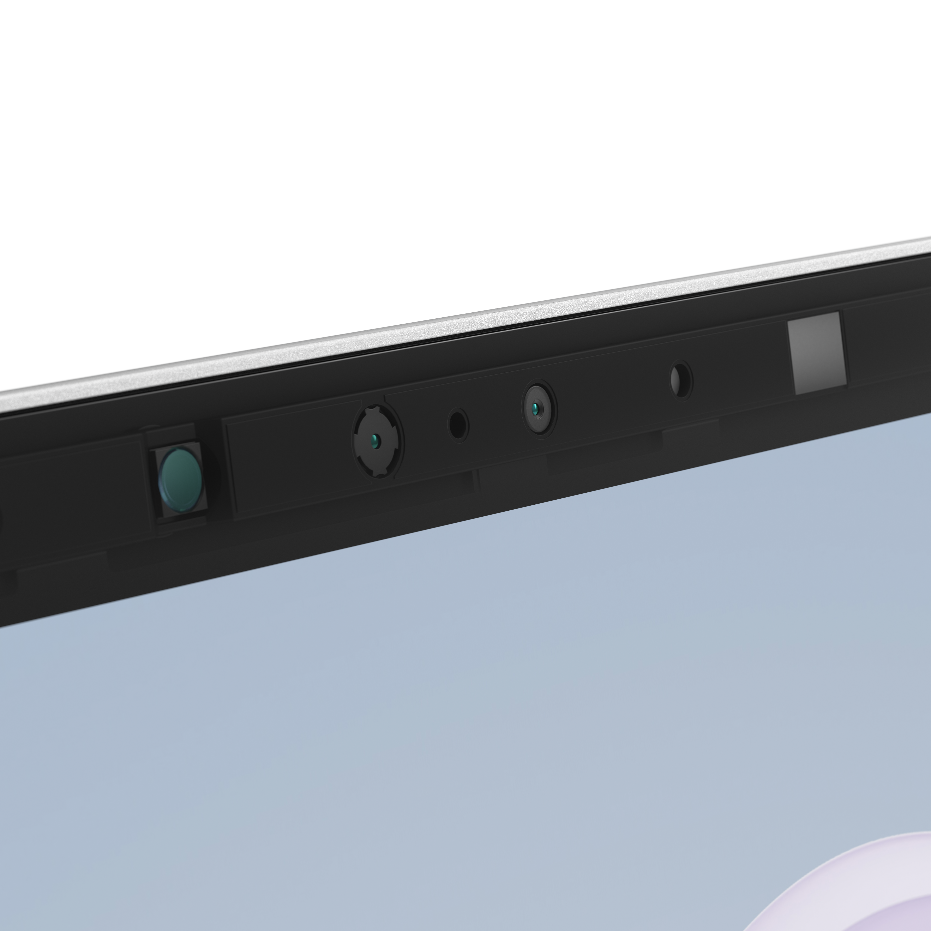


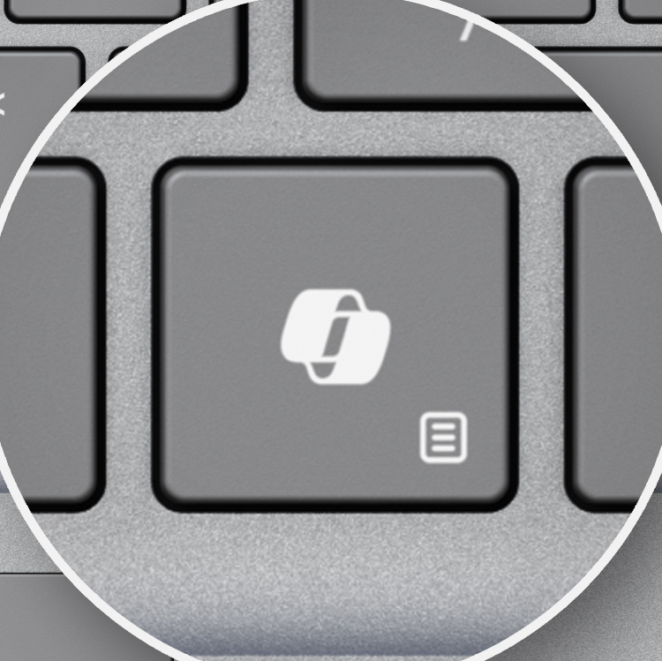
Surface Laptop 6
Relentless power for demanding workloads | Productivity realized with Microsoft Copilot*
Fuel productivity through a full workday with power and performance designed to keep pace with business. | Experience Copilot in Windows 11 Pro* and Microsoft Copilot for Microsoft 365¹ in ways only Surface can create, with detailed support for inclusive styles of work.
Power and design in an AI PC,
built for business workloads
Surface Laptop 6 elevates business with an elite level of performance, power, and sleek design. Built for demanding workloads, Surface Laptop 6 unleashes a new era of productivity through the power of the Intel® Core™ Ultra processor H-series. With Surface Laptop, employees get the benefits of an AI PC that accelerates Microsoft Copilot* experiences and offers integrated AI engines that enable the next wave of business features.
A sleek and durable Microsoft design | Multi-layered security and manageability
Surface Laptop 6 will surpass expectations: meticulously crafted, designed for longevity, and featuring collaborative tools and AI-driven features. | Windows 11’s industry-leading security safeguards sensitive data, and remote management provides protection at every layer—hardware, firmware, application, cloud, and identity.
Up to 19 hours of battery life² and supported fast charging³
AI-enhanced 1080p HD Studio Camera with Windows Studio Effects
Anti-reflective technology reduces reflections by up to 50%, to make it easier to see what's on screen in bright light and even outdoors
Secured-core PC designed to elevate the benefits of Windows 11 security
Intel® Core™ Ultra processor
H-series with up to 2x faster performance⁴
Optional integrated smart card reader on select models in select markets⁵
Multitasking with Surface Laptop 6 and Windows 11 Pro AI experiences, intelligent workflows, and unmatched personalization
New Copilot key⁶ for quick access to Copilot in Windows 11 Pro*
Simplified repairs and replaceable parts including the motherboard and battery⁷
Omnisonic® Speakers with Dolby® Atmos^{®8} and dual Studio Mics with voice focus⁹
*Copilot in Windows (in preview) is available in select global markets and will be rolled out to additional markets over time. Learn more. Copilot with commercial data protection is available at no additional cost for users with an Entra ID with an enabled, eligible Microsoft 365 license. ¹Copilot for Microsoft 365 sold separately and requires a qualifying volume license or subscription - Microsoft Copilot for Microsoft 365 | Microsoft 365. ²Battery life varies significantly based on usage, network and feature configuration, signal strength, settings and other factors. See aka.ms/SurfaceBatteryPerformance for details. ³13.5" Surface Laptop 6 comes with 39 W Surface power supply. Fast charging (from 5% to 80%) is supported with minimum 45W Surface power supply or USB-C® PD charger, sold separately. Testing was conducted at Microsoft in February 2024, using pre-production devices, software, and minimum of 45W USB-C® charger under controlled conditions. The device was powered on to the desktop screen with default display brightness settings. Actual charge time will vary based on operating conditions. Measured at typical office ambient temperature of 23C. ⁴Based on 3DMark TimeSpy benchmark measuring graphic performance compared to Surface Laptop 5. ⁵Integrated smart card reader available only on Surface Laptop 6 in Black in one of these configurations: 15" 5/16/512, 7/16/256, 7/16/512, 7/32/512 and only in US and Canada. ⁶Feature availability varies by market, see aka.ms/WindowsAIFeatures. When Copilot for Windows is not available or enabled on the device, pressing the Copilot key will launch Windows Search. ⁷Replacement components are available through Surface Commercial authorized device resellers. Components can be replaced on-site by a skilled technician following Microsoft’s Service Guide. Microsoft tools (sold separately) may also be required. Availability of replacement components and service options may vary by product, market and over time. See [Surface service options - Surface | Microsoft Learn]. Opening and/or repairing your device can present electric shock, fire and personal injury risks and other hazards. Use caution if undertaking do-it-yourself repairs. Unless required by law, device damage caused during repair will not be covered under Microsoft’s Hardware Warranty or protection plans. ⁸Requires Dolby® Atmos® encoded content/audio. ⁹Voice focus requires activation, Windows 11 and is available in apps which use integrated device microphones and use certain Windows audio processing modes.

Slide 2
| Surface Laptop 6
PROCESSOR Intel® Core™ Ultra 5 processor 135H Intel® Core™ Ultra 7 processor 165H NPU: Intel® AI Boost
MEMORY AND STORAGE¹ Memory options: 8GB LPDDR5 RAM, 16GB, 32GB or 64GB LPDDR5x RAM Storage options: Removable² solid-state drive (Gen 4 SSD): 256GB, 512GB, 1TB
SECURITY Hardware TPM 2.0 chip for enterprise-grade security and BitLocker support Windows Hello facial recognition with Enhanced Sign-in Security Integrated smart card reader authentication (available on select models and markets)³ Windows 11 Secured-core PC
PORTS AND CHARGING Surface Laptop 6 13.5”: USB-C® with USB4®/Thunderbolt™ 4 with support for: Charging Data transfer DisplayPort 2.1 with support up to 1 x 8K monitor* Supports fast charging with minimum 45W power supply via Surface Connect or USB-C⁴ USB-A 3.1 3.5 mm headset jack Surface Connect port Surface Laptop 6 15”: 2 x USB-C® with USB4®/Thunderbolt™ 4 with support for: Charging Data transfer DisplayPort 2.1 with support up to 1 x 8K monitor* Supports fast charging with minimum 45W power supply via Surface Connect or USB-C⁴ USB-A 3.1 3.5 mm headset jack Surface Connect port Integrated smart card reader (available on select models and markets)³
BATTERY LIFE⁵ Surface Laptop 6 13.5”: Up to 18.5 hours of typical device usage⁶ Surface Laptop 6 15”: Up to 19 hours of typical device usage⁷
CAMERAS Full HD front-facing Surface Studio Camera 1080p Full HD camera Windows Studio Effects with automatic framing, eye contact, and background blur Windows Hello face authentication camera
SIZE AND WEIGHT⁸ Surface Laptop 6 13.5”: Length: 12.1 inch (308 mm) Width: 8.8 inch (223 mm) Height: 0.66 inch (16.7 mm) Weight: 3.06 lbs (1.38 kg) Surface Laptop 6 15”: Length: 13.4 inch (340 mm) Width: 9.6 inch (244 mm) Height: 0.67 inch (16.9 mm) Weight: 3.70 lbs (1.68 kg) With smart card reader:³ 3.71 lbs (1.68 kg)
SOFTWARE Windows 11 Pro or Windows 10 Pro⁹ Preloaded Microsoft 365 Apps¹⁰ Microsoft 365 Business Standard, Microsoft 365 Business Premium, or Microsoft 365 Apps 30-day trial¹¹
KEYBOARD LAYOUT Activation: Moving keys Layout: QWERTY, full row of function keys (F1 – F12) Windows key and dedicated buttons for media controls, screen brightness Keyboard backlight Copilot key¹² Touchpad
AUDIO Dual Studio Mics with voice focus¹³ Omnisonic® Speakers with Dolby® Atmos^{®14} Support for Bluetooth® LE Audio
DISPLAY Surface Laptop 6 13.5”: Touchscreen: 13.5” PixelSense™ Display Resolution: 2256 x 1504 (201 PPI) Aspect ratio: 3:2 Contrast ratio 1300:1 Color profile: sRGB, and Enhanced Individually color-calibrated display Adaptive color Touch: 10-point multi-touch Dolby Vision IQ™¹⁵ support Corning® Gorilla® Glass 5 Anti-reflective Brightness: SDR 400 nits maximum (typical) Surface Laptop 6 15”: Touchscreen: 15” PixelSense™ Display Resolution: 2496 x 1664 (201 PPI) Aspect ratio: 3:2 Contrast ratio 1300:1 Color profile: sRGB, and Enhanced Individually color-calibrated display Adaptive color Touch: 10-point multi-touch Dolby Vision IQ™¹⁵ support Corning® Gorilla® Glass 5 Anti-reflective Brightness: SDR 400 nits maximum (typical)
SERVICEABILITY Replacement components:¹⁶ Display assembly (including camera) Keyboard assembly Removable solid-state drive Battery Motherboard module (main processor and main memory) Surface Connect Thermal module Audio jack Speakers Touchpad Enclosure Feet
ACCESSIBILITY Compatible with Surface Adaptive Kit Compatible with Microsoft Adaptive Accessories Includes Windows Accessibility Features – learn more Accessibility Features | Microsoft Accessibility Discover more Microsoft Accessible Devices & Products – Accessible Devices & Products for PC & Gaming | Assistive Tech Accessories - Microsoft Store
SENSORS Ambient light sensor
WHAT’S IN THE BOX Surface Laptop 6 13.5” or 15” Power Supply: 13.5”: 39W 15”: 65W Quick Start Guide Safety and warranty documents
Battery capacities^{6,7} Battery Capacity Nominal (WH) 47 Battery Capacity Min (WH) 46
EXTERIOR Casing: Anodized aluminum Colors:¹⁷ Platinum or Black
SUSTAINABILITY More recycled materials Enclosure is made with a minimum of 25.8% recycled content, including 100% recycled aluminum alloy and 100% recycled rare earth metals¹⁸ More energy efficient ENERGY STAR® certified More repairable More replaceable components than Surface Laptop 5. Built-in QR code provides convenient access to instructions.¹⁶
Surface Trade-in We make trade-in convenient and secure for our commercial customers in the USA at Microsoft Trade In Program Microsoft is committed to be carbon negative, water, positive, and achieve zero waste by 2030. Learn more about how we design with sustainability in mind: Sustainable Products & Solutions | Microsoft CSR Microsoft Surface Sustainability - Microsoft Sustainability
Warranty¹⁹ 1-year limited hardware warranty
PEN and accessories COMPATIBILITY Supports Microsoft Pen Protocol (MPP)
NETWORK AND CONNECTIVITY Wi-Fi 6E: 802.11ax compatible²⁰ Bluetooth® Wireless 5.3 technology
GRAPHICS 8GB memory: Intel® Graphics 16GB, 32GB or 64GB memory: Intel® Arc™ Graphics
*See www.displayport.org for details on cables that support DisplayPort 2.1. ¹System System software uses significant storage space. Available storage is subject to change based on system software updates and apps usage. 1GB = 1 billion bytes. 1TB = 1,000 GB. Surface.com/Storage more details. ²Solid State Drive (SSD) Retention is only available on Microsoft Surface devices in which the SSD is marketed as removable per the Technical Specifications. Solid State Drive (SSD) Retention is included in both Extended Hardware Service Plus and Microsoft Complete for Business Plus and is also available as an Optional Add-on when purchasing Microsoft Extended Hardware Service and Microsoft Complete for Business. Devices returned to Microsoft with a missing Solid State Drive (SSD) are subject to a Solid State Drive (SSD) replacement fee unless the device is enrolled in the Drive (SSD) Retention offer. ³Integrated smart card reader available only on Surface Laptop 6 in Black in one of these configurations: 15" 5/16/512, 7/16/256, 7/16/512, 7/32/512 and only in US and Canada. ⁴Battery life varies significantly based on usage, network and feature configuration, signal strength, settings and other factors. See aka.ms/SurfaceBatteryPerformance for details. ⁴13.5" Surface Laptop 6 comes with 39 W Surface power supply. Fast charging (from 5% to 80%) is supported with minimum 45W Surface power supply or USB-C® PD charger, sold separately. Testing was conducted at Microsoft in February 2024, using pre-production devices, software, and minimum of 45W USB-C® charger under controlled conditions. The device was powered on to the desktop screen with default display brightness settings. Actual charge time will vary based on operating conditions. Measured at typical office ambient temperature of 23C. ⁵Battery life varies significantly based on usage, network and feature configuration, signal strength, settings and other factors. See aka.ms/SurfaceBatteryPerformance for details. ⁶Up to 18.5 hours of battery life based on typical Surface device usage on Surface Laptop 6 13.5”: Testing conducted by Microsoft in February 2024 using preproduction Windows 11 software and preproduction Surface Laptop 6 Intel® Core™ Ultra 7 processor 165H 256GB SSD, 16GB RAM. Testing consisted of full battery discharge with a mixture of active use and modern standby. The active use portion consists of (1) a web browsing test accessing eight popular websites over multiple open tabs, (2) a productivity test utilizing Microsoft Word, PowerPoint, Excel, OneNote and Outlook, and (3) a portion of time with the device in use with idle applications. Personalization colors set to Light mode for Windows and apps. All settings were default except screen brightness was set to 150 nits with auto-brightness and adaptive color disabled. Wi-Fi was connected to a network. Tested with Windows 11 Version 22631.3085. Battery life varies significantly with settings, usage, and other factors. ⁷Up to 19 hours of battery life based on typical Surface device usage on Surface Laptop 6 15”: Testing conducted by Microsoft in February 2024 using preproduction Windows 11 software and preproduction Surface Laptop 6 Intel® Core™ Ultra 7 processor 165H 512GB SSD, 16GB RAM. Testing consisted of full battery discharge with a mixture of active use and modern standby. The active use portion consists of (1) a web browsing test accessing eight popular websites over multiple open tabs, (2) a productivity test utilizing Microsoft Word, PowerPoint, Excel, OneNote and Outlook, and (3) a portion of time with the device in use with idle applications. Personalization colors set to Light mode for Windows and apps. All settings were default except screen brightness was set to 150 nits with auto-brightness and adaptive color disabled. Wi-Fi was connected to a network. Tested with Windows 11 Version 22631.3085. Battery life varies significantly with settings, usage, and other factors. ⁸Might vary depending on manufacturing processes. ⁹Windows 10 is not available for purchase but is supported by Surface Laptop 6. Visit https://aka.ms/SurfaceSupportedOperatingSystems for more information. ¹⁰Sold separately. Software license required for some features. ¹¹Activation required. If your device is managed by your organization’s IT department, contact your IT administrator for activation. If you activate your trial outside your organization, after 30 days, you will be charged the applicable monthly or annual subscription fee. Credit card required. Cancel any time to stop future charges. See https://aka.ms/m365businesstrialinfo. ¹²Feature availability varies by market, see aka.ms/WindowsAIFeatures – When Copilot for Windows is not available or enabled on the device, pressing the Copilot key will launch Windows Search. ¹³Voice focus requires activation, Windows 11 and is available in apps which use integrated device microphones and use certain Windows audio processing modes. ¹⁴Requires Dolby® Atmos® encoded content/audio. ¹⁵Requires Dolby Vision® encoded content and video. ¹⁶Replacement components available through Surface Commercial authorized device resellers. Components can be replaced on-site by a skilled technician following Microsoft’s Service Guide. Microsoft tools (sold separately) may also be required. Availability of replacement components and service options may vary by product, market and over time. See [Surface service options - Surface | Microsoft Learn]. Opening and/or repairing your device can present electric shock, fire and personal injury risks and other hazards. Use caution if undertaking do-it-yourself repairs. Unless required by law, device damage caused during repair will not be covered under Microsoft’s Hardware Warranty or protection plans. ¹⁷Colors available on selected models only. Available colors, sizes, finishes, and processors may vary by store, market, and configuration. ¹⁸Enclosure includes A Cover, C Cover and D Bucket. 100% recycled aluminum alloy in A Cover. 100% recycled rare earth metals in magnets. Based on validation performed by Underwriter Laboratories, Inc. using Environmental Claim Validation Procedure for Recycled Content, UL 2809-2, Second Edition, November 7, 2023. ¹⁹Microsoft’s Limited Warranty is in addition to your consumer law rights. ²⁰WiFi 6E is not available in all areas.

