Slide 1
Dicker Data OnPoint
FY25 Cloud Partner Program Updates: Incentives & Updates to SPDs
Wednesday, 16 October 2024

Slide 2

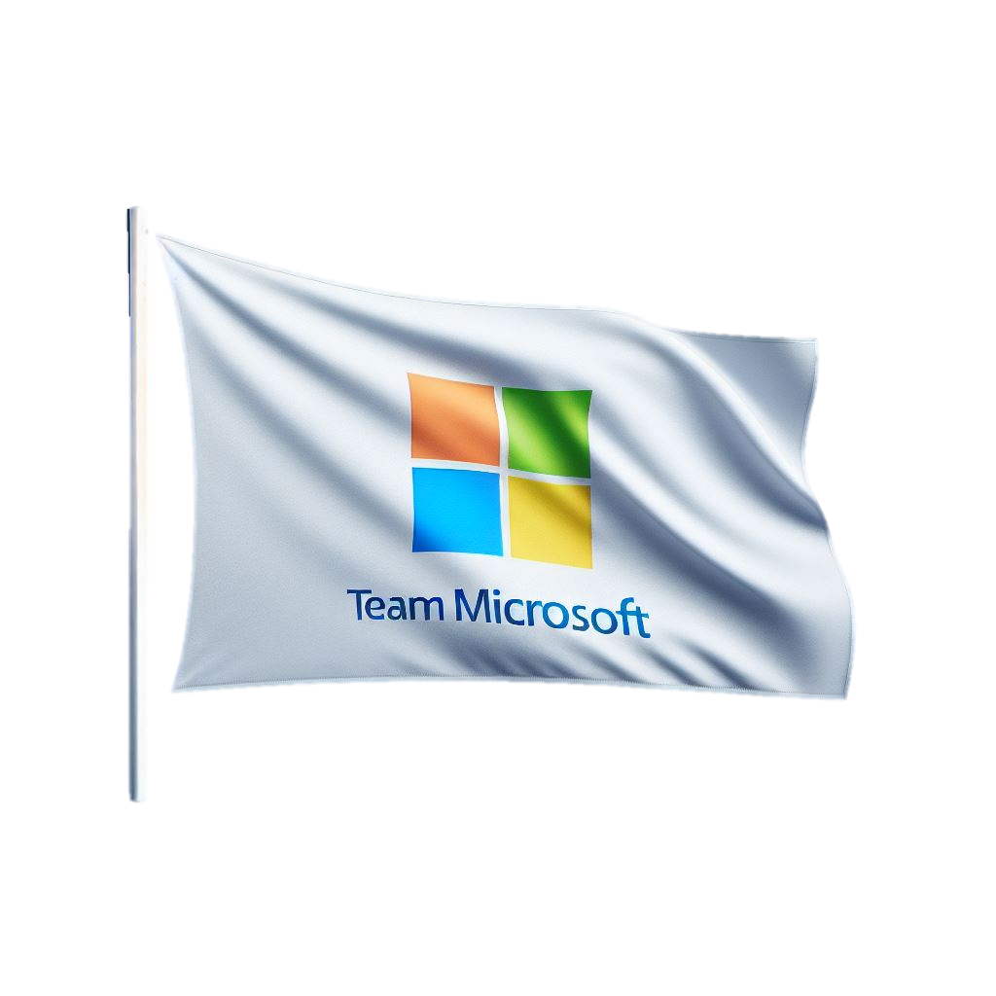


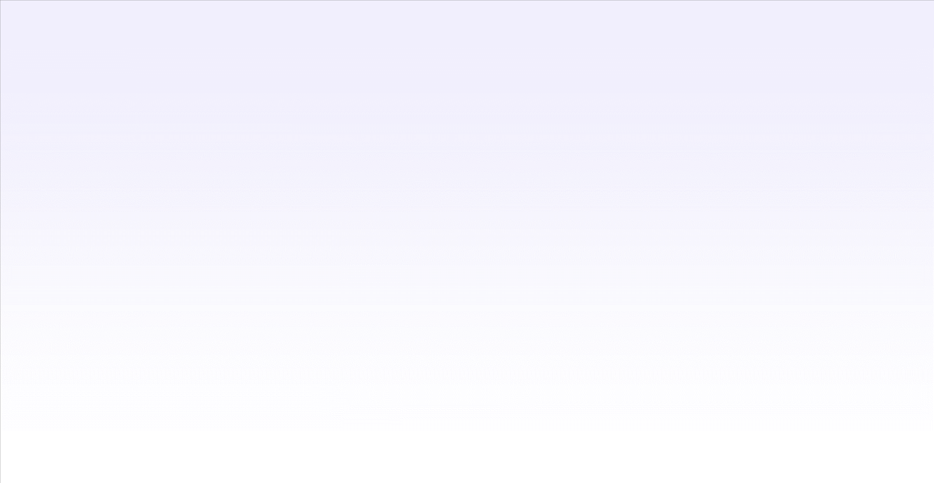
Presenters Today:
Geoff Smith
geoff.smith@dickerdata.com.au
Partner Development Manager
Carol Pomare
carol.pomare@dickerdata.co.nz
Partner Development Manager

Slide 3

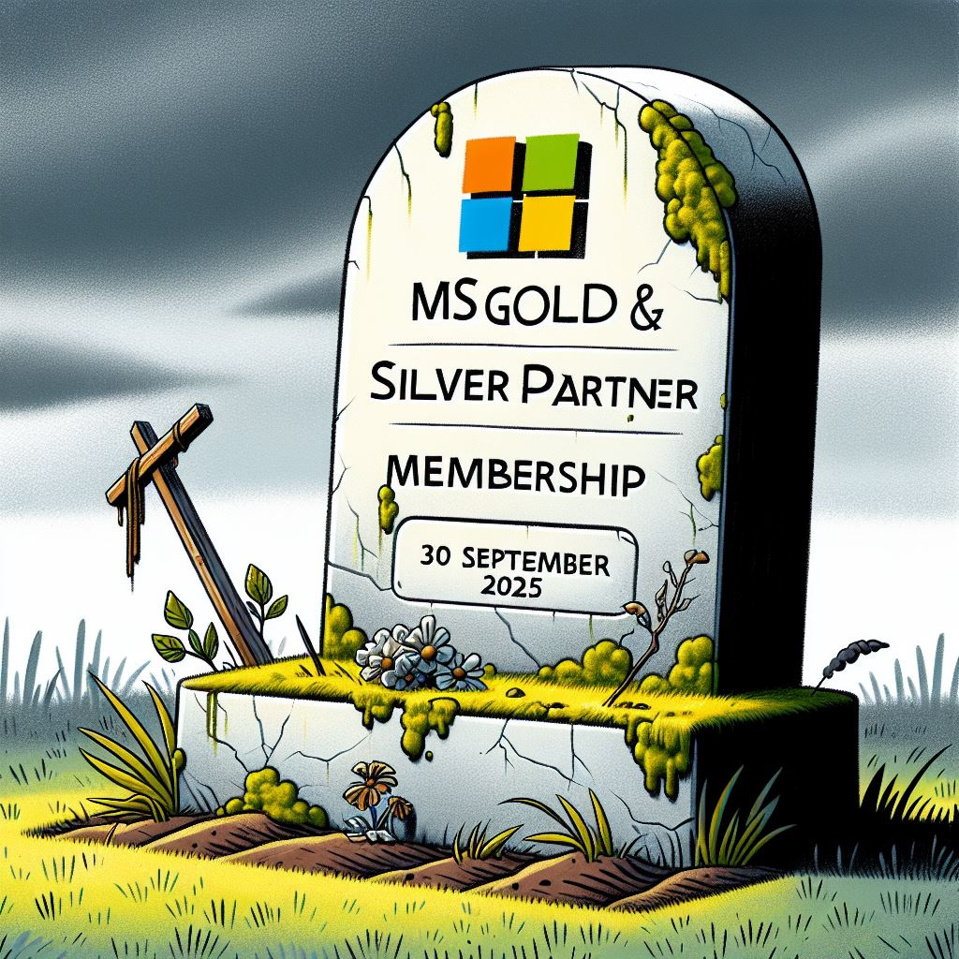
Agenda:
News & Updates
Legacy Memberships – key dates
MAP’s EOL & Replacement Options
Common Oversights
Silver/Gold EOL & Replacements
Solution Partner Designations
Skilling & Customer Success
Workloads vs CPOR
Key Points
Handy Links
Sneak Peek
Thank you
Dicker Data AU
microsoft.sales@dickerdata.com.au
+61 2 8556 8061
www.dickerdata.com.au
Dicker Data NZ
onpoint@dickerdata.co.nz
+64 0800 337 253
www.dickerdata.co.nz

Slide 4

News & Updates:
Teams bundles for M365 E3 & E5; O365 E3 & E5 are no longer available, if any changes to existing licensing, billing or commit terms are made, a forced change is applied, and you will need to purchase the Teams standalone license. Including migrations and transfers.
You will now be seeing the price increase on some Dynamics 365 licenses that renew after 1 October 2024
The new SPD for Azure & Security SMB path, delayed a further quarter!
15% off promo for Copilot M365, 10 to 150 Users from 1/9/24-31/12/24!
Notes:
The first item here is concerning the enterprise CSP plans, where traditionally teams was bundled and we were informed that if the tenant already had a bundled E license they would be fine to acquire the bundled licenses going forward…this has now changed.
If a bundled E license resides in the tenant already, it will remain, but if you need to change this in anyway, you then have to get the unbundled license as all the Teams bundled licenses are no longer available.
Also a reminder that the price increase for some of Dynamics 365 licenses started on the 1 October 2024. There was not a fixed percentage increase and the pricing increase fluctuates. The increases are applied on the anniversary date of the license so you may already have increases .

Slide 5

Legacy Memberships EOL – Key Dates:
Silver & Gold Legacy Memberships cannot be renewed after 21st January 2025
IUR licensing, incentives, rebates, claims, co-op etc will no longer be available after
30 September 2025
Replacement Plans for these are the Microsoft Solution Partner Designations.
Solutions Partner for Business Applications
Solutions Partner for Data and AI (Azure)
Solutions Partner for Digital and App Innovation (Azure)
Solutions Partner for Infrastructure (Azure)
Solutions Partner for Security
Solutions Partner for Modern Work
Notes:
Silver and Gold have EOL dates and will definitely be going this time
There will be an easier SMB Path for Azure but this options has been delayed until next quarter, New Year

Slide 6

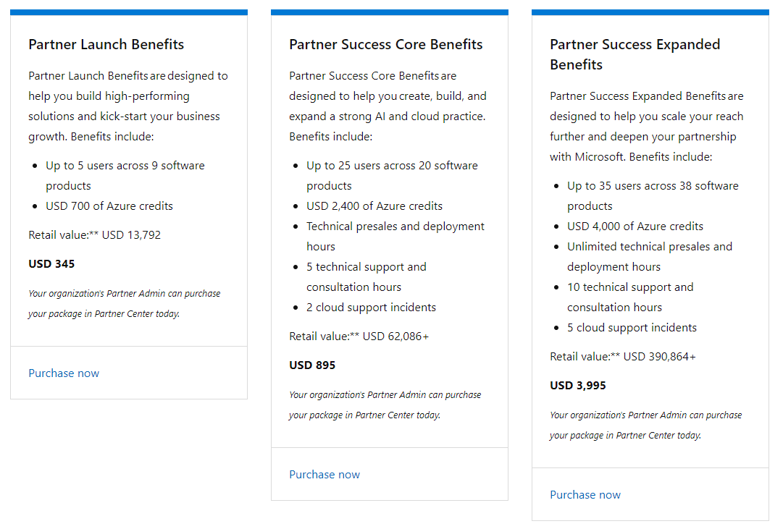
Microsoft Action Pack EOL – Key Dates & Replacements
MAP’s Memberships cannot be renewed after 21 January 2025
IUR licensing will no longer be available after 30 September 2025
Three replacement Partner Benefit plans to
now choose from
You need to be a Microsoft Partner to purchase
There are NO rebates or incentives with these
plans
Notes:
After many years both Microsoft Action Packs are retiring 21 Jan 25
Three options are replacing these, the cheapest being less than what MAP’s was

Slide 7
Common Oversights:
Remember to associate your staff in your Partner Centre Account.
Make sure staff are linked to Partner University & MS Learn (private emails)
In your Account Settings, make sure the Payout & Tax Profiles are updated
  If not actioned recently, this will require Microsoft re-validation.
Ensure your Location MPN is used for all CSP transactions and is the MPN enrolled
for MCI Engagements.
If you transact more than $40K in CSP, likely earn more than $2,500 per month in MS Incentives, then you are likely in the zone where Microsoft pay you out 60% of your incentives and “keep 40%”, so then you MUST claim Co-Op every July and January (latest)! If you don’t use it, you lose it!!!!
Remember only YOU have access to your Partner Centre, Not MS or Dicker Data!
Notes:
Geoff to talk to this slide, keep it simple!

Slide 8
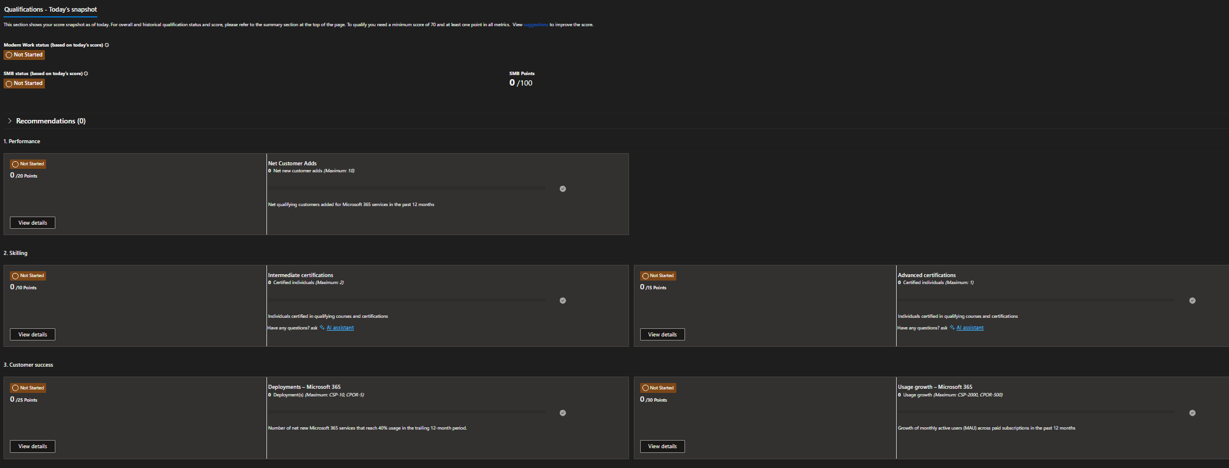
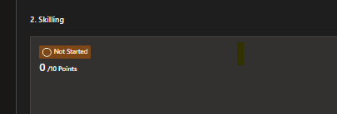
Modern Work Solution Designation
Skilling
Notes:
For this presentation we are going use the SMB Modern Work SPD as it’s the easiest to obtain out of all the current offerings.
You will receive 2 points for every net new customer added to your Partner Account, up to 10 points maximum. For the customer tenant to be included in this calculation, you need to have 11 or more end users. We do know that this has been a real concern for partners, so we are trying to help you along with this and see that working on the other points options may get you over the line
The certifications to obtain this SPD are pretty easy and you can gain the points by having two different folk pass the MS-900 Fundamentals exam, giving you a total of 10 points. This exam qualification never expires so doesn’t require refreshing annually. Then one person completing the the MS Teams Professional Advanced blah blah for 15 points.
So with these two you then have 25 points.

Slide 9
How to Skill for Modern Work Solution Designation
INTERMEDIATE
Microsoft Learn training path MS-900: MS-900 Microsoft 365 Fundamentals: Describe Microsoft 365 apps and services - Training | Microsoft Learn
Study guide for Exam MS-900: Microsoft 365 Fundamentals | Microsoft Learn
John Savill’s cramming session before sitting the exam: MS-900 Microsoft 365 Fundamentals Study Cram (youtube.com)
Get at least one person to pass this online assessment and this will give you points towards the solution designation. The assessment should be done using a personal account and not a work account.
ADVANCED
Teams Rooms Learning Options:
Virtual Bootcamp: Microsoft 365 and Security Learning Paths | Microsoft Teams Rooms Learning path
Get started with Microsoft Teams Rooms - Training | Microsoft Learn
Teams Rooms Actual Assessment:
https://partneruniversity.microsoft.com/?whr=uri:MicrosoftAccount&courseId=18819&scoId=AEFzAQFhH_2013787008

Slide 10
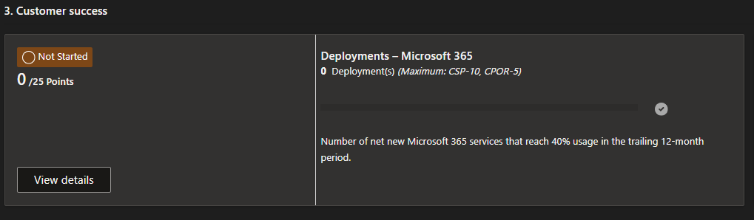
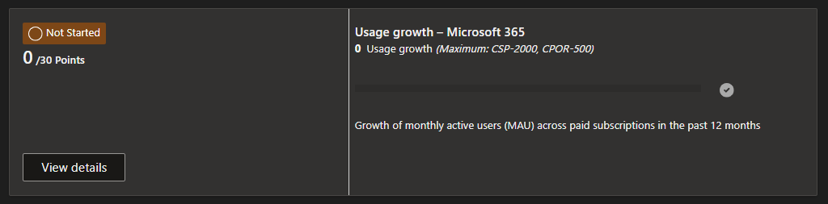
WORKLOADS
Intune
Exchange
Microsoft 365 Apps
SharePoint
Teams
Teams Meetings
Teams Phone
Teams Phone Enabled Users
Teams Phone Calling
Teams Apps
Viva Engage
Viva Insights
Viva Topics
Viva Learning
Viva Connections
Customer Success
Notes:
So, continuing with the MW SPD, with customer success there are two things Microsoft are focusing here. Deployments and Usage Growth.
With deployments, you gain points by ensuring your end customers are utilising at least 40% of the licenses listed, this will get you 2.5 points for each deployment, up to 25 points.
Each SPD has it’s own workloads, this being the licensing that is included in the points calculation. Licensing outside of the workload is not included unless you have the SPD that has that licensing listed in the workload.
Usage growth is basically head count. MS want to see more users in your tenant and will compare the growth for each tenant against the same time last year.

Slide 11
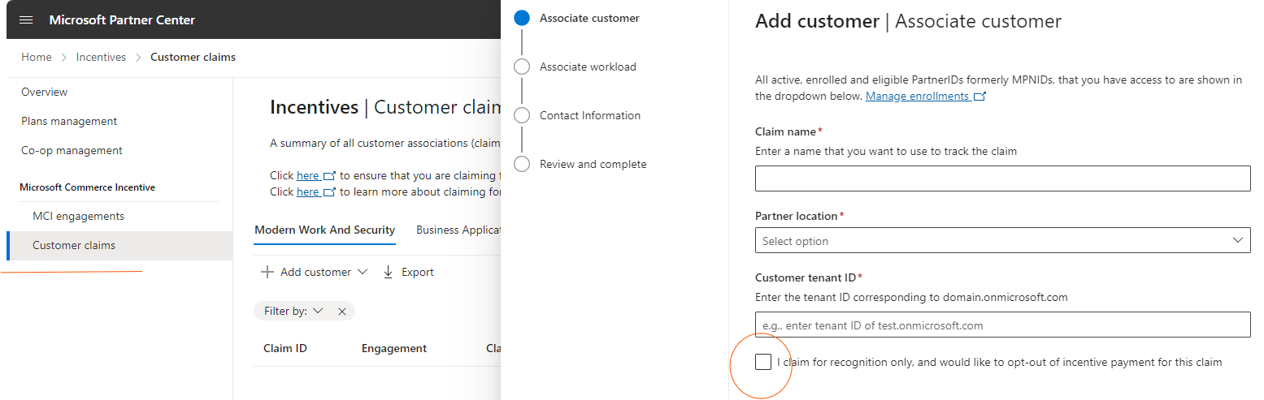
Workload vs CPOR
Lets start a conversation…..
Notes:
Quick insight for another session, but all security workloads must be claimed to receive recognition for both Financial & Points.

Slide 12
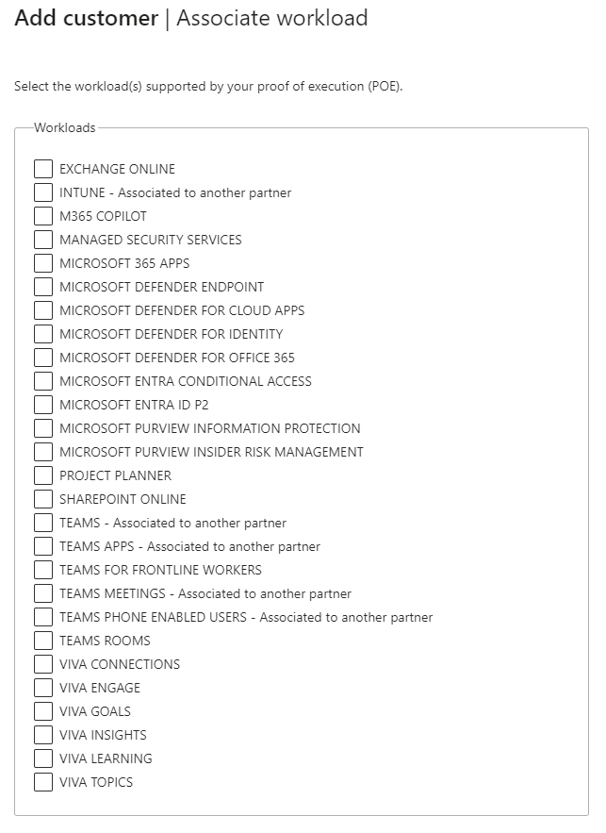
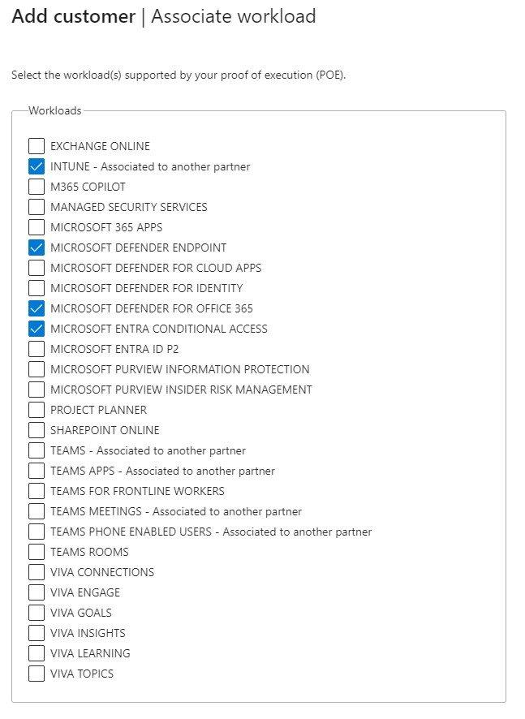

Slide 13
Key Points:
All SPD’s can be renewed if the existing SPD has reached 70 points or over (with no 0 points in 5 qualifying areas), in the period 5 months before the anniversary date & one month after.
The Modern Work: SMB SPD is generally the easiest to obtain.
You can gain multiple SPD’s and are only required to pay for the first one obtained.
If you have a legacy membership of either Silver or Gold (which ends in January 25) and get 70 points, you don’t have to pay again to obtain your SPD, but your benefits stay at Silver or Gold level until your renewal date.
All legacy membership benefits end on the 30 September 2025 for Gold, Silver and MAP’s regardless of your existing anniversary date.
SPD is between $7000 & $8000 per annum, but the benefits far outweigh the costs..
  - Internal Use 200 x ME5 (value $200k), 5 x Copilot M365 and so much more!
  - Incentives/Rebates at a minimum rate of 3.75% on all licenses!
Notes:
6 month renewal window for the 70+ points
You can stack SPDs with Benefits, have as many as you like but only one of each.

Slide 14
Handy Links:
These are good basic steps and great information for partners that have never obtained a MS SPD or just making sure the essentials are covered: https://learn.microsoft.com/en-nz/partner-center/incentives-ten-essentials#next-steps
Membership Overview: Manage membership with Microsoft in Partner Center - Partner Center | Microsoft Learn
This is the best place to go for most of your queries and to see what exams are available: https://learn.microsoft.com/en-us/certifications/
Solutions Partner benefits Guide: https://aka.ms/Solutionspartner.Benefits
Notes:
Just some handy links

Slide 15
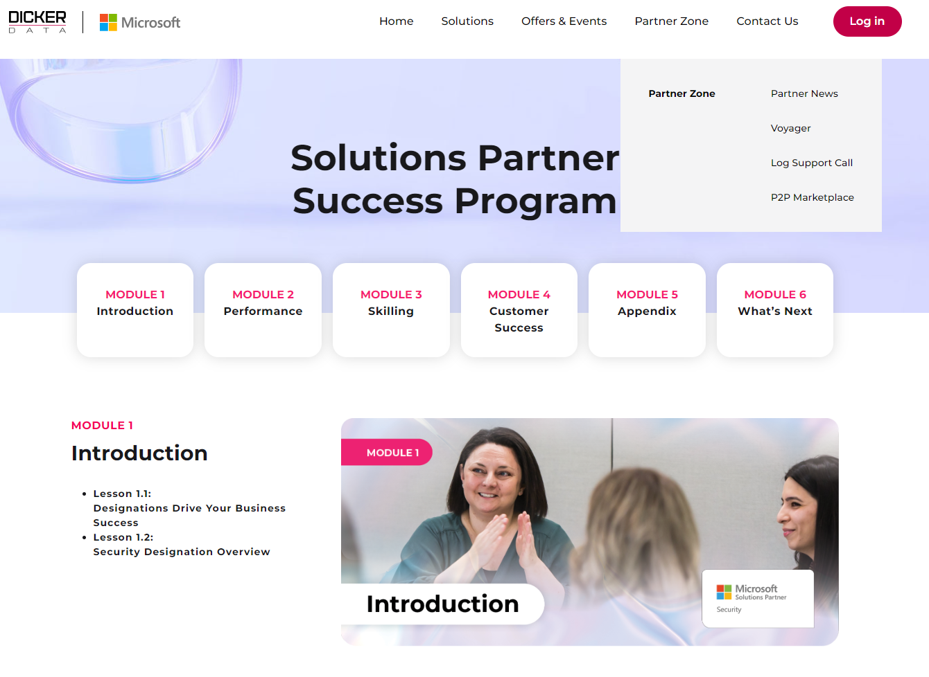
Sneak Peek!
Coming Soon!
Notes:
Coming Soon for all SPD’s!

Slide 16
Thank You
Next session: Surface Copilot + / Fuel up with Surface Promo
23 October 2024
www.dickerdata.co.nz/microsoft
www.dickerdata.com.au/microsoft
Click here to register

