Slide 1
Dicker Data Webinar
E:27 Updates to Microsoft Partner Benefits and FY25 Solution Assessments
Notes:
Thank you for joining will start shortly
MAKE SURE RECORDING IS ON

Slide 2

Agenda
1
News
2
Main Topic: Updates to Microsoft Partner Benefits and FY25 Solution Assessments
3
Close
5
Code of Conduct
Notes:
For those of you new to Powerpoint live. A quick familiarisation, We welcome your reactions using the emotion icon at the top right of your screens. Please ask questions in the chat window during the call. We will invite you to come off mute at the end of the call if you would prefer to ask your question out loud. During the call, please ensure you are on mute, and your video is turned off.
All links to sites are available by clicking on the link in the slide or will be posted to the chat window. We recommend you click on all relevant links and then review post call.
Calls will be recorded and made available post call, The teams generated recording will not be available external so don’t panic we will make the recording available to you later .
Participation in these calls means that you agree to Microsofts terms and conditions for digital meetings a link is available on this slide should you wish to review these. or to test the live link feature
Introduce speakers Role and location

Slide 3



News
What you need to know
Notes:
But First The News. This is the section which is a concise update of relevant information, or opportunities compiled by Dickers subject matter experts. Who attend those early morning calls, wade through endless emails, yammer messages etc so you don’t have to

Slide 4
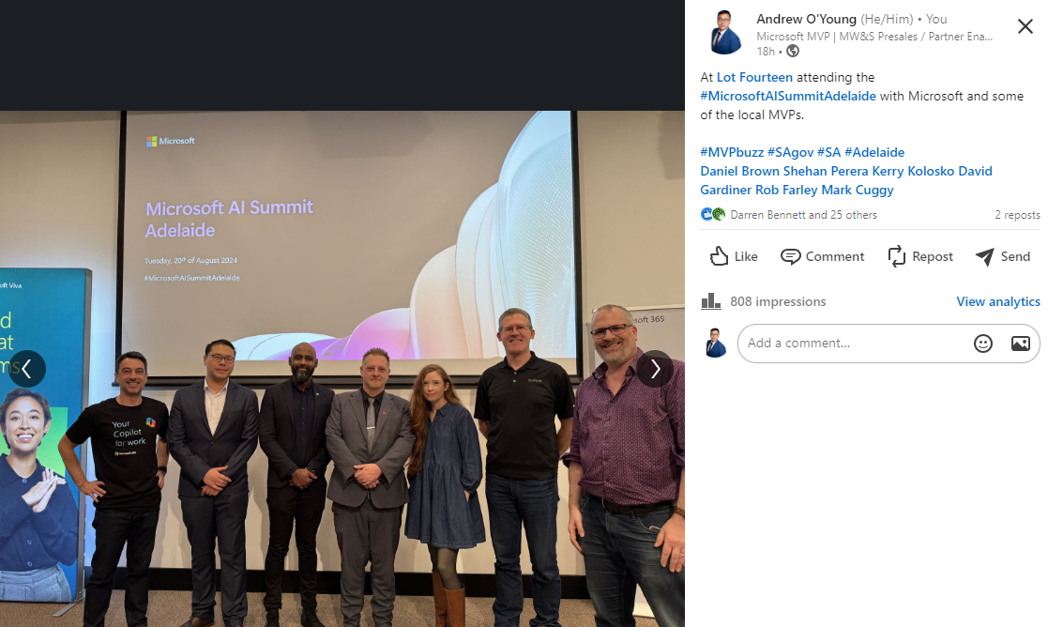
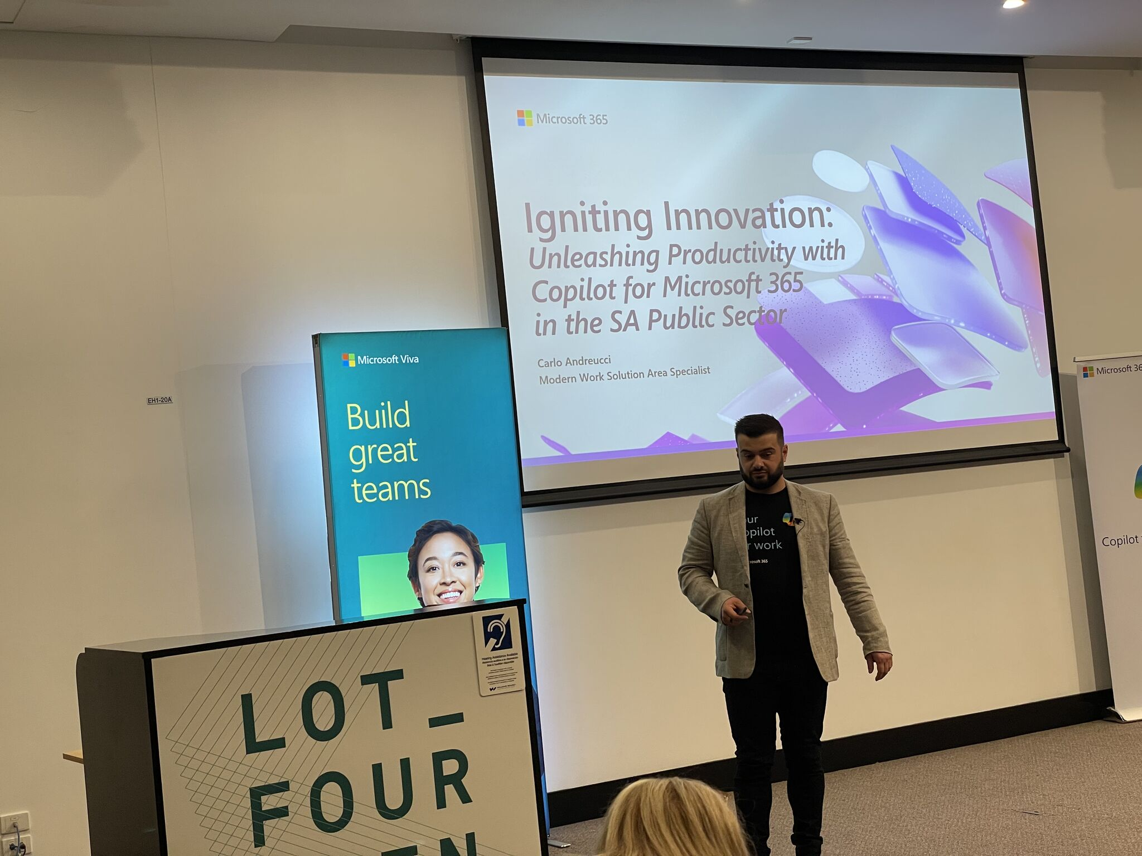

Slide 5
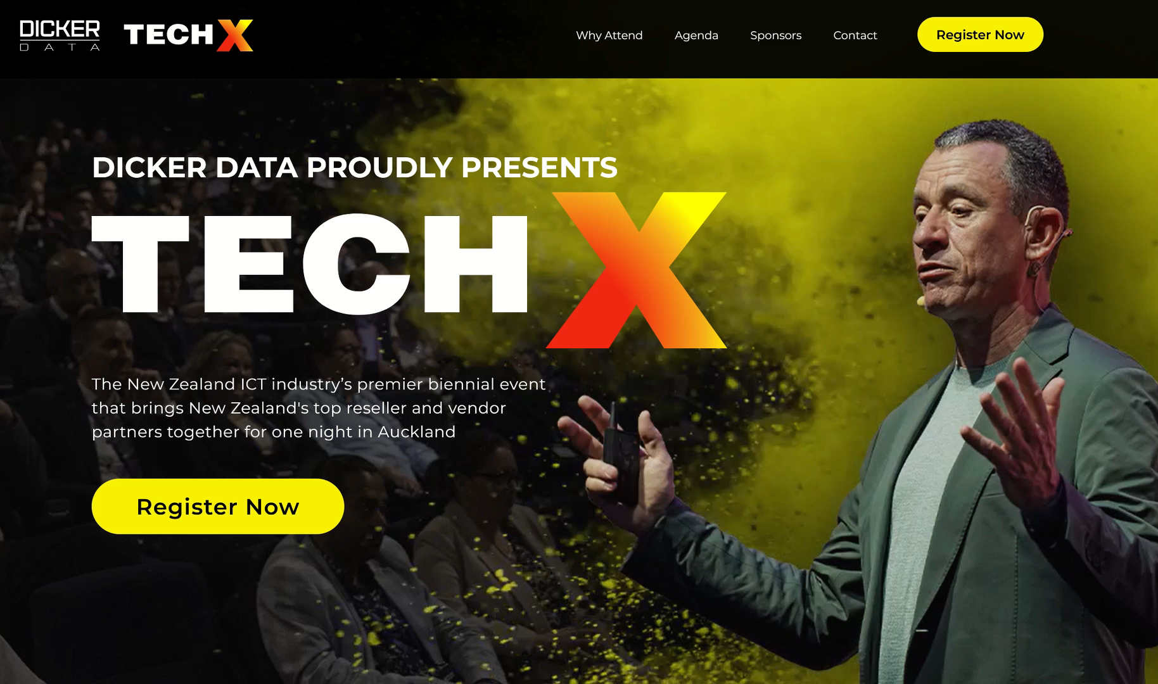
NZ
AU

Slide 6

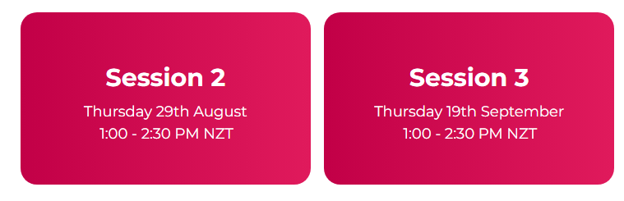
Copilot Webinars
Our next Copilot webinars is on 29th August at 1pm NZT/ 11am AEST.
Agenda:
Copilot early insights
Overview of Copilot’s
Security foundations of Copilot
Live demo
Readiness & Adoption
Register here:
NZ: Microsoft Copilot Ready (dickerdata.co.nz)
AU: https://www.dickerdata.com.au/microsoft/copilot-demo-webinar-registration

Slide 7
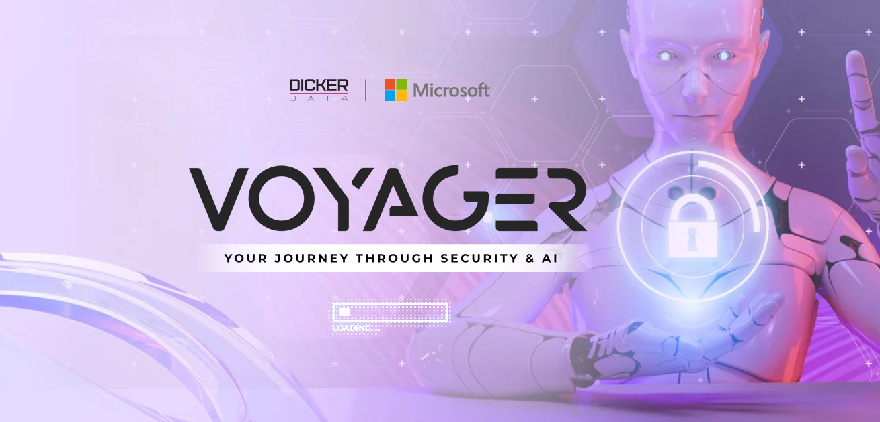
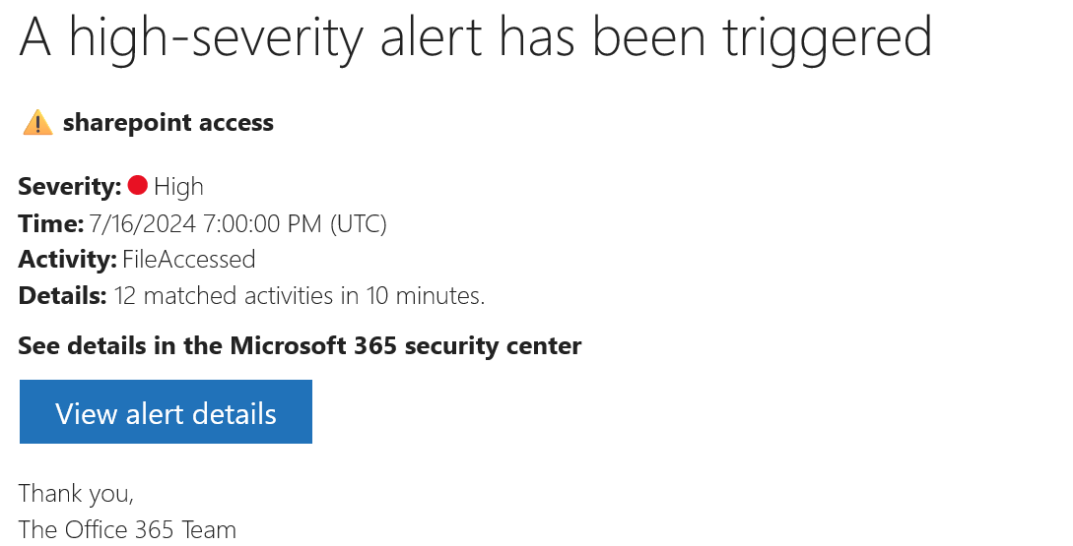
NZ
AU
Notes:
3rd session of the month, Deep Dive into Security in Azure, unfortunately clashes with Lauren’s Webinar ☹ not playing favourites, but if you’re in MW join Lauren, if you’re Azure join Lauren, but maybe do AzSecurity :D
Comprehensive insights into Cloud Workload Protection Platform (CWPP)
Detailed exploration of Cloud Security Posture Management (CSPM)
In-depth understanding of Cloud-Native Application Protection Platform (CNAPP)
How these solutions provide robust and comprehensive protection
3 x Sessions of our new Security & AI Series : Voyager
This is a technical series aimed at engineers, analysts & architects.
These sessions are designed to provide you with a foundational understanding of key security concepts and serve as a pre-requisite for our more in-depth future events.
Kicking off tomorrow 1st of August at 1pm NZT or 11am AEST
Session 1: Microsoft Security & AI Concepts
Session 2: Foundations of Microsoft AI (15th August)
Session 3: Deep Dive into Security in Azure (29th August)
Further sessions in September, including the Cloud Workload Protection Platform
& Microsoft Defender Cloud Security Posture Management
Saeed, Mikki & Daniel

Slide 8
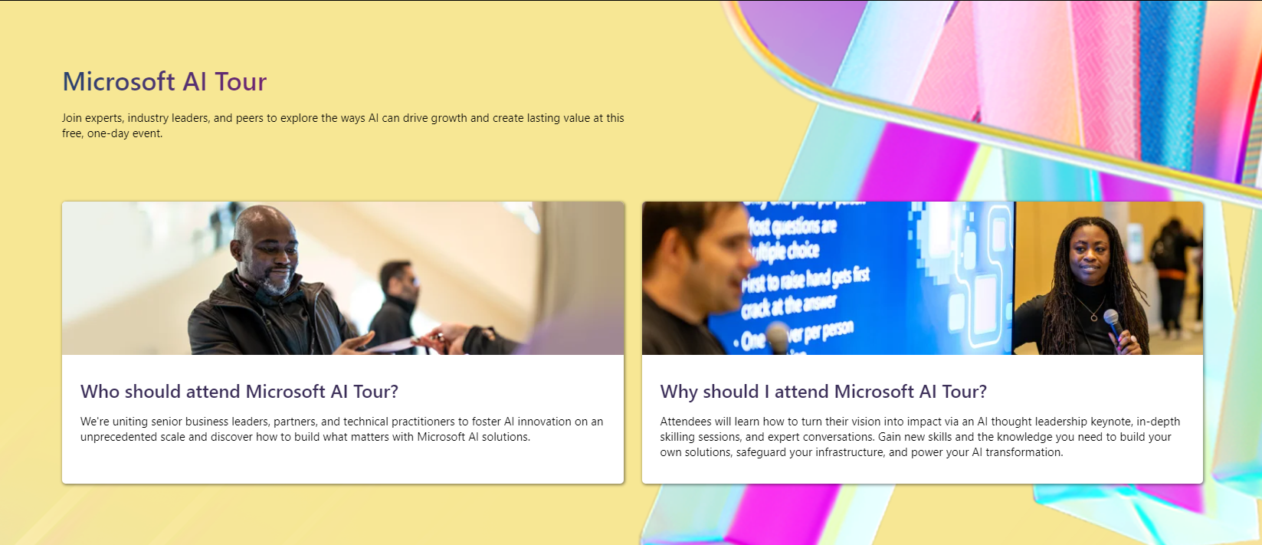
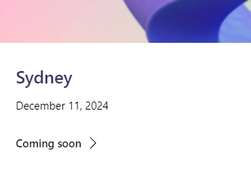
Learn More

Slide 9
Learn
New Certification for Dynamics 365 Customer Experience Analysts in Beta
Microsoft Entra Suite Tech Accelerator – On Demand
Microsoft Loop Live five-part product learning Series
Level Up CSP Microsoft 365 and Copilot Bootcamps
Copilot Customer Adoption | Train the Trainer – Virtual
Modern Work for Partners - What's New
CSP Copilot & M365 Activation Event – 28 Aug / 6 Sep
Notes:
New Certification for Dynamics 365 Customer Experience Analysts in Beta
Microsoft Entra Suite Tech Accelerator – On Demand
Microsoft Loop Live five-part product learning Series
Level Up CSP Microsoft 365 and Copilot Bootcamps
Copilot Customer Adoption | Train the Trainer
Modern Work for Partners - What's New
CSP Copilot & M365 Activation Event

Slide 10
Learn
New Certification for Dynamics 365 Customer Experience Analysts in Beta
Microsoft Entra Suite Tech Accelerator – On Demand
Microsoft Loop Live five-part product learning Series
Level Up CSP Microsoft 365 and Copilot Bootcamps
Copilot Customer Adoption | Train the Trainer - Virtual
Fortify your Data Security with Microsoft Purview – In Person (SYD)
Modern Work for Partners - What's New
CSP Copilot & M365 Activation Event – 28 Aug / 6 Sep
Notes:
New Certification for Dynamics 365 Customer Experience Analysts in Beta
Microsoft Entra Suite Tech Accelerator – On Demand
Microsoft Loop Live five-part product learning Series
Level Up CSP Microsoft 365 and Copilot Bootcamps
Copilot Customer Adoption | Train the Trainer
Fortify your Data Security with Microsoft Purview
Modern Work for Partners - What's New
CSP Copilot & M365 Activation Event

Slide 11
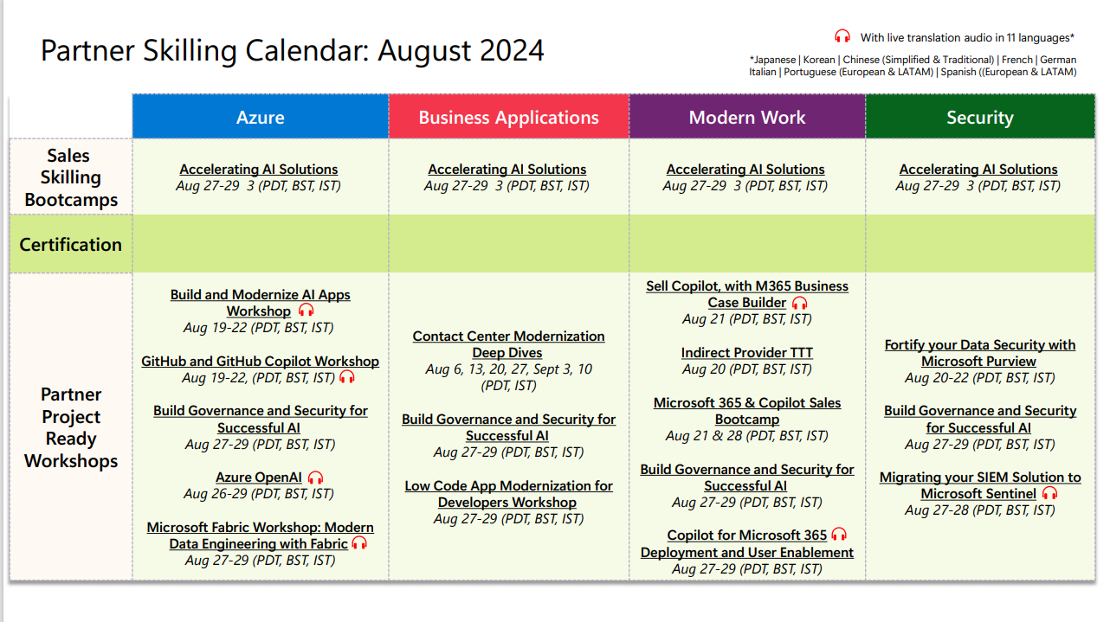

Slide 12
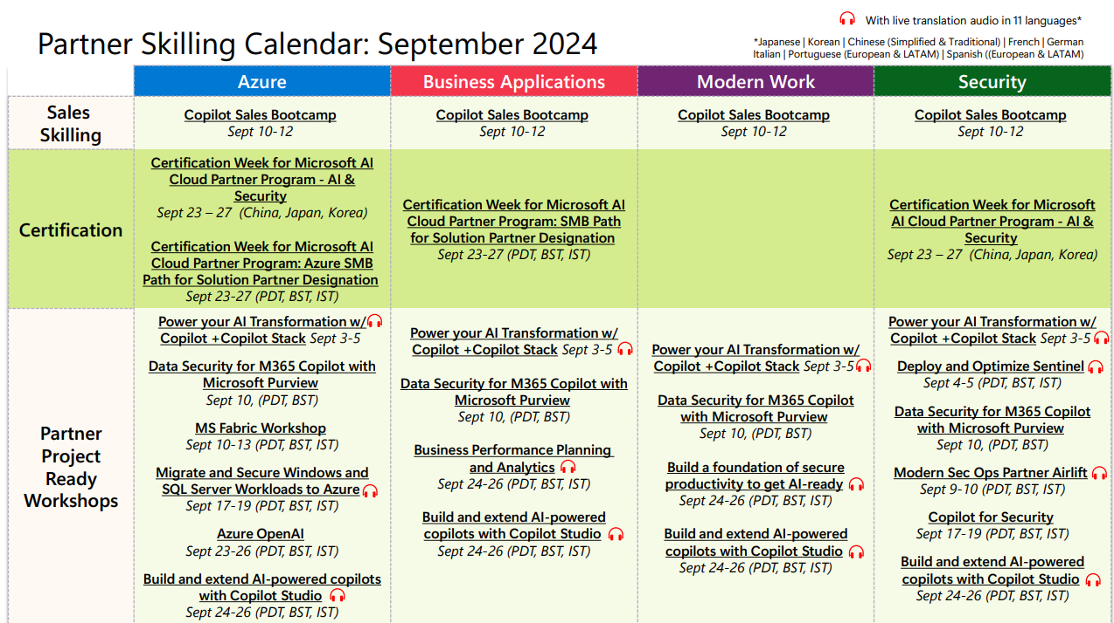

Slide 13
Microsoft AI Cloud Partner Program Benefits Update
Andrew O’Young

Slide 14
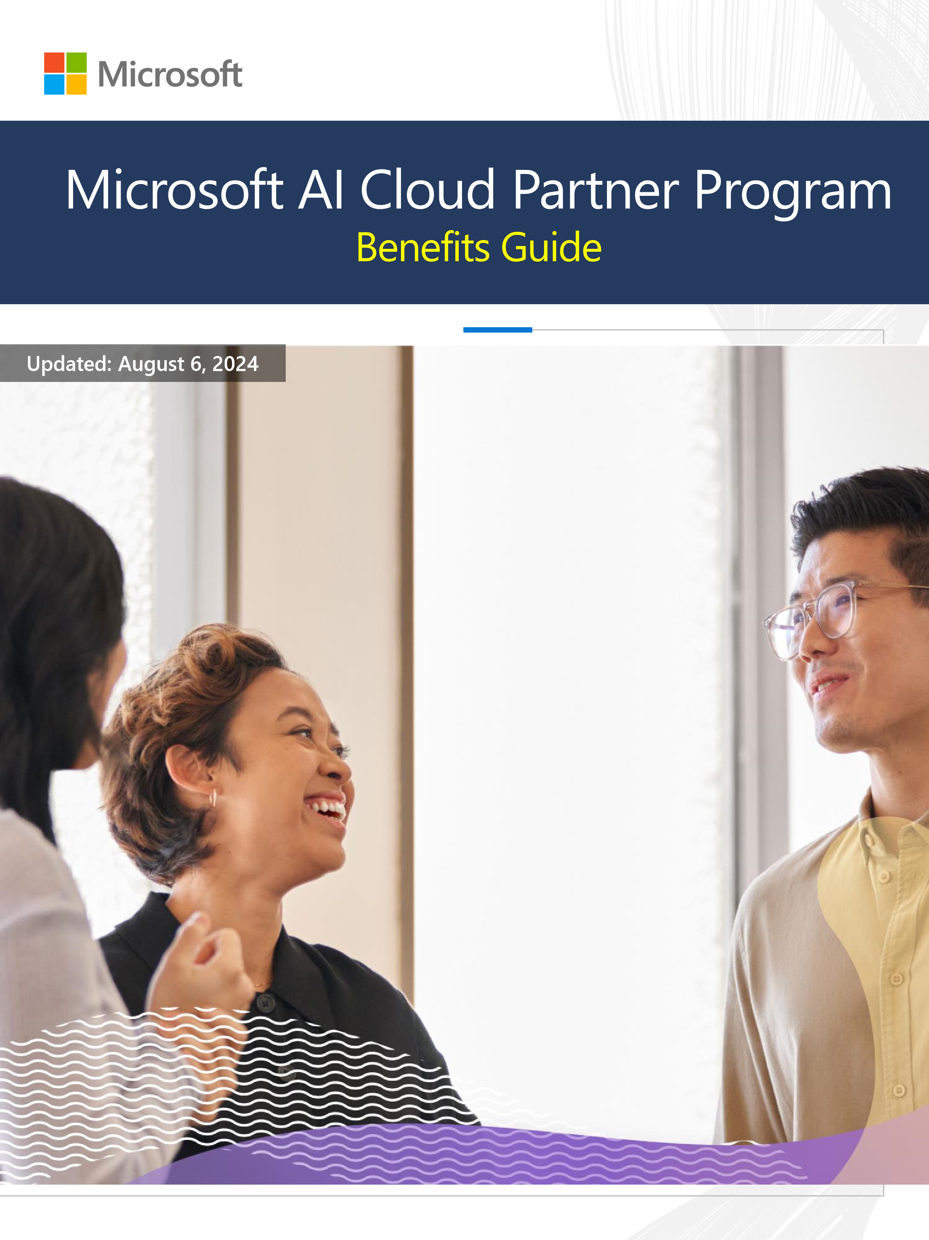
Benefits built for your business
Strengthen Solutions for Customers
  Build your cloud and AI practice
Scale Your Business
  Cost-saving packages to achieve more
Deepen Partnership with Microsoft
  Drive long-term profitability
Exclusive Product Support and Advisory Benefits
  Access in-demand licenses and Azure credits
  Collaborate, develop offerings, and deliver solutions
Cost-Efficient Access to Microsoft Products and Services
  Significant discount on key products and support services
Flexible Packages for All Growth Stages
Notes:
After joining the Microsoft AI Cloud Partner Program, new members are encouraged to explore the benefits packages. These packages are designed to help you achieve your goals, regardless of your size or stage of growth.
Partner benefits packages help strengthen your cloud and AI practice, scale your business, and deepen your partnership with Microsoft. They offer exclusive product support, cost-efficient access to Microsoft products, and flexible packages for all growth stages.
Original Content:
Benefits built for your business
Partner benefits packages provide the offerings you need to help strengthen your cloud and Al practice through expanded benefits and support. With partner benefits packages, you can
help:
Strengthen your solutions for customers through benefits that build your cloud and Al practice.
Scale your business with cost-saving packages designed to help you achieve more.
Deepen your partnership with Microsoft and drive long-term profitability.
Tap into exclusive product support and advisory benefits to drive success for your business. Partner benefits packages offer the in-demand licenses, Azure credits, and support you need to collaborate, develop offerings, and deliver high-performing solutions for your customers.
Each partner benefits package provides you with a portfolio of key Microsoft products and support services at a significant discount. Partner benefits packages are a cost-efficient way to access the tools you need to grow your business.
No matter your stage of growth, there is a partner benefits package for you. With several increasingly robust options to choose from, you can select the package that best serves your current needs, then expand your benefits as you continue to grow with Microsoft.

Slide 15
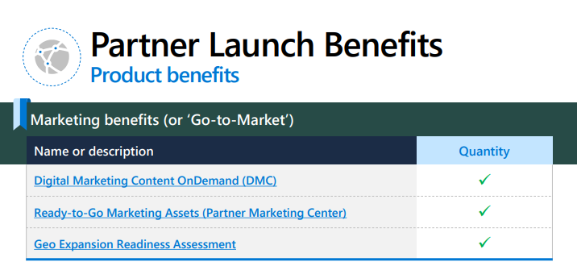
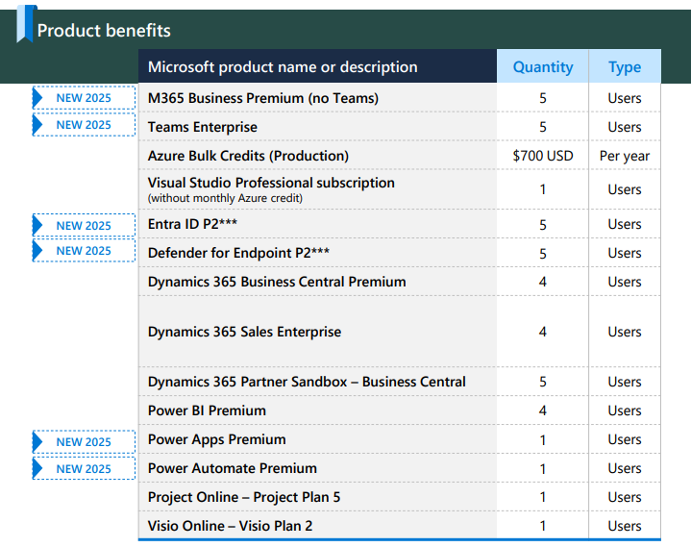
$345 USD Retail Value $13,792 USD
Notes:
Partner Launch Benefits are designed to build high-performing solutions and kickstart your business growth.
Partner Launch Benefits are designed to help you build high-performing solutions and kick-start your business growth. Benefits include:
Up to 5 users across 9 software products
Original Content:
After joining the Microsoft Al Cloud Partner Program, we encourage
New members you to explore the benefits packages that can best help you achieve your goals–no matter your size or stage of growth.

Slide 16
$895 USD Retail Value $62,086+ USD
Notes:
Partner Success Core Benefits are designed to help you create, build, and expand a strong AI and cloud practice. Benefits include:
Up to 25 users across​ 20 software products

Slide 17
$3,995 USD Retail Value $390,864+ USD
Notes:
Partner Success Expanded Benefits are designed to help you scale your reach further and deepen your partnership with Microsoft. Benefits include:
Up to 35 users across​ 38 software products

Slide 18
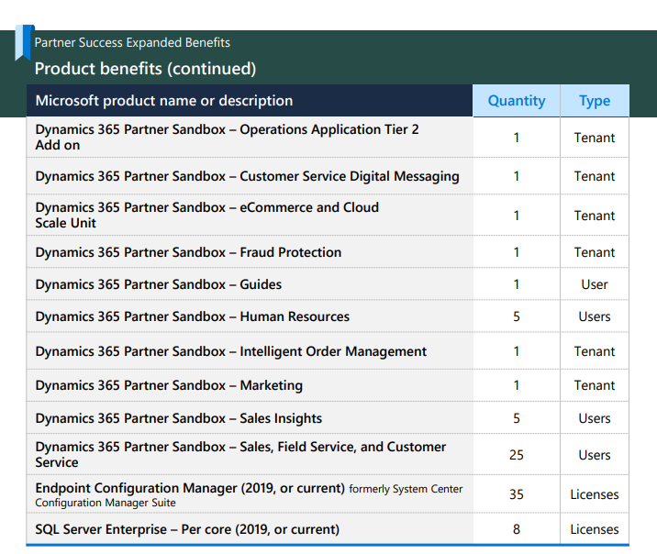
Notes:
After joining the Microsoft AI Cloud Partner Program, new members are encouraged to explore the benefits packages. These packages are designed to help you achieve your goals, regardless of your size or stage of growth.
Original Content:
After joining the Microsoft Al Cloud Partner Program, we encourage
New members you to explore the benefits packages that can best help you achieve your goals–no matter your size or stage of growth.

Slide 19
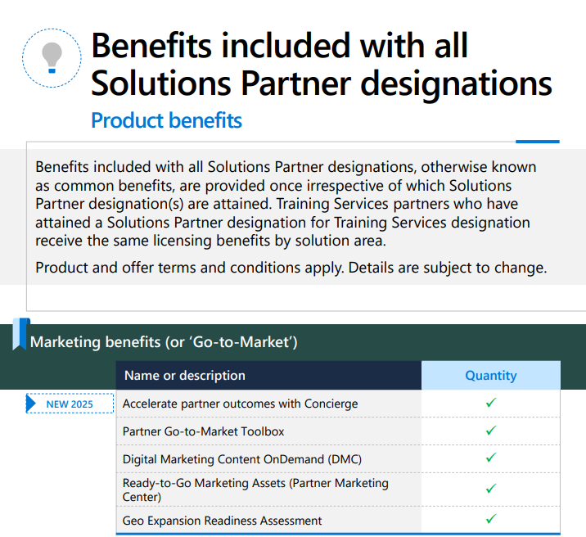
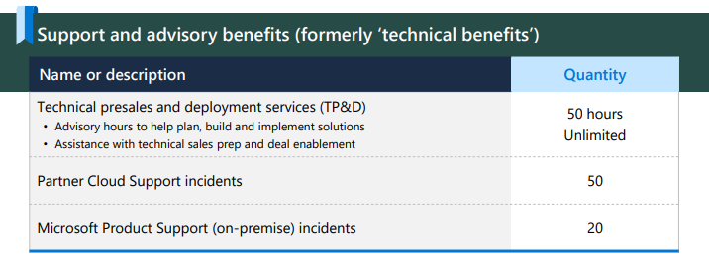
Notes:
Stand out from the competition by attaining a Solutions Partner designation.
Solutions Partner designations are aligned to solution areas with high market demand and offer exclusive badging to help customers identify your organization's capabilities.

Slide 20
$4,730 USD

Slide 22
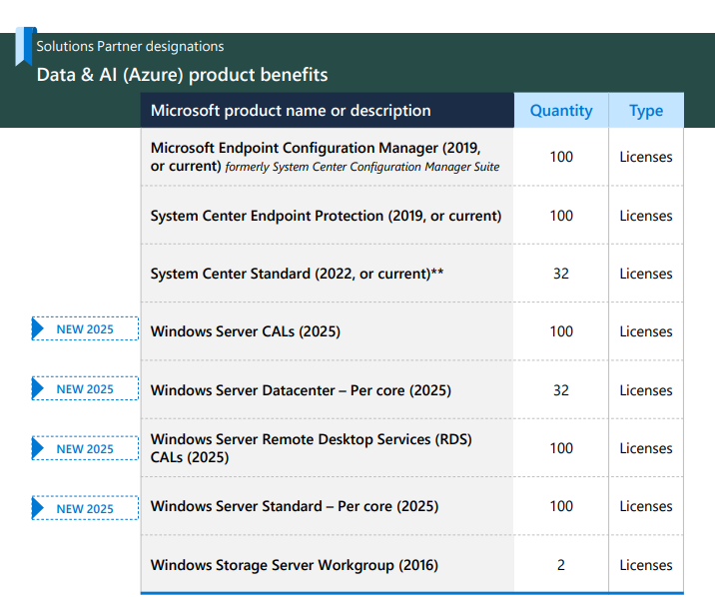

Slide 28
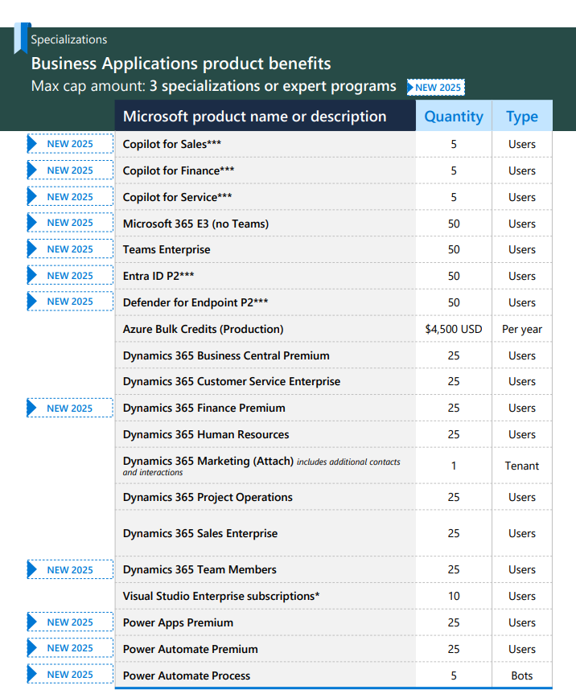

Slide 29
Notes:
End Sep 25
Reach out, for SolDes

Slide 30
FY25 SMB Desk Solution Assessments
Andrew O’Young

Slide 31
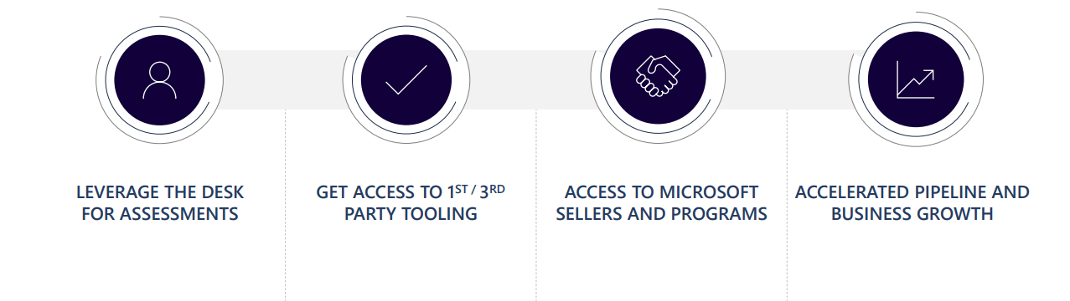

Increasing partner profitability with the NEW SMB Desk
Growing topline business and reducing cost of sales
To learn more visit https://www.Microsoft.com/en-us/solutionassessments/
Notes:
The NEW SMB Desk helps partners increase profitability by leveraging assessments, accessing tooling, and Microsoft programs. This accelerates pipeline and business growth, growing topline business and reducing sales costs.
easing the path to cloud migration for customers, highlighting the collaborative approach with partners and customers to define cloud journeys confidently.

Slide 32
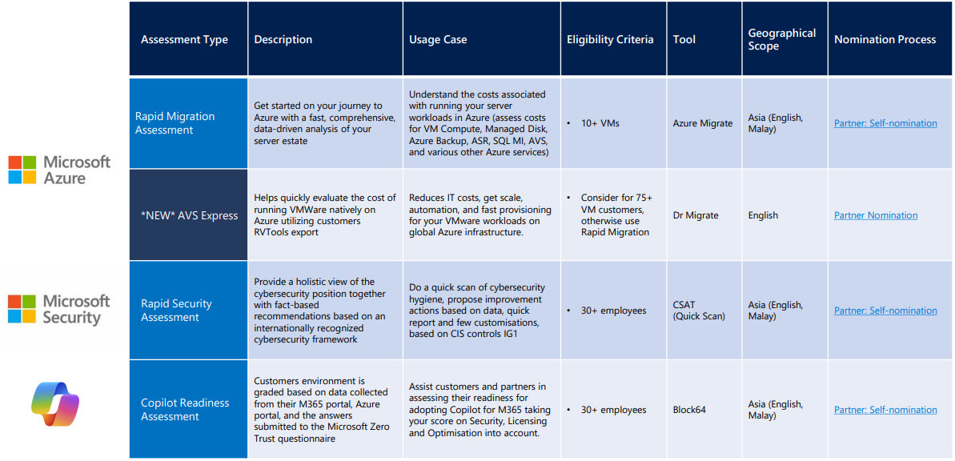
SMB Solution Assessment Overview
Notes:
new AVS Express assessment, explaining its quick turnaround time using RV tools output from customers and its focus on comparing AVS with on-prem environments. Financially viable 75+ VMs
Doesn’t assess Az Native, <75 look at Rapid Migration Assessment
RVTools is .NET app using Vmware vSphere Mang SDK and CIS REST API to display info about your virtual env
Rapid Mig, AzExpress last year, Rapid this year and not using the Excel Workbook for assessment, incr 10+ VMs, same link.
The Rapid Security Assessment offers a comprehensive evaluation using CSAT Quickscan. It provides actionable recommendations to enhance security for M365 and Azure, driving better security consumption.
E8 in AU, CIS in APAC
The Copilot Readiness Assessment helps customers and partners evaluate their readiness for adopting Copilot for M365 by considering key factors such as security, licensing, and optimization.
DLP/Sensitivity Labelling, Groups in SPO, usage and savings est
Always a human in the loop at MS side, Consultant will get in touch for pre-assessment call with client
Add weight

Slide 33
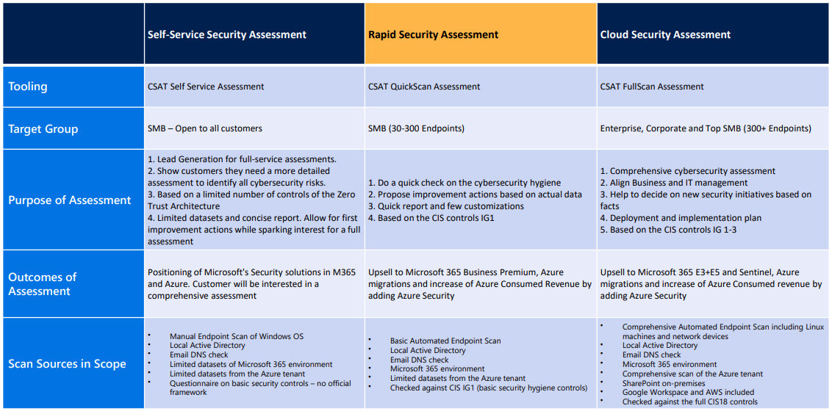
Security Assessment Types
Self-Service Security
Partner: Self-Nomination
Notes:
There are two types of security assessments: Self-service Security, where users manage their own assessments, and Partner: Self-nomination, where partners nominate themselves for assessments.
Original Content:
• Copilot Readiness Assessment - Assist customers and partners in assessing their readiness for adopting Copilot for M365 taking your score on Security, Licensing and Optimisation into account.

Slide 34
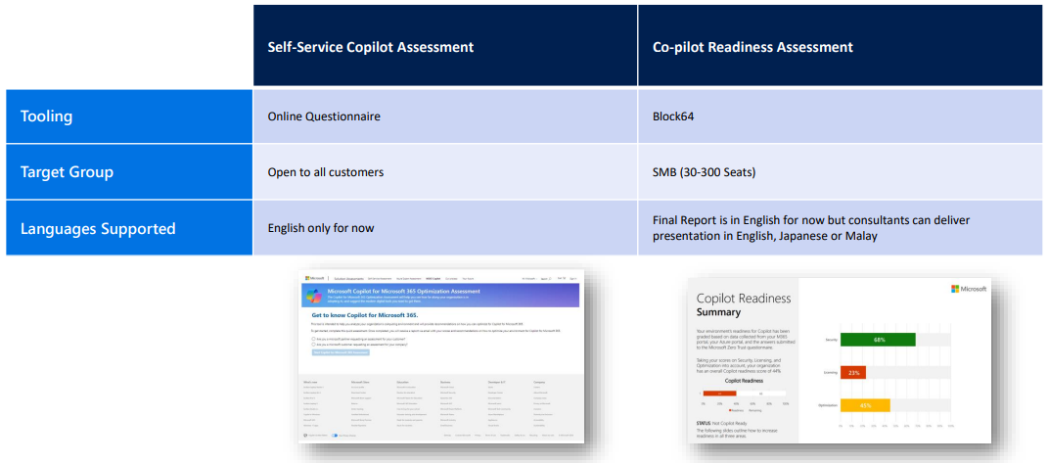
Self-Serve Copilot Assessment
Self-Serve Assessment
Partner: Self-Nomination
Notes:
Original Content:
Increasing partner profitability with the NEW SMB Desk
LEVERAGE THE DESK FOR ASSESSMENTS GET ACCESS TO 1 ST / 3 RD PARTY TOOLING ACCESS TO MICROSOFT SELLERS AND PROGRAMS ACCELERATED PIPELINE AND BUSINESS GROWTH To learn more visit n https://www.microsoft.com/e - / us/solutionassessments Growing topline business and reducing cost of sales
4

Slide 35
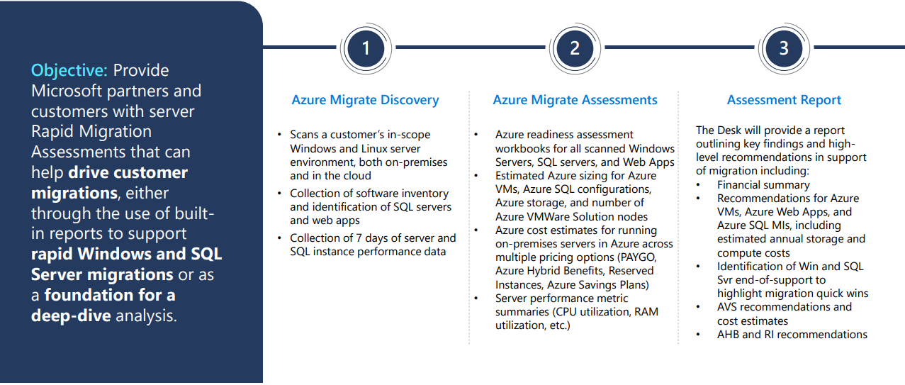
Rapid Migration Assessment
Notes:
Not just OnPrem, incl GCP and AWS, right-sizing -> PAYG an RI

Slide 36
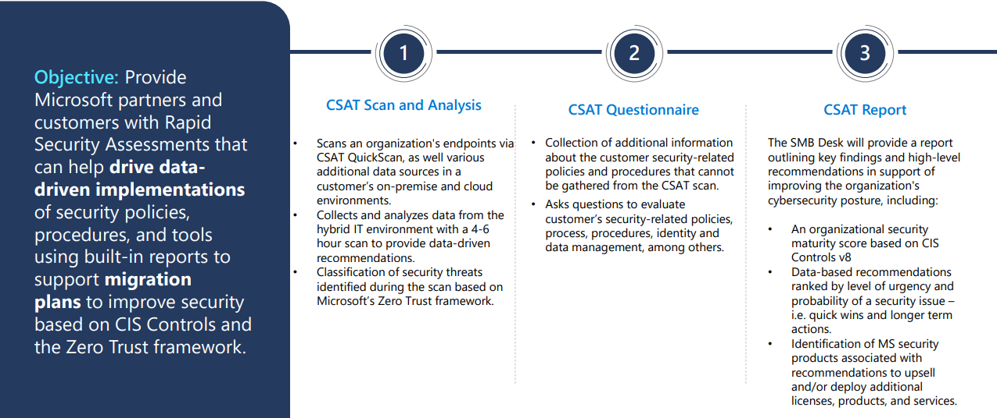
Rapid Security Assessment
Notes:
Recommend MS Products, and Upsell E3/E5
Findings ranked by urgency/roadmap

Slide 37
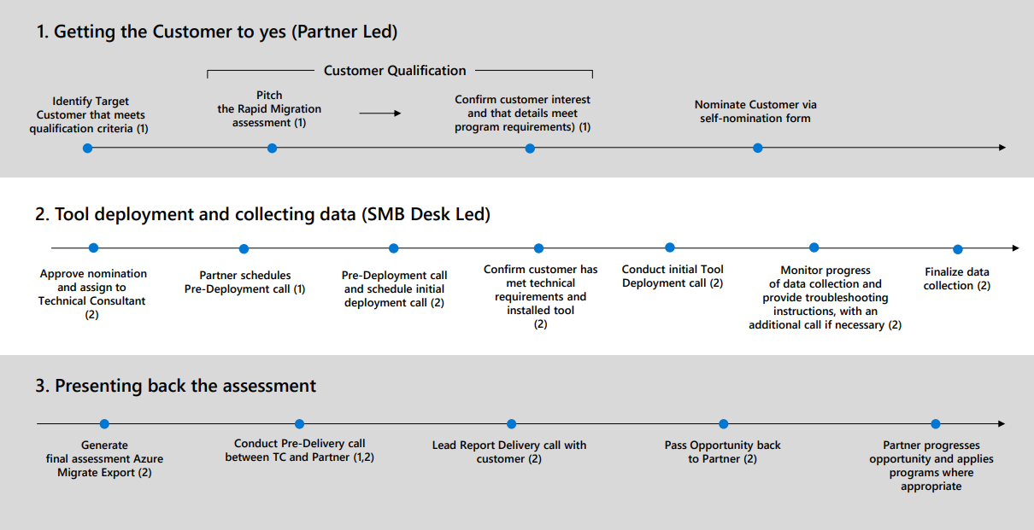
SMB Desk Assessment Process for Partners
Notes:
Customer Flyers incl time req

Slide 38
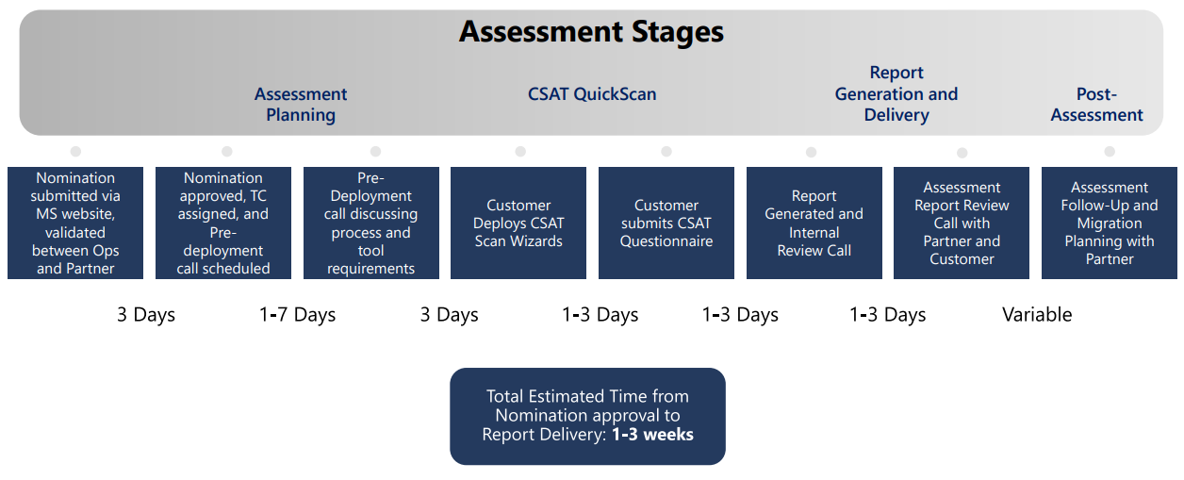
Rapid Security Assessment | Estimated Timeline

Slide 39
Flyers and Sample Reports
<Insert awkward sharing transition.>

Slide 40
Nominate Today!

Slide 41
Links
Microsoft AI Cloud Partner Program
Compare Partner Benefits Packages
Solutions Partner Designation Areas
Specialisations
Benefits Guide
Benefits offerings transition walking deck
FAQ
Announcement blog
Solution Assessments Program
Self Service Assessment (Security)
Self Service Assessment (Copilot for M365)
Partner Nominated Solution Assessments
Notes:
Microsoft AI Cloud Partner Program
Compare Partner Benefits Packages
Solutions Partner Designation Areas
Specialisations
Benefits Guide
Benefits offerings transition walking deck
FAQ
Announcement blog
Solution Assessments Program
Self Service Assessment (Security)
Self Service Assessment (Copilot for M365)
Partner Nominated Solution Assessments

Slide 42
Dicker Data Webinar
Thank you
Notes:
Microsoft Teams Prem Thank you for your attendance and if you have any questions we will stop recording. Feel free to ask in the chat window.
HOW CAN WE HELP?

