Slide 1
Dicker Data Webinar
Notes:
Thank you for joining will start shortly
MAKE SURE RECORDING IS ON

Slide 2
Agenda
1
News
2
Main Topic: Transform your Microsoft Tenancy Management experience with EcpPro
3
Close
5
Subscribe to receive email communications from Dicker Data
Code of Conduct
Contact Us: www.dickerdata.co.nz | 0800 337 253
Notes:
Welcome to Opoint 2024, Happy New year. If you are joining for the first time welcome and thank you, we hope that you find the next 30 mins informative and possibly a little entertaining.
If you have attended our previous onpoints welcome back and thanks for all your support. You will find this year we are doing things a little different this year. More about that in a moment.
Then we do a quick catchup on our carefully hand curated Microsoft relevant news for the previous week,
Followed by the subject de semaine (week in English) today we will explain on why you should choose Dicker Data as your Distributor and the benefits of being a Dicker Partner.
Then we close out with an open Q&A session /prize draw
For those of you new to Powerpoint live. A quick familiarisation, We welcome your reactions using the emotion icon at the top right of your screens. Please ask questions in the chat window during the call. We will invite you to come off mute at the end of the call if you would prefer to ask your question out loud. During the call, please ensure you are on mute, and your video is turned off.
All links to sites are available by clicking on the link in the slide or will be posted to the chat window. We recommend you click on all relevant links and then review post call.
Calls will be recorded and made available post call, The teams generated recording will not be available external so don’t panic we will make the recording available to you later .
Participation in these calls means that you agree to Microsofts terms and conditions for digital meetings a link is available on this slide should you wish to review these. or to test the live link feature
Introduce speakers Role and location

Slide 3
News
What you need to know
Notes:
But First The News. This is the section which is a concise update of relevant information, or opportunities compiled by Dickers subject matter experts. Who attend those early morning calls, wade through endless emails, yammer messages etc so you don’t have to

Slide 4

Auckland • Monday 10th June
9.00am – 6.00pm
Microsoft Auckland, Microsoft House, Level 5/22 Viaduct Harbour Avenue, Auckland CBD, Auckland 1010
You will receive a QR code which will give you access to the building from 9AM.
Wellington • Wednesday 12th June
9.00am – 6.00pm
Microsoft Wellington, 10 Brandon Street, Wellington Central, Wellington 6011
Christchurch • Friday 14th June
9.00am – 6.00pm
Te Pae Convention Centre
188 Oxford Terrace, Christchurch Central City, Christchurch 8011
This CSP Masters Sales Training will be hosted by Microsoft MVP & Microsoft Certified Trainer Robert Crane.
This catered event will train resellers on how to position different Microsoft Products to their customers, with sessions in Auckland, Christchurch, and Wellington.
Suggested Audience: Business Leaders & Practice Leads
Notes:
NZ only registration link click on venues

Slide 5

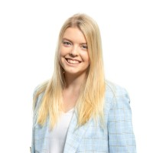
DATE & TIME:
Wednesday 26th June 1:00 PM NZT / 11:00 AM Sydney
Dicker Data is inviting you to bring your customers to our live digital briefing where we’ll showcase how Microsoft 365 can help put the power of AI to work with a live demo of Copilot for Microsoft 365! Copilot for Microsoft 365 can dramatically transform the way work gets done, empowering people to focus on more innovation and creativity – and unlocking a new wave of productivity growth.
Notes:
ANZ Final chance 220 attendees last time.
What’s New in Copilot | May 2024 - Microsoft Community Hub

Slide 6
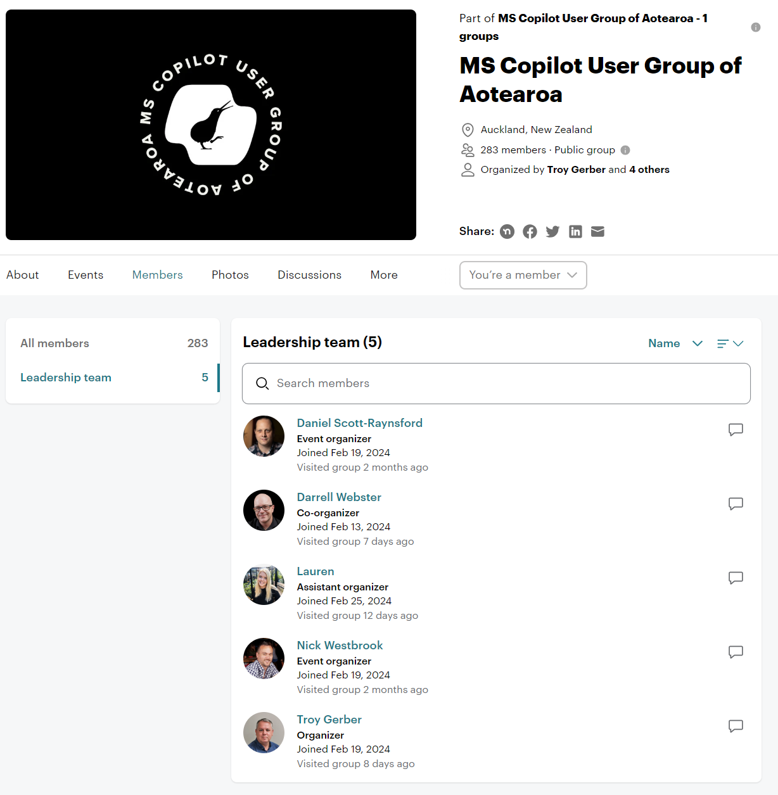
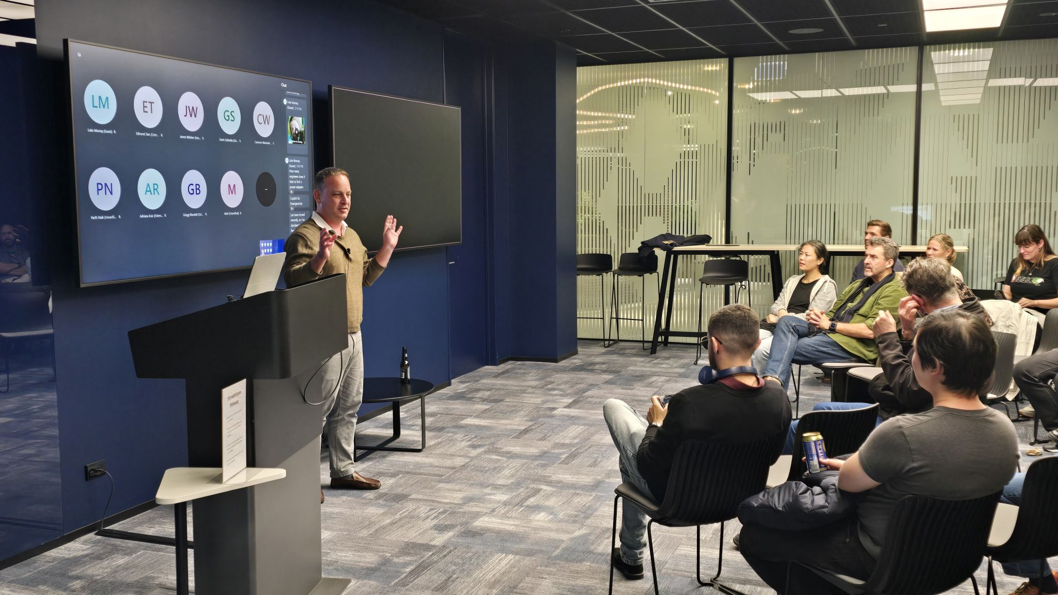
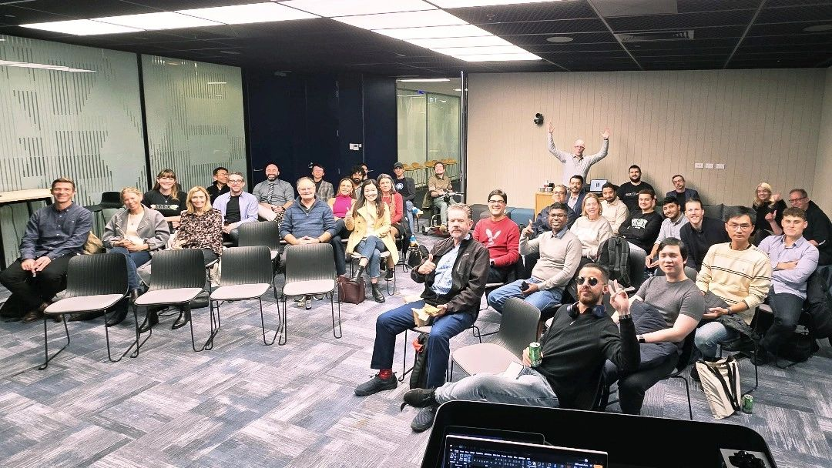
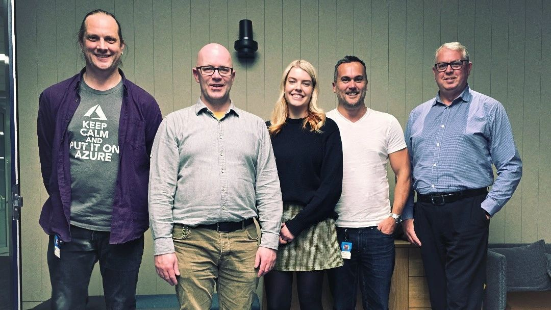
Notes:
Congratulations to our very own Lauren, on being a co-organiser for NZ’s copilot user group. If you would like to register to attend either in person in Auckland or online click on the logo

Slide 7
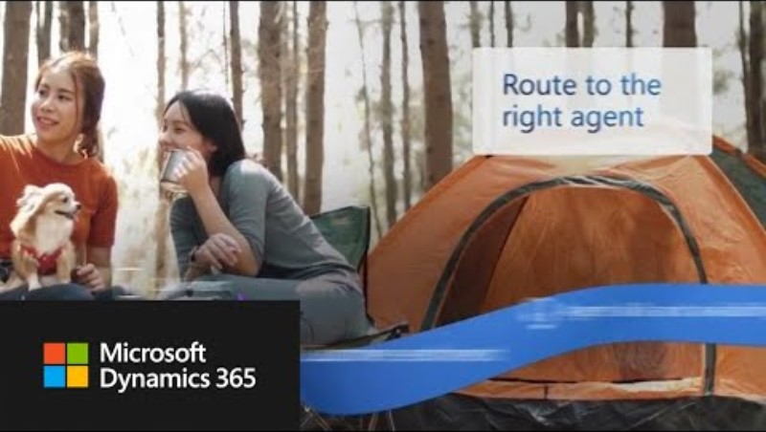
Introducing Microsoft Dynamics 365 Contact Centre
Notes:
Overnight, Microsoft have announced Microsoft Dynamics 365 Contact Centre, a Copilot-first contact centre solution.
This is due to go Generally Available on July the 1st, and is a standalone Contact Centre as a Service solution that can integrate with your preferred CRM System or custom apps, so customers no longer have to be running Dynamics CRM which significantly expands the opportunity for this solution.
There is a quick sizzle video, so let’s check it out.

Slide 8
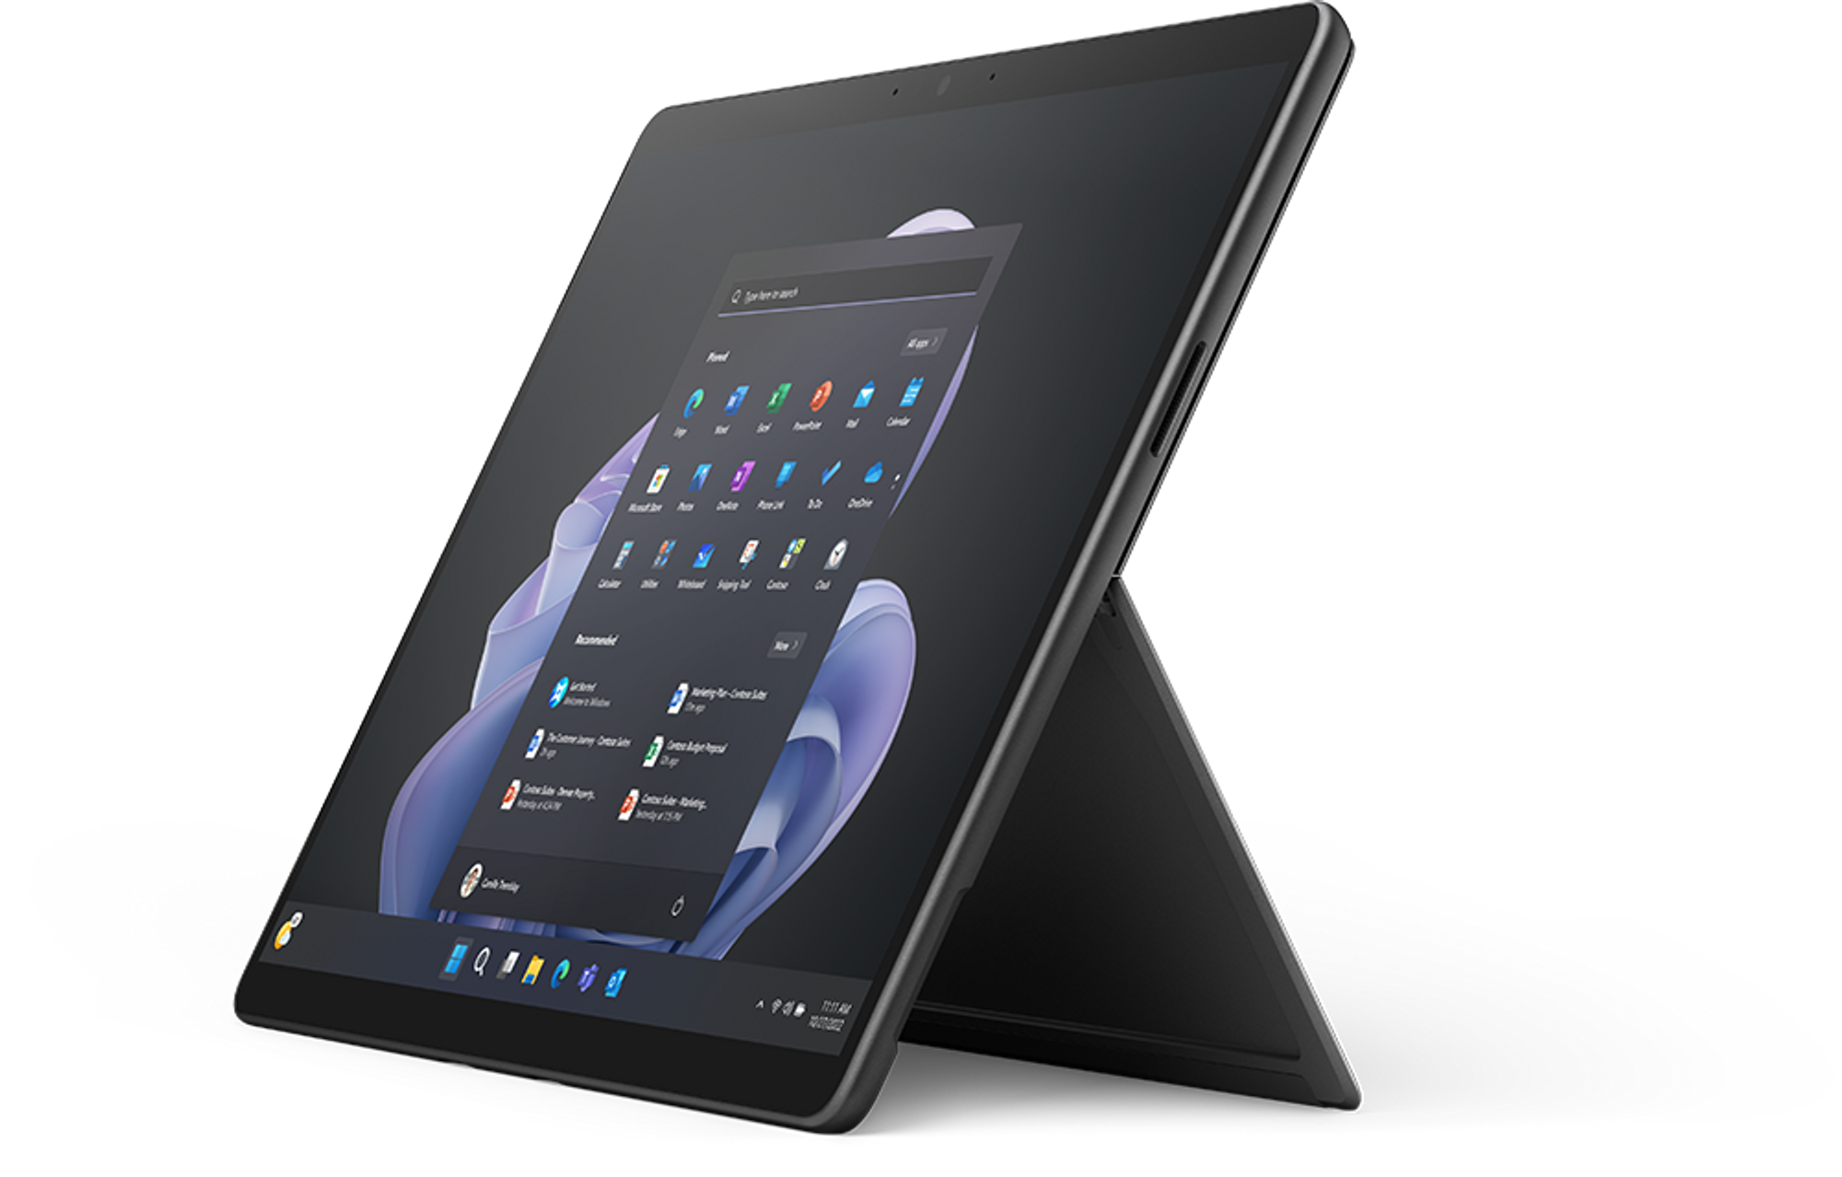
June Surface Promos
Surface Pro 9s – 20% off!!
  Last of the Pro 9 stock, get them while you can!
  Promo ends: 30th of June
20% off EHS+ & Warranties
  Promo ends: 30th of June
Promos available to authorised Surface partners only. Become authorised here.
Notes:
We have stock – 60 Pro Pro9s remaining, as we understand it – last in country and no more are expected to land so grab a bit of a deal before the end of the month

Slide 9
EcpPro

Slide 10


Effortless Azure Tenant Management & Service Desk
Notes:
Designed specifically for MSPs, and available exclusively through Dicker Data here in NZ EcpPro is a thoughtful blend of functionality and simplicity, helping you deliver better service to clients while also boosting your profitability.
EcpPro can offer a more streamlined way to manage your tenants across, M365, On-Prem & Azure. By consolidating a wide variety of functions, EcpPro significantly reduces the need for service desk personnel to juggle multiple websites and applications, leading to fewer mistakes and quicker issue resolution for your customers.

Slide 11


Demo - EcpPro
Presented by :
Ryan Macnamee CTO
Andrew Tucker CEO
Notes:
Now to take us through a bit of a demo on some of the functionality that EcpPro can offer, I’m pleased to introduce Ryan Macnamee, the CTO of EcpPro.

Slide 12

Foundation Pricing: Until the end of June
EcpPro
$400 up to 5,000 users
$800 up to 10,000 users
$1,200 up to 15,000 users
This is for the life of the product. Only CPI increases
Addons
Adsync $50 a tenant capped at 10 tenants – Your 11th onwards is free!
AVD $20 a tenant capped at 10 tenants – Your 11th onwards is free!

Slide 13

Book a demo
Andrew - +61 410 81 49 21
EcpPro.com
Thank you

Slide 14
Dicker Data Webinar
Thank you
Microsoft Partner Centre
Notes:
Thank you for your attendance and if you have any questions we will stop recording. Feel free to ask in the chat window.
HOW CAN WE HELP?

