Slide 1
Dicker Data Webinar
Modern Work, Security Assessments
Notes:
Thank you for joining will start shortly

Slide 2

Agenda
1
News
2
Main Topic: Modern Work, Security Assessments
3
Close
5
Code of Conduct
Notes:
Welcome to Opoint 2024, Happy New year. If you are joining for the first time welcome and thank you, we hope that you find the next 30 mins informative and possibly a little entertaining.
If you have attended our previous onpoints welcome back and thanks for all your support. You will find this year we are doing things a little different this year. More about that in a moment.
Then we do a quick catchup on our carefully hand curated Microsoft relevant news for the previous week,
Followed by the subject de semaine (week in English) today we will explain on why you should choose Dicker Data as your Distributor and the benefits of being a Dicker Partner.
Then we close out with an open Q&A session /prize draw
For those of you new to Powerpoint live. A quick familiarisation, We welcome your reactions using the emotion icon at the top right of your screens. Please ask questions in the chat window during the call. We will invite you to come off mute at the end of the call if you would prefer to ask your question out loud. During the call, please ensure you are on mute, and your video is turned off.
All links to sites are available by clicking on the link in the slide or will be posted to the chat window. We recommend you click on all relevant links and then review post call.
Calls will be recorded and made available post call, The teams generated recording will not be available external so don’t panic we will make the recording available to you later .
Participation in these calls means that you agree to Microsofts terms and conditions for digital meetings a link is available on this slide should you wish to review these. or to test the live link feature
Introduce speakers Role and location

Slide 3
News
Need to know
Notes:
But First The News. This is the section which is a concise update of relevant information, or opportunities compiled by Dickers subject matter experts. Who attend those early morning calls, wade through endless emails, yammer messages etc so you don’t have to

Slide 4
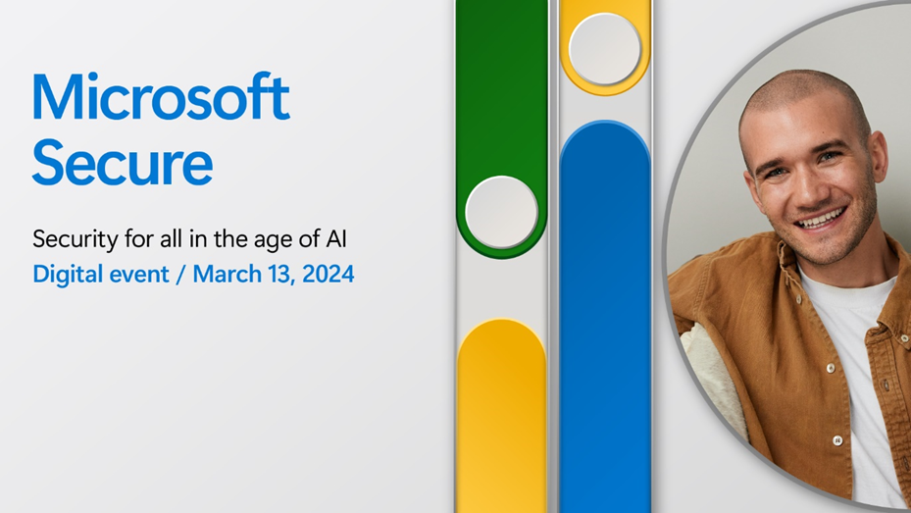
Microsoft Secure
Microsoft Secure 2024 is a two-hour digital event from 3:00 AM – 5:00 AM AEDT where Microsoft experts share insights, practices, and most importantly—new technology—to safeguard your organization. —it’s an opportunity to be the first to see what Microsoft is building to help you secure your organization.
Whether you are new to security or a seasoned professional, you’ll find something valuable and relevant to help you take your security to the next level. AI, in the wrong hands, fuels sophisticated attacks exploiting system vulnerabilities. In the right hands, it empowers defenders, giving organizations a decisive advantage. Expect some exciting announcements on the availability of Copilot for security.
So don’t wait. Register today and join me on March 14, 2024, from 3:00 AM – 5:00 AM AEDT, for the ultimate AI security showcase.
Want more after Secure?
Practitioners can also join the Microsoft Secure Tech Accelerator post-event in the Tech Community on April 4, 2024. The 5-hour live event gives you deeper technical information on implementation and a chance to ask the team questions. Learn more, RSVP, and build your schedule. 1:00 AM – 5:00 AM AEDT.

Slide 5

DD Microsoft Security Labs
Join our experts Darren Bennett, Sean McGrath & Steven Lanfranca as they host our 3-part Microsoft Security Deep Dive Series. Over the 3 virtual sessions, the team will deep dive into Microsoft's Modern Work Security platform.
These sessions will explore Microsoft 365 Security functionality as well as the intersection with Microsoft Azure to give you a thorough understanding of Microsoft’s Security platform for SMBs.
Sessions begin in a live practice environment and then move to discuss real customer scenarios as well as positioning guides to help you hit the ground running.
The course runs across three 2-hour virtual sessions.
Register for Session III: Tues 12th March 2024 10am AEDT
Notes:
Recommend Session 3 which is focussed on copilot readiness
Register for our Microsoft Security Deep Dive Series. Session III on 12th March will be focused on Copilot Technical Readiness. We’ll cover:
Introduction to AI
Introduction to Copilot for Microsoft 365
Copilot Readiness Assessment
Licensing Requirements
Information Protection and why it is important
Demo of the Copilot deployment process
Demo of creating an Information Protection/Data Loss Prevention security baseline

Slide 6
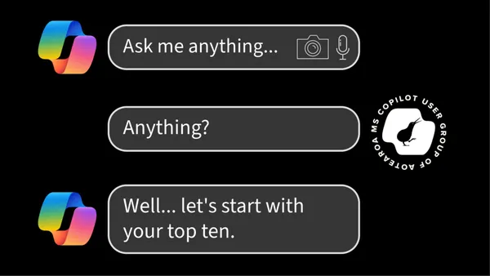
Meetups NZ
What Copilots can I use today, with or without an M365 Copilot license?
Broadly speaking, what can I do with M365 Copilot today?
What is a prompt and why should I learn how to use them?
How does M365 Copilot work? Explain it to me like I’m a 12-year-old.
The meetup will be a hybrid meetup. Join:
😁 In-person at the Microsoft House, Viaduct Harbour Ave in Auckland.
💻 Online via Teams meeting at https://aka.ms/copilots-of-aotearoa/stream
🔴 View later on YouTube at the following playlist – MS Copilot User Group of Aotearoa
REGISTER
Tuesday, March 26, 2024 at 5:00 PM to Tuesday, March 26, 2024 at 7:00 PM NZDT

Slide 7

We’ve updated our Privacy Impact Assessment Toolkit
We’re sure the readership of this newsletter is well versed in how a PIA works but we’ve recently updated our content so please share with colleagues who might not be as privacy savvy. We’re also trying to make our website content more diverse, so our new page includes a progress chart for the stages of a PIA.
See what’s new on our PIA page.
The Privacy Officer Toolkit workshop for new Privacy Officers runs on 7- 8 May 2024.
Read details and register.

Slide 8


During this event, you’ll be able to:
Get a detailed overview of the Surface chip-to-cloud security features.
Understand the benefits of Surface and Windows 11 endpoint security.
Get insights into management and compliance using self-serve hardware portals.
Here’s what you can expect:
Microsoft Security at every level
Demo: Microsoft Surface Unified Extensible Firmware Interface (UEFI) and Device Firmware Configuration Interface
Demo: Microsoft Surface Management Portal
Question and answer

Slide 9

Learn from the Microsoft team about the latest programs and offers available for partners.
Discover how to position Modern Work, Security, AI, Azure, Biz Apps to help nonprofits achieve their goals.
Explore latest GTM programs available for Partners to generate new opportunities.
Network with other partners and industry experts.
Enjoy complimentary food and beverages.

Slide 10

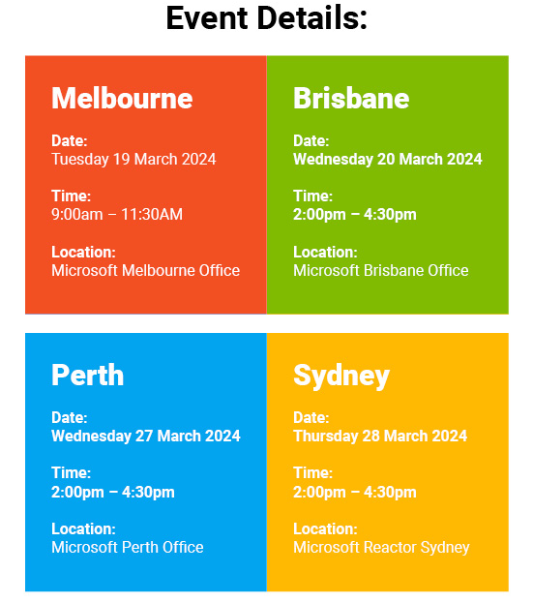
Learn from the Microsoft team about the latest programs and offers available for partners.
Discover how to position Modern Work, Security, AI, Azure, Biz Apps to help nonprofits achieve their goals.
Explore latest GTM programs available for Partners to generate new opportunities.
Network with other partners and industry experts.
Enjoy complimentary food and beverages.
Register Here

Slide 11

Did you know?
US Voltage is 110v
AU/NZ Voltage is 240v
So, what is the voltage of an EV battery?

Slide 12
Modern Work Security Assessments

Slide 13
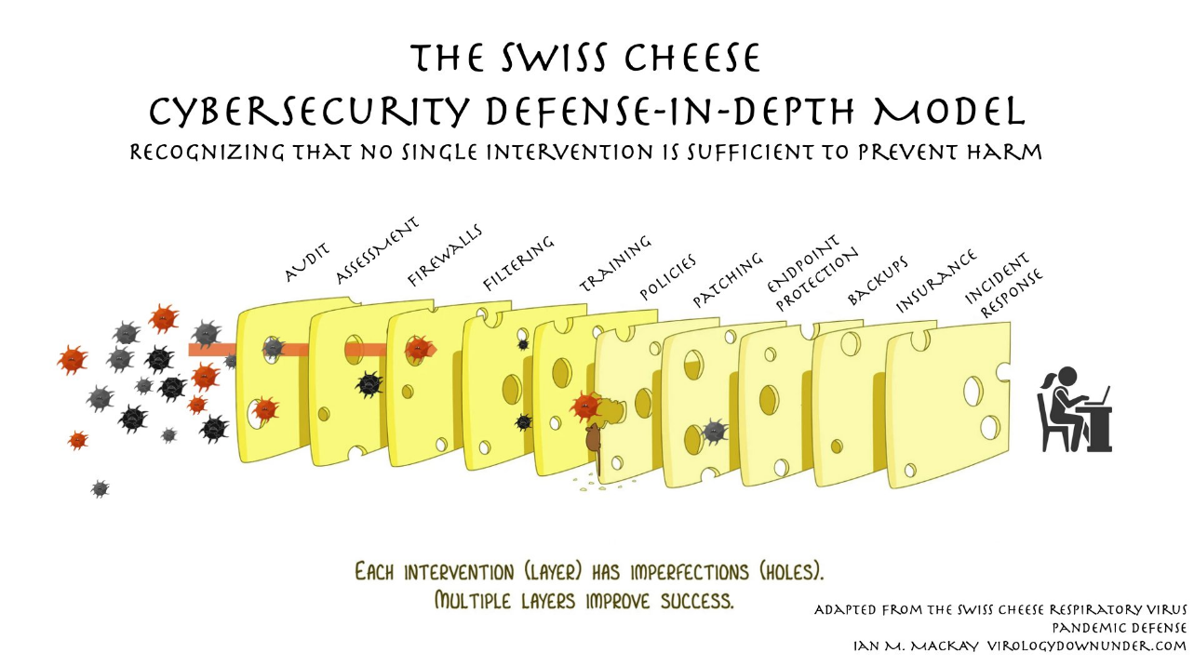
Notes:
When we talk about security, I really like this analogy around the swiss cheese.
A really simple way to communicate that no layer of defence is perfect, and a layered approach is critical.
We will be covering the assessment layer of cheese in this section today.
But it is important to point out that each of these layers is as important as the next.
If you have a look at the other layers in the cheese. We will cover off the majority throughout the Onpoint sessions this year. Our limit may be the insurance part.

Slide 14



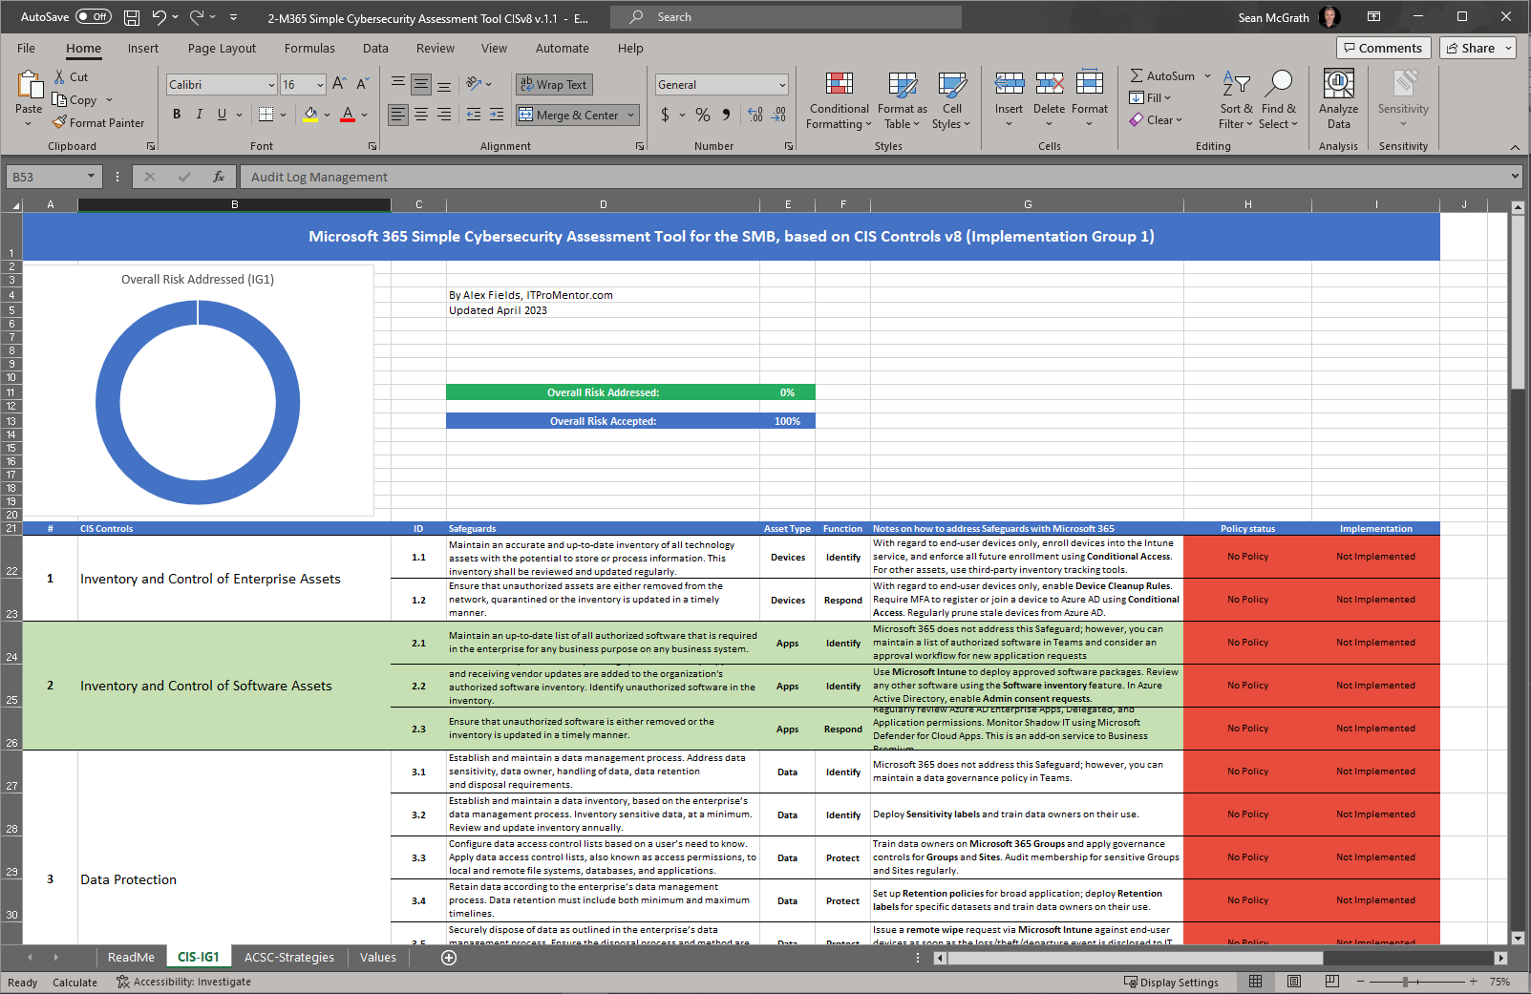
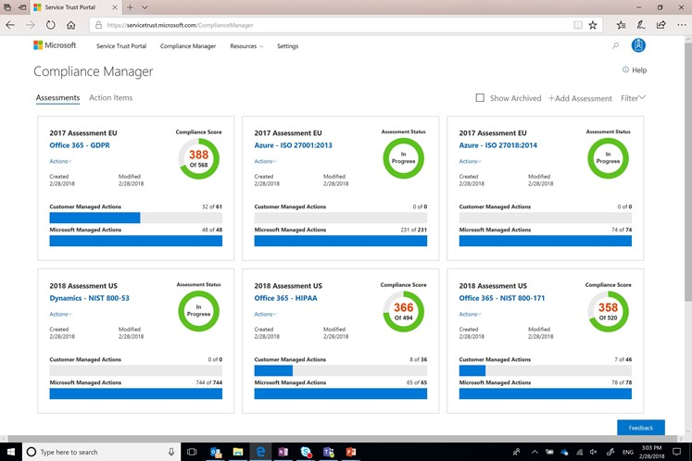
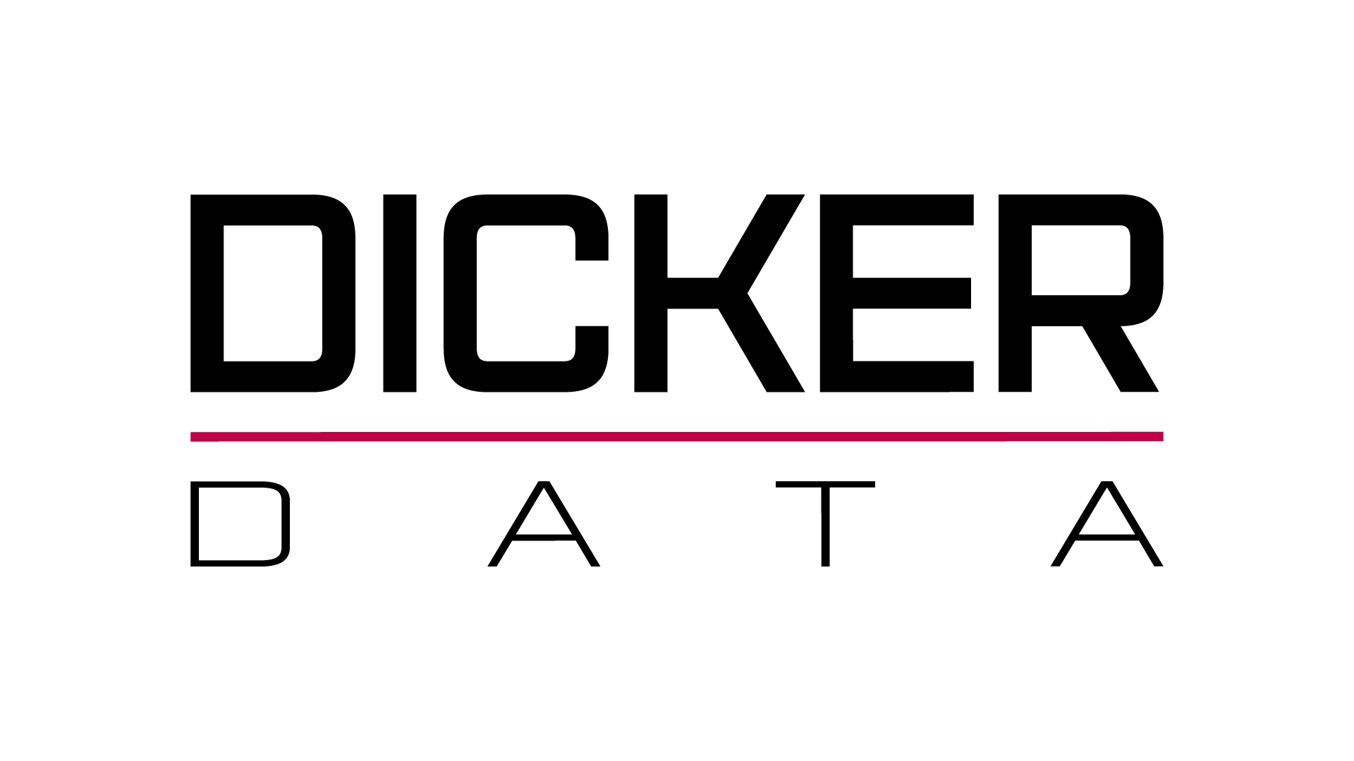

Evolving Role of MSPs:
Managed Security Services
Security Managed Services Partner Kit
Step by step guidance on how to begin with services
Practical guidance on expanding from IT management to security
Integration with security frameworks and key partner tools.
Security Managed Services Partner Kit
Notes:
I will start with a pure do it yourself type solution. Not direct Essential 8 related however it’s a must have.
The security managed services partner kit.
From security beginners to advanced. You are provided with a comprehensive guide on how to begin with security solutions and how to build your business around it.
That is combined with a simple cyber security assessment tool in excel, which is based on CIS version 8 controls.
Make sure you click on the link and download the latest partner kit.
I will give you quick look at the assessment tool during our demo today.

Slide 15
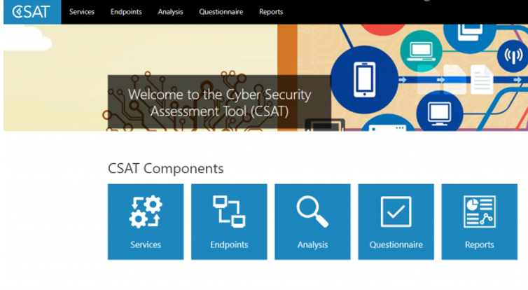
Autopilot, Intune & Security
The Power of Microsoft Assessments
Cyber Security Assessment Tool
Notes:
Let’s get into the more detailed assessments that Microsoft provide.
You want to provide your customers with a clear picture of their current security posture today, then recommendations on where you as the MSP can assist.
You may be aware of the CSAT self assessment solution that Microsoft has made available at no cost for some time.
This is still available. You can run the tool yourself, or your customer can run it directly.
I heard an interesting stat from Microsoft recently when discussing CSAT. They said when a partner runs a self-service assessment for a customer, they see a 90% conversion rate. That is based on the licensing data.
Feel free to click the link. It will take you to a Microsoft page which then leads to the assessment.
To add to this, there has been some big news around the Microsoft CSAT offering.

Slide 16
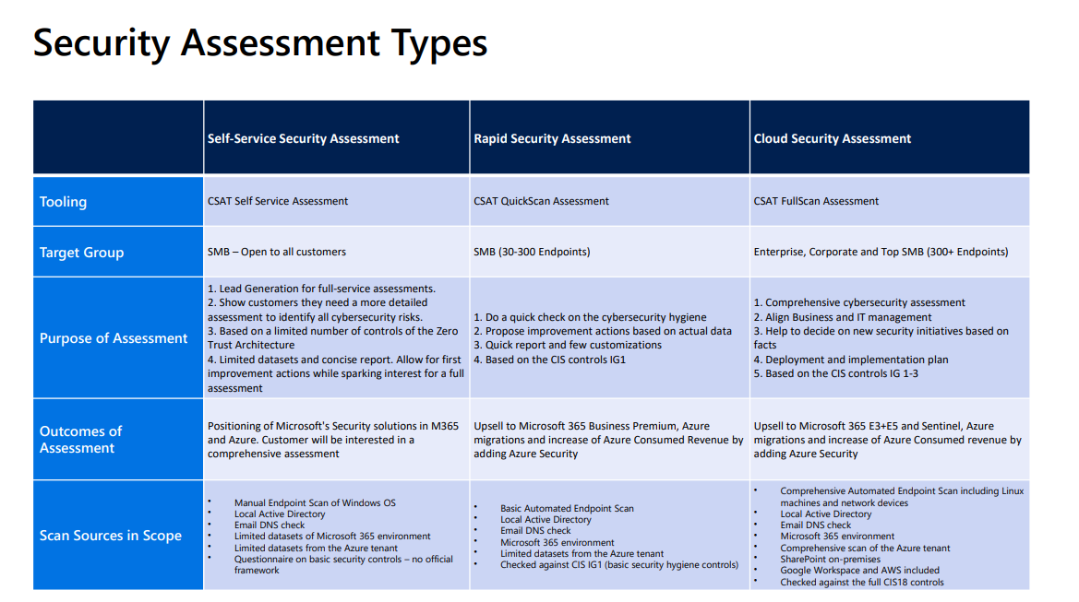
Notes:
As of October 2023, Microsoft are offering much more detailed scans and reports that will go a lot deeper and provide you comprehensive reports and insights into your customers environment.
As you can see the self-service assessment is still there. However, for the scenarios where the self –service is not enough, the rapid security assessment comes in.
The only entry criteria is that your customer has 30 or more endpoints.
The best news is, it's all at no cost to you.

Slide 17
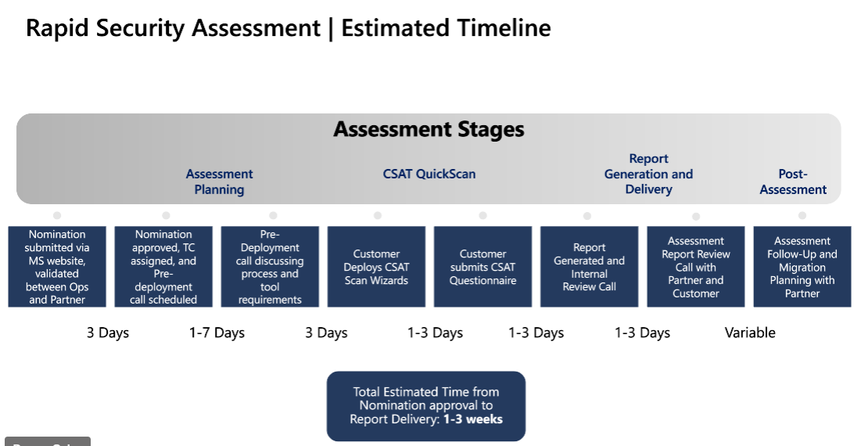
Notes:
At a high level, the Microsoft assessment desk is waiting and ready to accept assessment requests.
The assessment desk will guide you as the partner through how to setup the tools required to run the scan.
From there, a report will be put together and with your assistance presented to the customer.
Typically, the process will take 1-3 weeks. The timing really depends on you and your customers availability to complete your part.

Slide 18
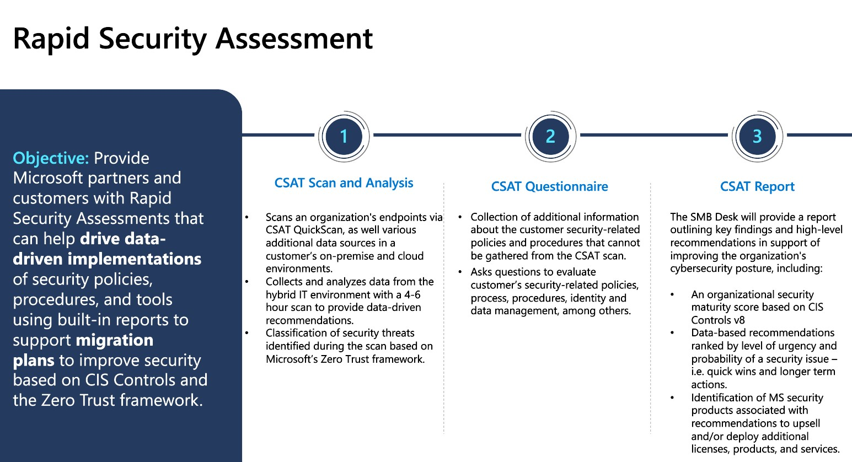
Notes:
Mapped out here is the process the assessment takes. From the CSAT Scan, to the questionnaire and finally the report.
This report does reference the CIS version 8 controls.

Slide 19
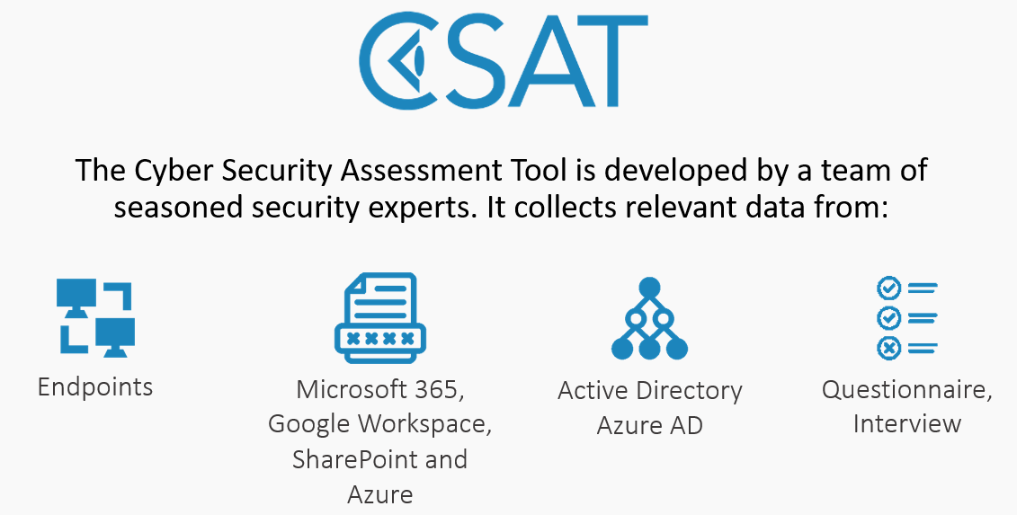
Autopilot, Intune & Security
The Power of Microsoft Assessments
Notes:
Now, CSAT is produced and powered by an ISV called QS Solutions.
As a result, all the levels of assessments that we have just mentioned are available directly from QS Solutions. Just to note up front CSAT direct is a paid solution.
There are a number of reasons why you would consider going direct here.
Firstly, Your customer may have resources outside of the Microsoft stack that you want to assess. Things like Google workspace or AWS. Particularly when you are looking at migrating towards a Microsoft cloud solution
Your customer may not meet the requirements for the Microsoft Rapid Assessment. For eg, they under 30 endpoints.
Also, You have the freedom to run scans multiple times via a subscription based license model. Very handy when you would like to run multiple assessments as you implement your improvements. Solid proof that you are making a difference to the security of your customers environment.
Finally, If you are looking at making assessments a part of your managed security offering, then you would seriously consider this option as well.
If you would like more details around their pricing structure, please reach to me via email or drop a comment in this webinar chat. We can get you in touch with the QS Solutions team.

Slide 20
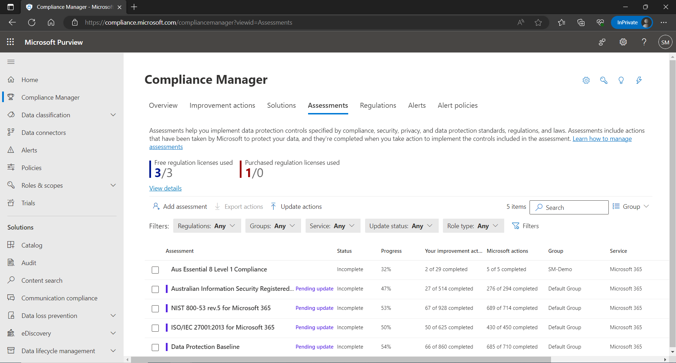
Compliance Manager
Manage your compliance from one place
Ongoing risk assessment
An intelligent score reflects your compliance posture against regulations or standards
Actionable insights
Recommended actions to improve your data protection capabilities
Simplified compliance
Streamlined workflow across teams and richly detailed reports for auditing preparation
Compliance Manager is a dashboard that provides the Compliance Score and a summary of your data protection and compliance stature as well as recommendations to improve data protection and compliance. This is a recommendation; it is up to you to evaluate and validate the effectiveness of customer controls as per your regulatory environment. Recommendations from Compliance Manager and Compliance Score should not be interpreted as a guarantee of compliance.
Notes:
I would also like to touch on an assessments feature that is built into M365. It sits within the Purview feature set and does require an E5 or A5 license in the tenant. Alternatively, you can purchase Assessments as a standalone offering. However, it is quite expensive. At last look it was $6000 per assessment per year.
With E5 or A5 you will be provided with up to 3 x concurrent premium assessments. Which means you could assess against multiple security frameworks all at once. Some examples are NIST and ISO 27001 templates.
It’s a powerful tool for you to assess the maturity of your customer and build solutions around that to uplift the tenant to whatever level is required.

Slide 21

Demonstration

Slide 22
Dicker Data Webinar
Thank you
Notes:
Thank you for your attendance and if you have any questions we will stop recording. Feel free to ask in the chat window.
HOW CAN WE HELP?

