Slide 1
Dicker Data Webinar
E:14 Azure Lighthouse
Notes:
Thank you for joining will start shortly

Slide 2
Agenda
1
News
2
Main Topic: Azure Lighthouse
3
Close
5
Code of Conduct
Notes:
Welcome to Opoint 2024, Happy New year. If you are joining for the first time welcome and thank you, we hope that you find the next 30 mins informative and possibly a little entertaining.
If you have attended our previous onpoints welcome back and thanks for all your support. You will find this year we are doing things a little different this year. More about that in a moment.
Then we do a quick catchup on our carefully hand curated Microsoft relevant news for the previous week,
Followed by the subject de semaine (week in English) today we will explain on why you should choose Dicker Data as your Distributor and the benefits of being a Dicker Partner.
Then we close out with an open Q&A session /prize draw
For those of you new to Powerpoint live. A quick familiarisation, We welcome your reactions using the emotion icon at the top right of your screens. Please ask questions in the chat window during the call. We will invite you to come off mute at the end of the call if you would prefer to ask your question out loud. During the call, please ensure you are on mute, and your video is turned off.
All links to sites are available by clicking on the link in the slide or will be posted to the chat window. We recommend you click on all relevant links and then review post call.
Calls will be recorded and made available post call, The teams generated recording will not be available external so don’t panic we will make the recording available to you later .
Participation in these calls means that you agree to Microsofts terms and conditions for digital meetings a link is available on this slide should you wish to review these. or to test the live link feature
Introduce speakers Role and location

Slide 3

Notes:
But First The News. This is the section which is a concise update of relevant information, or opportunities compiled by Dickers subject matter experts. Who attend those early morning calls, wade through endless emails, yammer messages etc so you don’t have to

Slide 4
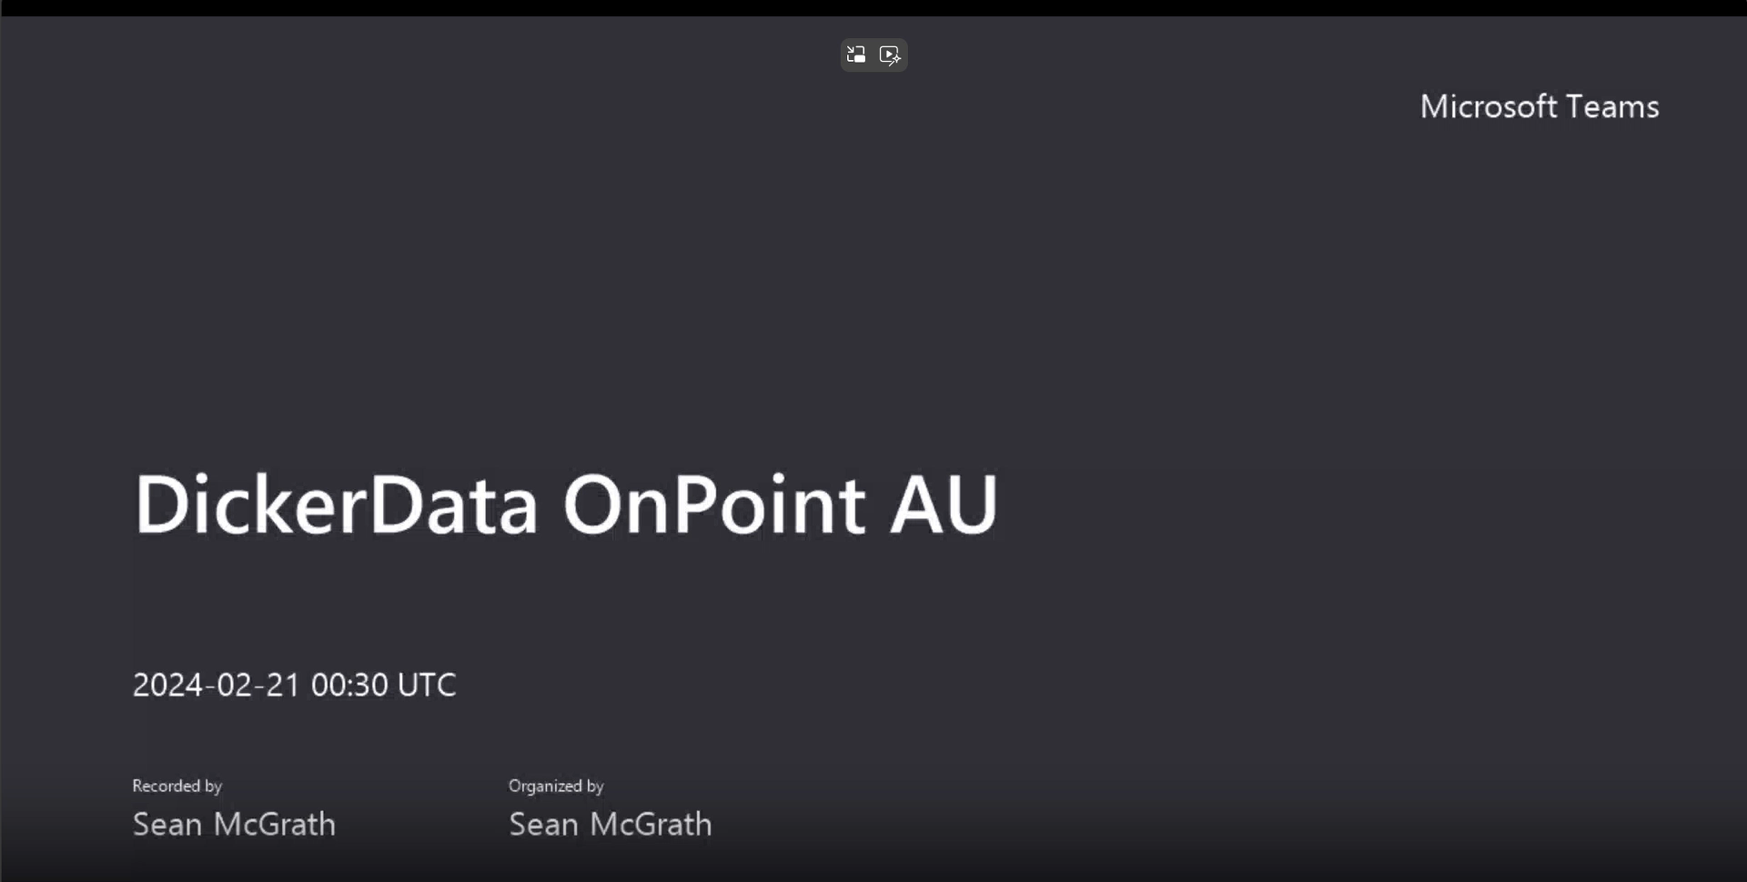
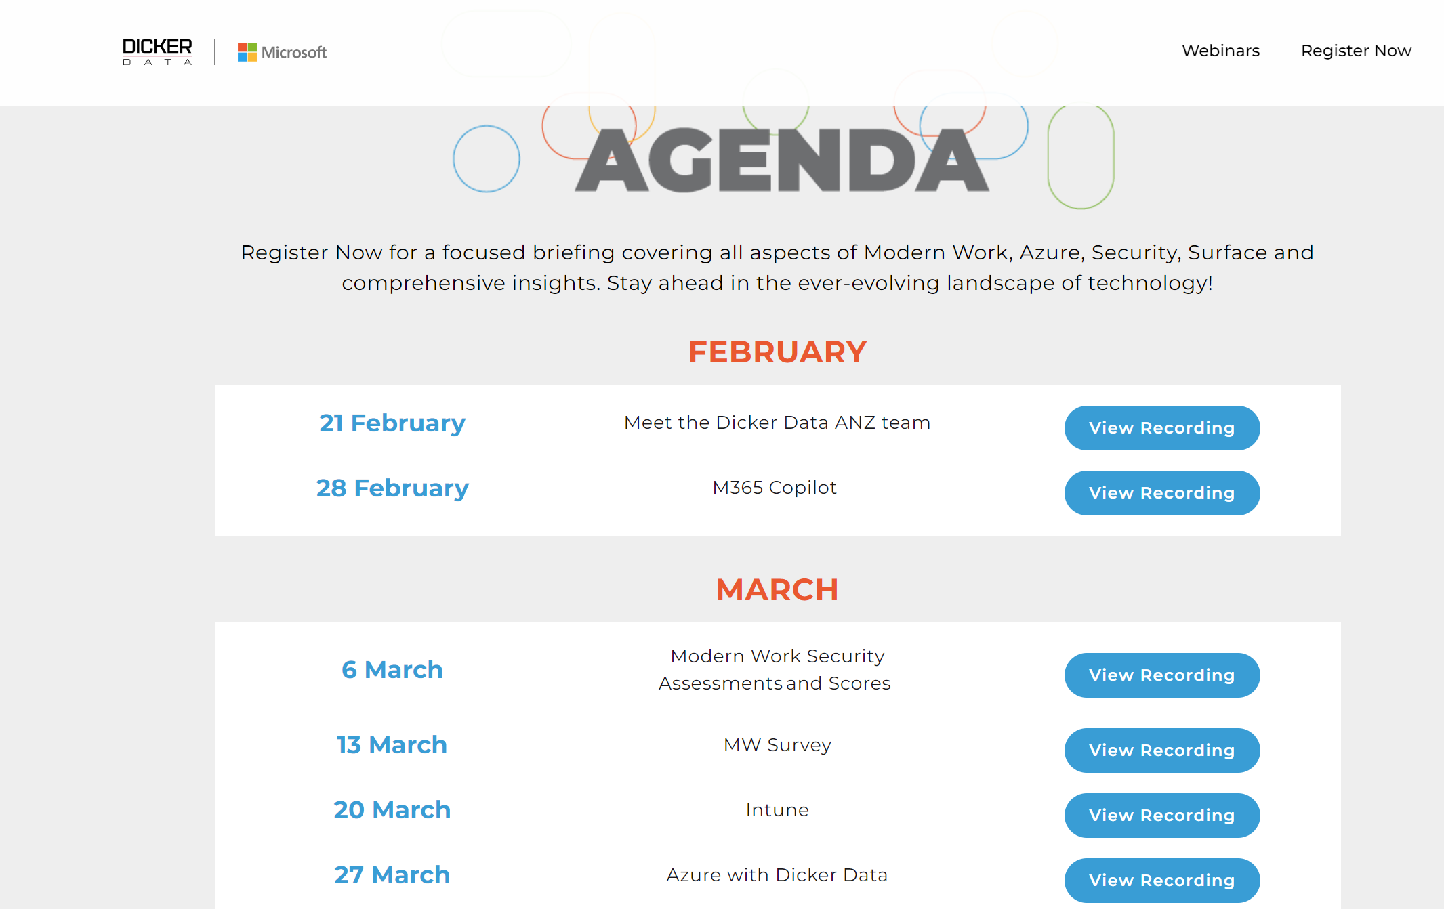
View all the OnPoint (AU) 2024 Webinars so far!
Notes:
AU Only

Slide 5
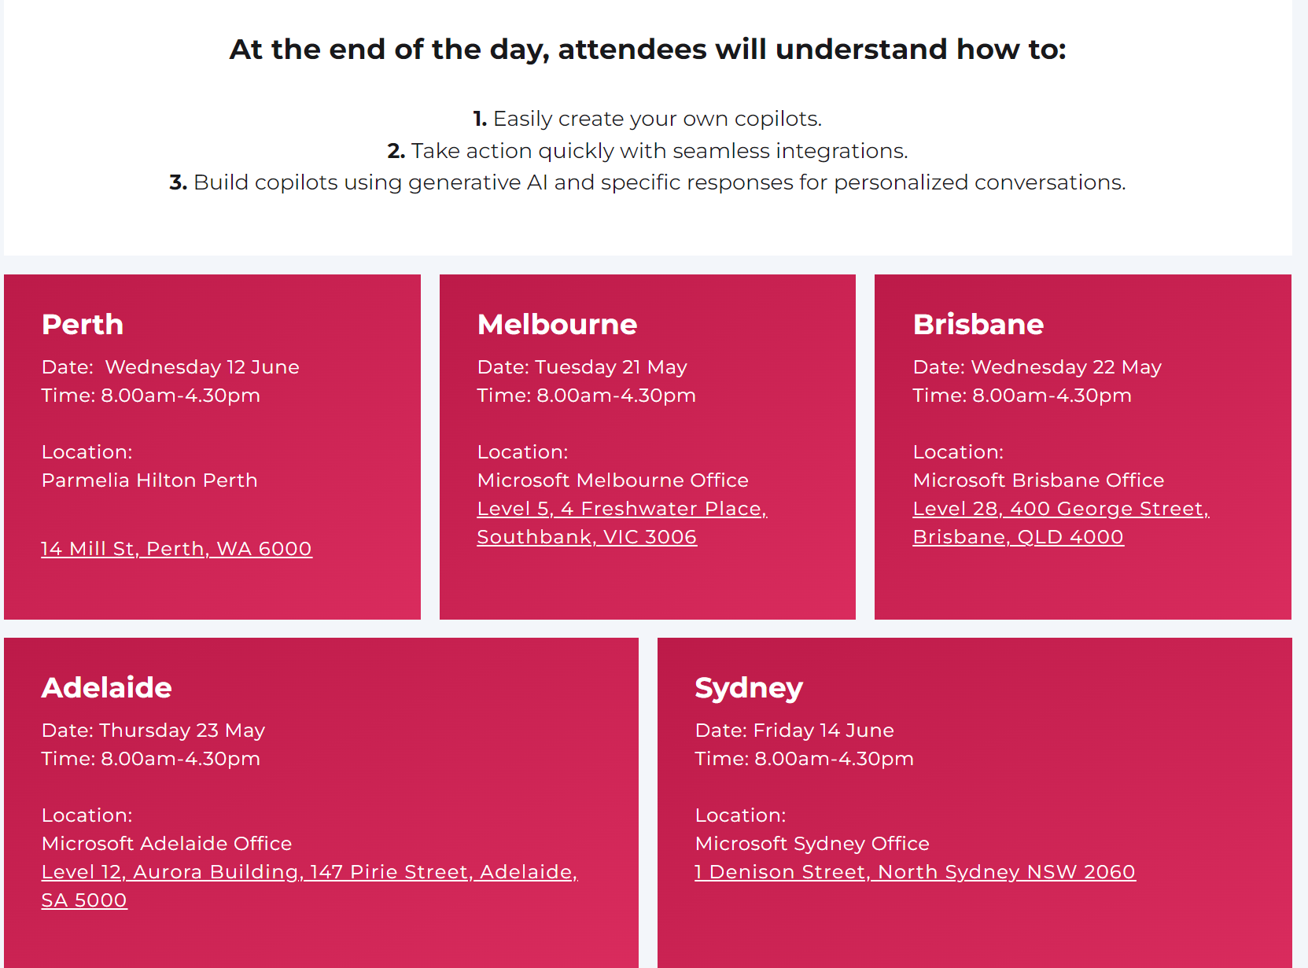

Notes:
AU

Slide 6
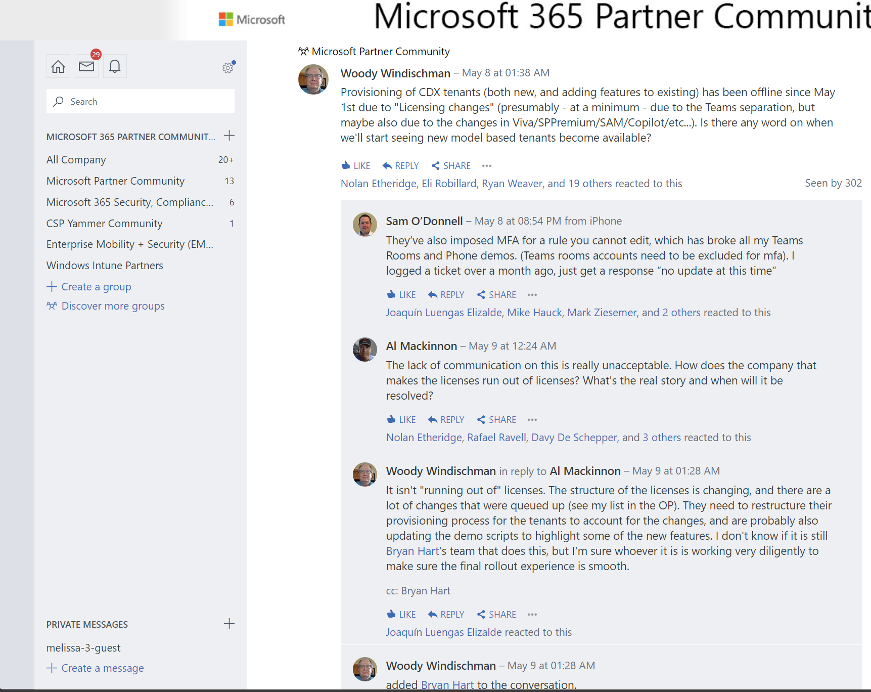

Notes:
ANZ

Slide 7

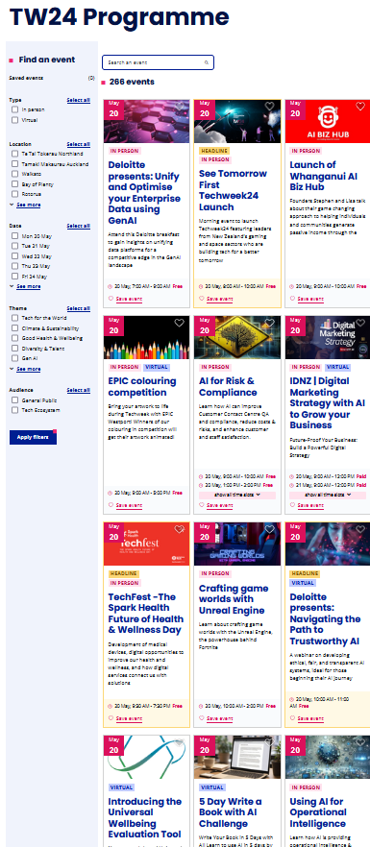

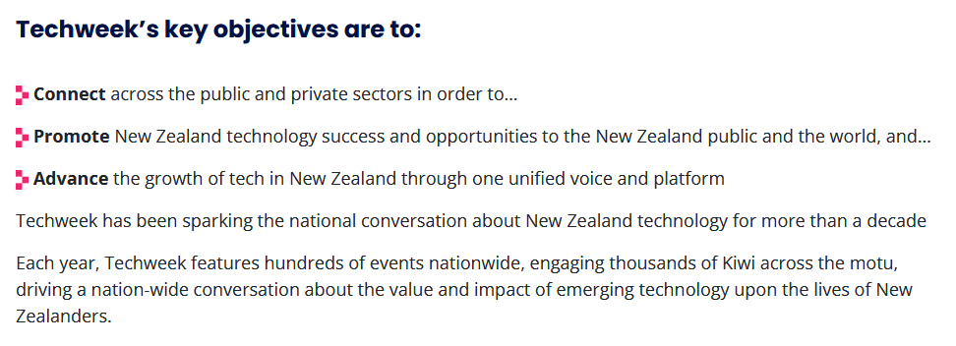

https://techweek.co.nz/whats-on/programme/
Notes:
NZ Only

Slide 8
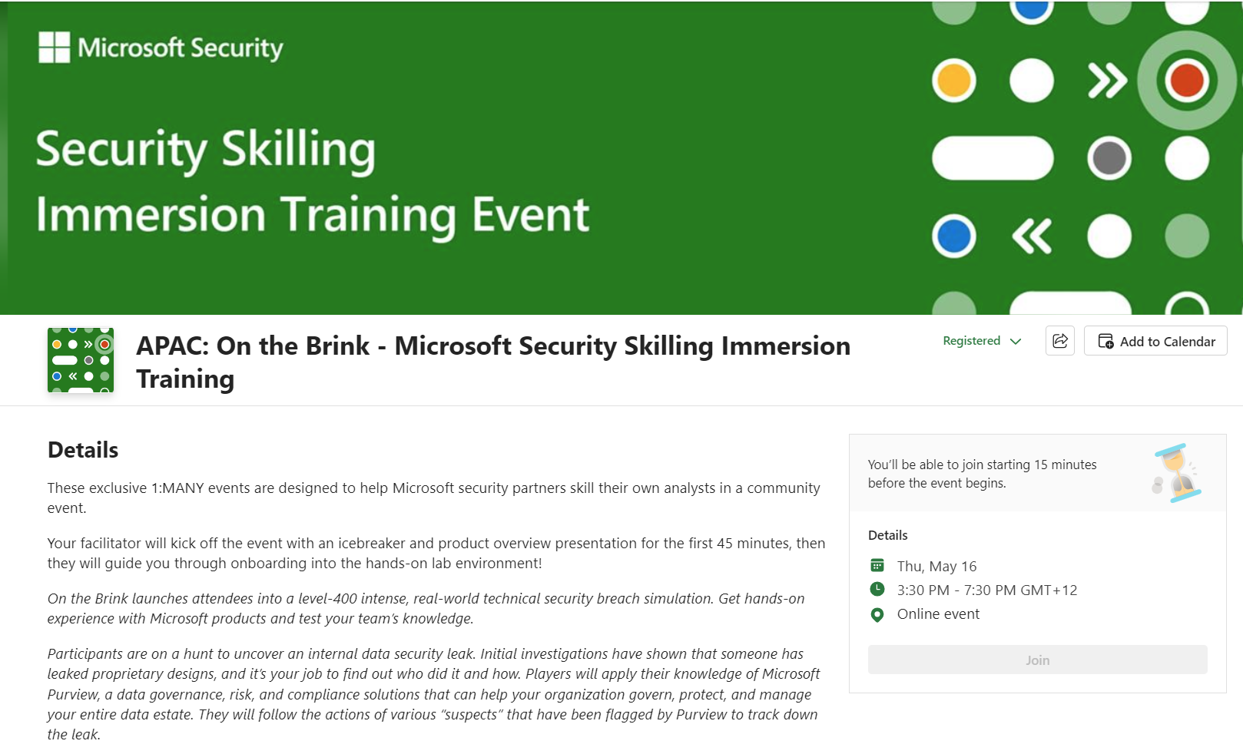

Notes:
ANZ

Slide 9


Slide 10
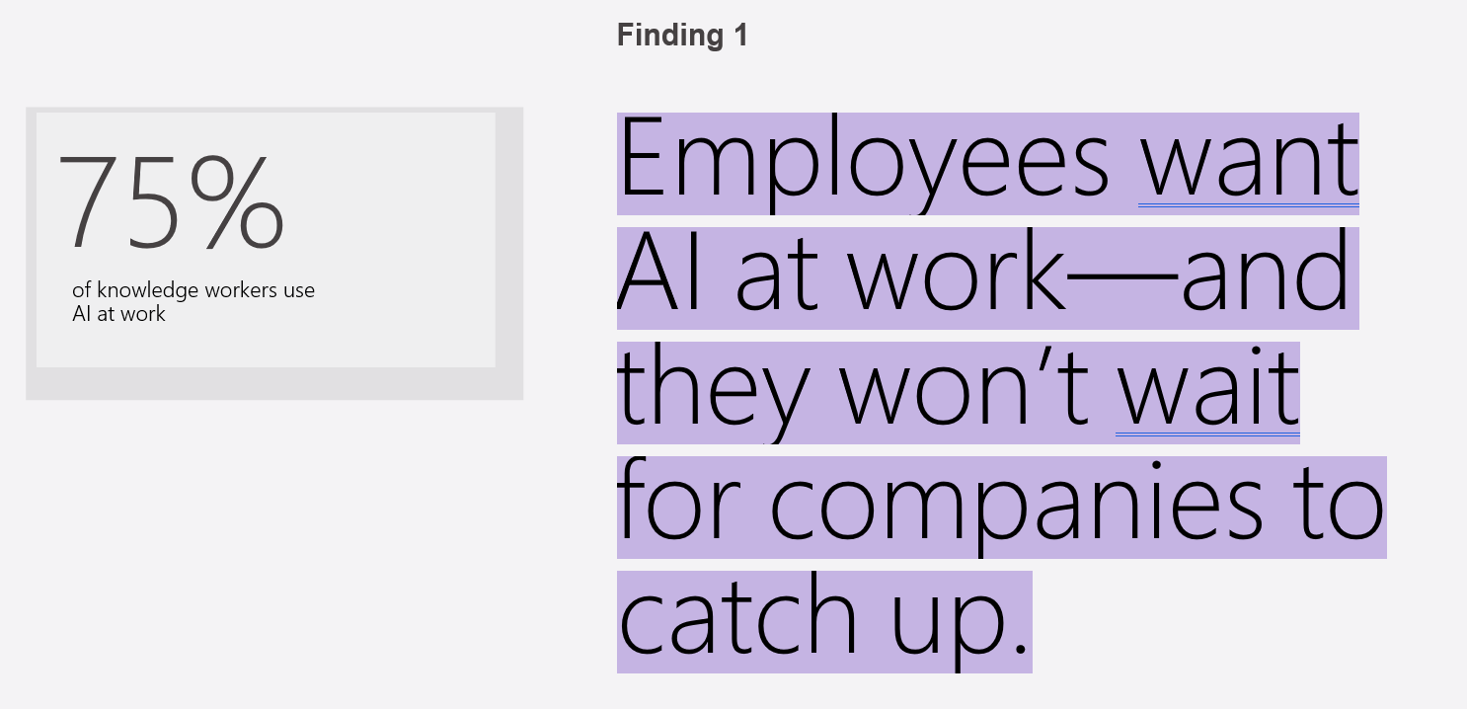
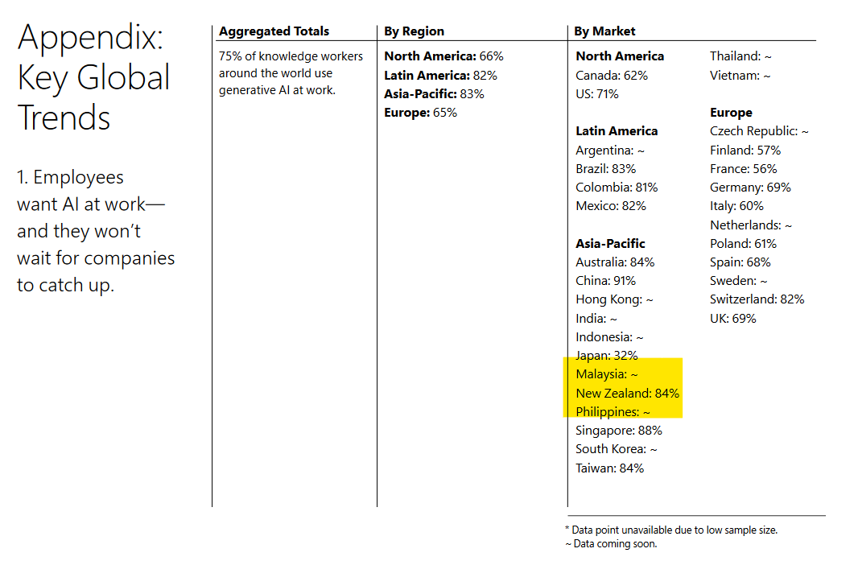
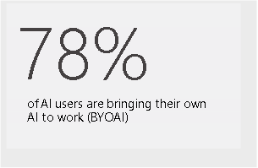
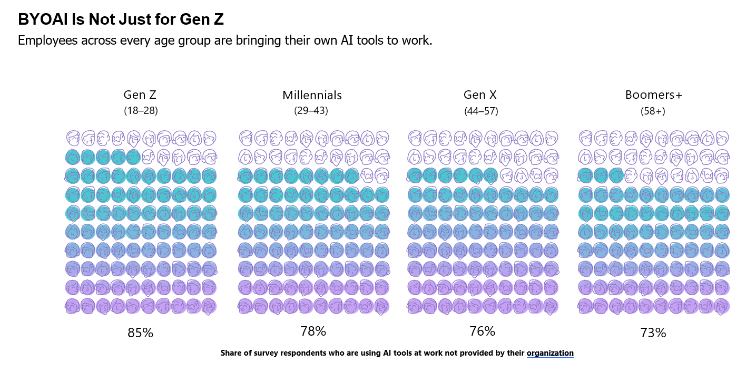
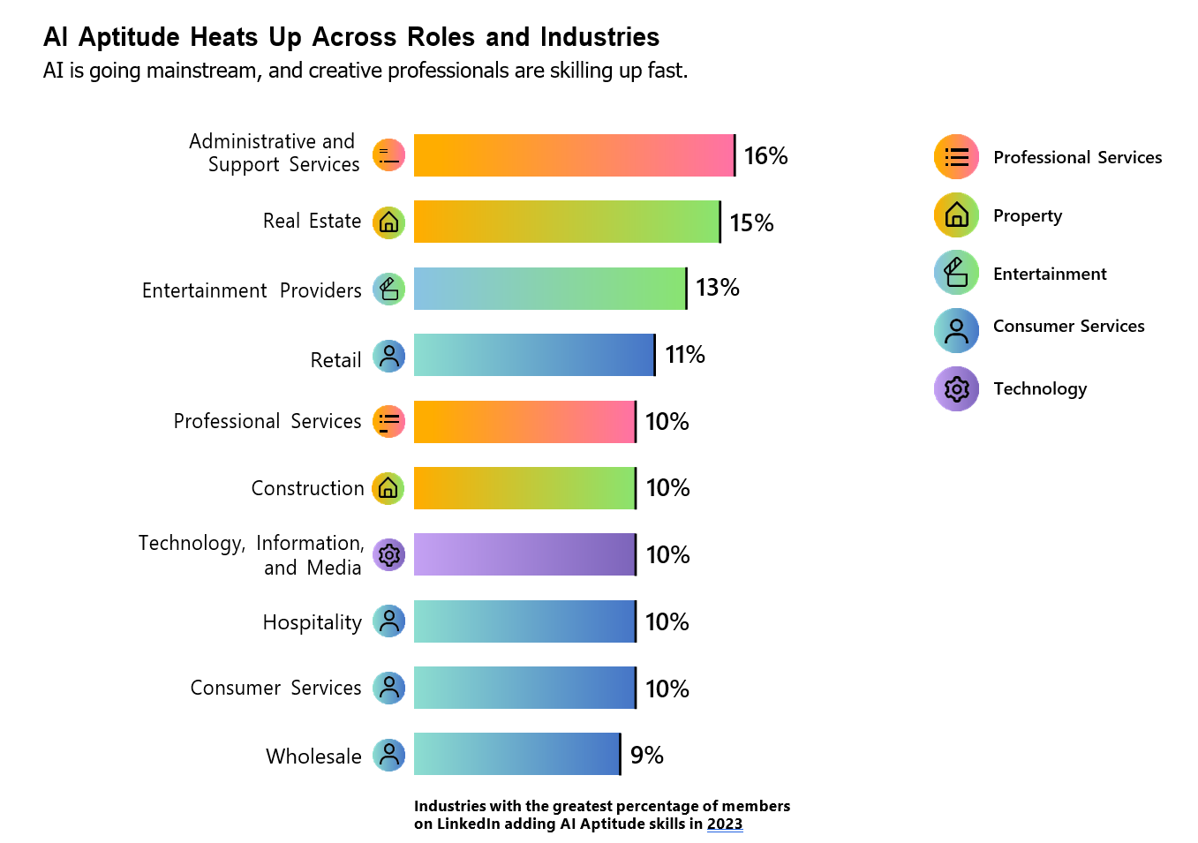

Slide 11
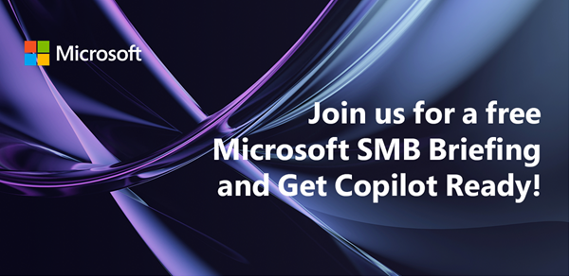

DATE & TIME:
Thursday 30th May 1:00 PM NZT 11:00 am Sydney
Dicker Data is inviting you to bring your customers to our live digital briefing where we’ll showcase how Microsoft 365 can help put the power of AI to work with a live demo of Copilot for Microsoft 365! Copilot for Microsoft 365 can dramatically transform the way work gets done, empowering people to focus on more innovation and creativity – and unlocking a new wave of productivity growth.
Notes:
ANZ

Slide 12
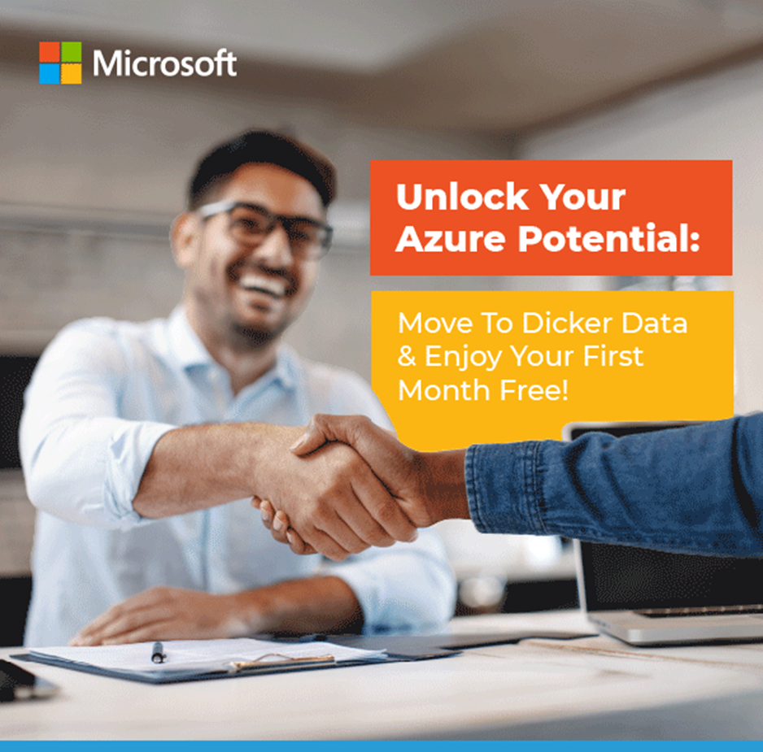
“Move your customers Azure to Dicker Data and receive the 1st full month’s consumption free of charge.”
Dicker Data can offer the 1st full month of Azure consumption as credit to your partner account.
To fund the services to move a customer from Web direct/Credit Card to CSP so you can receive the consumption as well as the services revenue.
Or if you’re not getting the support you need from your existing supplier, simply move your existing Azure customers across to Dicker Data to earn the credit.
Talk to your Dicker Data representative to learn more. T&Cs applies.
Notes:
NZ only

Slide 13

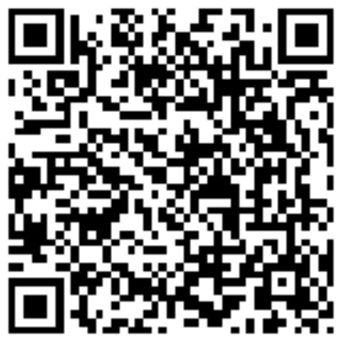

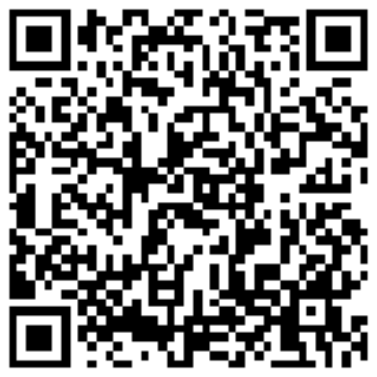

Microsoft Azure Lighthouse
Service provider’s solution for managing multiple customers
Saeed Nouri
Cloud Solution Architect ( MCT )
Saeed.Nouri@dickerdata.com.au
Mikki Chopra
Cloud Solution Architect ( MCT )
Mikki.Chopra@dickerdata.com.au
May 2024

Slide 14


Life without Lighthouse

Slide 15






Traditional Service Provider Access Model
Customer
Entra ID
External Users (B2B)
Service Provider
Entra ID
Subscription(s)
Resources
SP Group
Users
Roles
RBAC

Slide 16


Problems with traditional model
Service Provider engineer must constantly switch tenants ( miserable experience )
When people leave from service provider, user must be removed from every tenant ( what if you miss one ?)
Solution is hard to scale. Can I push a single task to multiple customers ?
Security risks and concerns

Slide 17

Azure Lighthouse enables multitenant management with scalability, higher automation, and enhanced governance across resources.
Benefits
Management at scale
Greater visibility and control for customers
Comprehensive and unified platform tooling
Notes:
Management at scale: Customer engagement and life-cycle operations to manage customer resources are easier and more scalable. Existing APIs, management tools, and workflows can be used with delegated resources, including machines hosted outside of Azure, regardless of the regions in which they're located.
Greater visibility and control for customers: Customers have precise control over the scopes they delegate and the permissions that are allowed. They can audit service provider actions and remove access completely at any time.
Comprehensive and unified platform tooling:

Slide 18

Azure Lighthouse includes multiple ways to help streamline engagement and management
Capabilities
Azure delegated resource management
New Azure portal experiences (Customer / Service provider pages)
Azure Resource Manager ( ARM ) template
Managed Service offer in Azure Marketplace

Slide 19





Azure Lighthouse Model
Customer 1
Entra ID
Marketplace
Service Provider
Entra ID
Subscription(s)
Resources
Group(s)
Customer 2
Entra ID
My Tenant ID
Authorization:
Security Principal ( Role ID)
Target [ subscription or resource group ]
Offer
Subscription(s)
JSON File
Resources

Slide 20
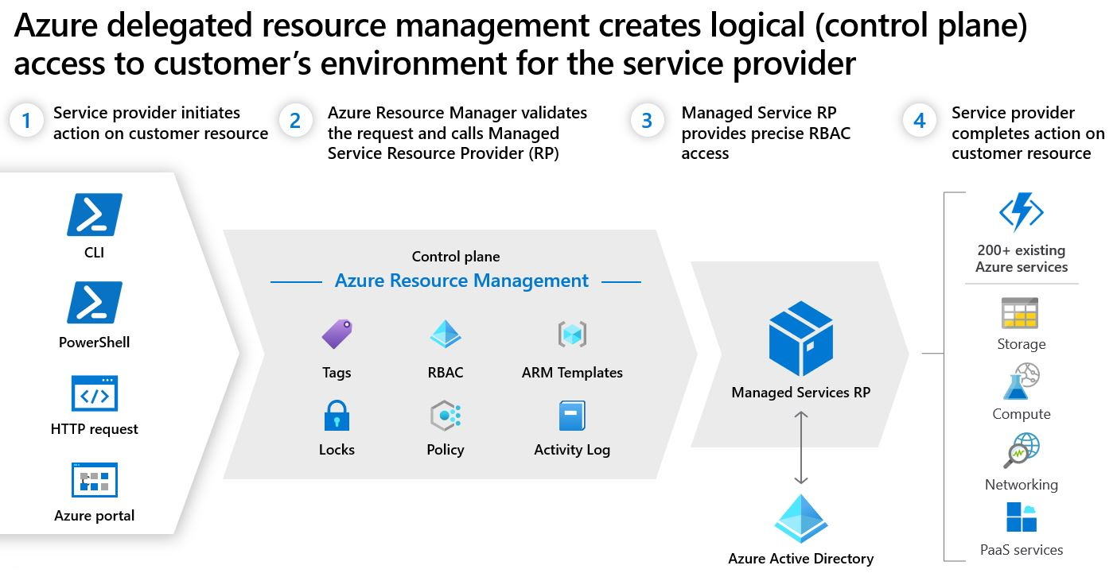

Slide 21
See it in a Demo

Slide 22
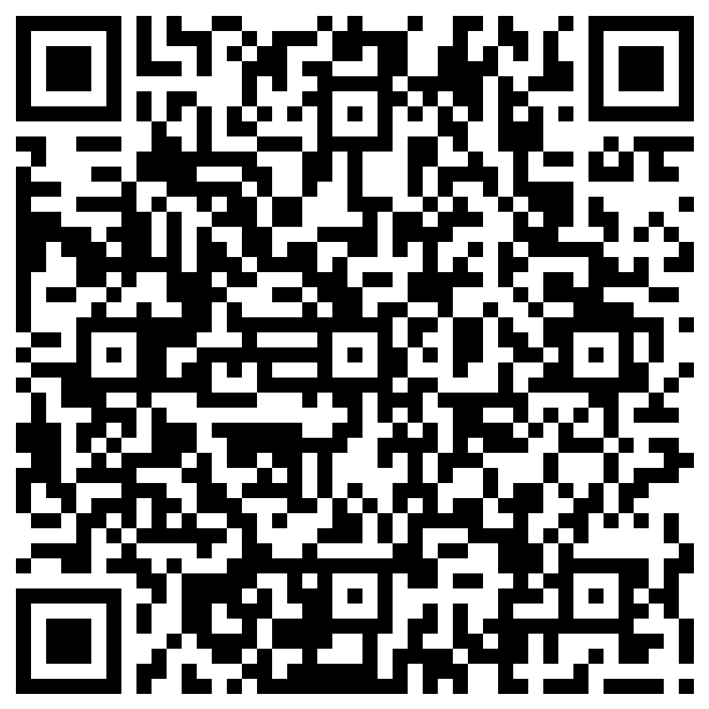
Dicker Data Webinar
Thank you E15 Defender for Office
Notes:
Thank you for your attendance and if you have any questions we will stop recording. Feel free to ask in the chat window.
HOW CAN WE HELP?

