Slide 1
Dicker Data Webinar
ANZ Episode 1 “How can we help?”
Notes:
Thank you for joining will start shortly

Slide 2
Agenda
1
What is OnPoint?
2
News
3
Main Topic: Why Choose Dicker Data as your Microsoft Partner?
4
Close
5
Code of Conduct
Notes:
Welcome to Opoint 2024, Happy New year. If you are joining for the first time welcome and thank you, we hope that you find the next 30 mins informative and possibly a little entertaining.
If you have attended our previous onpoints welcome back and thanks for all your support. You will find this year we are doing things a little different this year. More about that in a moment.
Then we do a quick catchup on our carefully hand curated Microsoft relevant news for the previous week,
Followed by the subject de semaine (week in English) today we will explain on why you should choose Dicker Data as your Distributor and the benefits of being a Dicker Partner.
Then we close out with an open Q&A session /prize draw
For those of you new to Powerpoint live. A quick familiarisation, We welcome your reactions using the emotion icon at the top right of your screens. Please ask questions in the chat window during the call. We will invite you to come off mute at the end of the call if you would prefer to ask your question out loud. During the call, please ensure you are on mute, and your video is turned off.
All links to sites are available by clicking on the link in the slide or will be posted to the chat window. We recommend you click on all relevant links and then review post call.
Calls will be recorded and made available post call, The teams generated recording will not be available external so don’t panic we will make the recording available to you later .
Participation in these calls means that you agree to Microsofts terms and conditions for digital meetings a link is available on this slide should you wish to review these. or to test the live link feature
Introduce speakers Role and location

Slide 3

OnPoint
Your weekly concise break down on all the Microsoft information you need to know. No fluff, OnPoint.
“Show me don’t tell me.”
Notes:
So, what is Onpoint and if you have been a previous attendee what has changed for 2024.
These webinars started as a weekly Security briefing for our NZ CSP partners at the beginning of Covid lock downs almost 4 years ago, evolving into a modern work and security briefing session and then going through a succession of 10-episode series. Eventually being renamed to represent our aim in bringing these webinars to you. Which is
To concisely analyse all the Microsoft channels of communicate and present the information that is most relevant and timely to dicker partners. While also providing a deeper dive into a main topic that represented real world live scenario. Enable you are partners or prospective partners to optimise your time. In summary we want to get to the point and not distract you with corporate/marketing speak. That’s why the name is on the Tin. WE aim to get to the point and stay onpoint.
And for those of you thinking that is marketing speak right there. The name was thought of by 2 of us non marketing types. .Also note that no marketers were harmed in the creation of this brand. (not by design)

Slide 4

OnPoint:
Australia and New Zealand
Notes:
What's changed for this year?
The most significate change is that this year we will be fully utilising Dickers full Microsoft resources, on both sides of the ditch. Not only will we be running these webinars at two different times, but the Microsoft teams will take turns creating content and localising for their own country. So, for the most part if you are joining from NZ, we will not be telling you about events running in Australia and vice versa. This means we can utilise expertise from both countries to communicate information in both the language and context that makes sense.
Onpoint will run at the same time for the full year. Starting at >><< promptly and finishing approximately 30 mins later. That means you can lock it into your calendars and make it part of your Wednesday morning routine. Coffee and Onpoint yum or in the spirit of Tasman cooperation may be Coffee, Pavola and Onpoint.
This year we are opening registration for the first time to non-Dicker partners as the feedback we have received is that all CSP partners gain value from our content. Some content will remain gated and offers that are for Dickerdata partners only will be clearly identified. Should you wish to participate in these we will be happy to assist in transitioning you to Dicker Data Microsoft.
Why should you consider moving? We are coming to that. Hang tight

Slide 5
News
Need to know
Notes:
But First The News. This is the section which is a concise update of relevant information, or opportunities compiled by Dickers subject matter experts. Who attend those early morning calls, wade through endless emails, yammer messages etc so you don’t have to

Slide 6

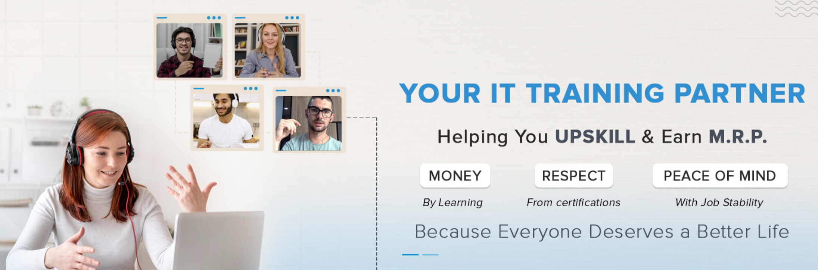
NZ Partners https://www.dickerdata.co.nz/courses
AZ-900 11th - 12th Mar 24 11:30 AM - 03:30 PM AEDT / 01:30 PM - 05:30 PM NZDT Register Now SC-900 14th - 15th Mar 24 11:30 AM - 03:30 PM AEDT / 01:30 PM - 05:30 PM NZDT Register Now AI-900 18th - 19th Mar 24 11:30 AM - 03:30 PM AEDT / 01:30 PM - 05:30 PM NZDT Register Now MB-910 21st - 22nd Mar 24 11:30 AM - 03:30 PM AEDT / 01:30 PM - 05:30 PM NZDT Register Now
Notes:
Koenig, a US based training provider is offering fundamentals training at NZ and AU friendly times. These Certificates are often the basic requirements to work towards achieving your Partner designations. These are available to everyone on the call and should be seen as a prerequisite for all staff to understand each of the Microsoft solution areas. AZ is Azure, SC is security, AI is AI while MB is obviously Dynamics. Dickerdata also has recorded modules available to Dicker Partners for MS-500 and AZ-104. These are posted on our microsite for Partners.
These are free courses only and do NOT offer an exam voucher. Dicker can offer discounts towards exam fees subject to voucher availability. If you are a Dicker Partner and would like to participate in Koenigs training and get a voucher, please contact your Dicker Microsoft PDM or BDM. MSLearn are also running a 30days to learn promo with a 50% off voucher at successful completion.

Slide 7
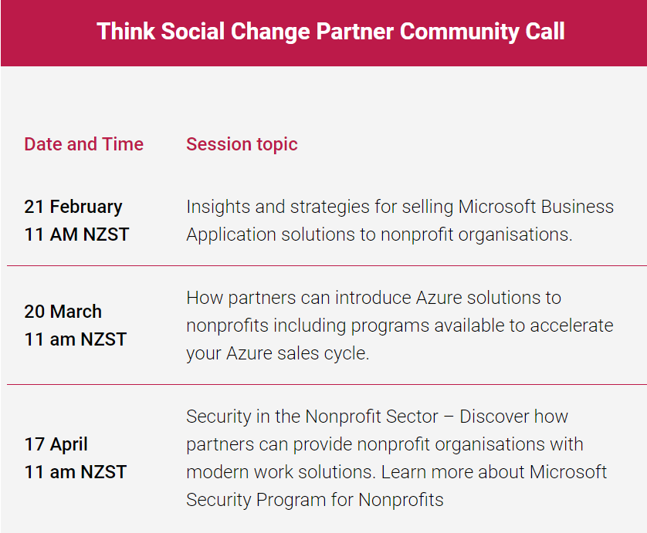
Join Amrish Bora (Dicker Data ANZ lead Nonprofit Lead) and Microsoft experts for this webinar series to empower you in expanding both your business and influence within the nonprofit sector.
This session is suitable for Sales, Marketing and Business leaders. If you are interested in building & promoting Microsoft Nonprofit offers, then this is for you!

Slide 8

MS Secure
AI-powered innovations in cybersecurity are reshaping how businesses of every size—and across every industry—secure and protect their data. Join us at Microsoft Secure on Wednesday, March 13, 2024, 9:00 AM-11:00 AM Pacific Time (UTC-7).
Notes:
From Microsoft an announcement that Emma secure is back with a session on March 13th unfortunately these time zones aren't really appropriate for NZ but your digger data team will be across it and bring you anything that is relevant. From the world of open I I which Microsoft owns 47% off a huge advancement that now allows us to create video from text this is just an indication of how fast I I is moving we'll cover off more of copilot and AI in the next session of on point and in our news items

Slide 9
COPILOT for Security News
It’s graduation time! With general availability (GA) of Microsoft Copilot for Security on the horizon, we are now moving the initial communications we put in place to support early partners into mainstream partner readiness motions. So, this is the final issue you’ll receive of this community newsletter. Thank you for being along for the ride! It’s been great to have this shared experience with all of you over the last six months, and we so appreciate the interest and cooperation along the way. While you may be seeing some new communications and events, what’s not changing is our commitment to providing you with the tools and resources you need for success with Copilot for Security. Read below for more information. Here’s to a strong future ahead as we continue to work together, helping customers to protect at machine speed with state-of-the-art security for greater impact and efficiency.
Upcoming events Register for February bootcamp We are excited to invite you to our first Copilot for Security Partner Bootcamp on February 20-21, 2024 (PST) & February 21-22, 2024 (IST & GMT). This virtual two-day training will help you understand the value propositions Copilot for Security brings to customers and how you can leverage its abilities to deliver against customers’ increasing security requirements. This is an advanced training for sales professionals and technical experts. Day 1: Sales Track Learn how to go-to-market with Microsoft Copilot for Security. Understand the value proposition and perfect your pitch for Microsoft Copilot for Security. Day 2: Technical Track Understand data controls, data sharing, and architecture for Microsoft Copilot for Security. Learn all about prompts and plugins and how to troubleshoot common issues and errors.
Notes:
Speaking of copilots Microsoft have announced when copilot for security will be going GA. We highly recommend that you attend the upcoming events which are both sales and technical tracks to fully understand the power of copilot and defending at machine speed. To register simply click on the slide

Slide 10
Microsoft Copilot for M365
https://learn.microsoft.com/en-us/training/paths/get-started-with-microsoft-365-copilot/
Clarifications and misconceptions
“your existing understanding indicates that you think the critical stuff being held in one database and nothing is further from the truth with this stuff. Most people talk about this stuff but haven't done the leg work to understand how it operates and what the true threats are. For them it is easier to apply an old model rather than start with a clean slate and learn new stuff. Most wanna be first rather than factual.”
Notes:
With the rapid launch of Microsoft 365 copilot there are a lot of misconceptions and areas that need to be clarified. This quote is from Lincoln and show some of the vigorous conversations happening about copilot 4M365. At the top of the slide I have included a link to the Microsoft learn module on copilot for Microsoft 365 I recommend that you have a look at that and get first hand information about Microsoft copilot before venturing to have conversations with your customers or on LinkedIn. One of the underlying areas of confusion appears to be but use of your data and inputs or prompts to train the underlying models. This is not true. The model does not learn what does learn if we could use that word is the underlying semantic index. The semantic index is not just a search index but includes then better Dara or relationships between entities within that index and also the style what tone of conversations. Bus by building a more complete semantic index Microsoft Copilot for M365 can ground its responses on a more complete index. For more complete and in depth presentation on copilot please attend next week's on point and which Lauren will go through Microsoft 365 Copilot and depth and answered the most asked questions. Monthly payment, Demos or IUR are NOT available before you ask. as well as asking about longer term commits and will let you know when we know.

Slide 11
New Microsoft Partner Benefits Available
Not to be overshadowed by the Microsoft 365 CoPilot release. we see some new partner benefits for partners. Microsoft has seen the need for more diverse and license appropriate options that sit alongside Microsoft Actions Pack (MAPs).
There are three new benefits available now
New Partner Launch Benefits - $345USD (appx. $565NZD)
Existing MAP’s- $475USD (appx. $780 NZD)
New Success Core Benefits- $895USD (appx. $1,460NZD)
New Success Expanded Benefits- $3,995USD (appx. $6,520NZD)
Existing Solutions Designations- $4,730USD (appx. $7,715NZD)
Notes:
These options can be stacked, so you can purchase as many different benefits as possible that you need but only one of each unique benefit, this applies to the new and existing benefits.
The new benefits include M365 Business Premium licenses, Azure Credits, Dynamics licensing and Marketing benefits. The Success benefits include Technical Consulting and Presales benefits in addition to the above.
You can compare the different packages here: Microsoft Partner Benefits and Offerings | Compare Offers
The only prerequisite to purchasing these benefits is that you must be enrolled in the Microsoft AI Cloud Partner Program, then you can purchase any of the above benefits, excluding Solutions Designations.
The other important thing to note is that these new benefits do not include incentives of any kind, incentives are only paid out to partners with a Solutions Designation.
To purchase any Microsoft AI Cloud Partner Program benefit, go to the Membership workspace in your partner centre account. Microsoft Partner Center - Home. These new benefits have been released by Microsoft from the 22 January 2024, but rollout continues so keep checking if they aren’t showing as currently available.

Slide 12
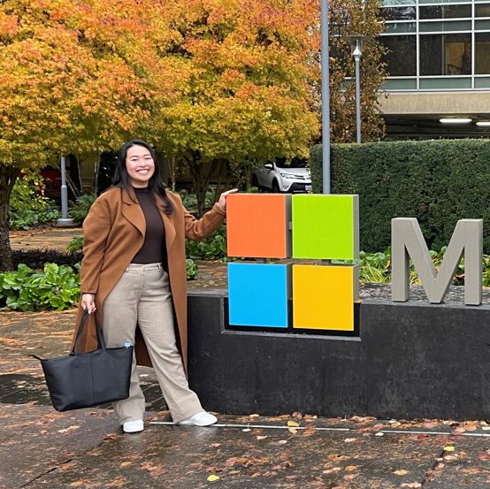
Main Topic
Notes:
And now for the main topic.

Slide 13
Why Dicker Data?
Experience is the Difference
Notes:
As partners you have a choice and distribution partner so why choose to cantata. The tagline is experience is the difference, So what do we mean by experience? Why is our experience beta

Slide 14
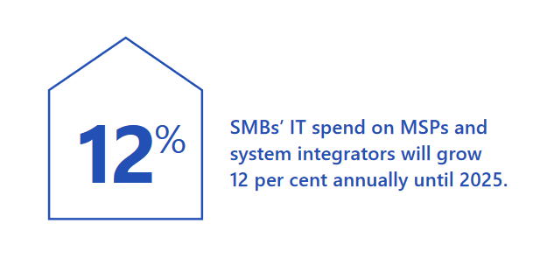
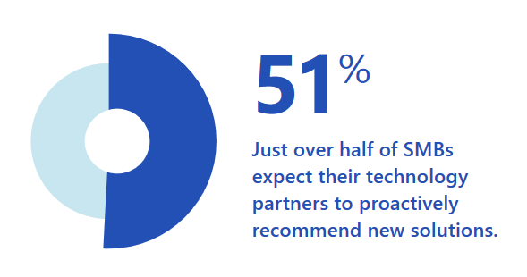
About Dicker Data
Being trusted by over 7,000 partners like you, across ANZ doesn’t happen by chance.
Dicker Data prides itself on establishing and developing strong, long-term relationships with its partner base. “Experience the difference today.”
Notes:
Dicker data as one of the biggest distributors across ANZ with over 7000 partners just like you our heritage is in the SMB market the same market that you service. We are uniquely Australian and Kiwi in our approach. Where our word is our bond, deals are based on handshakes and trust, we respond and take accountability, often over a beer or coffee. When we say something, we do it, even if it's a question we can't answer we will get you the answer, with partners ranging from the largest tier ones to the smallest SMB partners we treat every partner with the same respect and value. Our aim is to grow every partner and thus grow Decker data.

Slide 15
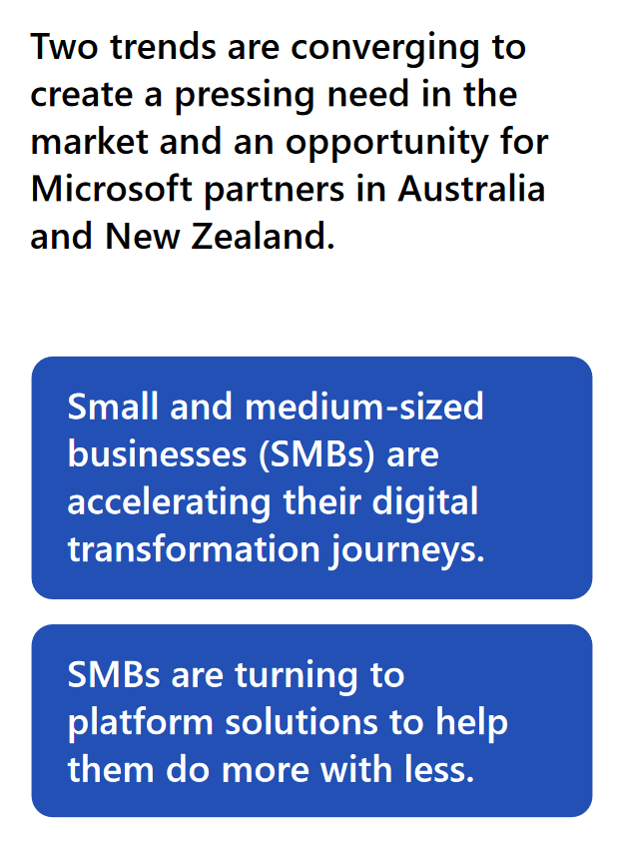
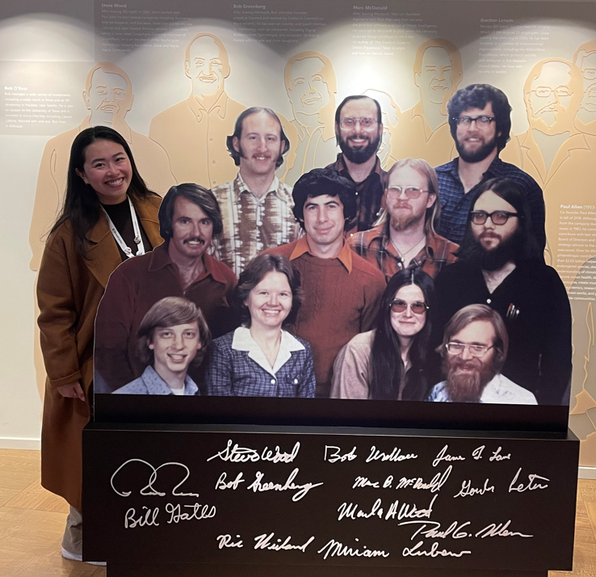
The Bestest (sic) Microsoft Team
Over 50 people dedicated to assisting you grow your Microsoft Business
                We are here for you
A culture of “let's make it happen.”
A portfolio of leading vendors (complimentary and competitive.)
A Growth mentality, agile, focused
Advocating for you at the highest levels within Microsoft.
“Start-ups and digital first businesses are digitally mature and hungry to invest in technology to fuel growth, enhance digital security, empower talent and improve efficiencies. That spells a massive opportunity for digital services providers and resellers, with more than 2.2 million SMBs in Australia and another 550,000-plus in New Zealand.”
Notes:
Yes, Bestest is a deliberate word, Decker datas Microsoft team is made up of over 50 highly qualified and experienced individuals, but our true strength wise and how we work as a team and the culture that underlies that. We draw upon individual strengths working towards a common goal of making you successful. No one is more important than anybody else the most important person is the partner.
Having complementary and competitive vendors allows us to offer complete tailor-made solutions for you to present to your customers. Having complimentary products within our portfolio enable you as partners to increase the size of the opportunity. Having competitive products and vendors ensures that we stay on top of our game and are aware of all developments and advancements made within our specific vendors. We recognise that Sometimes the best solution is not made up of just one vendor and that innovation is not the sole domain of one vendor
We make sure process does not get in the way of progress.
We are seen as a force multiplier for Microsoft having access into their leadership at both and the ANZ level and global. All the team also maintain relationships with their Microsoft counterparts building that trust and escalation points as an when we need them.

Slide 16




HELPING YOU GROW YOUR MICROSOFT BUSINESS
LOCALLY BASED SUPPORT
TECHNICAL PRESALES ENGAGEMENTS
PARTNER ENABLEMENT & DEVELOPMENT.
THOUGHT LEADERSHIP
ACCESS TO MICROSOFT FUNDING & PROGRAMS
Notes:
So how can we help. We provide free of charge the next level of support for you, the support is local, meaning that we cover the times that you work. No more return phone calls at 3:00 AM on a Sunday morning. We answer the call be it by phone emails or teams chat. I support can escalate as required.
Our technical pre sales specialists are available to you to develop proof of concepts and sanity check implementation projects, as well as engaging with the end user customer on your behalf.
It was often said give a man a fish and he eats for one day teach him to fish and he feeds himself for a lifetime. We are invested enabling you 2 fish, by providing free of charge and enablement across both sales and technical teams. We anticipate what skills are required as new products and solutions come to market. For example, Microsoft 365 Copilot we see a requirement for partners to be upscaled around data governance, so Dickerdata will be providing free is SC300 information protection certification training too our partners.
Where Microsoft make available funding and incentives, we ensure thank you are realising all the benefits. Be backed taking part in take for social impact, workshops, skills training or monthly user ads.

Slide 17



SUPPORTING YOU & YOUR CUSTOMERS
ANZ BASED TECHNICAL SUPPORT TEAM
ACCESS TO MICROSOFT PREMIER SUPPORT
PRESALES & SOLUTION DESIGN SUPPORT
Notes:
How do we support you and your customers. As mentioned, our Technical Support team is local, so they emphasise and understand but New Zealand and Australian approach to business. Where responsive responsiveness and accountability are paramount. Where required our support team can escalate to Microsoft premier support. This capability as provided free of charge to dicker data partners. Whereas a Microsoft direct partner would have to pay in the region of $900,000 for this support. Utilising this premier support, we can also raise advisory tickets which means that Microsoft engineers can advise on presales design architecture and implementation plans.

Slide 18

INSTRUCTOR LED MICROSOFT CERTIFICATION TRAINING
MS-900:
MICROSOFT 365 FUNDAMENTALS
MS-500:
MICROSOFT 365 SECURITY ADMINISTRATOR
SC-900:
MICROSOFT SECURITY FUNDAMENTALS
AZ-900:
MICROSOFT AZURE FUNDAMENTALS
AZ-104:
MICROSOFT AZURE ADMINISTRATOR
Notes:
As proof of how we are invested and your success these are some of the certificate trainings that we have made available 2 our partners. These are not simply pre-canned training sessions. But are be spoke presentations delivered by our own Microsoft certified trainers, to advance your internal skill set. For the first half of this year we will be presenting I said 104 which will be updated to reflect changes to the Microsoft certification exam. We will also be presenting information protection yes see 300 to assist you and building I copilot readiness offering for your customers. As a bonus if you are a dickerdata partner we will assist in and providing vouchers to get you certified.

Slide 19
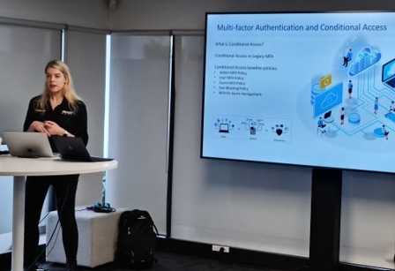
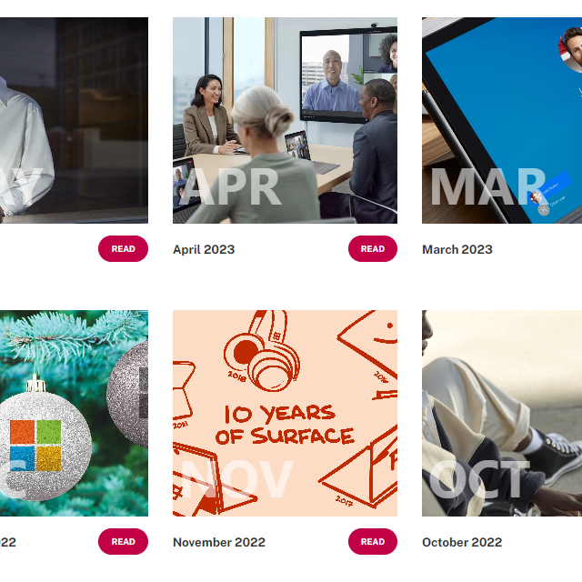

PARTNER ENABLEMENT:
THE PROOF
25+ WEBINARS DELIVERED
25 CUSTOMER FACING SMB WORKSHOPS JOINTLY DELIVERED*
MONTHLY NEWSLETTER & ON-DEMAND CONTENT*
* Dicker Data partners only
Notes:
Aside from the certificate training we provide webinars on subjects that matter, customer facing workshops satire jointly delivered too close opportunities. For example fact Microsoft do more with Microsoft workshops achieving a 95% conversion from Business Standard to business premium. All of our recorded content is made available on partner only microsite, so that you can use it as a reference material.

Slide 20



PARTNERING WITH DICKER DATA & MICROSOFT
TECH FOR SOCIAL IMPACT
SMB MASTERS TRAINING
YOUR CONDUIT INTO MICROSOFT
Notes:
We often run exclusive Microsoft programmes such as take the social impact and isn't the masters training which we invite partners to attend. Making the same resource is available to deca data internal specialists available to you. We attend these programmes alongside you as a true partner should.

Slide 21



STREAMLINE YOUR MICROSOFT OPERATIONS
INTEGRATED BILLING OPTIONS WITH CONNECTWISE, AUTOTASK, XERO
SCHEDULE NCE LICENSE CHANGES FROM DD PORTAL
END CUSTOMER WHITELABEL PORTAL
Notes:
Important in the channel is the cost of doing business. We strive to integrate into the billing software that you use and to make procurement of licencing as frictionless as possible. While no portal can be perfect, we actively improve our portal experience based on your feedback.

Slide 22
MAICPP
Designations
Azure AI
Modern Work
Dynamics
Certifications
632 x Microsoft Certifications and exams from Fundamentals to Expert level (Feb 2024) 335 x assessments
5 x in house Microsoft Certified Trainers
Notes:
The Microsoft AI cloud partner programme we hold designations for Azure I I, modern work and Biz apps dynamics. We are subject to the same criteria as you. With over six hundred certificates held internally across NZ and AU. You won't find another distributor that has made that investment in local resource. Additionally, we have 5 Microsoft Certified trainers available to assist you in becoming certified. These trainers only train on material that they have also been certified in. So, we sat the exam and passed before telling you what to do.

Slide 23




Results
Microsoft Partner of the year NZ Aus
MPOY Global runner up.
Highest percentage of
  Core licenses (Business premium, ME5)
  Certified partners
No1 by Microsoft revenue for ANZ
Notes:
Dicker has been recognised by Microsoft ANZ and Global as Partner of the year winners and finalists. But Results are what really matter. If you want to have the most satisfied customers on the best licensing and to also maximise your profitability, then you should partner with a Distributor that cares. “ A great experience is the difference”
If this presentation has raised issues for you, 24/7 support is available via your DickerData Product Development manager.

Slide 24

WE love the Channel!!
A Valentine's Day IT Love Story: MSPs, Vendors, Disties Talk About What They Adore About The Channel
CRN asked more than 25 MSPs and dozens of vendors and distributors what they love about the channel.
“The thing I love most about the channel are the salty, opinionated cynics that keep things real,” said Kyle Hanslovan, CEO of threat researching firm Huntress.“These are the real champs that see past the marketing fluff and lead with ‘show me, don’t tell me.’ Without these defenders of truth, ethics, and obscure knowledge, there would be little to keep the snake oil at bay and a lot fewer Lols.”
Notes:
In summary and most importantly this popped up on linked in from CRN. Kyle’s quote while humorous and typical Kyle, speaks volumes about why the IT channel is so different particularly in this part of the world. We are all competitors but come beer o’clock on Friday we enjoy each other's company, laugh out loud, share work stories and help each other to become better.
Thank you for attending todays webinar. We hope you found it useful and a reminder to join us for an indepth presentation on Copilot for M365 next week.

Slide 25
Dicker Data Webinar
Thank you
Notes:
Thank you for your attendance and if you have any questions we will stop recording. Feel free to ask in the chat window.
HOW CAN WE HELP?

