Slide 1
Dicker Data Webinar
Notes:
Thank you for joining will start shortly
MAKE SURE RECORDING IS ON

Slide 2
Agenda
1
News
2
Main Topic: Teams Premium
3
Close
5
Code of Conduct
Notes:
Welcome to Opoint 2024, Happy New year. If you are joining for the first time welcome and thank you, we hope that you find the next 30 mins informative and possibly a little entertaining.
If you have attended our previous onpoints welcome back and thanks for all your support. You will find this year we are doing things a little different this year. More about that in a moment.
Then we do a quick catchup on our carefully hand curated Microsoft relevant news for the previous week,
Followed by the subject de semaine (week in English) today we will explain on why you should choose Dicker Data as your Distributor and the benefits of being a Dicker Partner.
Then we close out with an open Q&A session /prize draw
For those of you new to Powerpoint live. A quick familiarisation, We welcome your reactions using the emotion icon at the top right of your screens. Please ask questions in the chat window during the call. We will invite you to come off mute at the end of the call if you would prefer to ask your question out loud. During the call, please ensure you are on mute, and your video is turned off.
All links to sites are available by clicking on the link in the slide or will be posted to the chat window. We recommend you click on all relevant links and then review post call.
Calls will be recorded and made available post call, The teams generated recording will not be available external so don’t panic we will make the recording available to you later .
Participation in these calls means that you agree to Microsofts terms and conditions for digital meetings a link is available on this slide should you wish to review these. or to test the live link feature
Introduce speakers Role and location

Slide 3

News
What you need to know
Content credentials
Generated with AI ∙ June 17, 2024 at 3:58 PM
Notes:
But First The News. This is the section which is a concise update of relevant information, or opportunities compiled by Dickers subject matter experts. Who attend those early morning calls, wade through endless emails, yammer messages etc so you don’t have to

Slide 4
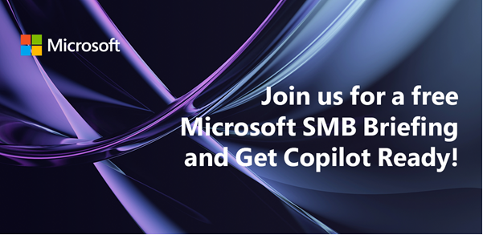
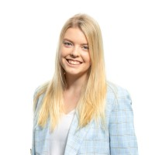
DATE & TIME:
Wednesday 26th June 1:00 PM NZT / 11:00 AM Sydney
Dicker Data is inviting you to bring your customers to our live digital briefing where we’ll showcase how Microsoft 365 can help put the power of AI to work with a live demo of Copilot for Microsoft 365! Copilot for Microsoft 365 can dramatically transform the way work gets done, empowering people to focus on more innovation and creativity – and unlocking a new wave of productivity growth.
Notes:
ANZ Final chance 220 attendees last time.
What’s New in Copilot | May 2024 - Microsoft Community Hub

Slide 5
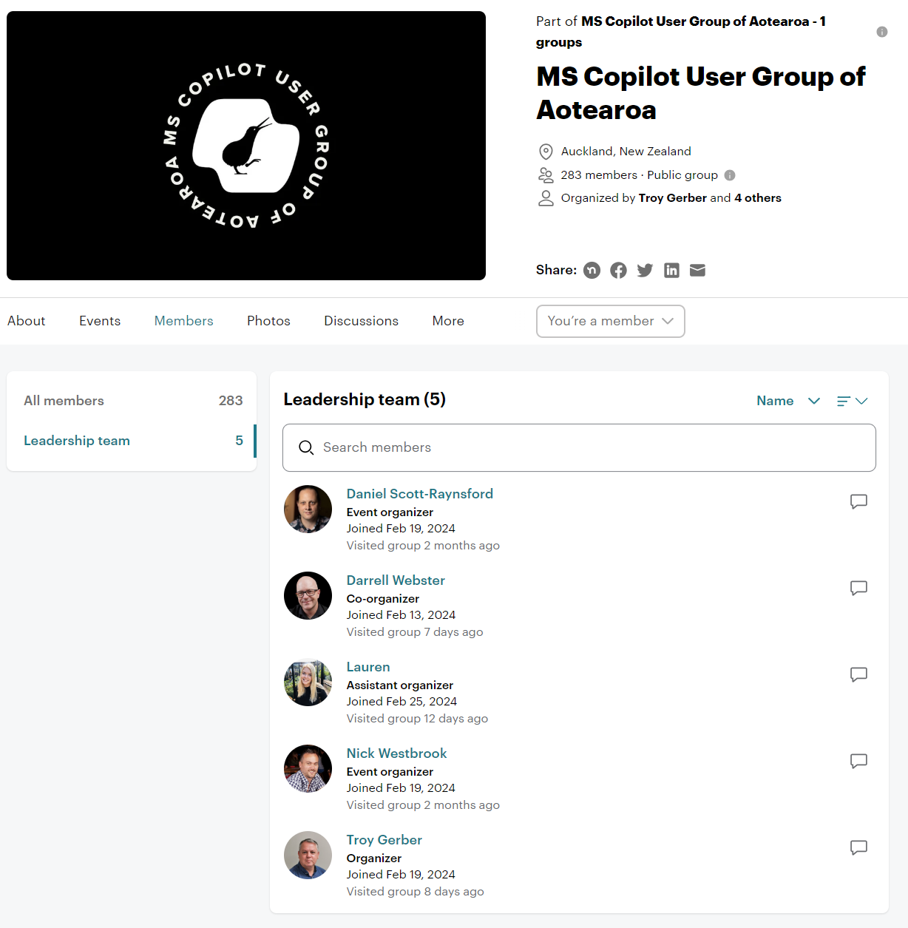
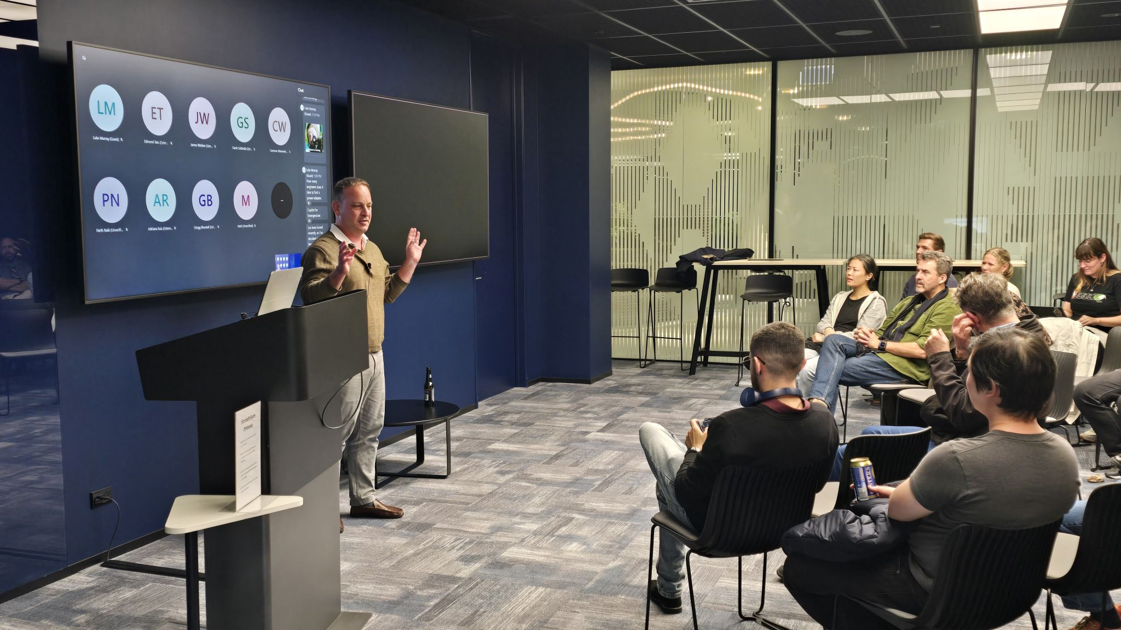
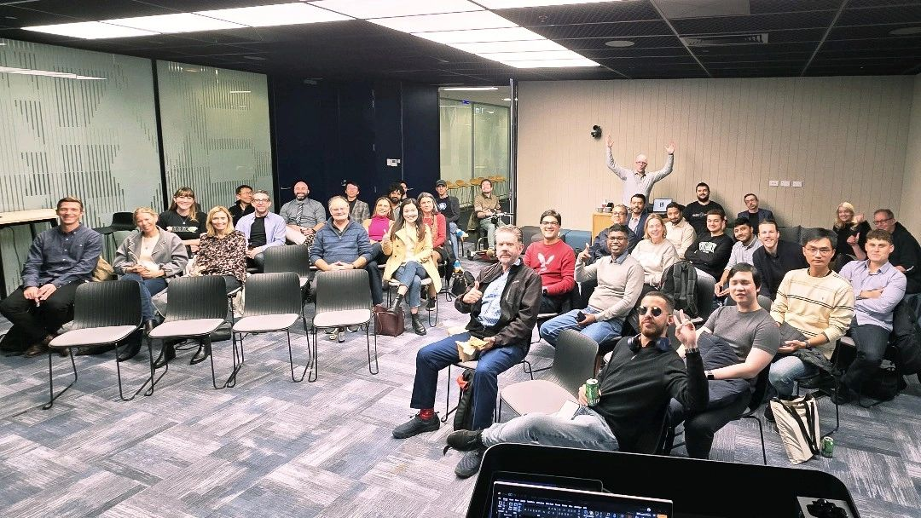
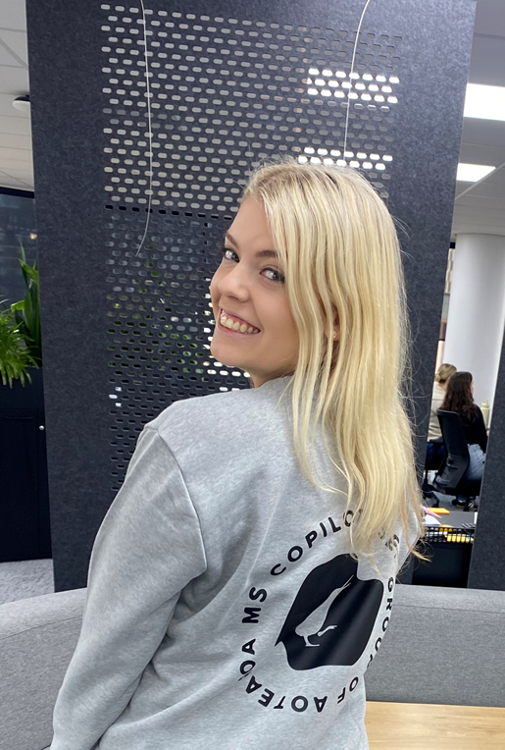
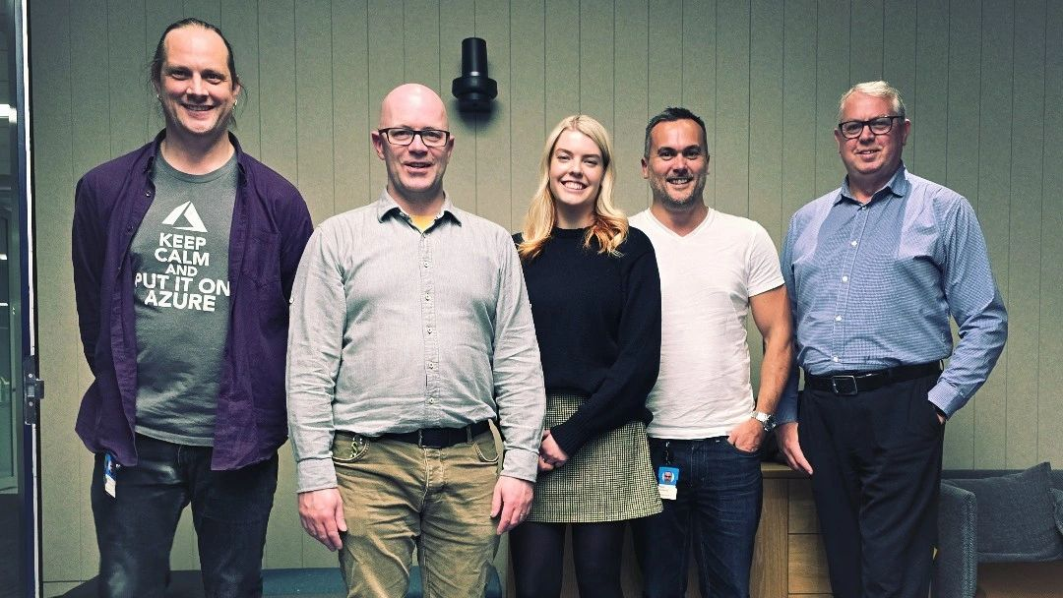
TUESDAY 25th “Adopting Copilot in your organisation
Notes:
Congratulations to our very own Lauren, on being a co-organiser for NZ’s copilot user group. If you would like to register to attend the next event on Tuesday either in person in Auckland or online click on the logo

Slide 6
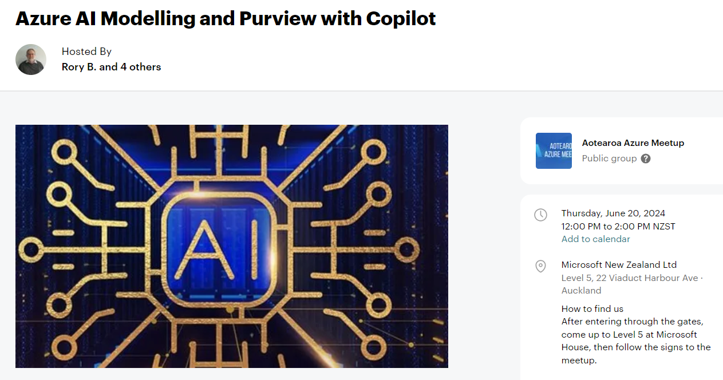

Slide 7
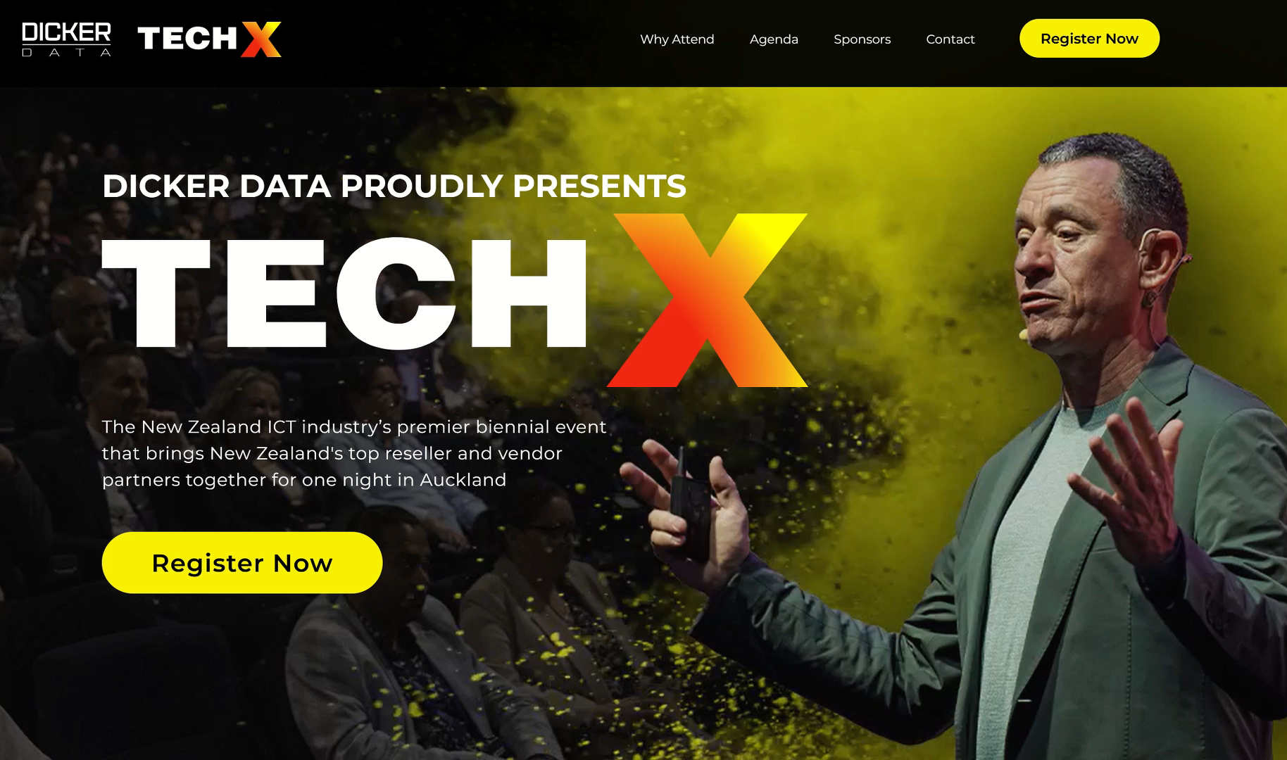


Slide 8
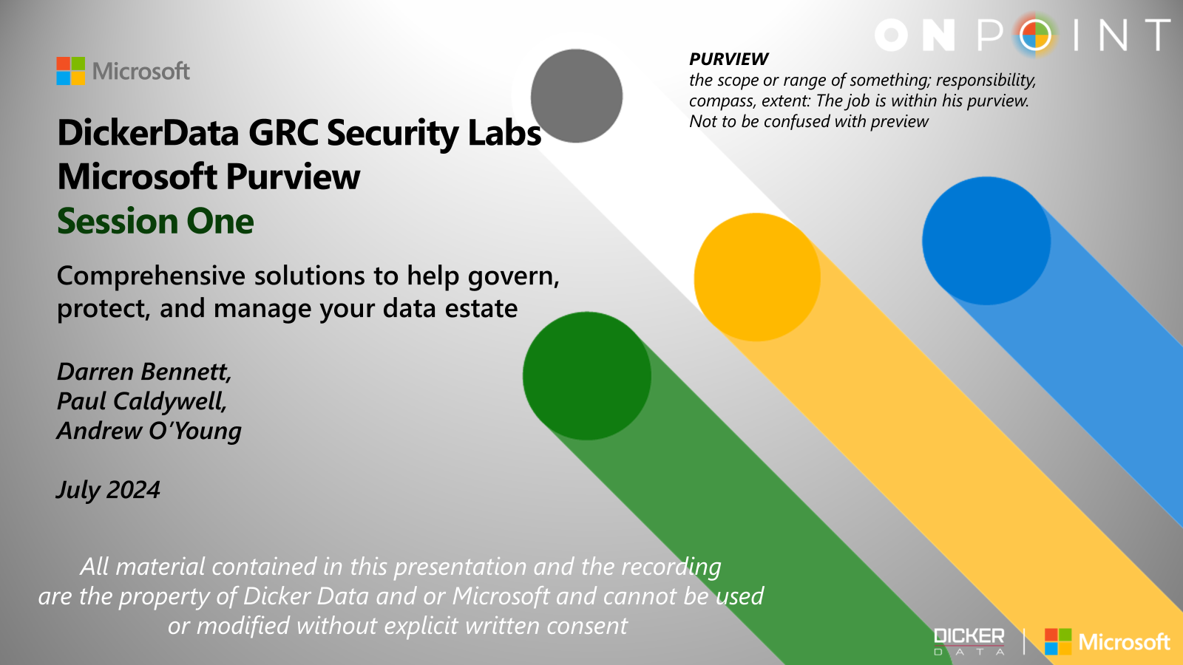
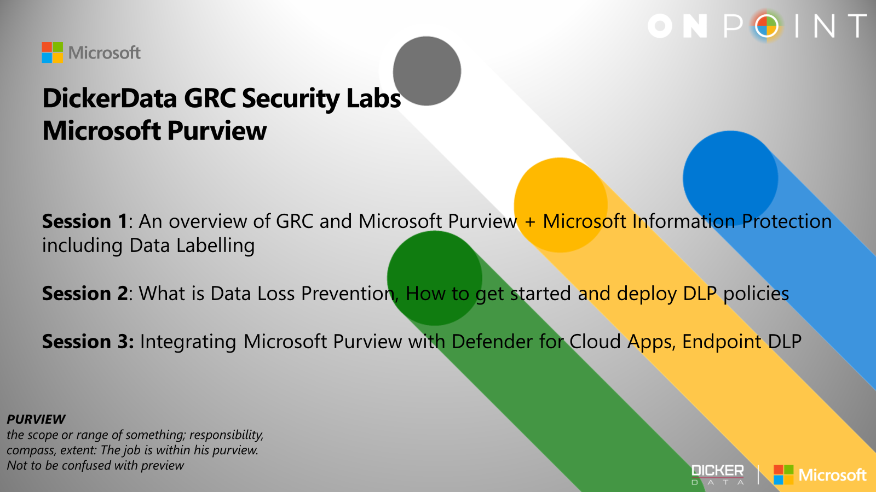
Purview Labs Workshops
ANZ 3 sessions Web 4, 11, 18 July
Notes:
EDM coming soon

Slide 9
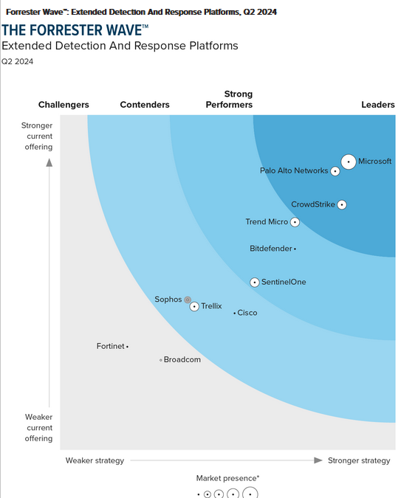
XDR Vendors Have Reached A Tipping Point To Compete With SIEM
In 2021, extended detection and response (XDR) vendors had offerings that were a jumble of features and a vision to ultimately replace security information and event management (SIEM) as the principal technology in the security operations center (SOC). Now, many vendors have reached a point of integration and product capability where customers can start to realize the SIEM replacement vision even if XDR still can’t compete for more niche SIEM use cases such as compliance, federated search, and heavy customization
“Microsoft has the most data-rich endpoint information in this evaluation. Reference customers cite unique features like a full timeline of activity that occurs on each endpoint as useful for investigation. The suite enables users to respond to alerts across integrated native tools (Defender for Cloud and Cloud Apps), search over the data, and build user-generated detections. References note the comprehensiveness and value of the suite, though prospects’ biggest frustration is how the licensing model all but forces practitioners to adopt with the rest of the business.”
Notes:
Microsoft's comprehensive XDR continues to receive recognition from analysts. The re-print is available in the link below. However here are some key points I pulled from the read.
* Forrester emphasized that Defender XDR is the broadest native XDR on the market today as it includes native support email, SaaS apps and more.
* Microsoft scored a 5/5 in native detection surface - (Quote) “Microsoft has the most data-rich endpoint information in this evaluation”.
* Automatic attack disruption, built on the foundation of AI & ML, can detect the intent of the attacker (accurately predict their next move) and disrupt attacks with 99% confidence. (wow)

Slide 10
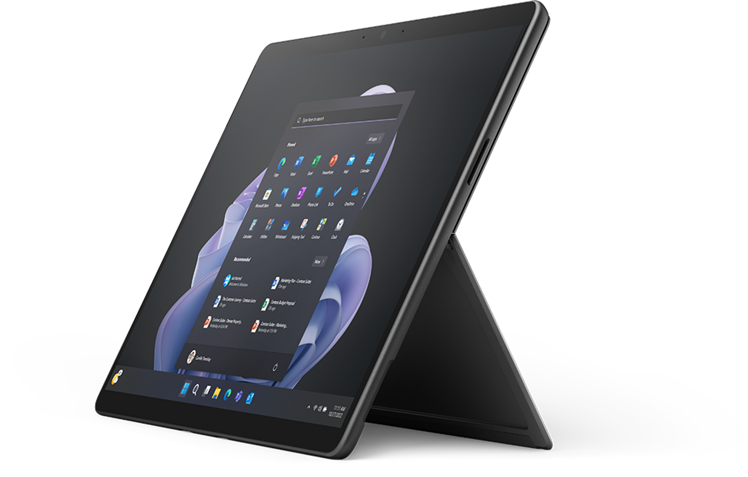
June Surface Promos
Surface Pro 9s – 20% off!!
  Last of the Pro 9 stock, get them while you can! Update: LIMITED STOCK!!!
  Promo ends: 30th of June
20% off EHS+ & Warranties
  Promo ends: 30th of June
Promos available to authorised Surface partners only. Become authorised here.
Notes:
We have stock – 60 Pro Pro9s remaining, as we understand it – last in country and no more are expected to land so grab a bit of a deal before the end of the month

Slide 11

Content credentials
Generated with AI ∙ June 17, 2024 at 4:41 PM

Slide 12
Teams Premium
Lauren Nobbs
Modern Work BDM
Agenda:
What is Teams Premium
Features
  Intelligent Recap
  Advanced Protection
  Richer engagements
  Advanced webinars
  Advanced virtual appointments
  Advanced Town halls
Teams Premium vs Copilot for Microsoft 365
Licensing
Resources
Notes:
Hi everyone, great to be part of OnPoint again and presenting on my favourite tool for partners – MS AI Partner Centre

Slide 13
What is Teams Premium?
Intelligent productivity
Focus on what matters most with meetings powered by AI, including GPT from OpenAI
Advanced protection
Collaborate more securely with advanced protection and customized Teams management
Richer engagement
Create deeper engagements with personalized experiences that help grow your business and brand
Notes:
Teams Premium is an add-on license to Microsoft Teams that offers advanced features to improve Teams Meetings.
Assist employees spending too much time in meetings by leverage intelligent productivity to focus on what matters most
Help reduce the chances of data leaks by adding advanced protection to meetings that involve sensitive business information
Drive richer engagement across all meeting types, audiences, and engagements
Do more with less by reducing outside spending with vendors and 3rd party management solutions

Slide 14
What is Teams Premium?
Intelligent productivity
Focus on what matters most with meetings powered by AI, including GPT from OpenAI
Advanced protection
Collaborate more securely with advanced protection and customized Teams management
Richer engagement
Create deeper engagements with personalized experiences that help grow your business and brand

Slide 15
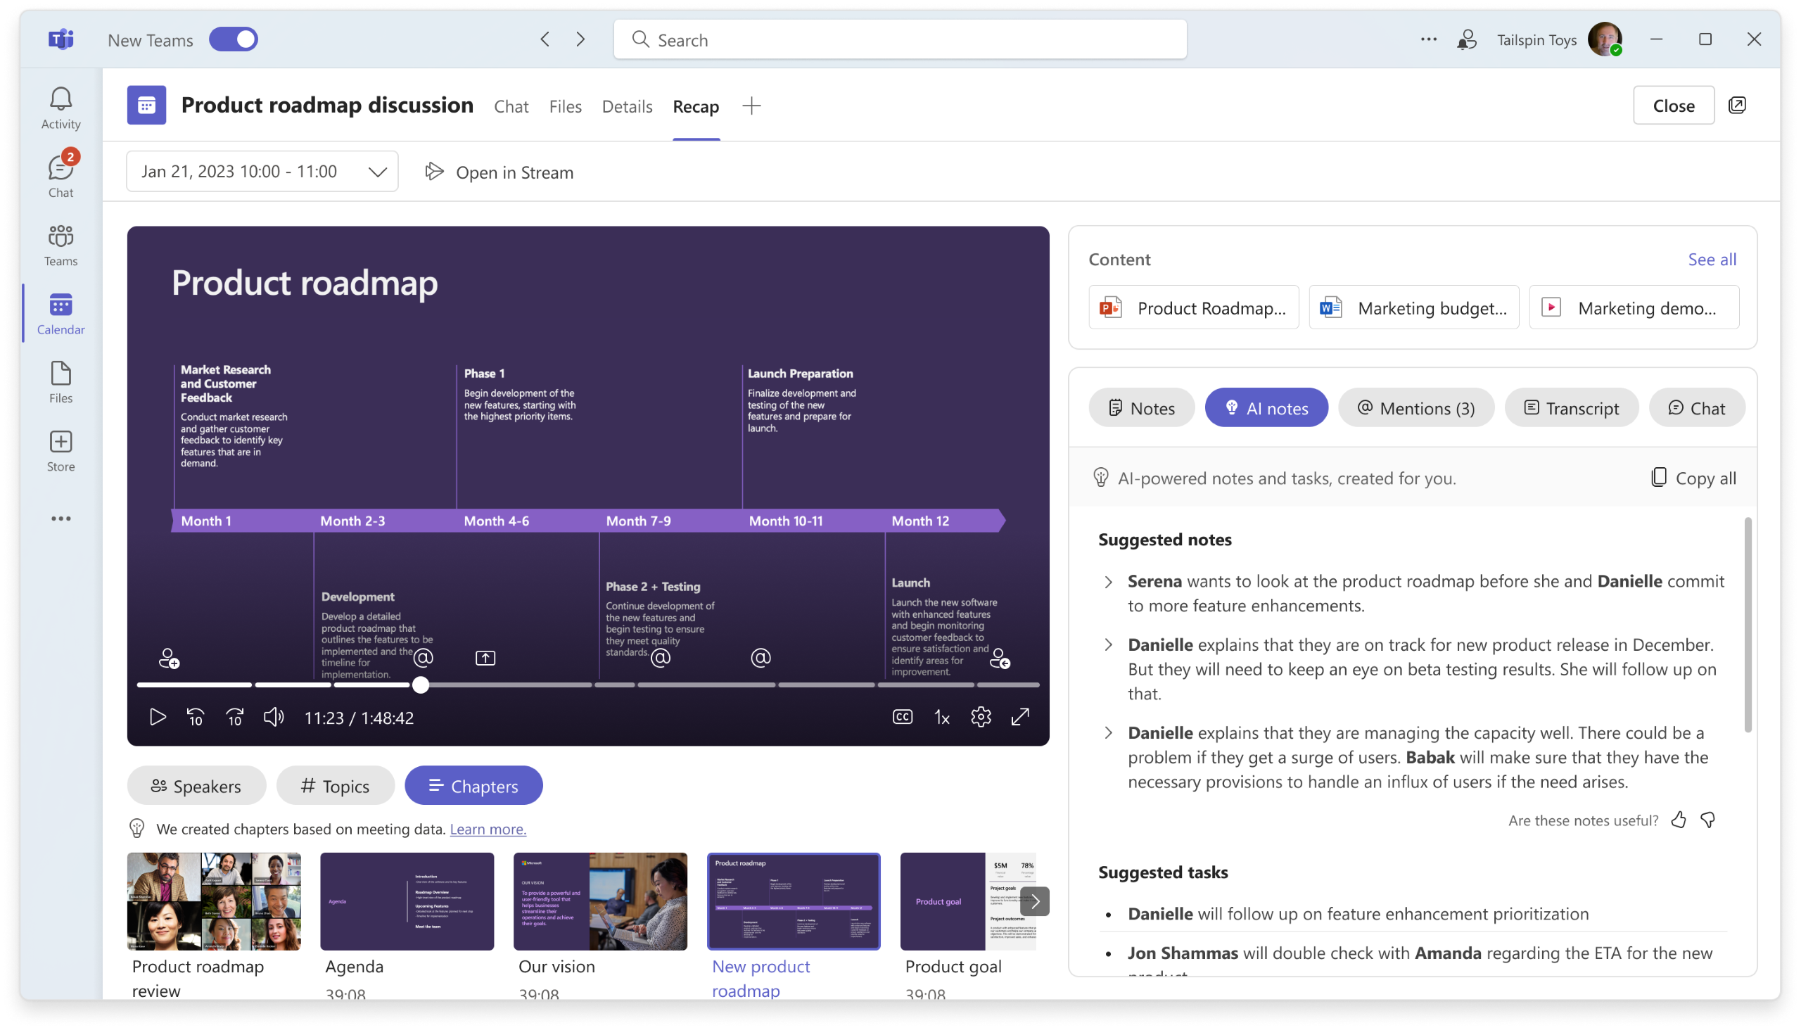
Intelligent Recap
Leverage the power of AI to make the meetings you attend (and miss) more productive and impactful
Save time on takeaways and action items with AI-generated notes and tasks
Quickly jump to the recording parts most relevant to you with personalized timeline markers
Catch up on the conversation, then skip right to what you need with auto-generated chapters and topics
Notes:
Intelligent Recap
Navigate meeting recordings with autogenerated chapters (coming soon)
View when a screen was shared in the meeting transcript
View time markers in meeting recordings when you joined or left a meeting
Jump to different speakers with speaker timeline markers
View AI-generated notes and tasks from meetings
View when you were mentioned in a meeting - Mentions of a user's name is pulled from the meeting transcript, not from an @mention tag in the meeting chat.
Meet App – Teams Premium
View and recap meetings that you missed
View and recap meetings that mention you*
View when you were mentioned in a meeting*
View AI-generated tasks from meetings
*Mentions of a user's name is pulled from the meeting transcript, not from an @mention tag in the meeting chat.

Slide 16

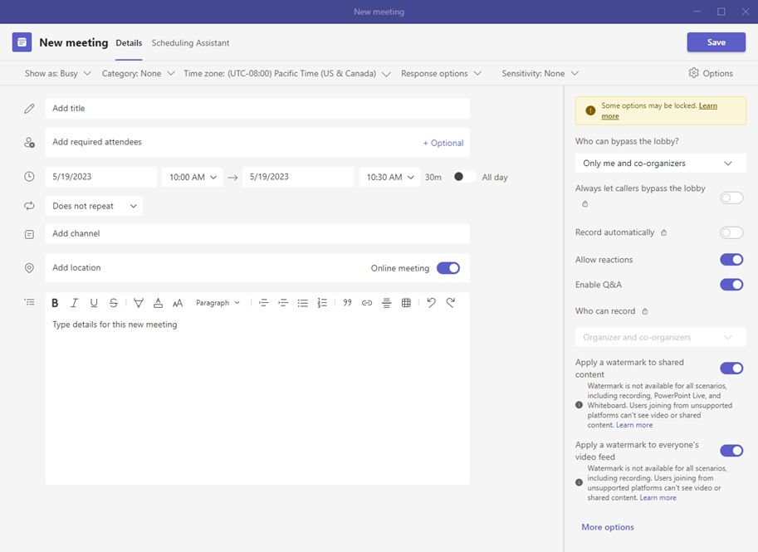
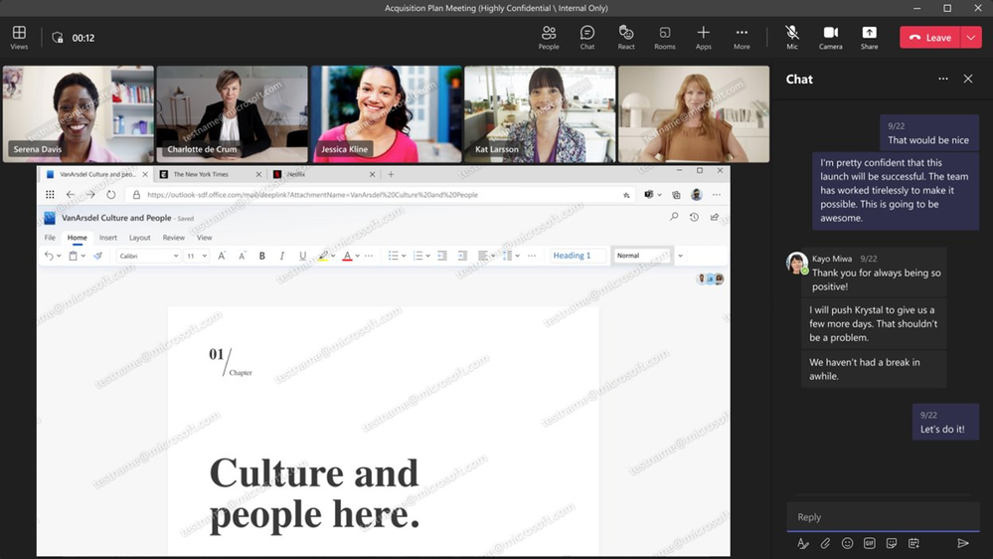
Advanced protection
19%
of data breaches occurred because of a compromise at a business partner¹
Collaborate more securely with advanced protection and customized Teams management
Increase meeting security
Leverage an end-to-end encryption option for meetings that need additional privacy protections*
Schedule meetings from customized templates created by IT, taking the work out of setting the right meeting options or controls
Protect sensitive information
Apply sensitivity labels to help uplevel protections in sensitive meetings**
Help deter data leaks with in-meeting watermarking over
screen shares and video feeds
Safeguard the meeting by limiting which attendees can record
¹IBM Security Cost of a Data Breach Report 2022 by Ponemon Institute, July 2022
*Teams protects your data with encryption in transit and at rest for all meetings. **Customers with an E5 license or E5 compliance
Notes:
Add watermarks to meetings
End-to-end encryption for meetings with up to 50 attendees
Control who can record
Prevent copy/paste in meeting chats
Assign Microsoft Purview Information Protection sensitivity labels for meetings – requires Microsoft 365 E5, E5 Compliance, F5 Compliance, or F5 Security + Compliance
Custom user policy packages
Prevent users from sharing content in external Teams meetings

Slide 17
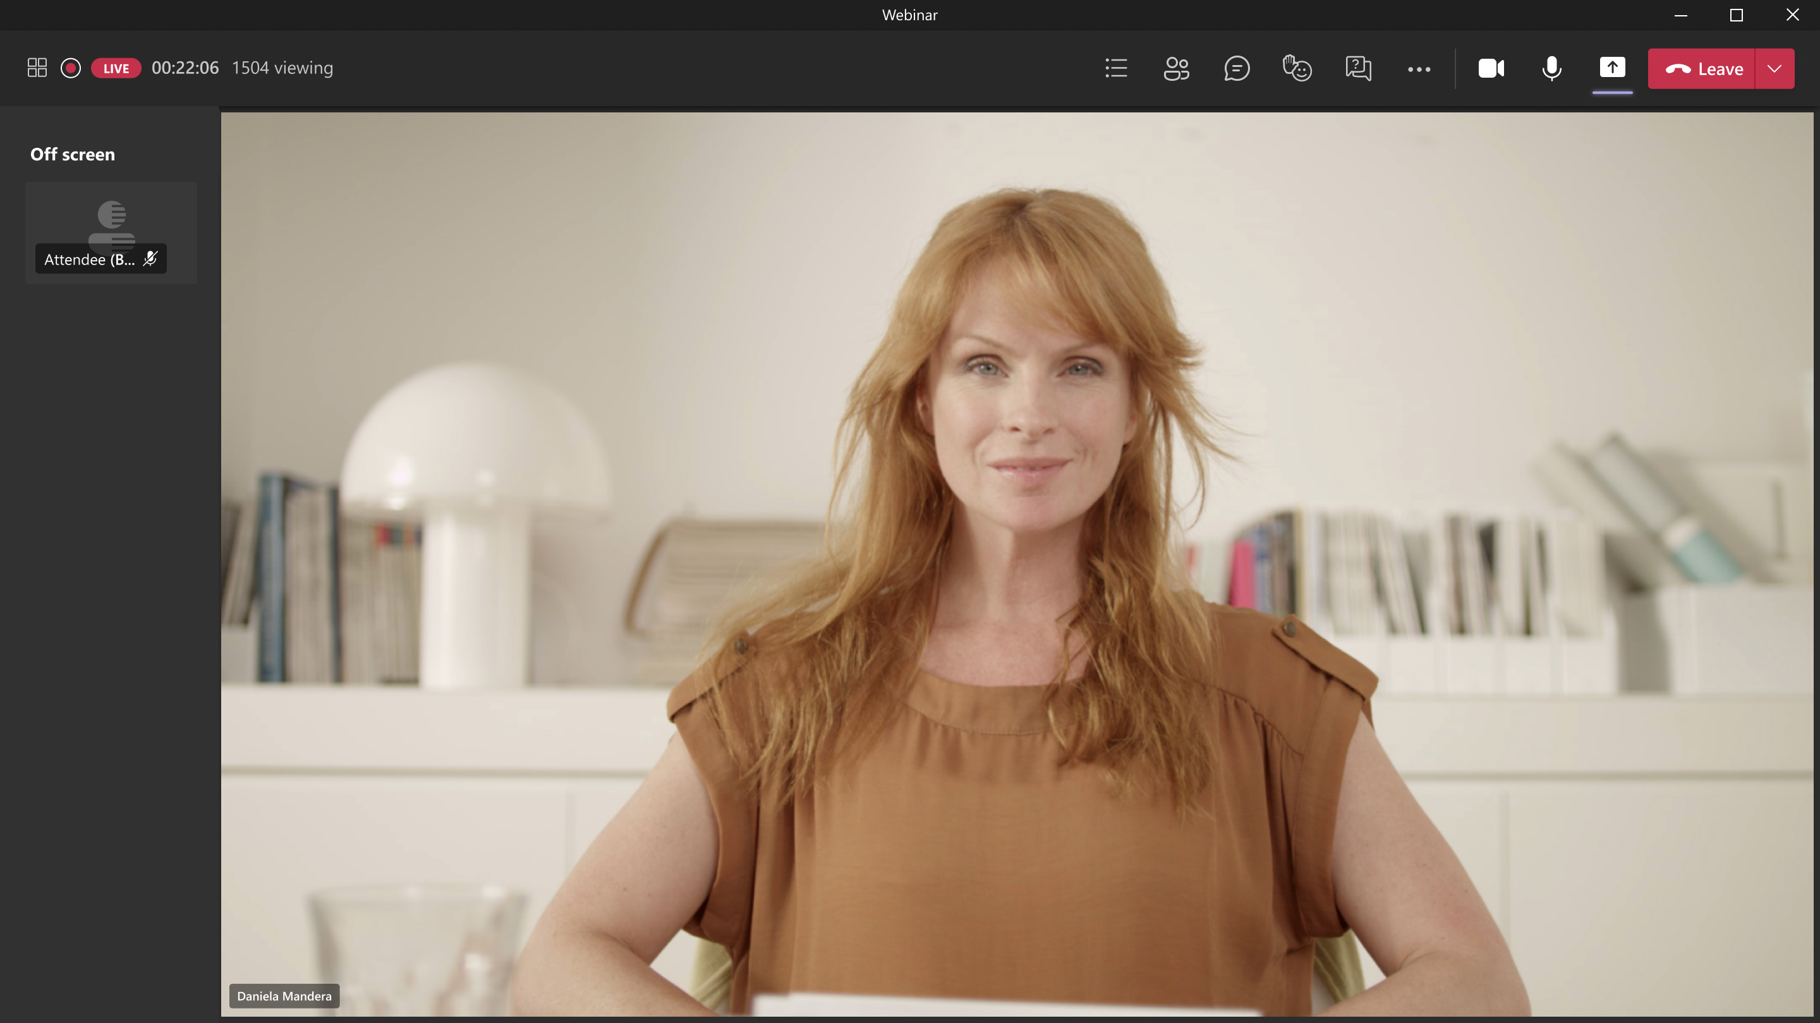
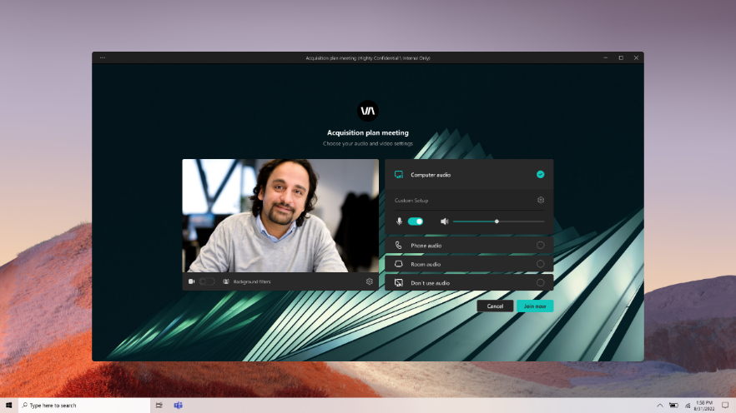
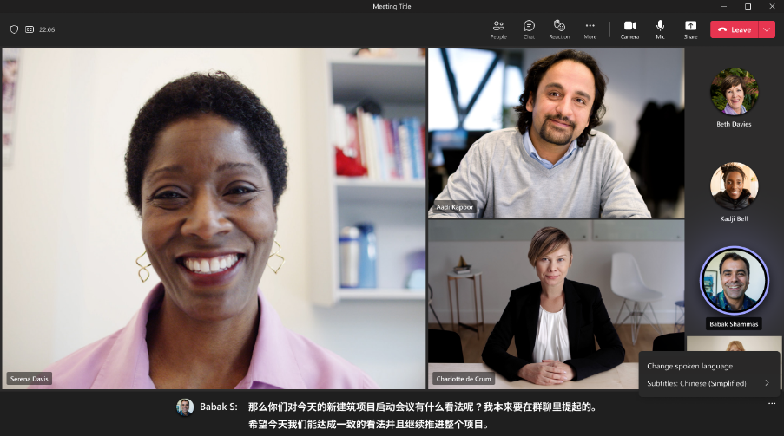
Richer engagements
Create deeper engagements with personalised experiences that help grow your business and brand
Host and deliver high-quality webinars and Town halls
Use advanced webinar & town hall functionality to drive richer engagement and help generate new leads
Build your brand into every interaction
Create custom backgrounds and unique together mode screens to bring people together and highlight your brand
Break down language barriers
Turn on live translated meeting captions in your chosen language
Notes:
Meetings:
Create custom meeting templates – templates have pre-configured meeting options, e.g. who can bypass lobby, auto-record, enable watermark, allow camera/mic, who can record etc
Company branding
Branded meeting lobby
Custom meeting backgrounds
Custom together mode scenes
Branded meeting invites and meeting launch join pages
Translation
Live translated captions during meetings - <supported languages>
Translate post-meeting transcriptions (coming soon)
Manage meetings:
Hide attendee names
Manage what attendees see
Prevent users from sharing content when attending external Teams meetings
View engagement reports
Use RTMP-In for meetings
Turn on eCDN Meetings*
Meeting quality
Audio quality alerts
Video quality alerts
Screen sharing quality alerts
Automatic real time telemetry with 7 day retention
Advanced Collaboration
Admin can view insights on inactive external domains*
Admin can view insights on inactive teams*
Admin can view insights on external collaboration by user*
Admin can view insights on external collaboration by team*
Admin can view insights on external collaboration by guest*
Users can block incoming chats from people in your organization
* Customers must acquire and assign Teams Premium licenses to each user in their tenant for its use of Advanced collaboration analytics.

Slide 18

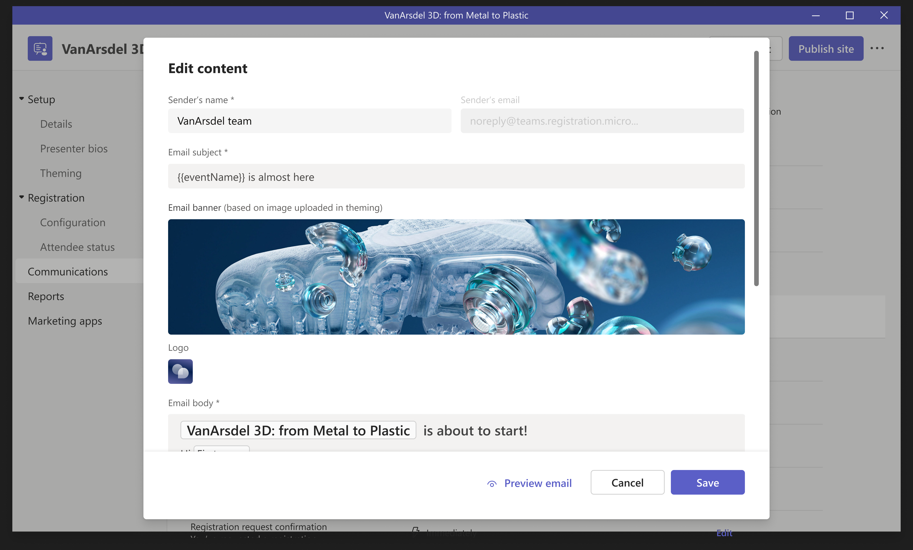
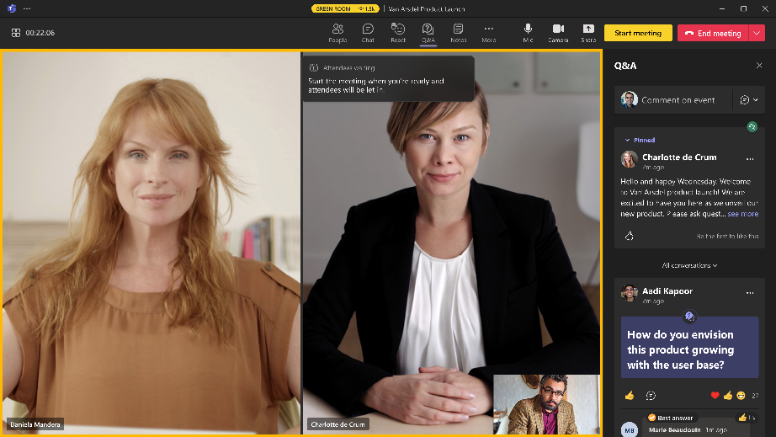
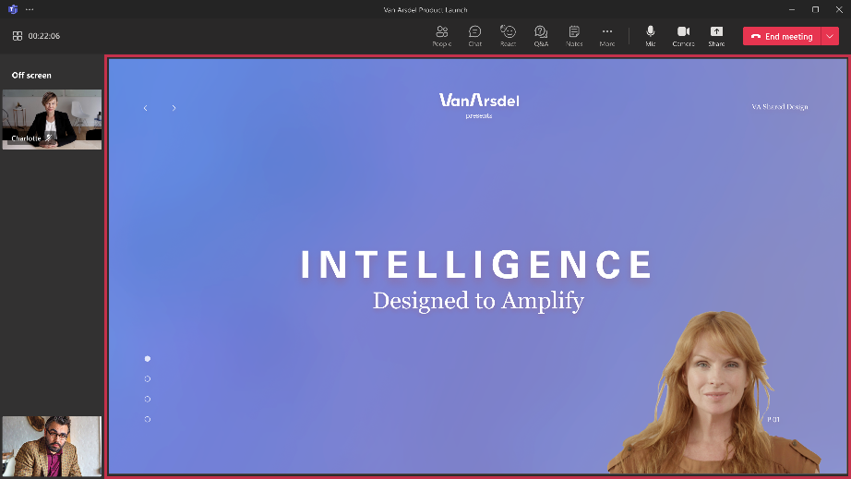
Advanced webinars
Create richer engagements with high-quality webinars
Attract attendees with customised emails and manage demand and registration capacity by enabling a waitlist and registrant approval
Connect with presenters in a virtual green room to stage content, socialise and prep, and respond to chats and Q&A
Deliver dynamic content by streaming different media types with RTMP-in
and minimise distractions by curating and managing what is presented to attendees
Notes:
With advanced webinars and Teams Premium, we want to enable organizations to deliver high-quality and engaging webinars:
Attract attendees with customized emails and manage demand and registration capacity by enabling a waitlist and registrant approval
Connect with presenters in a virtual green room to stage content, socialize and prep, and respond to chats and Q&A
Deliver dynamic content by streaming different media types with RTMP-in and minimize distractions by curating and managing what is presented to attendees
Webinars:
Manage what attendees see
Send custom and reminder emails to registrants
Create a webinar wait list
Webinar organizers can view engagement reports
Manually approve registrants
View engagement reports
Limit the day and time when people can register
Use RTMP-In for webinars

Slide 19
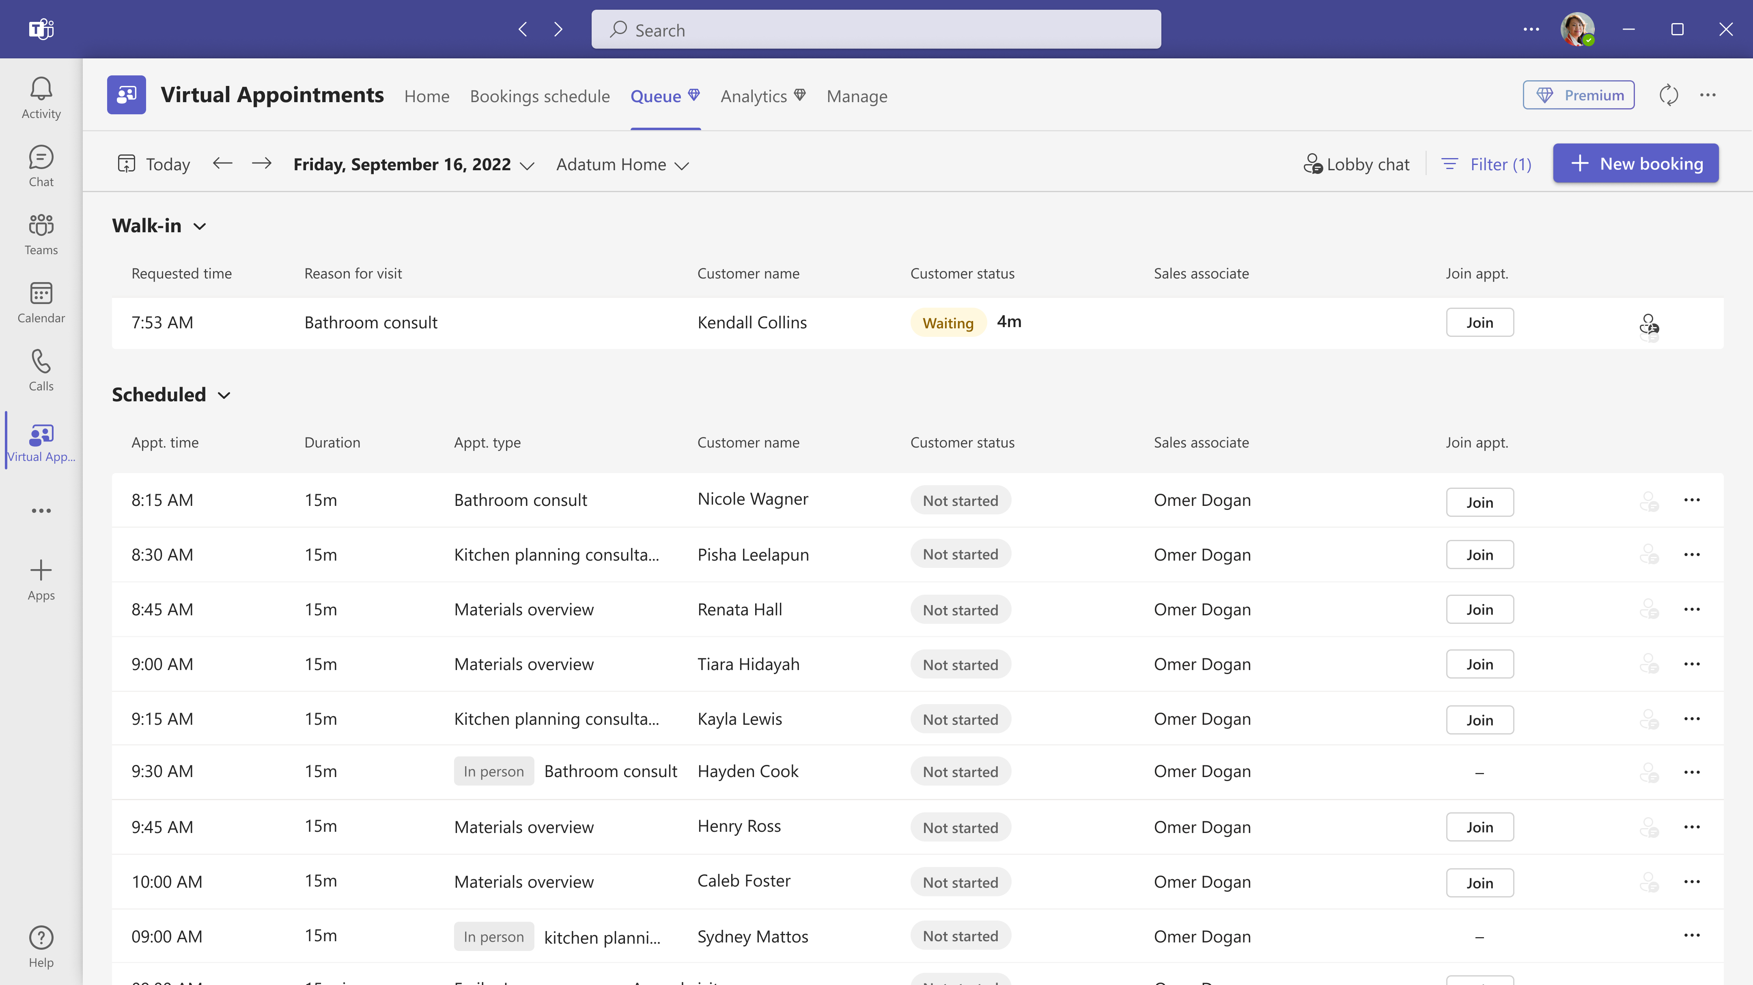
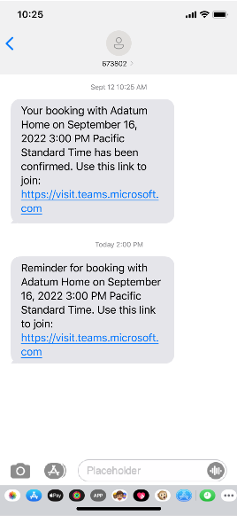
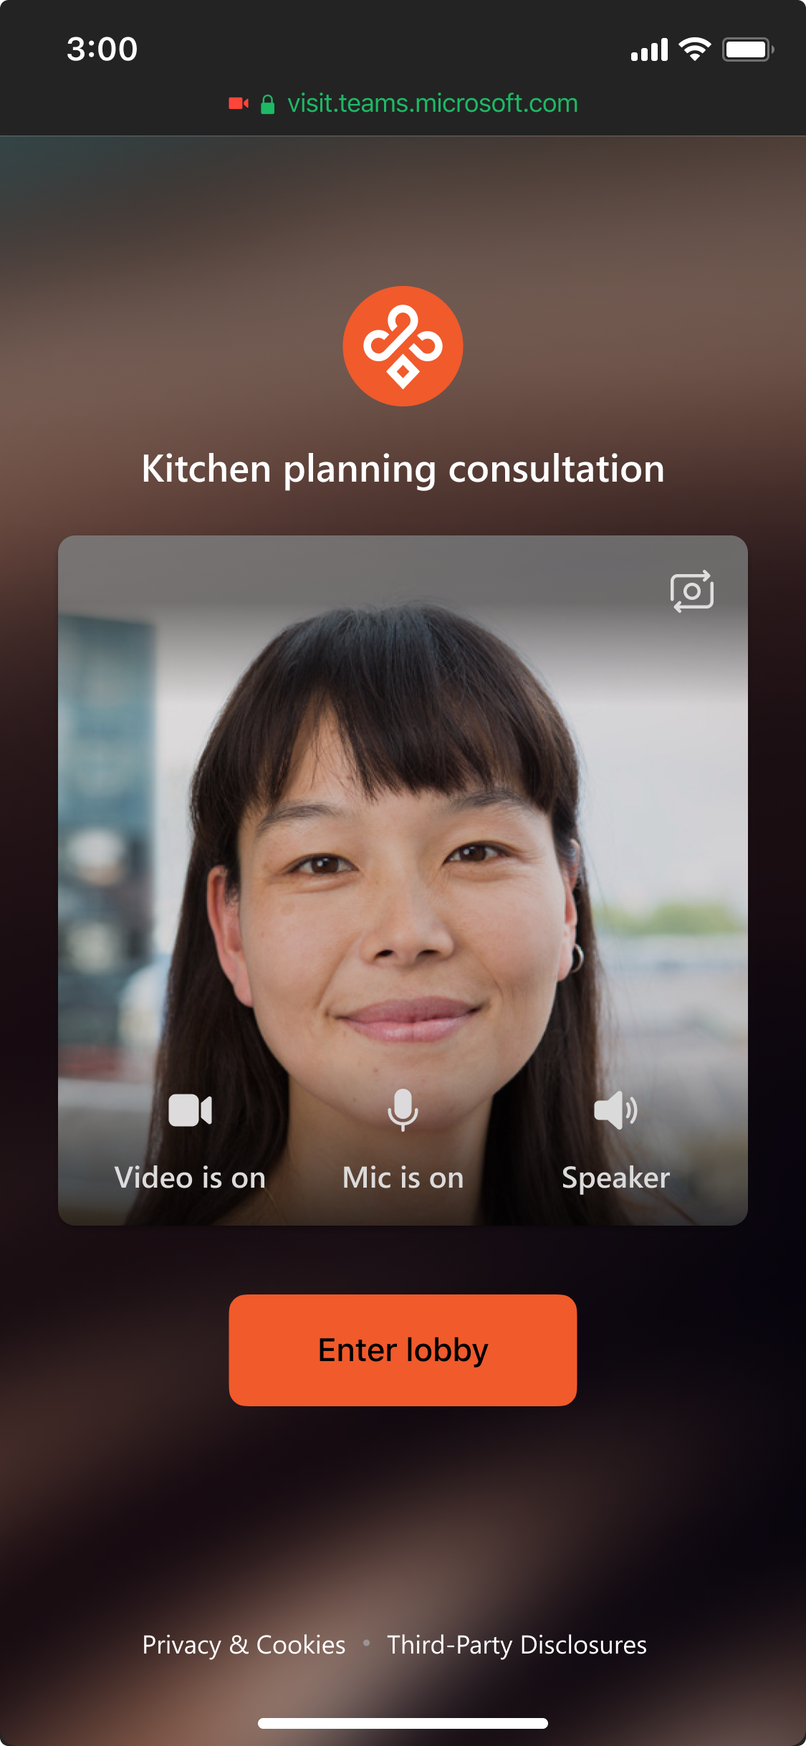
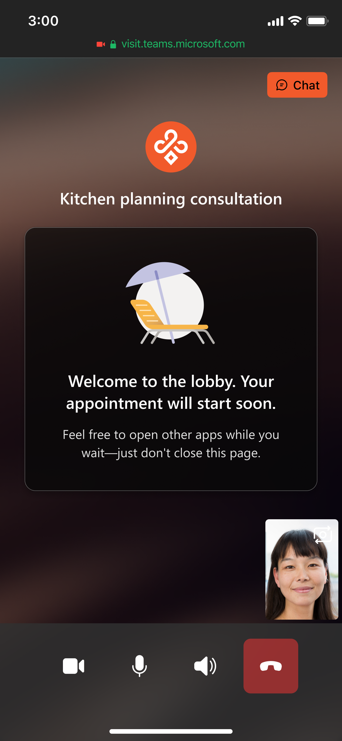
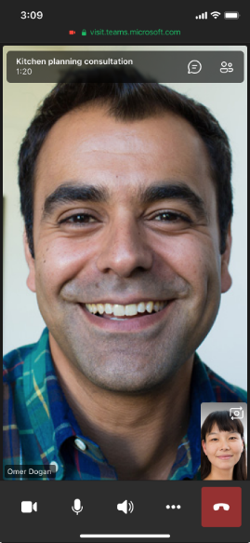
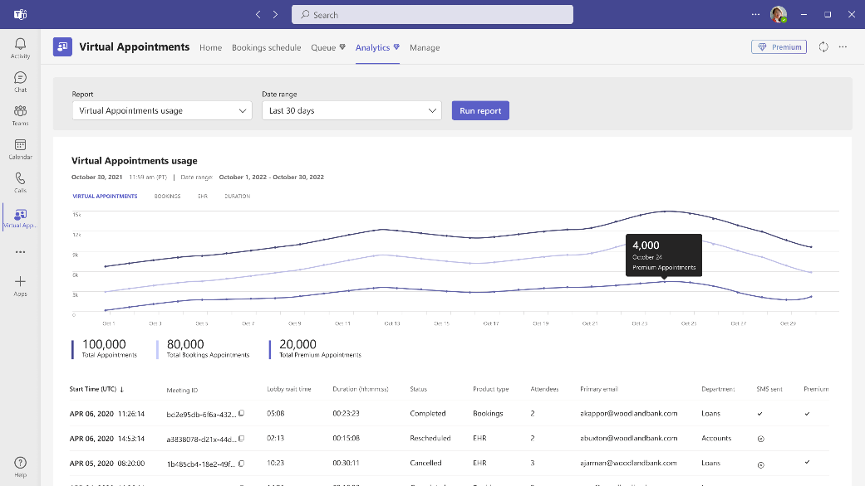
Advanced virtual appointments
Host personalised B2C engagements using advanced capabilities that improve performance
Review all scheduled and on-demand appointments in a single queue
Give customers a personalized end-to-end experience with pre-appointment SMS reminders, a branded virtual lobby, and the ability to join via web or mobile—without downloading Teams
View aggregated appointment reports and trends, such as no-shows and wait times, to improve business outcomes
Notes:
With advanced virtual appointments, you can help ensure a great end-to-end experience for your appointments:
Review all scheduled and on-demand appointments in a single queue
Give customers a personalized end-to-end experience with pre-appointment SMS reminders, a branded virtual lobby, and the ability to join via web or mobile—without downloading Teams
View aggregated appointment reports and trends, such as no-shows and wait times, to improve business outcomes
Advanced virtual appointments:
Customize the lobby waiting room with themes and logos
Send SMS notifications - * SMS notifications for Virtual Appointments are currently available in the US, Canada, and UK.
Organizational and departmental analytics
View and manage scheduled appointments in the queue
View and manage on-demand appointments in the queue
Send post-appointment follow-ups (coming soon)

Slide 20

Town halls
Town halls
Advanced Town halls
  Included in Office & Microsoft 365 offerings
  Included in Teams Premium
  Host up to 10,000 attendees with moderated Q&A
  Deliver up to 15 concurrent events
  Co-organizers
  Automated invitation and event recording emails
  Green room
  Manage what attendees see
  RTMP-in
  Live translated captions in
  6 languages
  Attendee reporting
  On-demand recording
  3P eCDN support
  Everything in town halls, plus:
  Host up to 20,000 attendees with moderated Q&A
  Deliver up to 50 concurrent events
  Microsoft eCDN support
  Live translated captions in
  10 languages
  Email customization
Notes:
Town Halls were introduced to replace Teams Live events, as Live events were set to retire in Sep 2024. Live events are no longer being retired in September, however it’s recommended to use Town halls going forward as this is the platform Microsoft will continue to develop and add features to.
Premium Town Halls
Broadcast town halls to 20k attendees
Host up to 50 town halls simultaneously
Town hall Q&A capacity of 20k attendees
Use Microsoft eCDN for Premium town halls*
Choose an eCDN provider for town halls*
View Microsoft Town hall insights
Town hall organizers can view engagement reports
Edit town hall emails
Organizers can pre-select 10 languages for live translated captions
*To take advantage of eCDN for all attendees, either a Teams Premium or standalone eCDN license is required. eCDN can be acquired as a standalone license, and more licenses can be purchased outside of Teams Premium, if needed
Meetings vs Webinars vs Town Halls
Attendees
Meetings:
Business: 300
Enterprise: 1,000 interactive, 11,000 total (20k through to June 30th 2024)
Webinars: 1,000
Town halls:
Teams: 10,000
Teams premium: 20,000
Lobby
Meetings: Yes
Webinars: Yes
Town halls: No
Theme & watermarks & end-end encryption
Meetings: Yes - premium
Webinars: No
Town halls: No
Breakout rooms
Meetings: yes
Webinars: No
Town halls: No
Content sharing and interaction
Meetings: Yes
Webinars: Yes
Town halls: Q&A only
Attendee camera and mic
Meetings: Yes
Webinars: Yes
Town halls: No

Slide 21
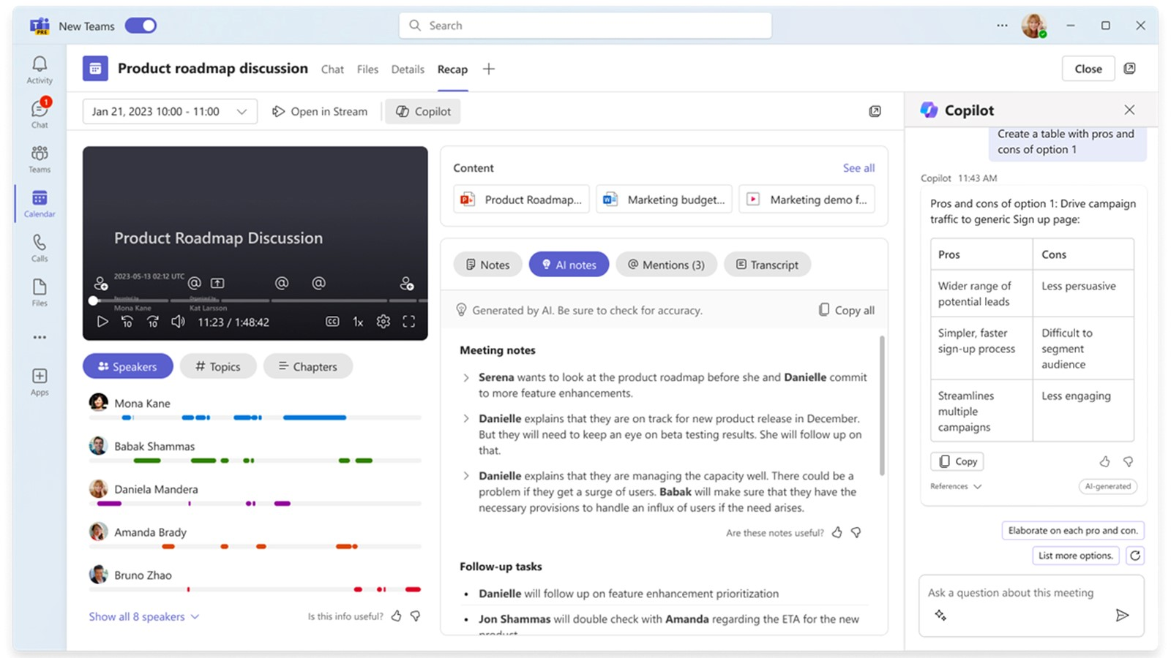
Teams Premium includes built-in summaries with intelligent recap. M365 Copilot expands on it with the ability to ask any question about the meeting
Intelligent recap
M365 Copilot
Built-in and automated
On-demand
Standardised
Based on unique prompts
Video, speaker, and chapter markers
Conversational interaction, with citations.
Available after meeting only
Available real-time
(during and after meeting)
Notes:
Let’s look at this in action by focusing on Intelligent recap, included today in Teams Premiums
Intelligent recap experience is a great way to get started because it is built-in and automated for all users, provides a familiar and standardized experience, segments the recording with video timeline markers, and is available after the meeting.
Copilot can expand on intelligent recap with the ability to ask any question about the meeting. Copilot, on the other hand, is on-demand, based on each user’s unique question or prompt, uses a conversational UI, and is available both during and after the meeting. Taking your insights and discovery to the next level.

Slide 22
Amanda uses intelligent recap to understand the key highlights of a missed meeting, then uses Copilot to progress her next steps
Intelligent recap
M365 Copilot
In order to start making progress on her task, she asks Copilot to organize the options discussed into a pros and cons table
She uses name mentions and speaker markers to hear about the task directly. And reviews the content shared using screenshare markers and Chapters.
First, Amanda skims the highlights on the Recap tab such as AI-generated notes and suggested tasks.
4
1
3
She notices a task was assigned to her
The table helps Amanda identify her preferred route, but she is curious how the rest of the team feels about that option. She asks Copilot how did the team react to option 2 to get a better sense of their sentiments during the meeting.
2
5

Slide 23
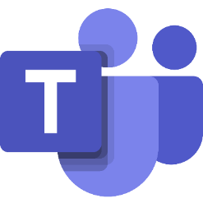

AI capabilities across licenses
Microsoft
Teams
Microsoft
Teams Premium
Microsoft
365 Copilot
AI capabilities deeply embedded in Teams | AI-based noise suppression | 
 | AI-based video optimization (brightness, backgrounds) | 
 | Suggested Replies | 
 | Live meeting captions and transcript | 
 | Cameo video overlay on screen share and PowerPoint Live | 
Meeting Experience | Real-time translation of meeting captions and transcript |  | 
 | Intelligent recap (after meeting) – standardized AI-notes and AI-tasks |  | 
 | Intelligent recap (after meeting) – video, speaker, and chapter markers |  | 
 | Ask any question about the meeting (available during and after meeting) |  |  | 
 | “How did the team react to this proposal?” |  |  | 
 | “Does this plan’s timeline have any conflicts?" |  |  | 
 | “Create a table with pros and cons of option 1” |  |  | 
Other capabilities | Microsoft Copilot UX |  |  | 
 | Bing Chat (LLM + Web) |  |  | 
 | Microsoft 365 Chat |  |  | 
 | Microsoft 365 apps |  |  | 
All licenses include Commercial Data Protection and Microsoft 365 Security, Privacy, and Compliance.
Notes:
We can talk about the bigger picture of how AI is infused throughout Teams at the different subscription levels.
-First, AI is already deeply embedded within the Teams platform. From automatic AI-based noise suppression and video optimization, to live meeting captions and Presenter Cameo and much more. The power of AI is already being used in so many of your core Teams experiences.
-Then we can look at how AI in the Teams app specifically can move up to the next level for more advanced experiences, available in Teams Premium. For example, real-time translation of meeting captions and transcript help break down language barriers. And of course the intelligent recap experience that we discussed in the previous section
-Staying within the Teams experience and the meeting experience, then we move up to Copilot which is your AI assistant at work that allows you to ask any question about the meeting, both during and after the meeting.
-Lastly, we can see that across other capabilities, and particularly all the other M365 apps, this is where Copilot value shines and goes beyond Teams.. It includes the M365 Chat which is a standalone experience that can query data across your unique environment, the Copilot conversational UI, and all the powerful ways that Copilot can help you navigate any task in all your other apps.

Slide 24
Licensing
Requires an O365/M365 base license that includes Teams
Commercial SKU introductory pricing SKU available till June 30th 2024 (30% discount)
NFP and Education discounted SKUs available
Which features are applied depend on the user’s role and license
  Organiser-based features: Applied at the organiser level. If the organiser has Teams Premium, the organiser-based features are shared and made accessible to the attendees only during the event. For example:
    AI-generated chapters in meeting recordings, Live translation for captions (40 languages)
    Meeting templates, custom meeting branding
    Watermarking, who can record, hide attendee names, labels, end-to-end encryption
    Custom lobby room for virtual appointments
    Manage attendee view, reminder emails, waitlists and approvals, RTMP-in for webinars
    Scale up to 20k attendees, custom emails for Town halls
  Attendee-based features: Applied at the attendee/user level. These features only benefit the Teams Premium licensed users. For example:
    AI-generated meeting notes and tasks, Personalised timeline markers in meeting recordings
    Custom organization backgrounds
  Admin-based features: Only accessible to Teams admins with a Teams Premium license. For example:
    Advanced collaboration analytics

Slide 25
Licensing
It can take up to 24 hours for Teams premium features to work after license assignment
The following features require admin-configuration after the licenses are purchased:
  Using end-to-end encryption on meetings up to 50 participants.
  Adding watermarks to meetings.
  Adding sensitivity labels.
  Preventing copy and paste in meeting chats.
  Using organisation customised backgrounds.
  Using organisation customised Together mode scenes.
  Admin must create the custom Together mode scene.
  Being assigned a custom policy package.
  Using organisation customised meeting templates.
  Seeing organisation customised branding.
  Using eCDN for town halls.
  Using RTMP-In.
  Customising Virtual Appointment lobby rooms with branding.
  Hiding attendees names from meetings and webinars.
  Using Priority account chat controls.

Slide 26
Resources
  Teams Premium
    Licensing documentation
    Download customer pitch deck
    Download one-pager
    Download partner guide use cases
    Download Copilot vs Teams Premium overview
    Download deployment guide
    Download user guide
  Town Halls
    Download town halls customer pitch deck
    Demo video
    Download quick-start guide
  All GTM resources

Slide 27
Dicker Data Webinar
Thank you
Purview Data Labelling Information protection
Notes:
Microsoft Teams Prem Thank you for your attendance and if you have any questions we will stop recording. Feel free to ask in the chat window.
HOW CAN WE HELP?

