Slide 1
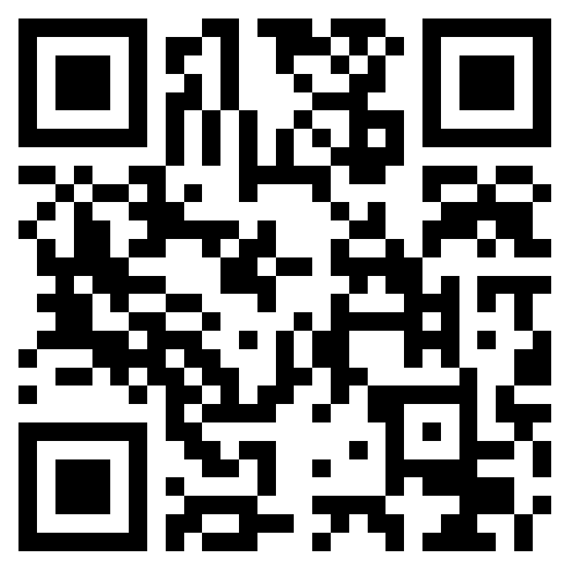
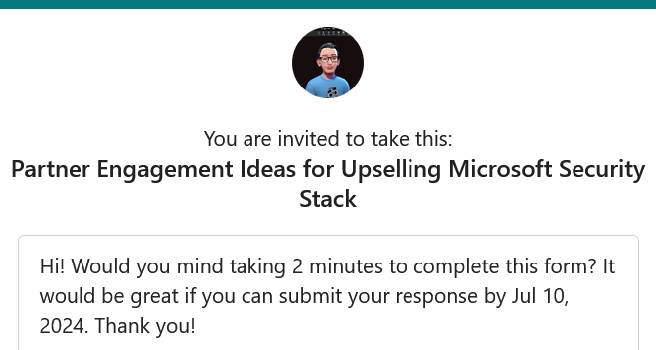
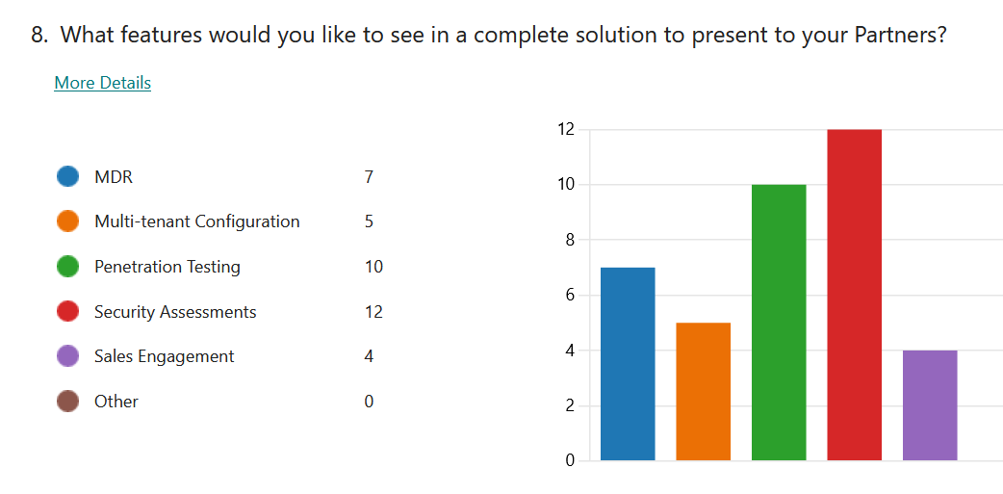
https://forms.office.com/r/MHRbtkRnDm

Slide 2
Dicker Data Webinar
Notes:
Thank you for joining will start shortly
MAKE SURE RECORDING IS ON

Slide 3

Agenda
1
News
2
Main Topic: Copilot Updates
3
Close
5
Code of Conduct
Notes:
For those of you new to Powerpoint live. A quick familiarisation, We welcome your reactions using the emotion icon at the top right of your screens. Please ask questions in the chat window during the call. We will invite you to come off mute at the end of the call if you would prefer to ask your question out loud. During the call, please ensure you are on mute, and your video is turned off.
All links to sites are available by clicking on the link in the slide or will be posted to the chat window. We recommend you click on all relevant links and then review post call.
Calls will be recorded and made available post call, The teams generated recording will not be available external so don’t panic we will make the recording available to you later .
Participation in these calls means that you agree to Microsofts terms and conditions for digital meetings a link is available on this slide should you wish to review these. or to test the live link feature
Introduce speakers Role and location

Slide 4



News
What you need to know
Notes:
But First The News. This is the section which is a concise update of relevant information, or opportunities compiled by Dickers subject matter experts. Who attend those early morning calls, wade through endless emails, yammer messages etc so you don’t have to

Slide 5
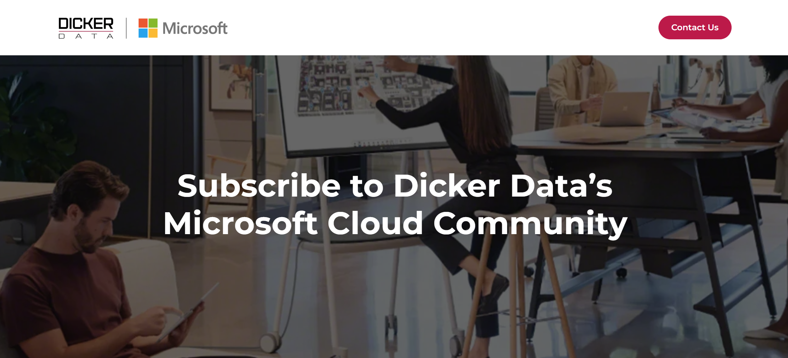
We have our own opt-in page for the Microsoft mailing list.
Notes:
NZ Only

Slide 6
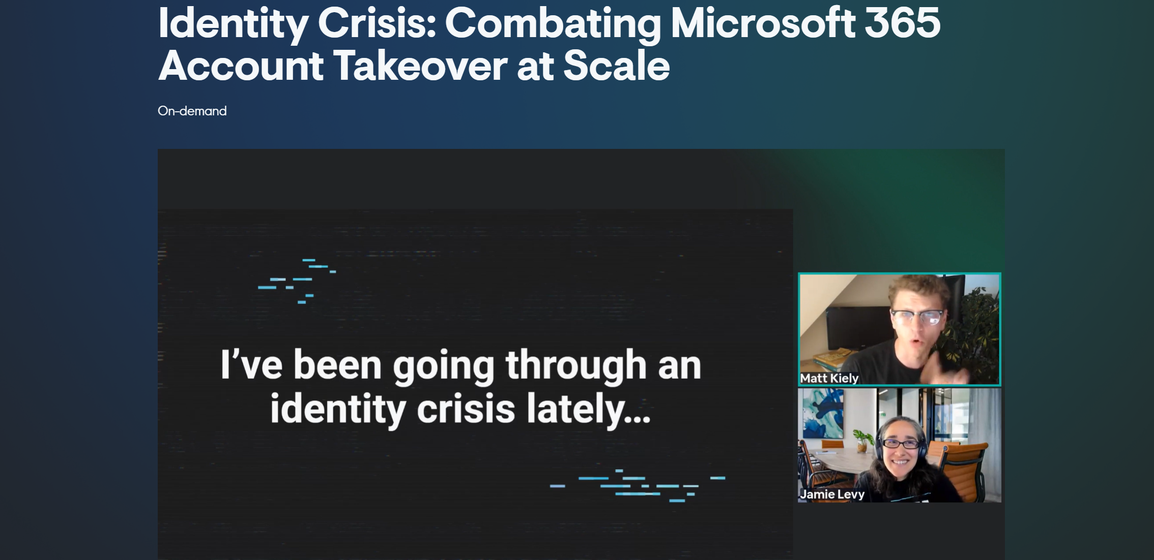

Slide 7
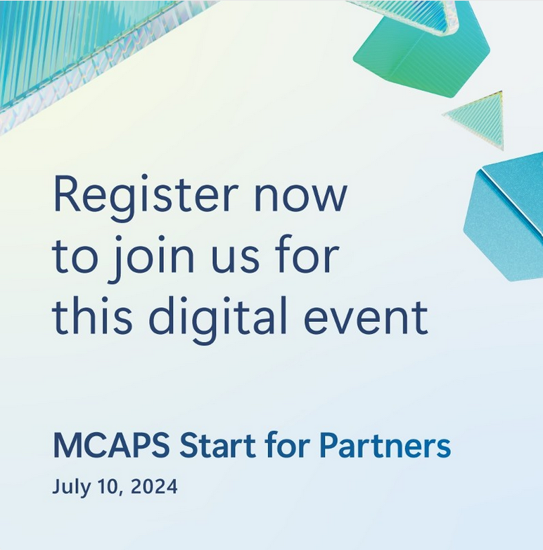
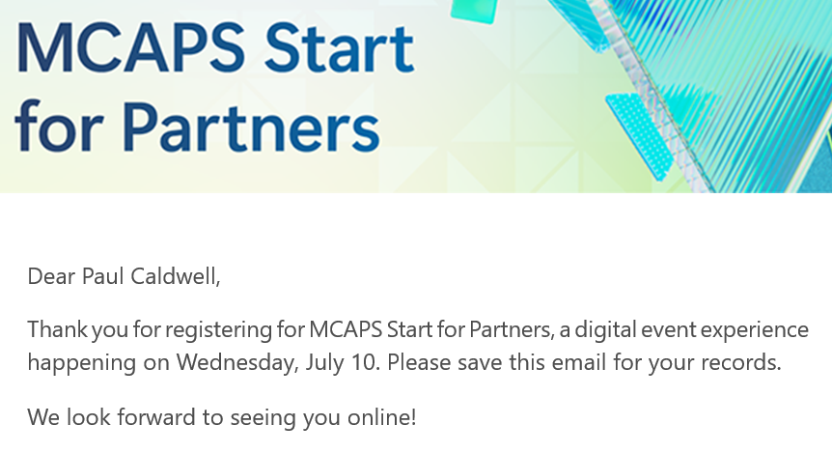
MCAPS Start
for Partners
Learn how we are empowering customers and partners through AI transformation, our strategic investments, new priorities, and key program changes for the fiscal year.

Slide 8
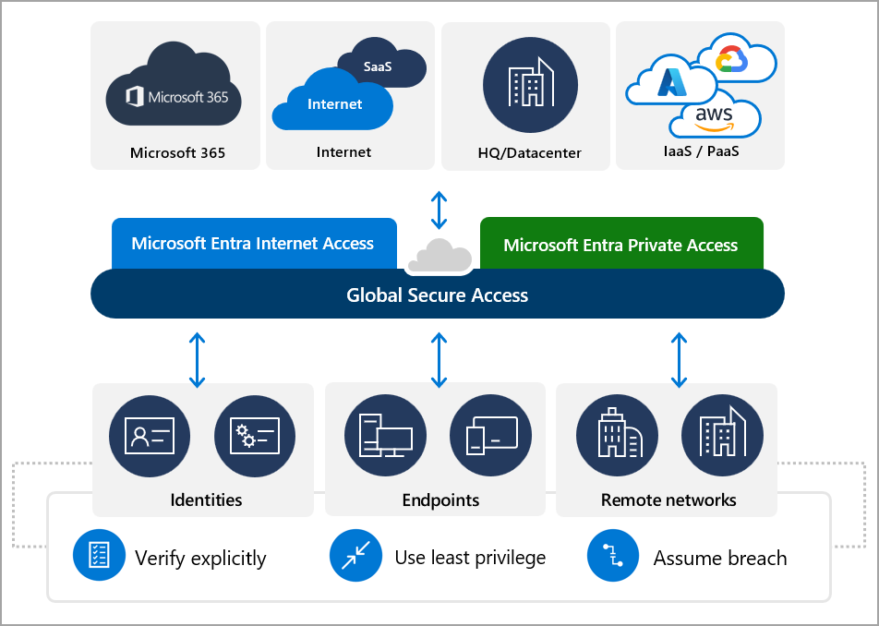
Microsoft Entra Global Secure Access is now in GA!
Microsoft Entra InternetAccess is great, but Microsoft Entra PrivateAccess is the star of the show. Private Access enables functionalities that would have sounded previously outlandish. For example, enforcing MFA when accessing on-prem resources such as SMB file shares, or accessing on-prem resources with a device that is not even connected to the on-prem domain.

Slide 9
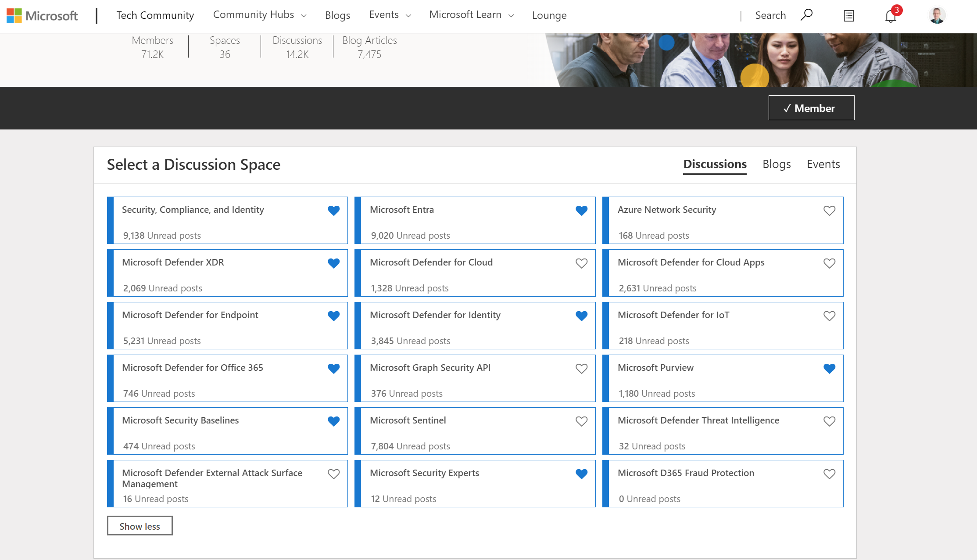

Slide 10
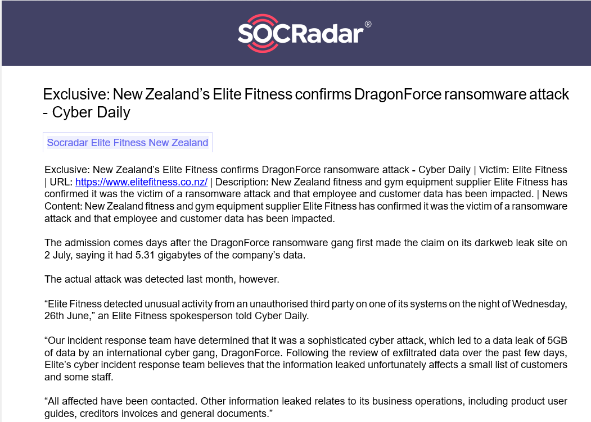

Slide 11
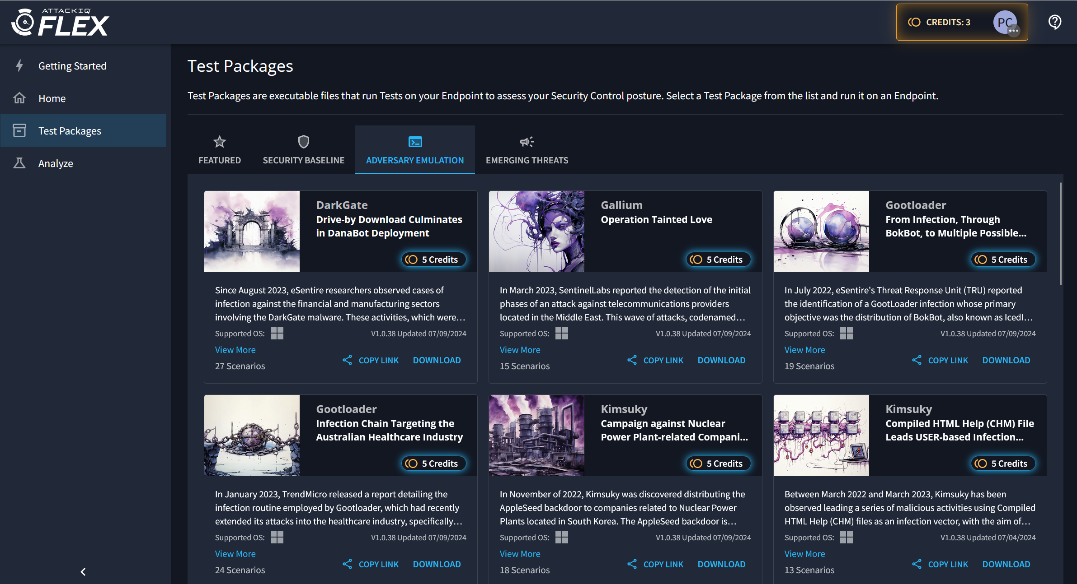
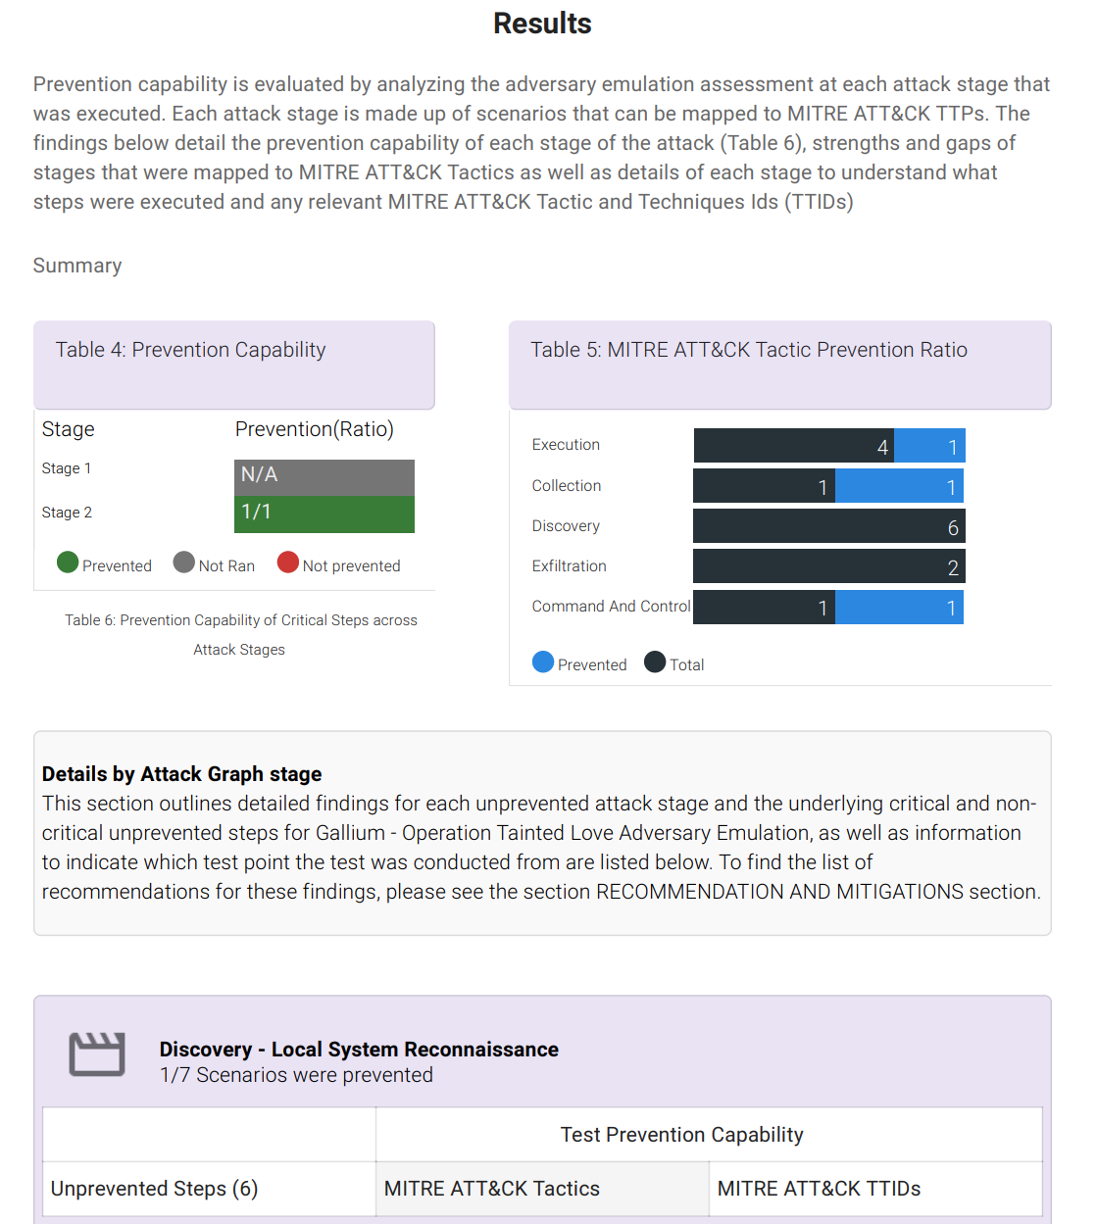
Breach and attack simulation (BAS) solutions

Slide 12
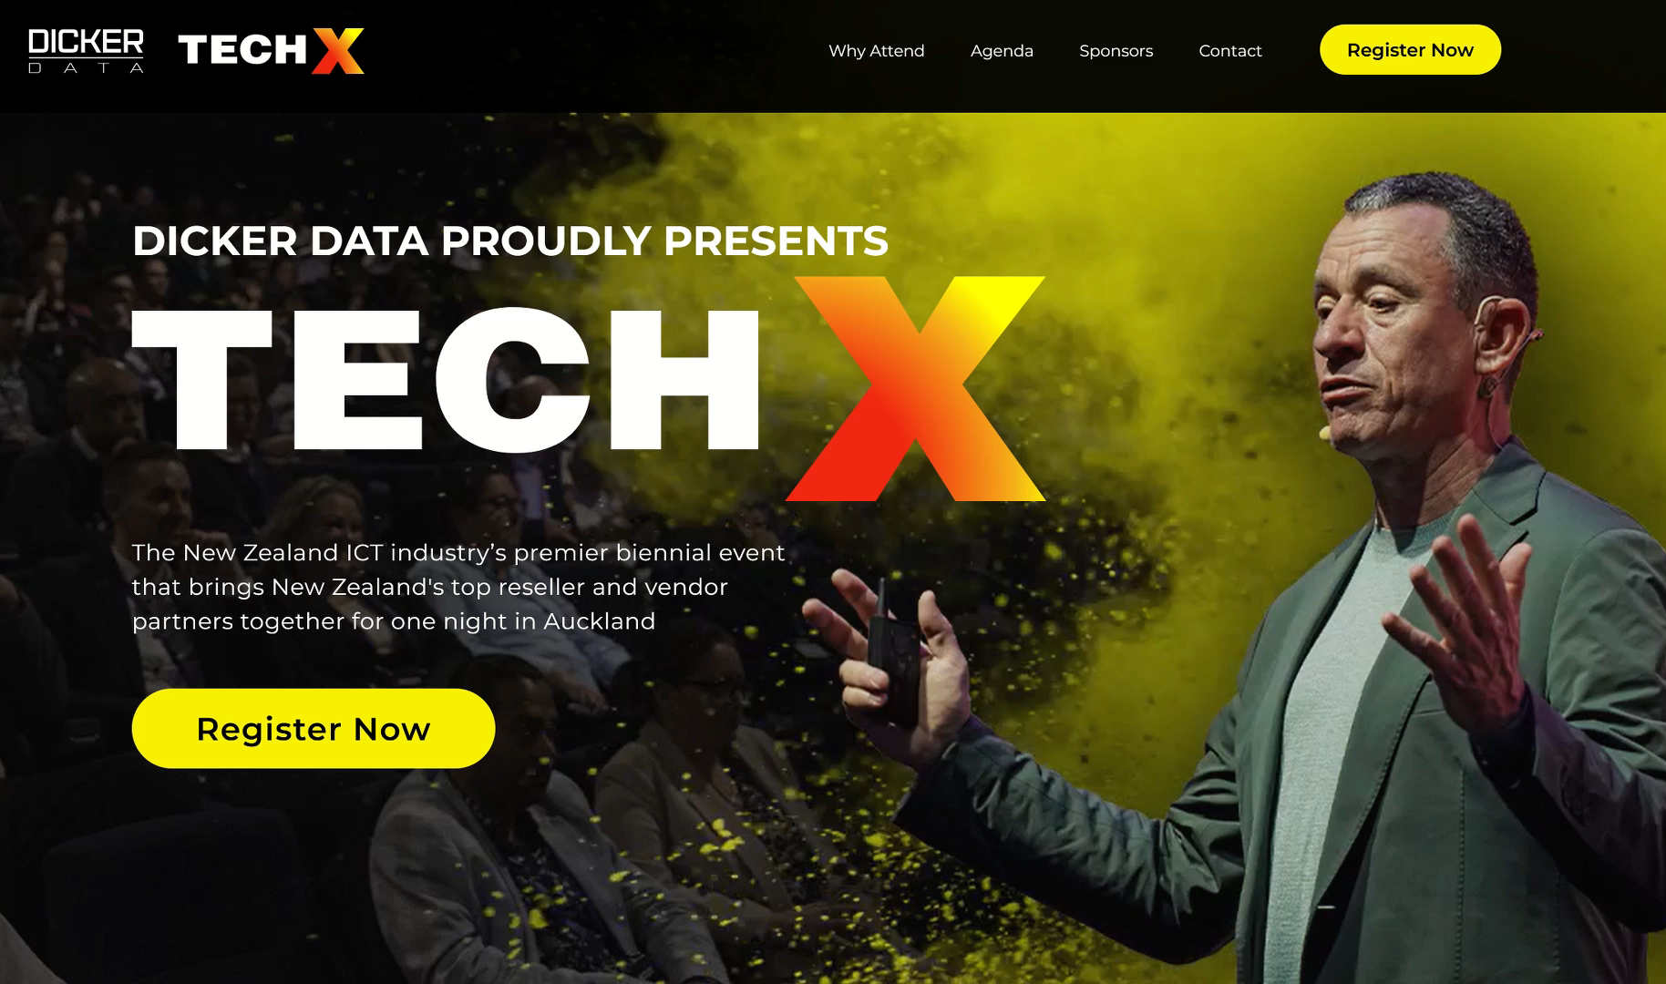
NZ
AU

Slide 13
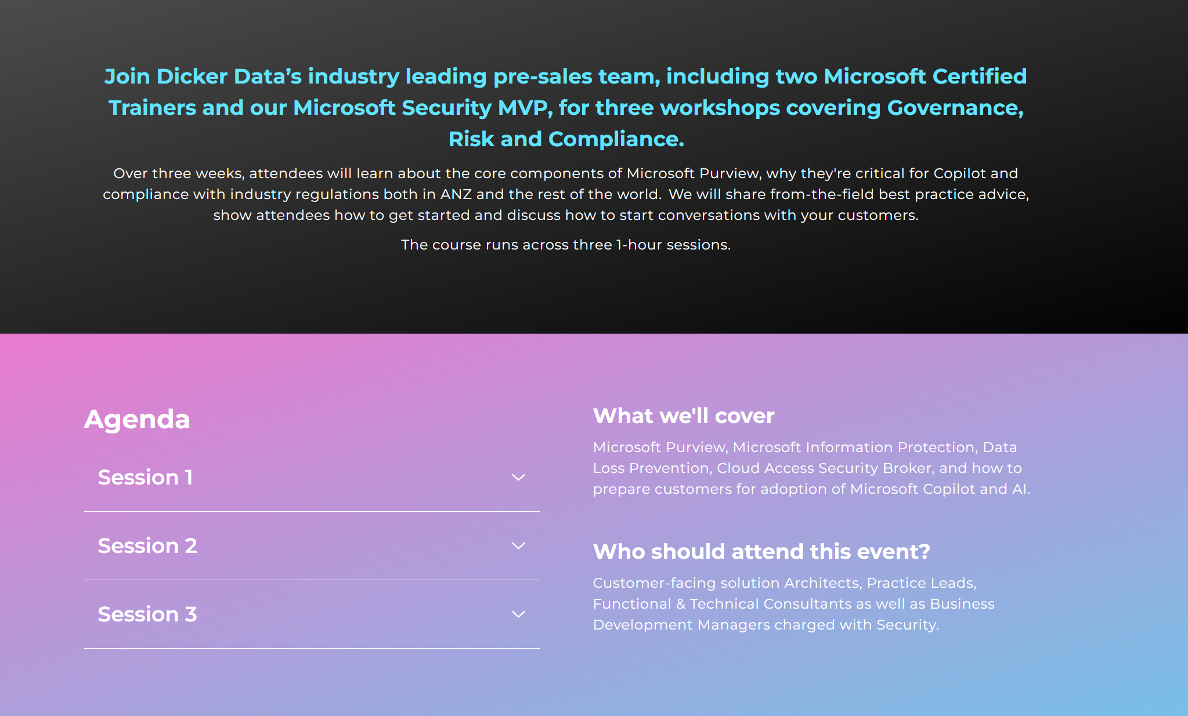
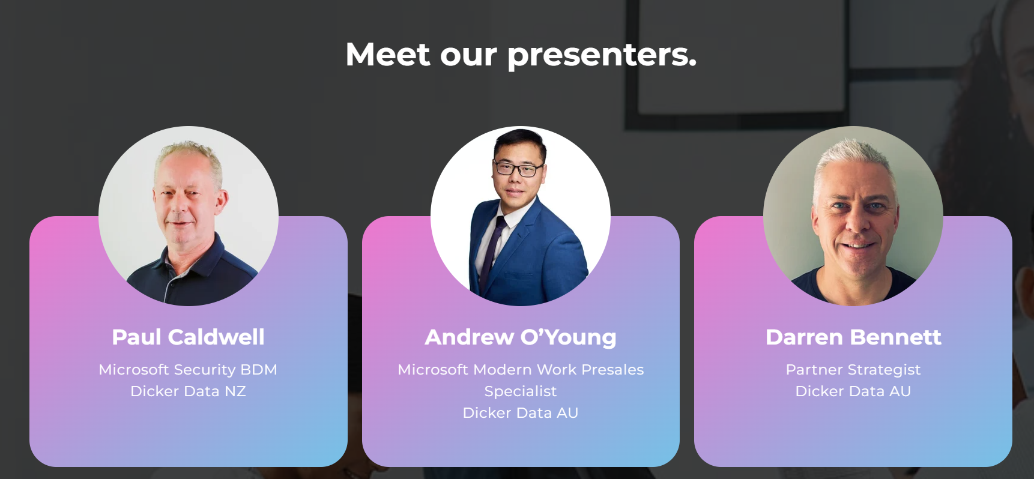
New Zealand
AU
Notes:
EDM coming soon aulink THURSDAY 4TH July
11th 18th

Slide 14


AuSAE - Future-Proofing NFP: Harnessing AI and Digital Tools
Join us for an event dedicated to future-proofing New Zealand’s not-for-profit (NFP) sector by harnessing the power of AI and digital tools.
Notes:
NZ ONLY

Slide 15
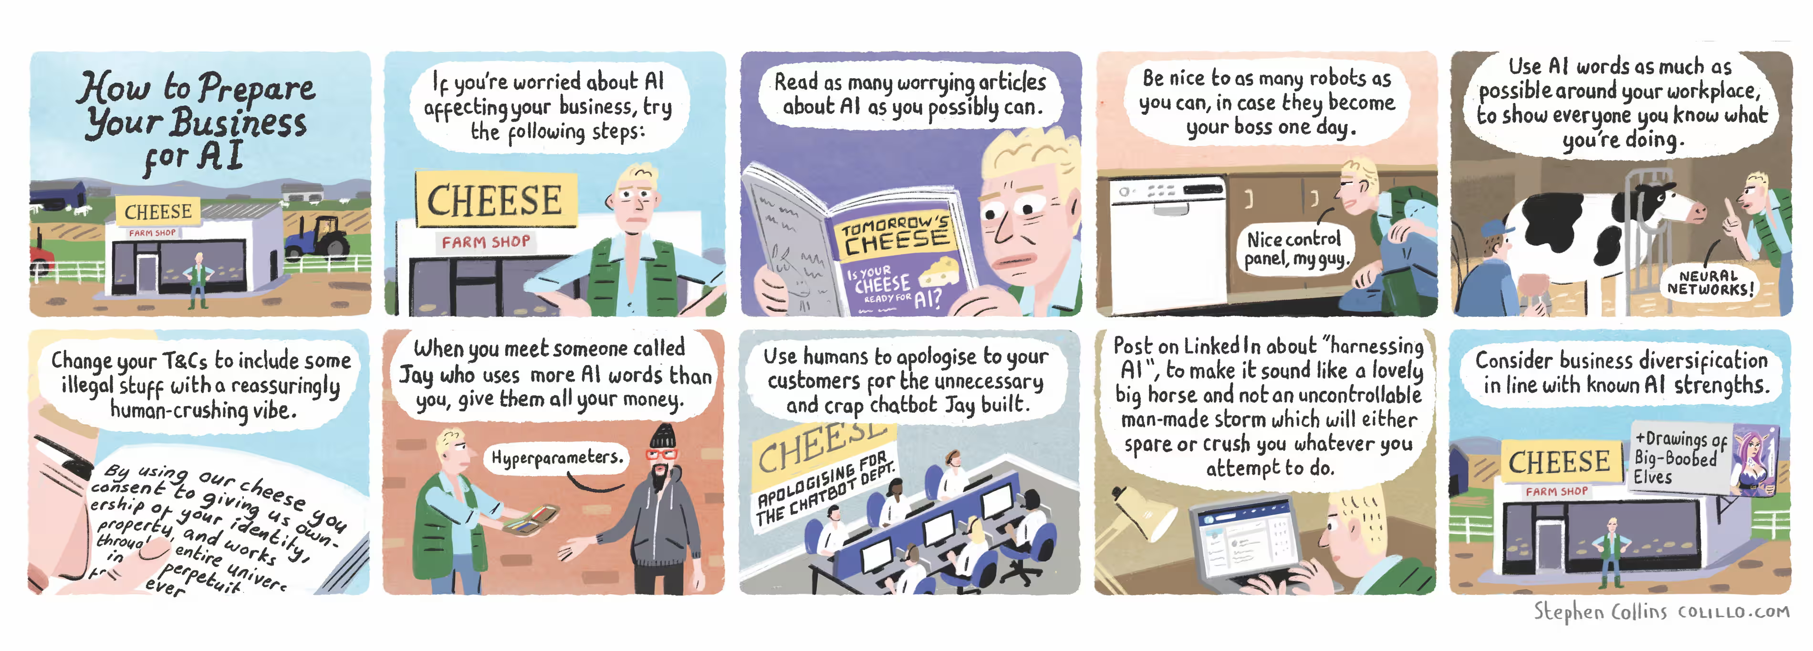
Be nice to robots: how to prepare your business for AI – the Stephen Collins cartoon

Slide 16


Copilot Updates – What’s happened since our last Copilot OnPoint back in March?!
Lauren Nobbs
Agenda:
Licensing & Subscriptions
Security Add-ons
New Copilots
New Features
  Copilot in Outlook
  Copilot in Word
  Copilot in Excel
  Copilot in PowerPoint
  Copilot in Teams
  Restricted SharePoint Search
Roadmap
New Tools
  Copilot Dashboard
  Copilot – Viva Learning
  AI Hub
How Dicker can help

Slide 17
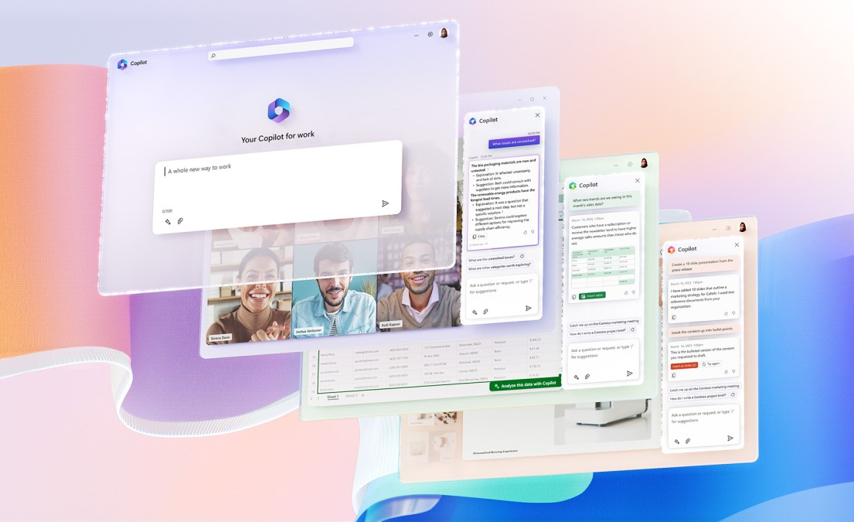
Co-terming
  Copilot for Microsoft 365 can only be purchased on an annual term subscription, annual billing
  Currently, there are no trials available
  You can co-term your Copilot for Microsoft 365 subscription to a base annual subscription – this allows you to align the subscription renewal dates
  The Copilot for Microsoft 365 subscription charge is prorated when you co-term it to a subscription with an expiry date less than 12 months away

Slide 18
Licensing Prerequisites
  No NFP licenses available
  Faculty and Higher Education Student (18+) licenses available
  Microsoft 365 Basic/Standard/Premium
  M365 E3/E5/A3/A5/F1/F3
  O365 E1/F3/E3/E5
  Microsoft 365 Apps for business and enterprise
  Microsoft Teams Essentials, Enterprise, and EEA
  Exchange Kiosk, Plan 1, and Plan 2
  SharePoint Plan 1 and Plan 2
  OneDrive for Business Plan 1 and Plan 2
  Microsoft Planner Plan 1 (formerly Project Plan 1)
  Microsoft Project Plan 3 and Plan 5
  Project Online Essentials
  Visio Plan 1 and Plan 2
  Microsoft ClipChamp

Slide 19
There are MORE Copilots
Copilot in Finance
Team Copilot
Copilot in Planner
Copilot+ PCs
Copilot in Fabric is GA
Copilot in Forms
Copilot in Whiteboard
Copilot in Stream
Copilot in SharePoint (Aug 2024)
Copilot in OneDrive (July 2024)
Notes:
Copilot for Finance
In Outlook, it supports the collections process. Users can connect to Microsoft Dynamics 365 Finance directly from Outlook to gain easy access to valuable insights from customer data in the ERP system, get help when they craft email responses, and save communication summaries and action items for scaled impact.
In Excel, Copilot for Finance enables more streamlined data reconciliation. Users get Copilot support to help them reconcile their financial data by using Excel. This support includes intelligent prompts when financial data structures are compared, automated reconciliation report creation, and automatically generated insights and suggestions for possible ways to address discrepancies. The reconciliation report summary and documented action items are automatically prepared and available and can be saved for future reference and auditing purposes. Copilot for Finance in Excel can be used with financial data users bring in from a multitude of the financial systems, including ERP and FP&A solutions.
Team Copilot
Works across Teams, Loop and Planner
Acts as a team member in Teams meetings
Managing the agenda (can track time for agenda items) and taking notes during the meeting that attendees can co-author
Collaborates in the chat – surfaces relevant information, tracks action items and addressing unresolved issues
In planner is helps manage projects by assigning tasks, tracking deadlines, and notifying team members when their input is needed.
available in preview later in 2024 for customers with a Microsoft Copilot for Microsoft 365 license.
Copilot in Planner
Copilot in Planner (preview) is rolling out to users with a Project Plan 3 or Project Plan 5 license
Help you get started with a plan – Copilot can take a natural language prompt and generate a plan for you, including goals, tasks and subtasks, and buckets
Help you manage your plan – As your plan evolves, Copilot can help suggest new tasks for you based on your new goals and keep you organized with new buckets where needed. Copilot can even help you add goals to your plan and generate tasks to achieve those goals
Help you track progress – Copilot can answer questions about your plan and help you stay informed about the latest developments
Copilot in Power BI
Copilot in Power BI is not available with the Power BI user licenses
Copilot in OneDrive
Ask questions about files in your onedrive without having to open them
• What were the total beverage sales last week? Put response in a table view by day.
• Compare the main differences between the selected files and put the differences in a table view.
• What are the pros and cons of project Moonshot?
Get help with finding files
I’ve been on vacation for a week. Show me recent files on Project Moonshot.
•What files should I read to get started on project SkyDance?
Create outlines, tables, and FAQs from your content: You can take things to the next level by asking Copilot to create content based on existing files using prompts like these
Using the /sales-enablement.docx as reference, create an outline of a sales pitch to a new customer.
For these selected resumes, create a table with names, current title, years of experience, educational qualifications, and current location.
Create a list of frequently asked questions about project Moonshot.
Look at /proposal1.docx and /proposal2.docx and create a table outlining the differences in cost, milestones, and date of delivery.
Improve content: Have a document, spreadsheet, or presentation that you want to improve? Try these prompts
What suggestions do you have to improve the deck /new-sales-process.ppt?
What improvements should I make to this selected file to prepare it for a leadership review?
Generate file summaries: Need a quick overview? Copilot can summarize the contents of one or multiple files, including PDFs, offering you quick insights without the need to sift through each file. Try prompts such as1:
Summarize the key points from moonshot-plan.pdf, Moonshot-timeline.docx, moonshot-GTM.ppt
Summarize long-industry-report.pdf. List out its 3 main points and tell me about the industry risks and open questions.
Copilot in SharePoint
Copilot in SharePoint combines the power of Large Language Models (LLMs), your data in the Microsoft Graph, and best practices to create engaging web content. Get assistance drafting your content when creating new pages. Adjust the tone, expand meeting bullets into structured text, or get help making your message more concise. All within our existing commitments to data security and privacy in the enterprise.

Slide 20
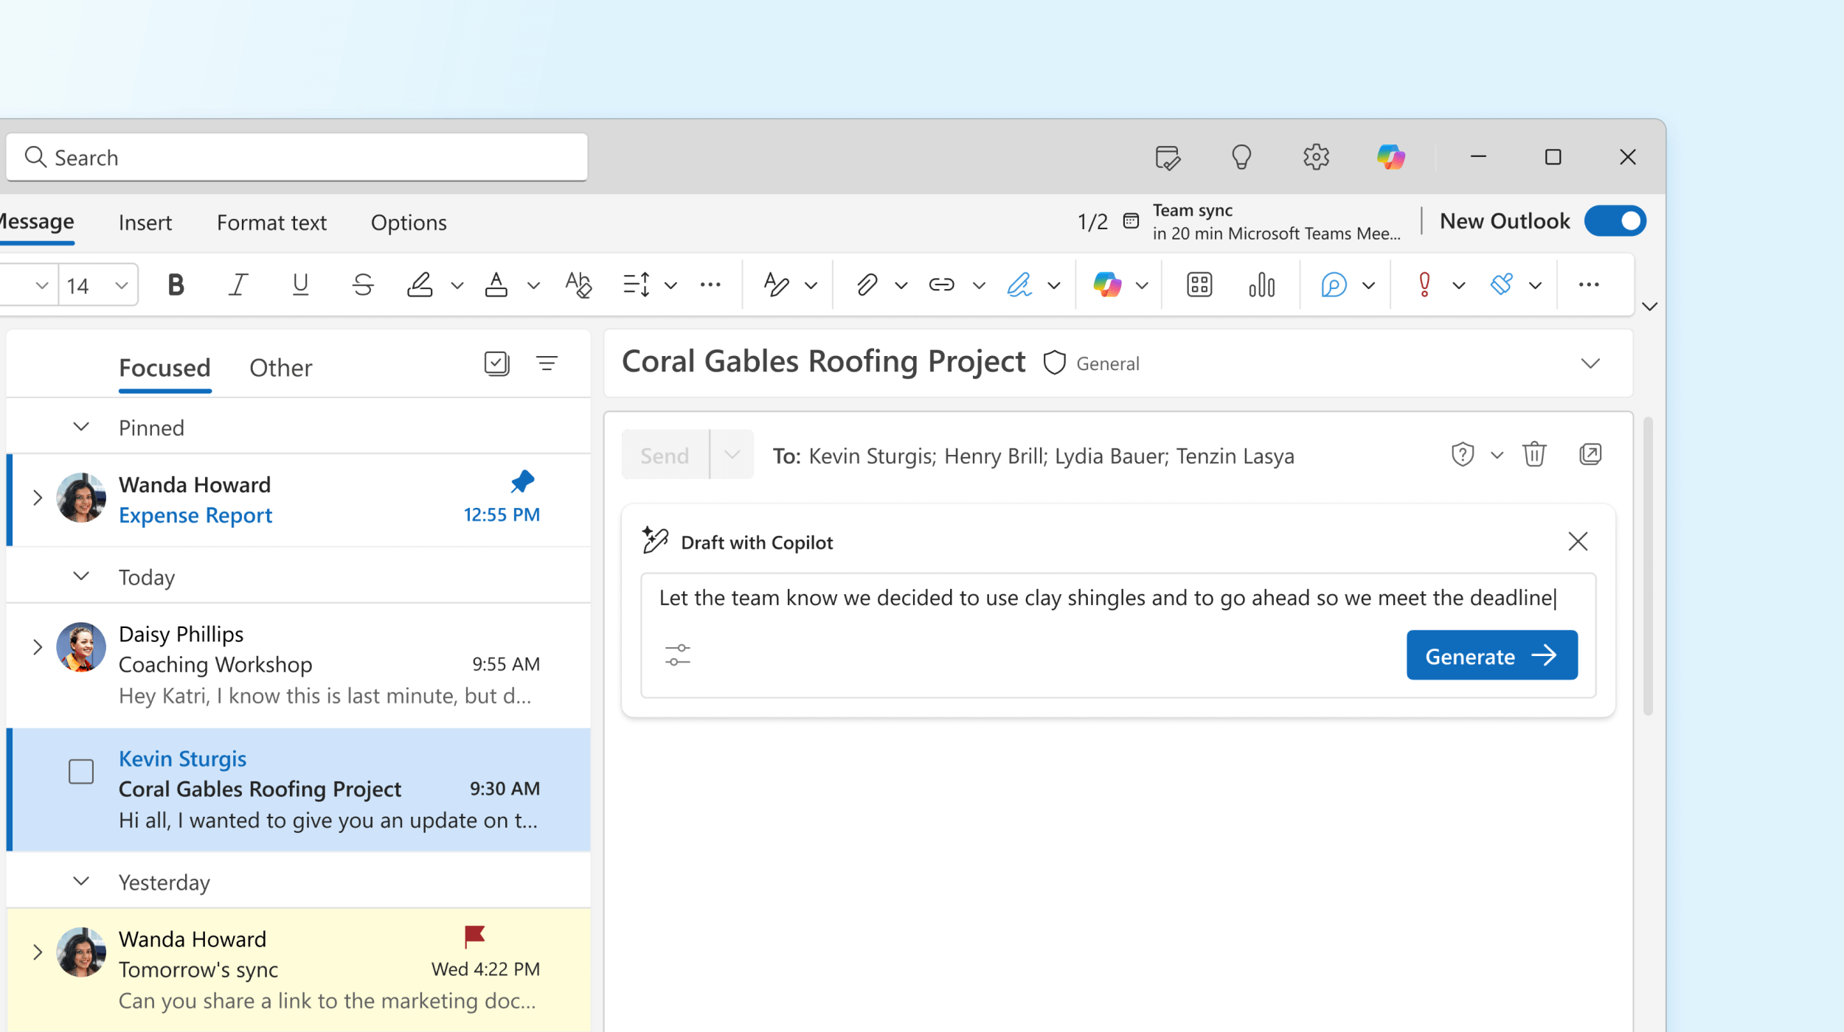
Copilot in Outlook
Draft with Copilot is available in classic Outlook
Copilot with Graph-Grounded Chat is now available in Outlook (web, new, & classic)
Notes:
Copilot with GGC in classic Outlook – may need to update license!

Slide 21
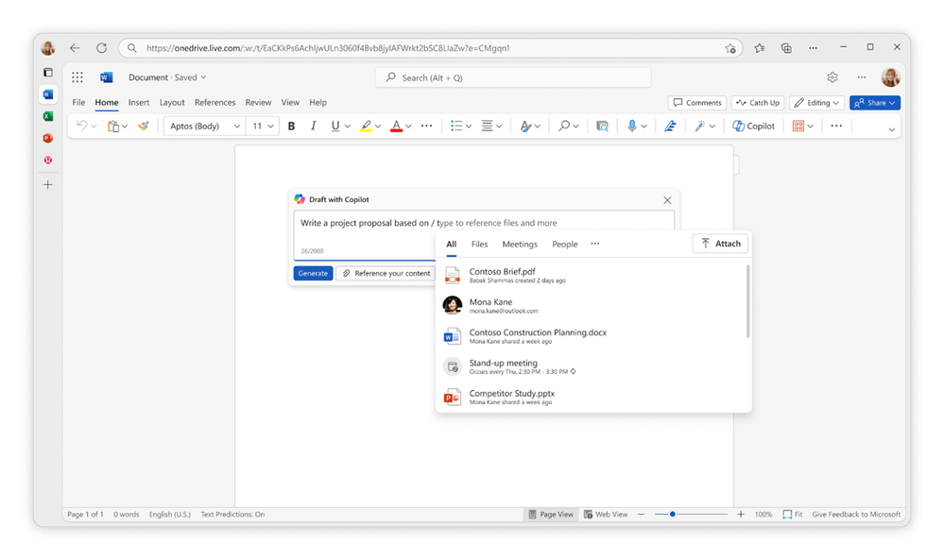
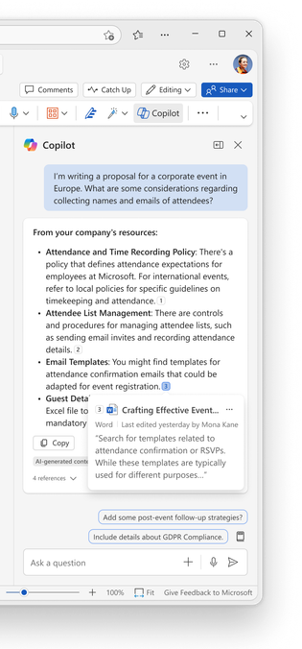
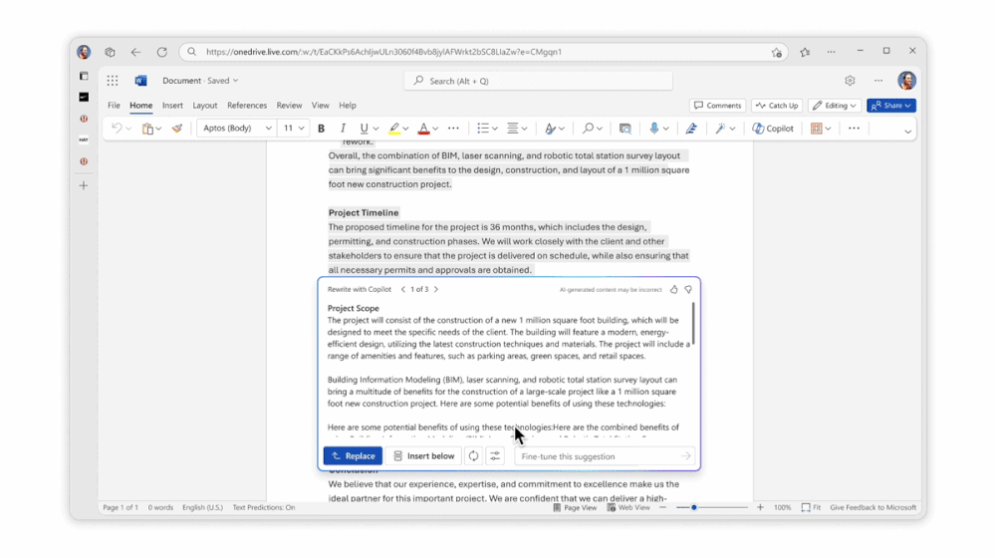
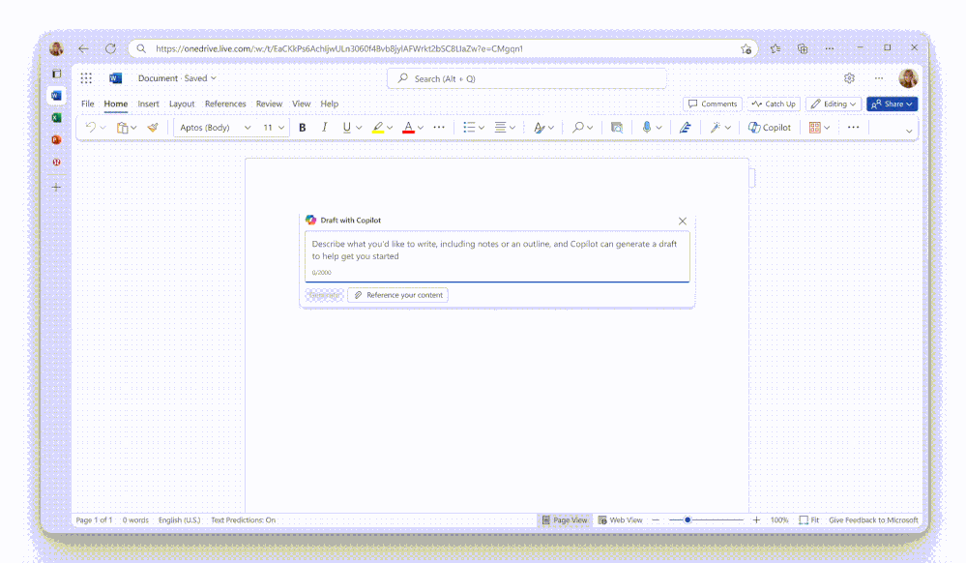
Copilot in Word
Graph-grounded search available in Copilot chat in Word
Re-write specific sections of content with the ‘Rewrite with Copilot’ feature
When using Draft with Copilot and referencing files, if the file referenced is labelled, the label will be automatically inherited on the new content generated
Use the Copilot chat to create summaries of selected text (web)
Add images to word documents – AI-generated images or stock photos
Reference PDFs and Microsoft Cloud Information (specific mails, chats, meetings, and people)
Copilot generated summaries when sharing documents
Notes:
Copilot with GGC in classic Outlook – may need to update license!
Add images to documents
Uses Microsoft designer
Prompt:
Find me an image of….. Will pull a stock images
Create me an image of…will create an AI-generated image using Dalle-3
Reference files – you can now also reference PDFs, and specific meetings and emails. Used to just be word and ppt docs. Referencing Microsoft Cloud information, starting with emails and meetings, is rolling out. Personally I can reference PDfs now but not cloud info yet. The limit is still three files.
Summaries on selection of text might not actually rollout till October – it’s not there for me yet

Slide 22
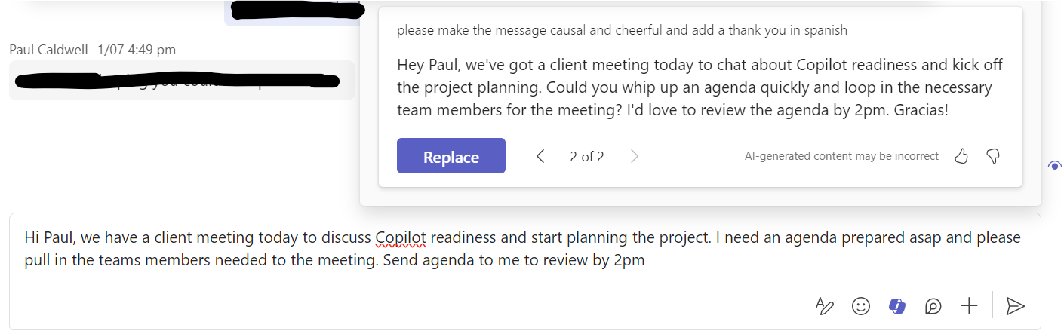
Copilot in Teams
Meeting organisers can control which attendees can access meeting recordings, transcripts, and copilot features
Manage Copilot availability in meetings – On or On with Retained Transcript
Intelligent recap on transcript only meetings
Intelligent recap on VoIP and PSTN calls
Use Copilot to transform your Teams chat
  Rewrite messages with Copilot
  Adapt your message to the audience with ‘Adjust’
  Set a ‘Custom tone’ to choose exactly how you want Copilot to rewrite the message
Notes:
Copilot in Teams Messages
Rewrite: goes beyond spell-checking and grammar correction; Copilot also suggests improvements, rewrites, and adjustments to enhance the clarity, tone, and impact of your messages
Adjust: change the length (concise or longer) or the tone (casual, professional, confident, or enthusiastic) of your message (doesn’t require a prompt)
Custom tone: expands on the adjust feature by giving you the freedom to choose how you want Copilot to rewrite your message
Meetings
Meeting organisers can control which attendees can access meeting recordings, transcripts, and copilot features
Choose (1) Everyone (2) Organizers and Co-organizers, or (3) Specific People. Set this in meeting options. Default is everyone.
Copilot On or On only with retained transcript from the dropdown for the Copilot setting:
When you select On and a meeting organizer with this policy creates a meeting or event, then the Copilot option is set so it is available Only during the meeting. The meeting organizer can change this value to During and after the meeting.
When you select On only with retained transcript and a meeting organizer with this policy creates a meeting or event, then the Copilot option is locked to During and after the meeting and the meeting organizer must turn on transcription to use Copilot.

Slide 23
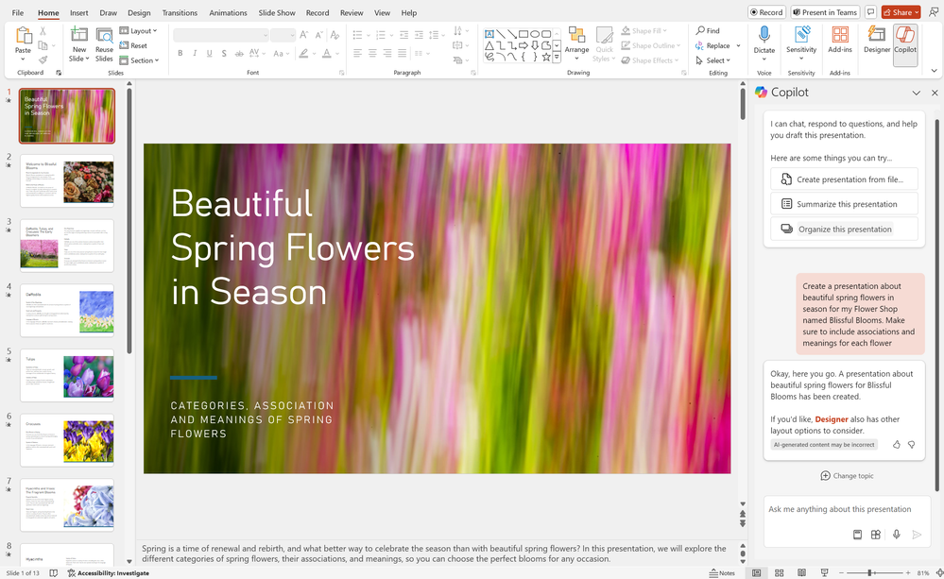
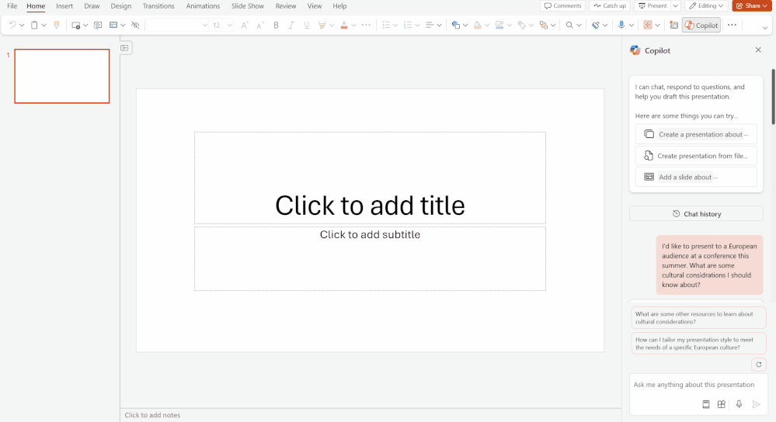
Copilot in PowerPoint
Create PowerPoint presentation from a PDF or encrypted word document
Copilot chat in PowerPoint can now generate responses using data from the Microsoft cloud, Microsoft Graph, and Microsoft Bing search
Copilot in PowerPoint will now create higher quality presentations with these improvements:
  Refined designs for title, section, and content slides
  Robust presentation structure with agenda, section and conclusion slides
  Elegant transitions and animations throughout the presentation

Slide 24
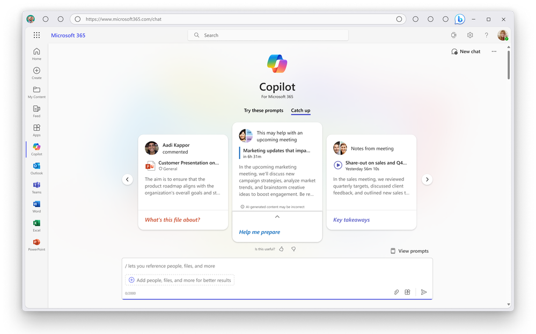
Copilot for M365
Use local files to ground Copilot prompts
New supported languages - Arabic, Czech, Danish, Dutch, Finnish, Hebrew, Hungarian, Korean, Norwegian (Bokmal), Polish, Portuguese (Portugal), Russian, Swedish, Thai, Turkish, and Ukrainian.
Notebook is like an enhanced scratch pad that lets you fine-tune your prompts - it allows for longer prompts
Copilot in Forms – use Copilot to help drive more responses by generating reminders
Catch-up in Copilot chat offers suggestions to help you prepare for your workday – e.g. documents that might help you prep for a meeting, meeting notes, comments added to files
Copilot in Loop components – use Copilot in the component directly
Notes:
Notebook
18k character limit instead of 4k
Only available in web, not work

Slide 25
Restricted SharePoint Search
This is intended as a temporary solution to give you time to review and audit site permissions, while implementing robust data security solutions from Microsoft Purview and content management with SharePoint Advanced Management.
  IMPACT
  Restricted SharePoint Search disables organization-wide search, while allowing you to select sites that you trust. This means users in your organization can use Copilot to reason over:
  An allowed list of curated SharePoint sites set up by admins (up to 100 SharePoint sites), honoring existing permissions on a site
  Users’ OneDrive for Business, chats they are part of, emails they send and receive, calendars to which they have access, etc.
  Files that are shared with, and accessed by users
  Content from users’ frequently visited sites
  Turning on Restricted SharePoint Search does not affect the site’s index or associated DLP and labeling policies.
  Access this blog for more info.
  Restricted SharePoint Search is designed for organizations particularly concerned about unintentional oversharing of content
  When enabled, Copilot experiences and organization-wide search are limited to a select set of SharePoint sites, as well as the individual user’s files and content
  PREREQUISITES
  Available to tenants with Copilot for Microsoft 365 subscriptions
  Activation requires Global/Tenant/SharePoint admin rights
Notes:
SharePoint Restricted Search allows you to create a curated list of up to 100 SharePoint sites that Copilot is allowed to search. The idea of it is to allow customers to comfortably rollout Copilot for M365 by buying them time to review and correct SharePoint site permissions for sites with sensitive/confidential content.
If Restricted SharePoint Search is enabled, your experience will be impacted in the following ways:
Search results and Copilot search results will be limited (enabling this feature impacts the search experience, even for non-Copilot users). Users will be able to discover content from:
An allowed list of curated SharePoint sites set up by admins (with up to 100 SharePoint sites), honoring sites’ existing permissions.
Content from their frequently visited SharePoint sites.
Users’ OneDrive files, chats, emails, calendars they have access to.
Files that were shared directly with the users.
Files that the users viewed, edited, or created.
Copilot will have less information available to reference, which may impact its ability to provide accurate and comprehensive responses to prompts.
Users within the organization will see the following banner on Copilot experiences: Your organization's admin has restricted Copilot from accessing certain SharePoint sites. This limits the content Copilot can search and reference when responding to your prompts.
Hub sites - Only the hub site (the URL in the Allowed list) is included in the 100. The sub sites under the hub site aren't counted against the 100 limit but RSS is effective on the sub sites.
RSS will go into effect within an hour after it's enabled.
The allowed list is configured via PowerShell.

Slide 26
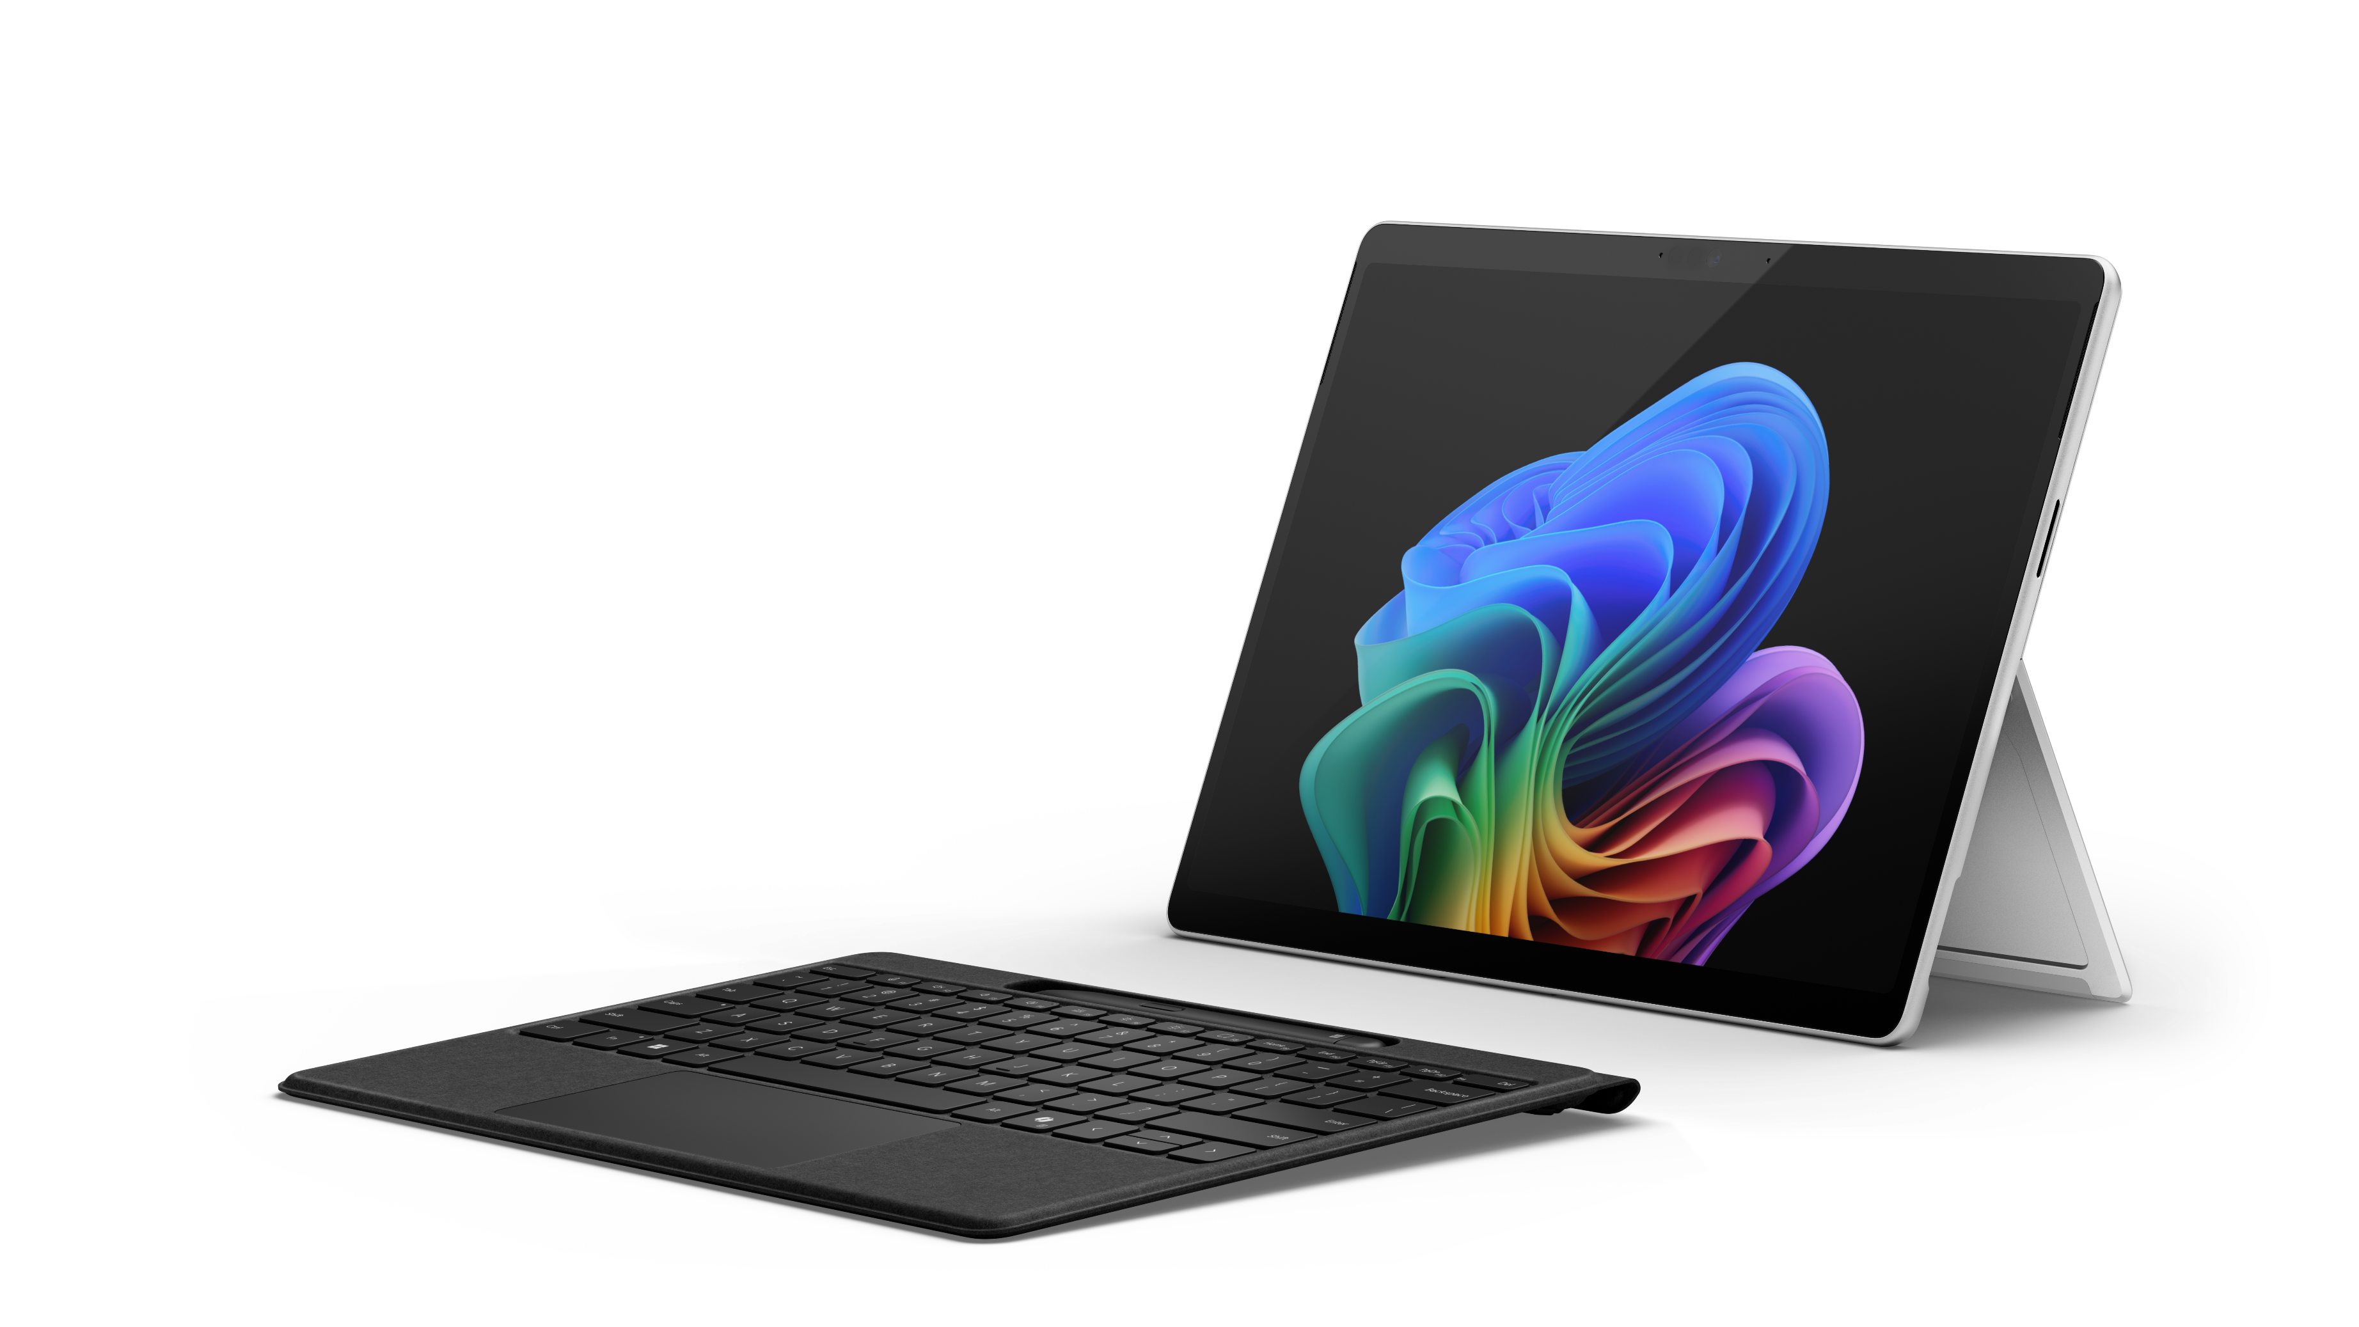
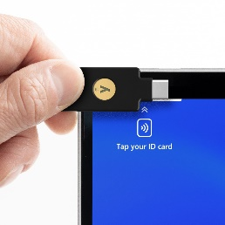


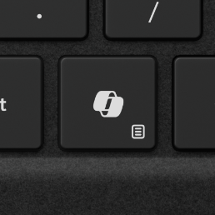
Surface Pro
Built-in
NFC reader¹
Ultrawide front-facing camera and unique AI Windows Studio Effects
On-device AI helps find almost anything fast with Recall¹¹ and empowers collaboration with real-time translation of 40+ languages to English with Live Captions¹⁰
Pioneering versatility matched by intelligent power
PixelSenseTM Flow Touchscreen display with optional OLED and HDR,¹⁴ adaptive color, and adaptive contrast
Snapdragon® X Elite and Plus processors with NPU driving up to 45 TOPS for on-device AI
Transfer data fast or support up to three 4K monitors with
USB-C®/USB4.®⁷ Wi-Fi 7 capable⁹
14 hours of battery life and built-in power-saving features⁵
Made with a minimum of 72% recycled content in the enclosure³
Copilot key for quick access in Windows 11 Pro⁶
Notes:
Last month we talked about AI PC’s – which are devices NPU’s made for running AI workloads such as copilot, auto-focus, background blur, eye contact correction. You use AI today if you use background blur. By offloading to NPU, you have a better experience when running teams, especially when doing powerpoint presentation.
Today I want to talk about Copilot + PC’s – particularly the recall feature.
Recall periodically takes a snapshot of what appears on your screen. These images are encrypted, stored and analyzed locally, using on-device AI capabilities to understand their context. When logged into your Copilot+ PC, you can easily retrace your steps visually using Recall to find things from apps, websites, images and documents that you’ve seen, operating like your own virtual and completely private “photographic memory.” You are always in control of what’s saved. You can disable saving snapshots, pause temporarily, filter applications and delete your snapshots at any time.
opt-in to saving snapshots using Recall. If you don’t proactively choose to turn it on, it will be off by default.
Windows Hello enrollment is required to enable Recall. In addition, proof of presence is also required to view your timeline and search in Recall.
adding additional layers of data protection including “just in time” decryption protected by Windows Hello Enhanced Sign-in Security (ESS) so Recall snapshots will only be decrypted and accessible when the user authenticates. In addition, we encrypted the search index database.
Snapshots are stored locally
Recall doesn’t share snapshots with Microsoft or any other 3rd party companies or apps.
Other users signed into the device can’t access the snapshots and per-user encryption ensures even administrators cannot view other users’ snapshots.
Digital rights managed or InPrivate browsing snapshots are not saved.
You can pause, filter and delete what’s saved at any time.
For customers using managed work devices, your IT administrator is provided the control to disable the ability to save snapshots. However, your IT administrator cannot enable saving snapshots on your behalf. The choice to enable saving snapshots is solely yours.
Purpose: To introduce a more detailed view of Surface Pro.
Script:
Unlock high performance in a form factor that redefines what a laptop can do. The brilliant display and adjustable kickstand combined with a Surface keyboard make work comfortable in more places. Turbo-boost productivity with Snapdragon®X Elite and Plus processors for seamless on-device AI—and a battery that runs all day on one charge.⁵ From security to serviceability, Surface Pro is tailored for trust to help your business outperform.
Footnotes:
1 NFC is available on Wi-Fi configurations of Surface Pro 10 and Surface Pro.
3 Enclosure includes Bucket and Kickstand. 100% recycled aluminum alloy in Bucket and Kickstand. 100% recycled rare earth metals in magnets. Based on validation performed by Underwriter Laboratories, Inc. using Environmental Claim Validation Procedure, UL 2809-2, Second Edition, November 7, 2023.
5 Based on local video playback test. Battery life varies significantly based on device configuration, usage, network and feature configuration, signal strength, settings, and other factors. See aka.ms/SurfaceBatteryPerformance for details.
6 Feature availability varies by market, see aka.ms/WindowsAIFeatures. When Copilot for Windows is not available or enabled on the device, pressing the Copilot key will launch Windows Search.
7 Supporting 3 external displays requires either 2 displays connected to a compatible dock or connected through daisy chain.
9 6GHz band not available in all regions
10 Currently supports translation for video and audio subtitles into English from 40+ languages. See https://aka.ms/nextgenaipcs.
11 Optimized for selected languages (English, Chinese (simplified), French, German, Japanese and Spanish). Content – based and storage limitation applied. https://www.microsoft.com/windows/.
14 HDR requires HDR content and enabling HDR in device settings.

Slide 27
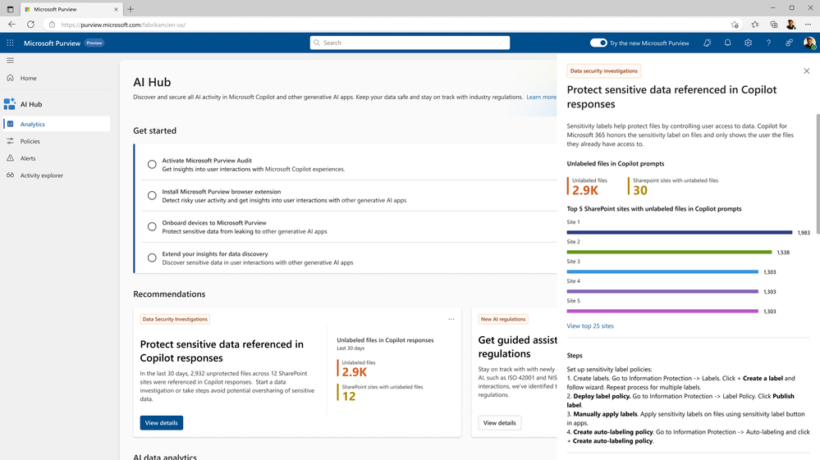
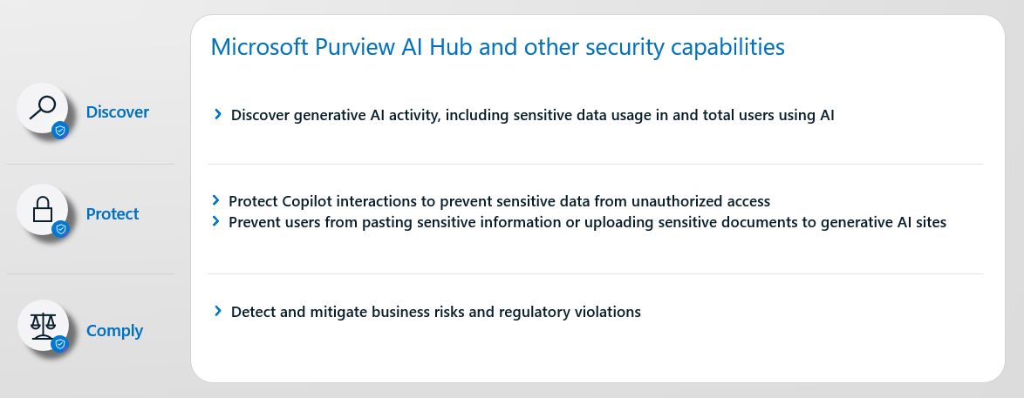
Purview AI Hub
Notes:
The AI hub from the Microsoft Purview portal or the Microsoft Purview compliance portal provides a central management location to help you quickly secure data for AI apps and proactively monitor AI use. These apps include Microsoft Copilot for Microsoft 365 and AI apps from third-party large language modules (LLMs).
Insights and analytics into AI activity in your organization
Ready-to-use policies to protect data and prevent data loss in AI prompts
Compliance controls to apply optimal data handling and storing policies

Slide 28
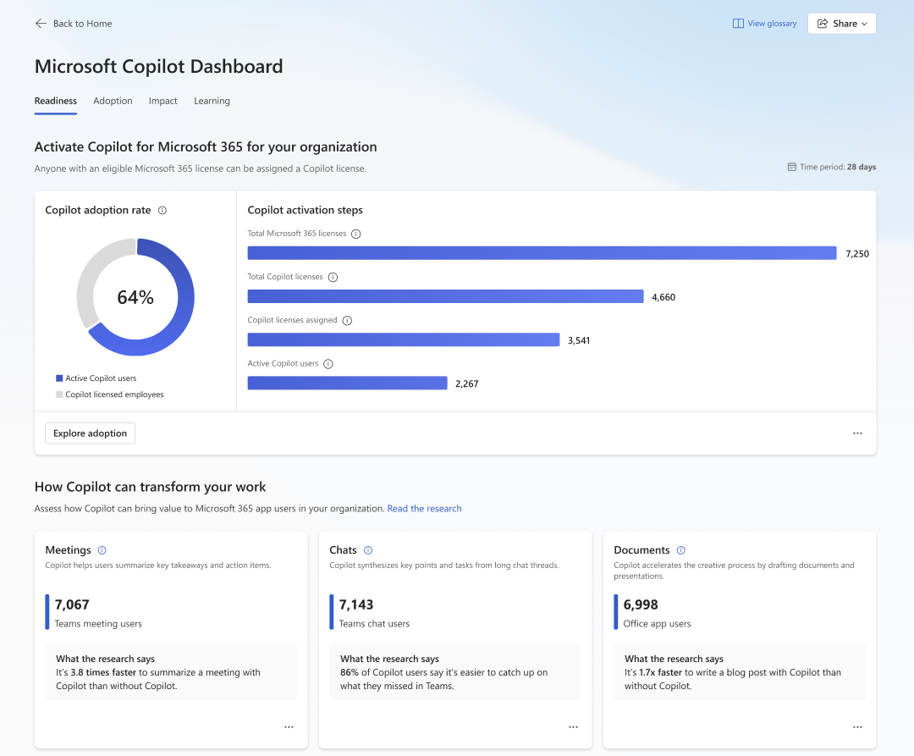
Copilot Dashboard
Notes:
The Microsoft Copilot Dashboard in Viva Insights is available to any customer with a Microsoft 365 or Office 365 subscription for business or enterprise. A paid Viva Insights license is not required.
The Microsoft Copilot Dashboard in Viva Insights helps organizations maximize the value of Copilot for Microsoft 365. It provides actionable insights to help your organization get ready to deploy AI, drive adoption based on how AI is transforming workplace behavior, and measure the impact of Copilot.

Slide 29
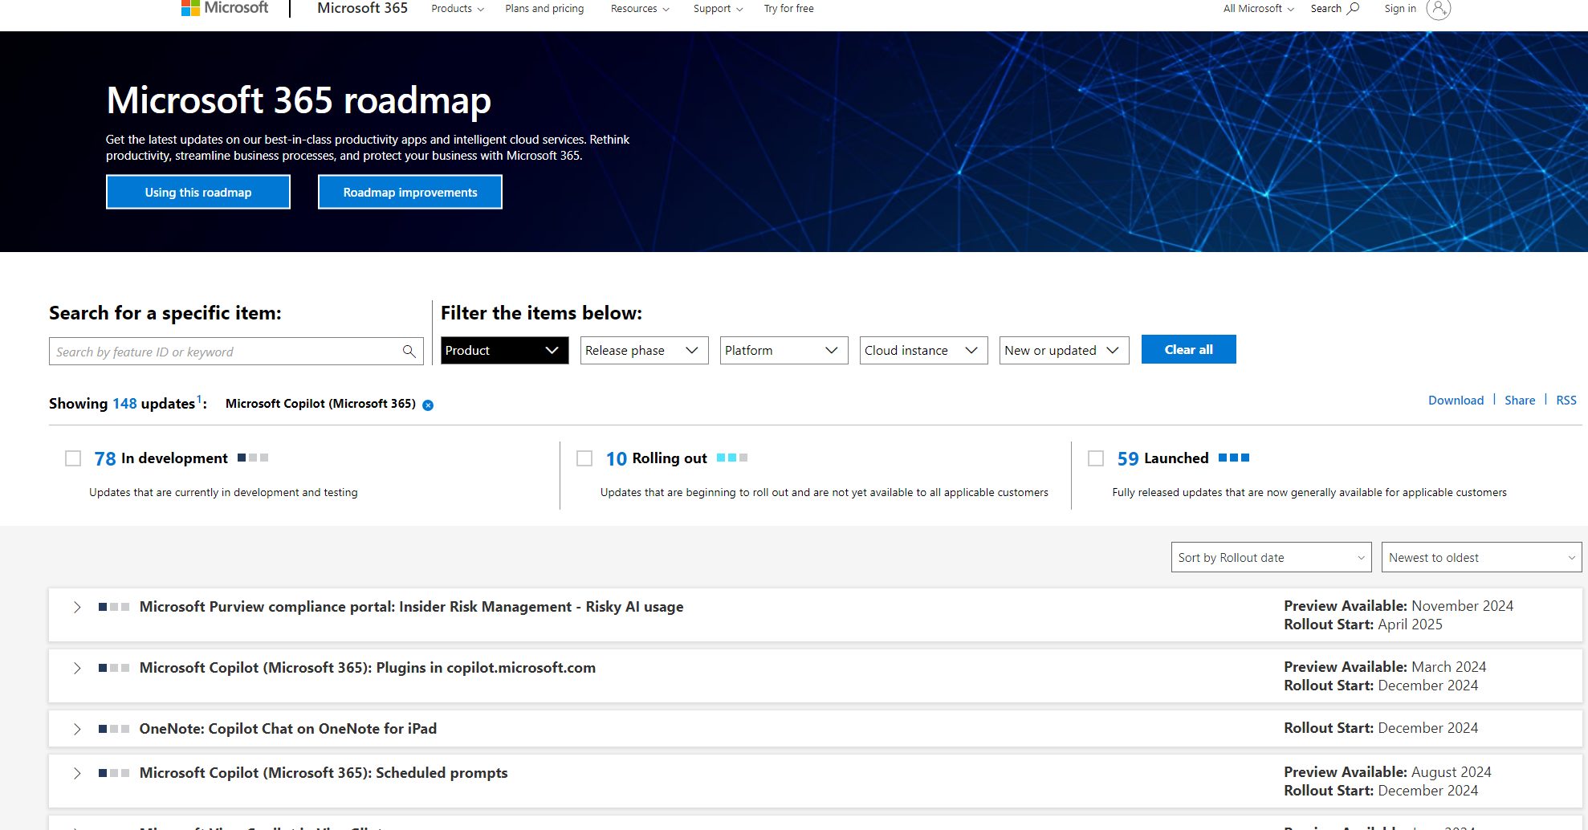
What’s on the Roadmap?
Schedule prompts in Copilot chat (Dec 2024)
Save and share your Copilot prompts in Word, Excel, PowerPoint, and OneNote using Copilot lab (Sep 2024)
Copilot w/ Graph Grounded Chat in Excel (Sep 2024)
Teams Meetings copilot queries to take meeting chat in account (Aug 2024)
Coaching by Copilot to allow you to apply the suggestions and rewrite your message (Aug 2024)
Prepare for meetings with Copilot in Outlook (July 2024)

Slide 30


Security and compliance add-ons available for Business Premium
Microsoft 365 Business Premium provides security and compliance controls that are sufficient for most small and medium-sized businesses (SMBs) when using Copilot for Microsoft 365. For those SMBs that require additional security, the following add-ons are available to purchase with your Business Premium license, with the IP&G being the key.
Information Protection
and Governance ($7pupm)
Insider Risk
Management ($6pupm)
eDiscovery
and Audit ($6pupm)
Adds the additional features below
to Microsoft 365 Business Premium:
*Microsoft Defender for Cloud Apps helps you discover SaaS apps and protect users from accessing risky apps
Communications DLP (Teams chat) blocks sensitive content when shared with Teams users
Endpoint DLP prevents data leak of sensitive items physical stored on Windows 10/11 and MacOS devices
Automatic sensitivity labels (client side) automatically discover, classify, label and protect sensitive data
Machine Learning-Based sensitivity Labels use trainable classifiers to identify items and apply labels
Records management helps manages businesses legal obligations
Advanced Message Encryption helps control sensitive emails shared outside the organization
Adds the additional features below
to Microsoft 365 Business Premium:
Insider risk management helps minimize internal risks by responding to malicious activities
Communication compliance helps detect business code of conduct violations
Adds the additional features below
to Microsoft 365 Business Premium:
eDiscovery (Premium) with end-to-end workflow for managing eDiscovery cases and investigations
Audit (Premium) with longer record retention and intelligent insights policies
*Can be purchased as a standalone product
Note: This may not reflect the full set of features available in these packages. The features identified above are highly relevant when using Copilot for M365.

Slide 31
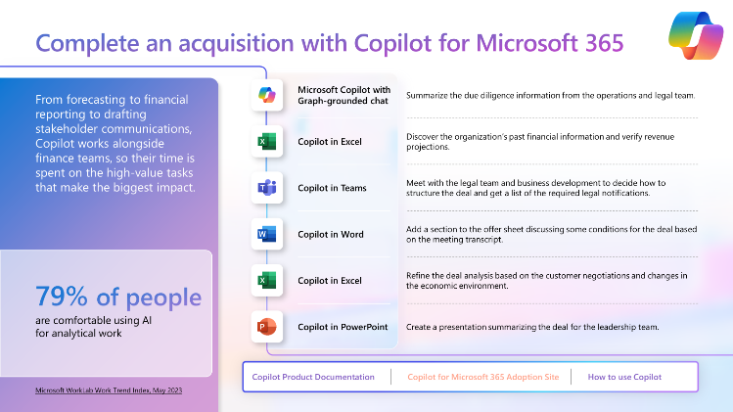
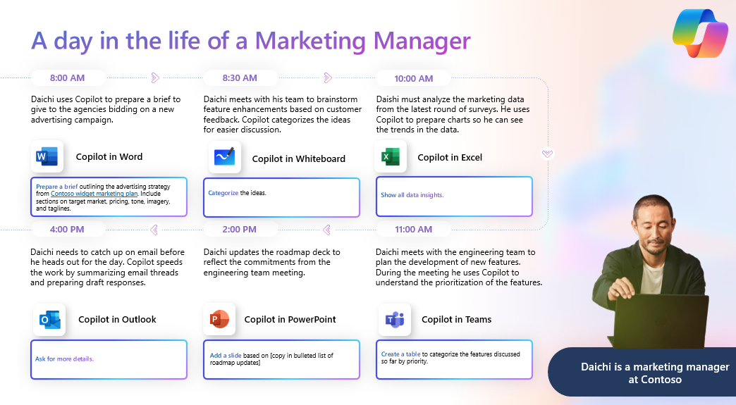
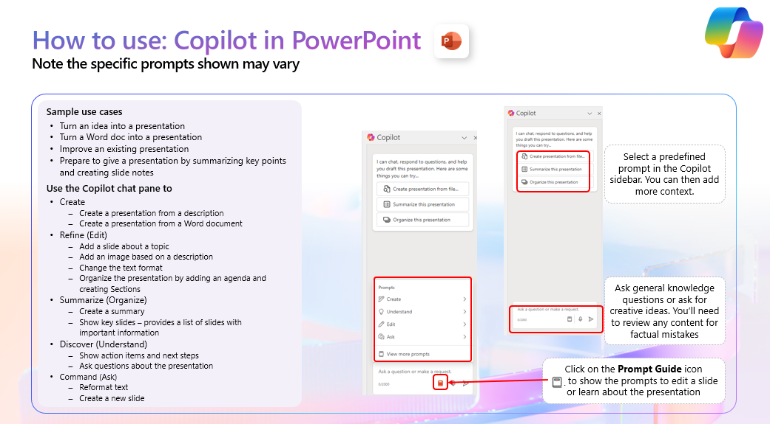
Copilot for Microsoft 365 Scenario Library
aka.ms/Copilot/ScenarioLibrary
Use case by role
Day in the Life by role
Product guidance
Tell the Copilot value story by showing how Copilot can be used to simplify key business processes. Includes detailed prompts, links to support and adoption materials, and so much more!
Get BDMs excited about Copilot by showing how Copilot can simplify their day. Includes detailed prompts.
Answer product capability questions with guidance on what each Copilot app can do with demos and prompt guidance.

Slide 32
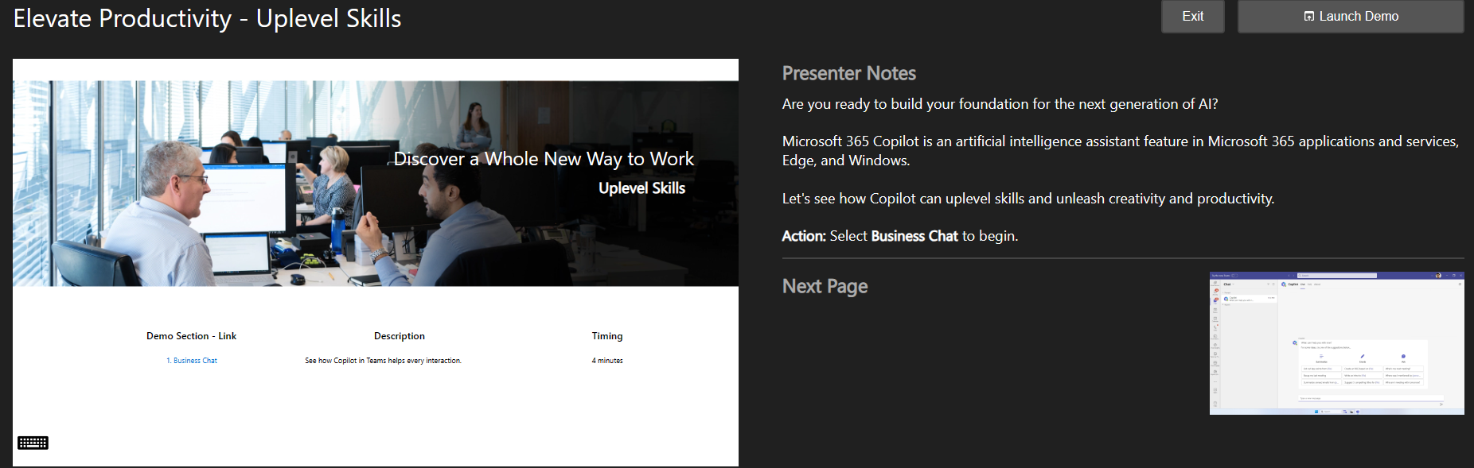
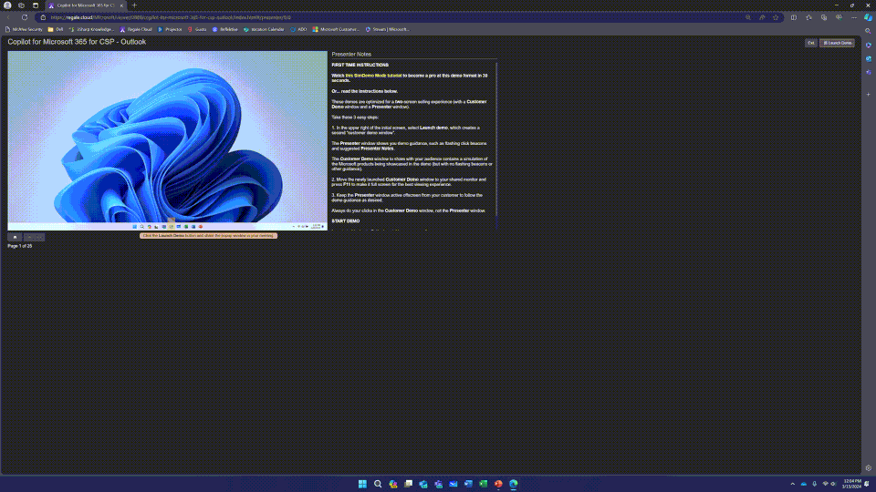
Partner-led User Immersion Training
Why? Accelerate time to value for new Copilot users through role-based immersion training
30–45-minute (per department) CSP partner-led training that moves beyond horizontal prompts and focuses on role-based guidance to show what’s possible with Copilot. Partner may invite pilot group or entire department to learning session virtually or in-person.
Starting with Marketing, HR, and Sales. Adding Legal and Finance soon.
Teams, Whiteboard, Loop, Outlook, Word, PowerPoint, Excel
Partners may modularize by department or mix & match for SMBs wearing multiple hats
3-part process to accelerate value and adoption
Simulated demo content to showcase what’s possible within each app (15 mins)
Provided dummy hydration content for end users to try (15 mins)
Bring your own files (BYOF) to drive immediate value and realization of Copilot (15 mins)
aka.ms/CopilotImmersionCSPLed

Slide 33
Dicker Data Webinar
Thank you
Copilot for Security
Notes:
Microsoft Teams Prem Thank you for your attendance and if you have any questions we will stop recording. Feel free to ask in the chat window.
HOW CAN WE HELP?

