Slide 2
TechClick
OnPoint Session – October 30th 2024
Presented by: Regina Melamed, TechClick

Slide 3
Agenda
About TechClick
TechClick Offerings
Microsoft Funding Options
Road To Azure
Azure Assessments
Migration
Recovery
Azure Virtual Desktop
Essential 8
Copilot
Fabric
NZ: microsoft.Sales@dickerdata.co.nz | +64 0800 337 253 0800 | Dicker Data | New Zealand's Most Trusted IT Distributor
AU: microsoft.sales@dickerdata.com.au | +61 2 8556 8061 | Dicker Data | Australia's Most Trusted IT Distributor

Slide 4
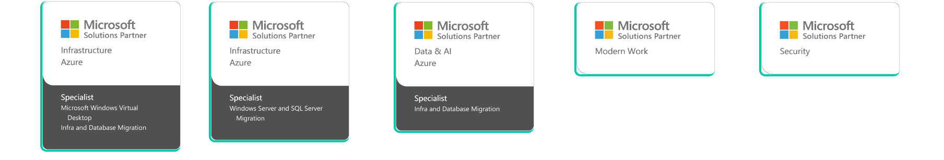
About TechClick
TechClick is an IT Solutions company that empowers partners to bring innovative solutions to their customers.
We act as your trusted delivery arm. Partner to Partner delivery only
Our Certifications

Slide 5
The Value Of TechClick
Offerings
TechClick is an Azure Migrate and Modernize & Azure Innovate Partner who has proven to be industry experts with Microsoft technologies and allows us to accelerate your customers cloud journey by providing specialized technical resources and access to Microsoft funding
Structured project approach with templates & experienced staff
Extensive experience delivering Microsoft project
Able to balance your customer expectations and your needs
Access to Microsoft Partner Funding

Slide 6
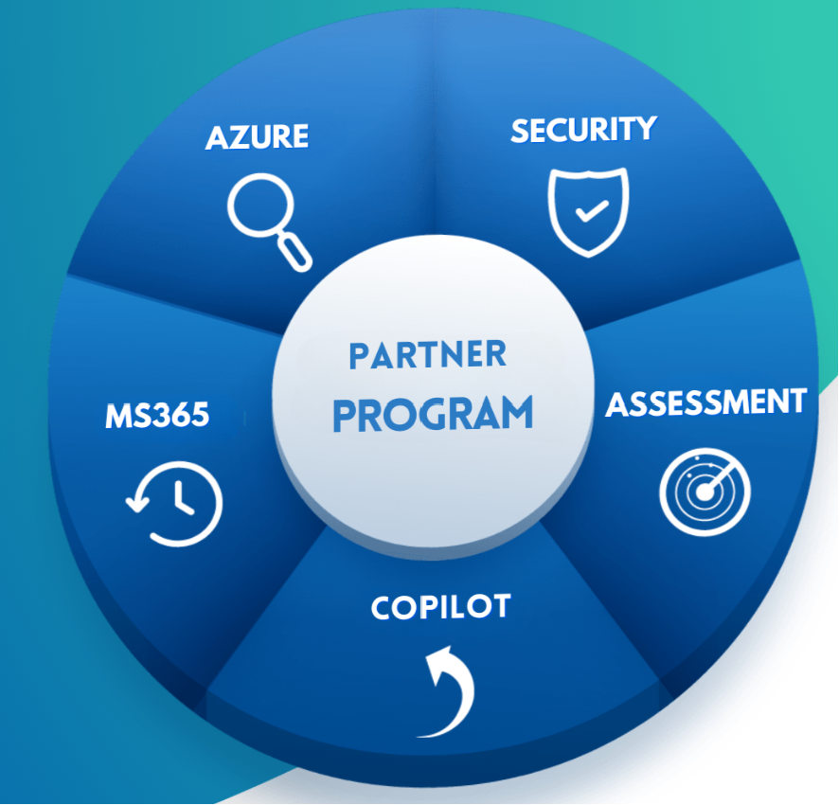

Slide 7
TechClick Microsoft Funding
Options
Due to TechClick’s Advanced Specialization status we have access to the below funding options for your customers.
Supported Scenarios
Funding Details
  Infra/Database migration
Offer | Eligibility (Planned Azure consumption in year 1) | Funding Available
Migrate & Modernize XS | Project size: $10K–$25K/year | $5,000
Migrate & Modernize Small | Project size: >$25K–$125K/year | $15,000
Migrate & Modernize Medium | Project size: >$125K–$250K/year | $35,000
Migrate & Modernize Large | Project size: >$250K–$500K/year | $50,000
Migrate & Modernize XL (Infra/DB migration only) | Project size: >$500K–$750K/year | $75,000
Migrate & Modernize XXL (Infra/DB migration only) | Project size: >$750K–$1 M/year | $100,000
Should this Funding not cover the entire project TechClick is able to provide direct cost for your organization.
  Migrate Enterprise apps
  Virtual desktop infrastructure
  Azure Analytics
  Modern Data Warehouse
  Microsoft Fabric
Important: Azure Subscriptions must be purchased through Dicker Data & TechClick needs to have partner of record on the customer tenant alongside your own.
Customer Criteria: TechClick must confirm customer eligibility, these criteria change often please speak to your TechClick Partner manager to have them confirm

Slide 8



TechClick Road To Azure
Informed by the Microsoft Cloud Adoption Framework for Azure
Microsoft Funding
Available
Pre-move
During move
Post move
TechClick - Migration and modernization Project
Take an iterative approach with each wave
comprising a defined set of workloads
TechClick – Presales Assistance - Define strategy
Align stakeholders, define strategy, and engage a partner
Current Partner - Govern
Establish cloud usage standards and guard-rails and enable cloud budget tracking
Migrate
Ready
Build out landing zone, skill up your staff and review best practices
Adopt
Migrate and modernize iteratively using built-in tools and automation
TechClick - Assessment Engagement
Discover and assess your environment, build a business case and a holistic plan
Current Partner - Manage
Ensure your workloads
are well managed
(e.g., backup, monitoring, DR)
Modernize
Secure
Establish security baseline and manage security posture

Slide 9
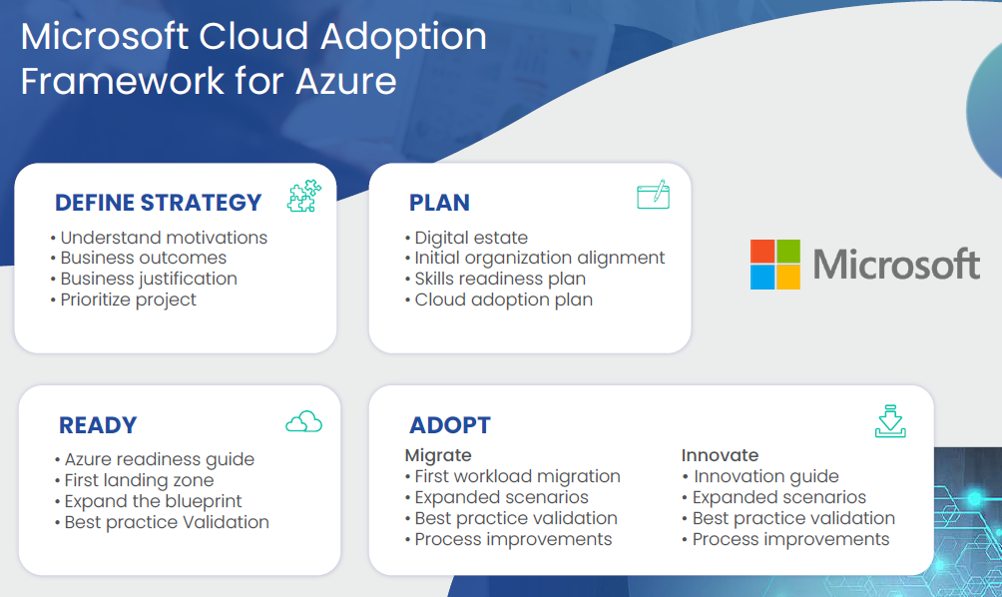
Azure Assessments
Microsoft Funding
Available

Slide 10
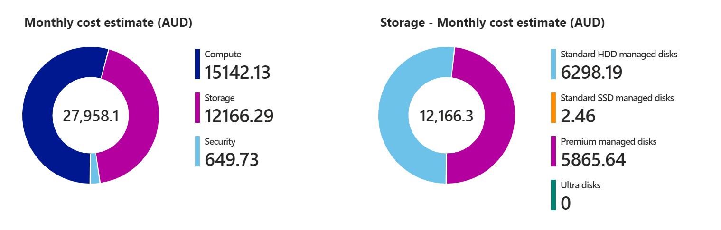
Azure Solution Assessment– Example Output
Review Findings – Workloads Optimized
Performance criteria applied
No HUB Applied
No RI or Savings Plan
All 29 VMs Included

Slide 11
Azure Solution Assessment– Example Output
Possible Microsoft Funding available:
  $50,000 AUD due to Estimated ACR is greater than $250k per annum
Estimated TechClick Professional Services $50,000 AUD which includes:
  Landing Zone in up to 4 four regions
    Includes Network Connectivity, Firewall configuration & Active Directory Domain Controllers
  Life & Shift of servers in scope
  Azure Virtual Desktop Implementation to replace terminal servers
  File Server Transition to Azure files
  Enable DR replication
    DR test is not current estimated in costs but can be added if desired.
Total customer cost of $0 due to Microsoft funding.
The Project is estimated to be 10-12 weeks duration from kick-off to closure

Slide 12
Azure Migration Solution Includes:
Microsoft Funding
Available
Foundation
Create your foundation landing zone ready to host production workloads
Migration
Migrating your customers Infrastructure into the Azure Cloud.
Enhancements
Can include BCP and DR considerations and implementations for your customers workloads.
Handover
TechClick training and documentation provided

Slide 13
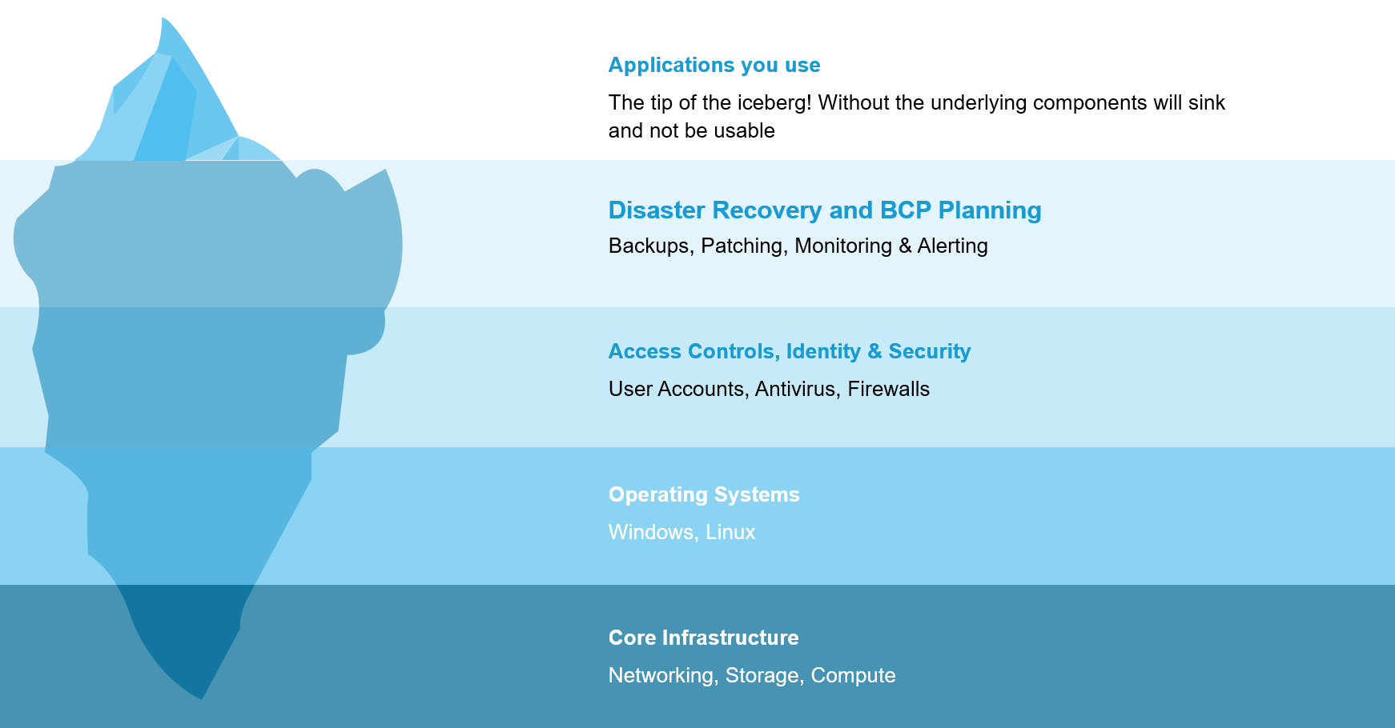
Azure Migration -
Foundation
Microsoft Funding
Available
Azure foundations comes in multiple flavors
Design & Education workshops to assist you in making informed decisions
Deploys all the core features of Azure to varying degrees
Support, Handover Training & Documentation

Slide 14


Microsoft Funding
Available
Enterprise Scale
Scalable for all organization sizes
Defined Architecture Guidelines
All operational Services enabled
Advanced
Required for highly regulated organizations
Define your own Architecture guidelines
Tailor Azure to suit your needs

Slide 15
Inclusions | Enterprise Scale | Foundations - Advanced
Timeframe | 1-2 Weeks | 4-24 Weeks*
Enterprise Scale Template Deployment | Included | Optional
Azure Billing Agreement Configuration | Dicker CSP | Design Workshop
Azure Active Directory Group Configuration | Not Included in Base - Add-ons Available | Design Workshop
Resource Naming Convention | Microsoft Standard | Design Workshop
Role Based Access Control Design & Implementation | Not Included in Base - Add-ons Available | Design Workshop
Privileged Identity Management Design & Implementation | Not Included in Base - Add-ons Available | Design Workshop
Conditional Access Design & Implementation | Not Included in Base - Add-ons Available | Design Workshop
Azure Security Defaults Enabled | Included | Included
Network Security Options | Included | Design Workshop
Networking Options | VPN & EXPRESSROUTE (EXPRESSROUTE will add to project timeline) | Design Workshop
Network Topology Options | Included | Design Workshop
User Defined Routes for Internet Traffic | Included | Included
Multi Region Deployment | Not Included in Base - Add-ons Available | Included
Azure Policy Deployment | Base Configuration | Design Workshop
Azure Security Center | Base Configuration | Design Workshop
Azure Sentinel | Base Configuration | Design Workshop
Azure Monitor Platform | Base Configuration | Design Workshop
Azure Cost Management | Base Configuration | Design Workshop
DevOps Platform | Not Included in Base - Add-ons Available | Design Workshop
Infrastructure as Code | Not Included in Base - Add-ons Available | Design Workshop
Azure Backup, Update Management Configuration | Base Configuration | Design Workshop
Azure Monitor Alerts | Platform Only | Design Workshop
Microsoft Funding
Available

Slide 16
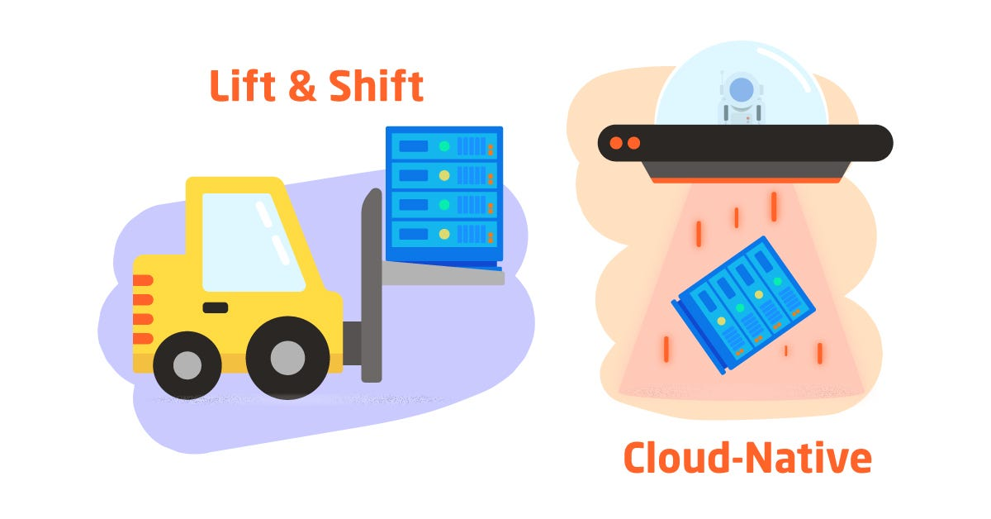
Migration – Lift & Shift & Cloud Native
Microsoft Funding
Available

Slide 17
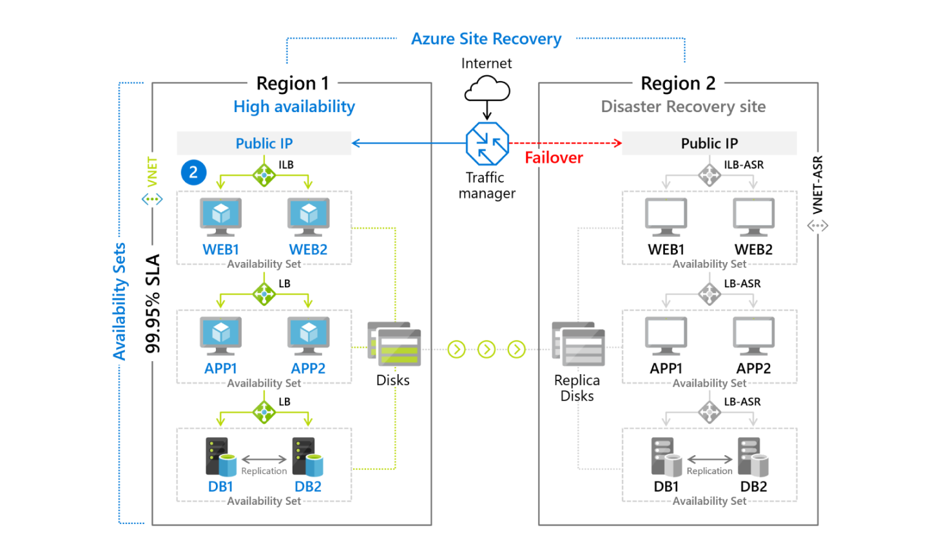
Disaster Recovery
Microsoft Funding
Available

Slide 18
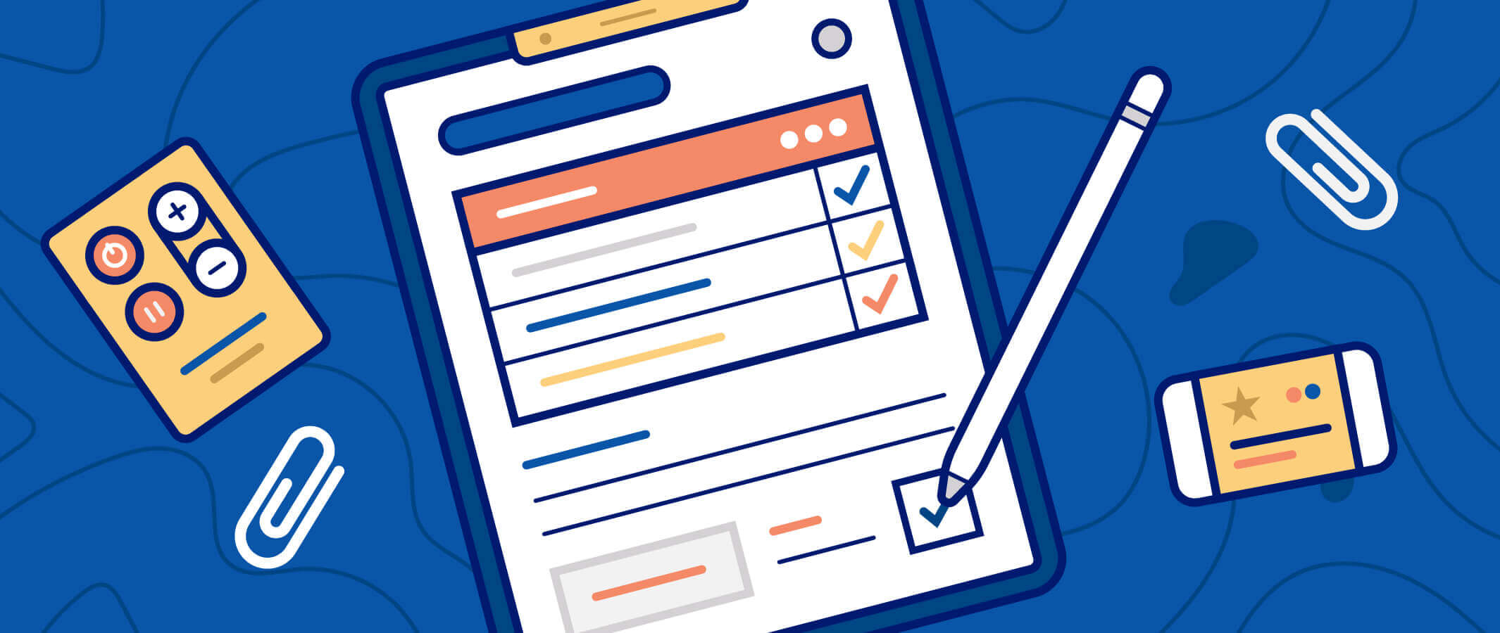
Handover
Microsoft Funding
Available

Slide 19
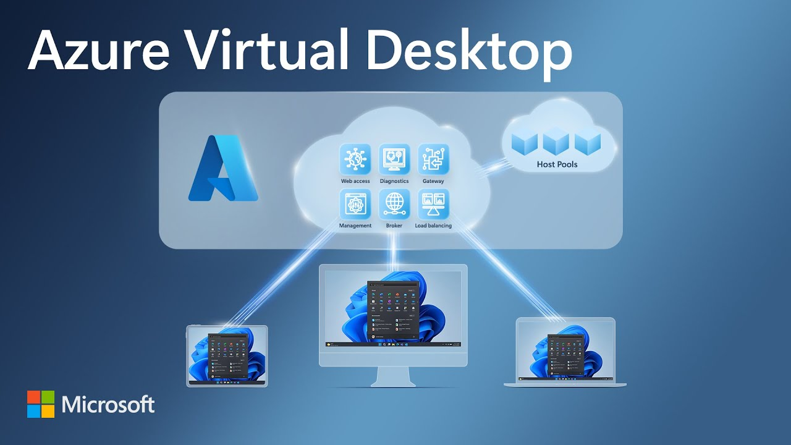
Azure Virtual Desktop
Microsoft Funding
Available

Slide 20
Service | TechClick Runway | Production | Multi Region
Active Directory Integration | Azure AD | Azure AD / On-Premise | Azure AD / On-Premise
Backup | FSlogix and Master image | FSlogix and Master image | FSlogix and Master image
Monitoring | Default AVD | Default AVD | Default AVD
Workspaces | 1 | 2-4 | 4-8
Session Pools | 1 | 2-4 | 4-8
Session Hosts | 1 | 2-8 | 4-32
Virtual Desktop | Y | Y | Y
Remote Application Groups | 1 | 5** | 5**
Number of Azure Regions | 1 | 1 | 2
Custom Images |  | 1-2 | 2-4
Customisable Image Patching |  | Y | Y
Disaster Recovery Region Support |  |  | Y
End Point Management |  | Y | Y
Pre-Installed Applications Office C2R Teams Adobe Reader Chrome AVD Add-in extensions | Y | Y | Y
Windows Patching | Y | Y | Y
Microsoft Funding
Available

Slide 21
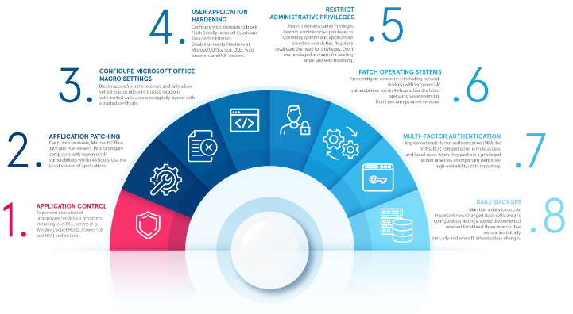
What Is The Essential 8?

Slide 22
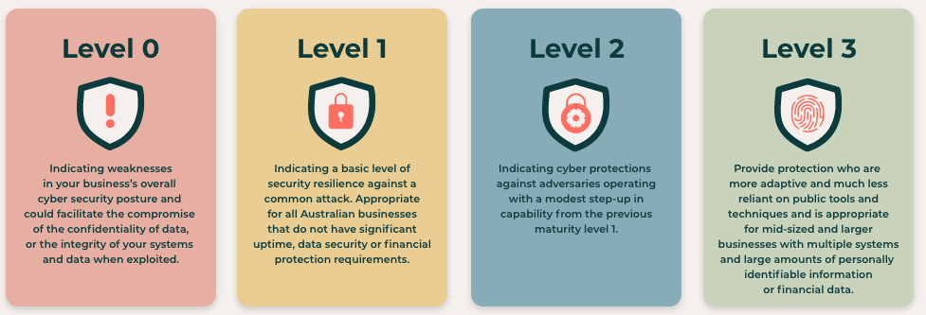
What Are The Maturity Levels?

Slide 23
Main Differences?
Level 1
  Base level, “common sense security” mostly non impacting
  Blocking of Macro’s often highly frustrating
  Blocking of scripts in websites sometimes causes problems
Level 3
  Focused on high priority target businesses
  Larger scope of blocked applications & functions
  All applications would need to be tested
  High impact for end users
Level 2
  Modest step up in security, stats to impact end users and business process
  Installed applications are now whitelist for install has large effort overhead
  Completely blocking internet explorer 11 which can cause legacy application failure
  Local administrator accounts are unique and managed

Slide 24
Essential 8 Control | How TechClick Recommend Managing the control
Application control | TechClick uses Intune compliance and configuration policies to manage these requirements.
Patch applications | TechClick implements Intune patch management alongside Defender for endpoint to manage these requirements.
Configure Microsoft Office macro settings | TechClick uses Intune compliance and configuration policies to manage these requirements.
User application hardening | TechClick uses Intune compliance and configuration policies to manage these requirements.
Restrict administrative privileges | TechClick uses Conditional access and Microsoft LAPS to manage these requirements
Patch operating systems | TechClick implements Intune patch management alongside Defender for endpoint to manage these requirements.
Multi-factor authentication | TechClick uses Conditional access to manage these requirements
Regular backups | TechClick recommends and configures the use of Skykick cloud backup for all office 365 systems and for on premises systems Linktech has experience in configuring Azure Backup, VEEAM, Commvault and other tier 1 backup systems.

Slide 25
Cloud Native 365 & Endpoint | Maturity Level
 | Level 1 | Level 2 | Level 3
Office 365 – Configurations required for maturity level | Included | Included | Included
Intune – Policies required for maturity level | Included | Included | Included
Autopilot – Policies required for maturity level | Included | Included | Included
Defender for Endpoint - Windows 10/11 | Included | Included | Included
SkyKick Office 365 Backup | Included | Included | Included
Microsoft Licensing Required | Business Premium Small Amount of Active Directory P2 or E5 for Executive or administrator users | Business Premium Small Amount of Active Directory P2 or E5 for Executive or administrator users | Microsoft 365 E5
SkyKick Licensing | $8 per user per month for all services $4 per user per month for mail only $4 per user per month for teams/SharePoint only
Fixed Cost (ex GST) | $25,000 | $50,000 | $75,000
Engagement Outcome
Required services are configured
All deployments are to 5 pilot devices
Hyper Care for the 5 devices pilot for 2 weeks is included
Admin guides & documentation on how to deploy to the rest of the business
Deployment to the rest of the business & all devices can be done at a T&M rate with an estimate.

Slide 26
Add-Ons
Addons | Maturity Level
 | Level 1 | Level 2 | Level 3
On Premises Active Directory | $5,000 | $10,000 | $15,000
Company Policies | $5,000 | $7,500 | $10,000
Patching - Windows & Linux Servers | $10,000 | $10,000 | $10,000
Defender for Endpoint - Windows & Linux Server | $10,000 | $10,000 | $10,000
Infrastructure Backup | $10,000 | $10,000 | $10,000
Microsoft Sentinel | $15,000 | $15,000 | $15,000
Engagement Outcome
Required services are configured
All deployments are to 5 pilot devices
Hyper Care for the 5 devices pilot for 2 weeks is included
Admin guides & documentation on how to deploy to the rest of the business
Deployment to the rest of the business & all devices can be done at a T&M rate with an estimate.

Slide 27
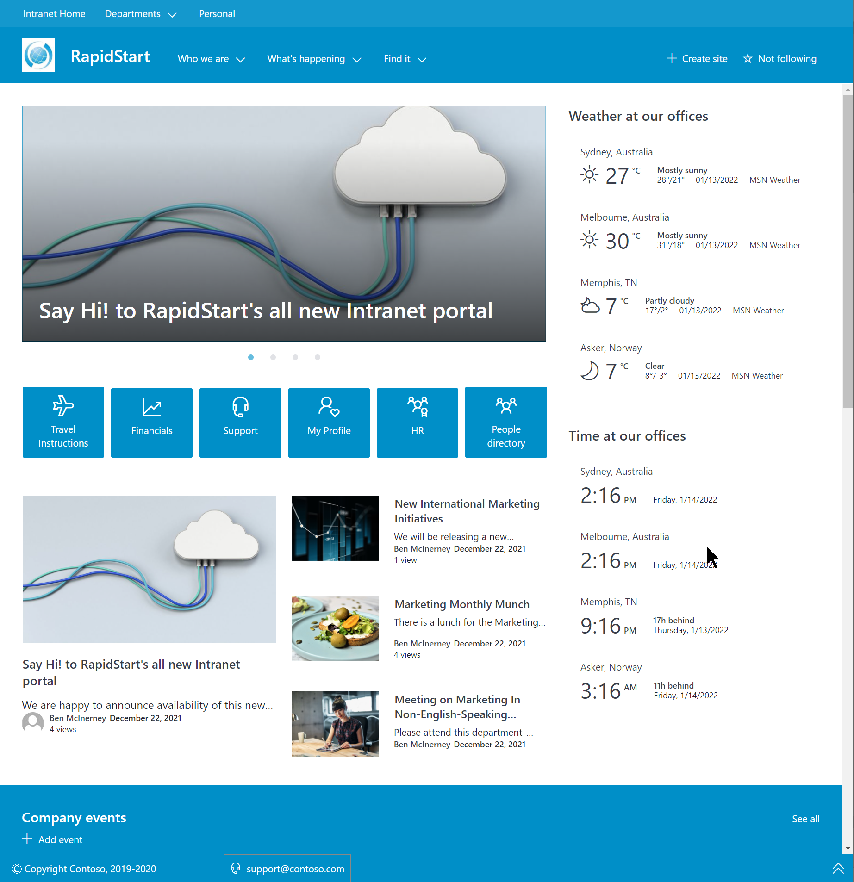
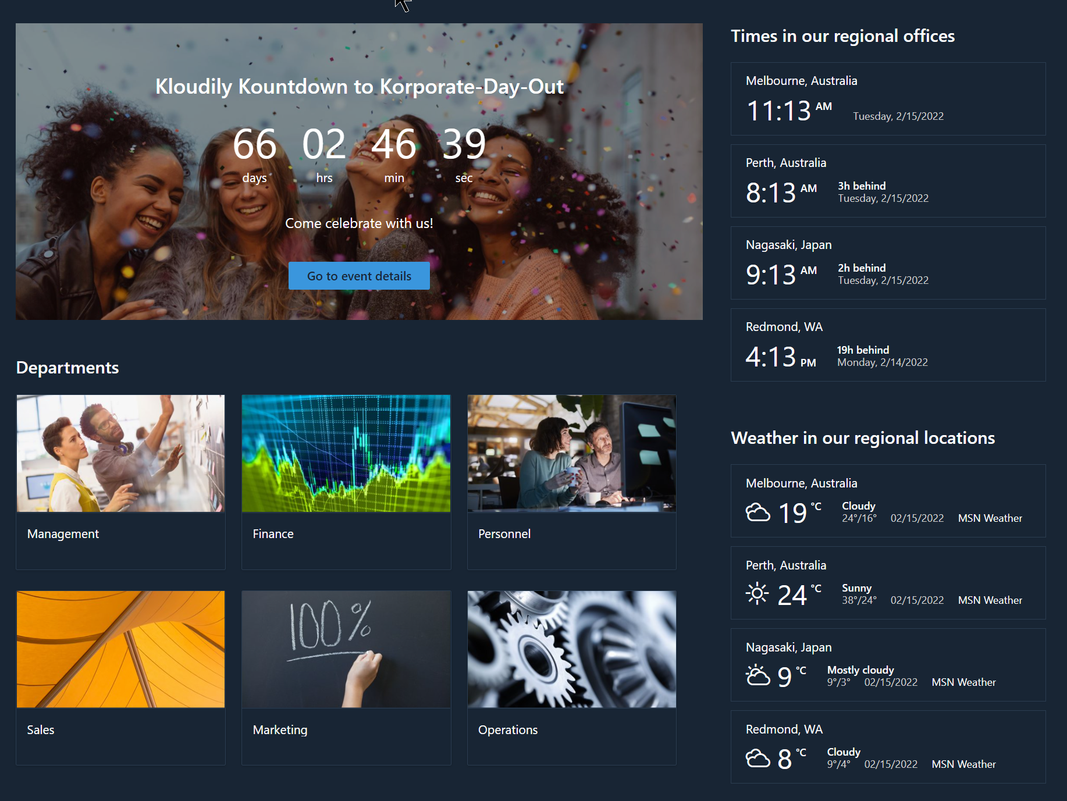
TechClick RapidStart

Slide 28
Service/Feature | Lite | Starter | Premium | Platinum
Main Site and Business Units Landing Pages | ❹ | ❹ | ❻ | ❻
Microsoft Teams Integration | ❹ | ❹ | ❻ | ❻
Quick Links (to Business Units) | ❹ | ❹ | ❻ | ❻
Mega-menu Site Navigation | ❶ | ❶ | ❶ | ❶
Communication Hub Configuration | ❹ | ❹ | ❻ | ❻
Core Corporate Document Libraries | ❻ | ❻ | ❻ | ❻
Core Metadata and Template Integration | ❶ | ❶ | ❶ | ❶
Corporate News, Calendar & Events |  | ❶ | ❶ | ❶
Countdown Event Timer |  |  | ❶ | ❶
Organisational Chart (Exchange) |  |  | ❶ | ❶
Weather & World Clock - Multi-location |  |  | ❶ | ❶
Bing Maps - Pre-set Location |  |  | ❶ | ❶
Online Forms – Pick 3 from selection |  |  |  | ❸
Convert Policy/Procedure/Guidelines to PDF |  |  |  | ❶
Twitter Feed |  |  |  | ❶
Yammer – Conversations & Highlights |  |  |  | ❶
Viva – Connections |  |  |  | ❶
YouTube & Microsoft Stream Videos |  |  |  | ❶
Image Gallery |  |  |  | ❶
Recent Activity |  |  |  | ❶
Ideas Box & Social Catch-up Areas |  |  |  | ❶
Handover Workshop | 1 hour | 1 hour | 2 Hour | 4 Hours
Quick Reference Guides | ❻ | ❻ | ❻ | ❼
Pricing ex-GST | $7,500 | $12,000 | $18,000 | $25,000

Slide 29
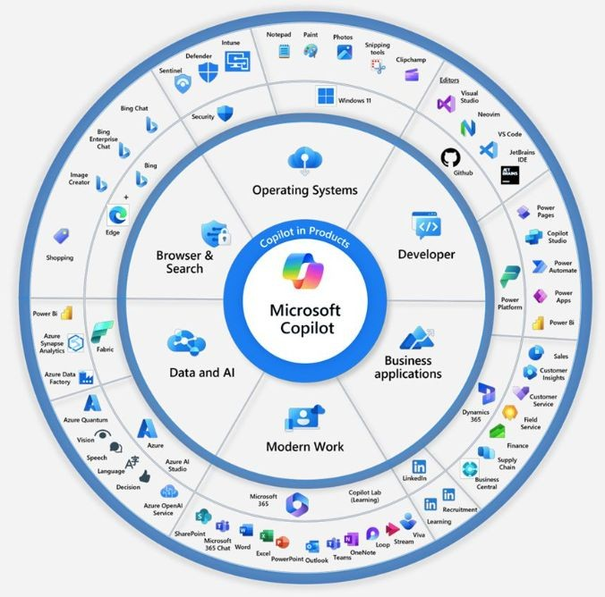

Slide 30
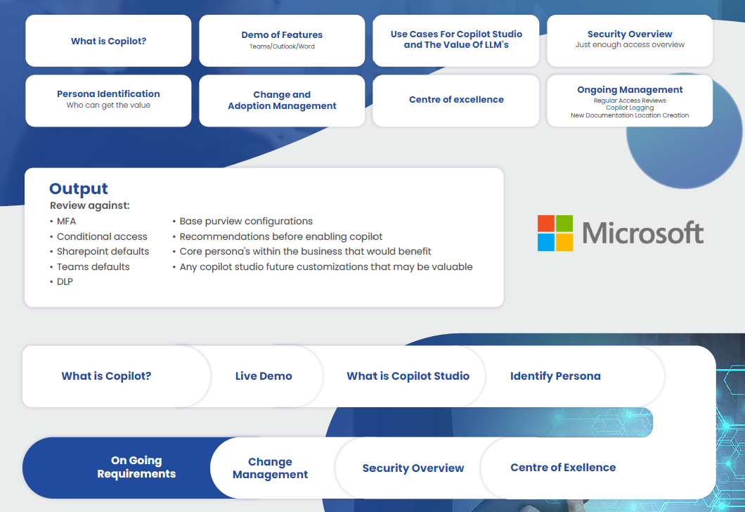
Copilot Assessment

Slide 31
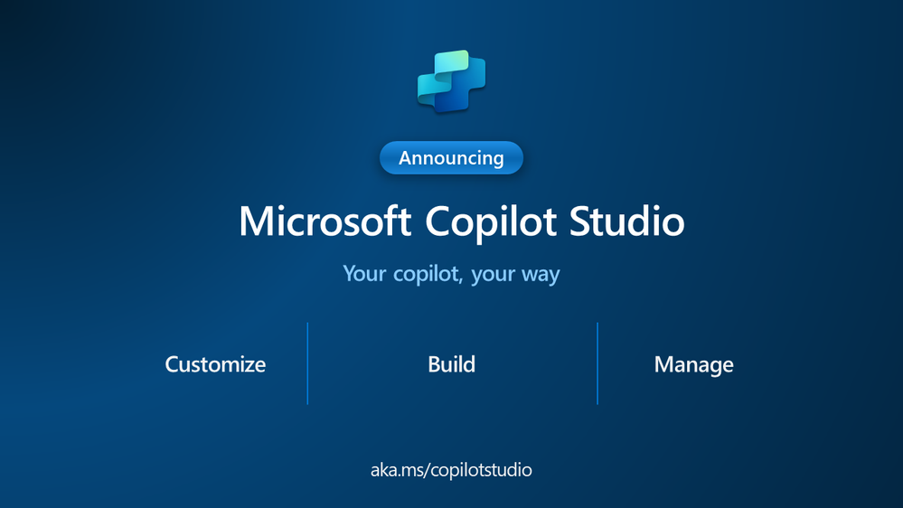

Slide 32
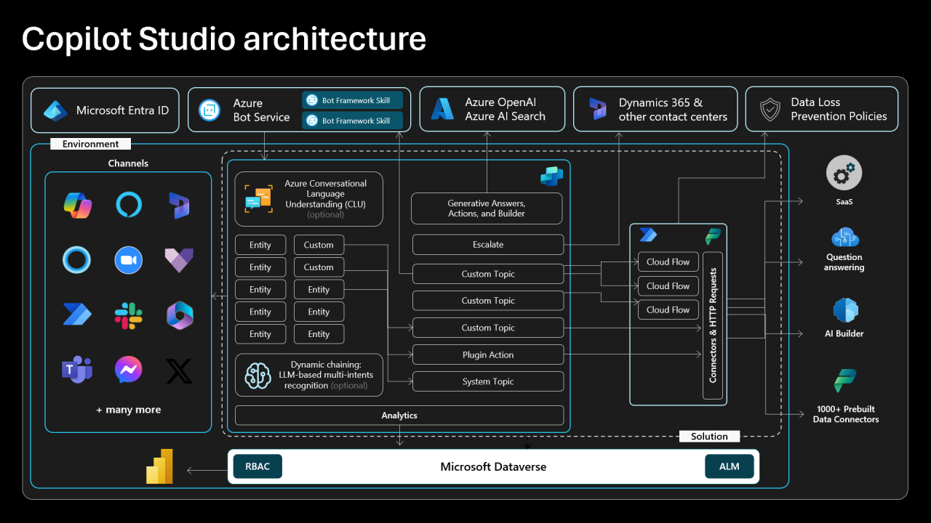

Slide 33
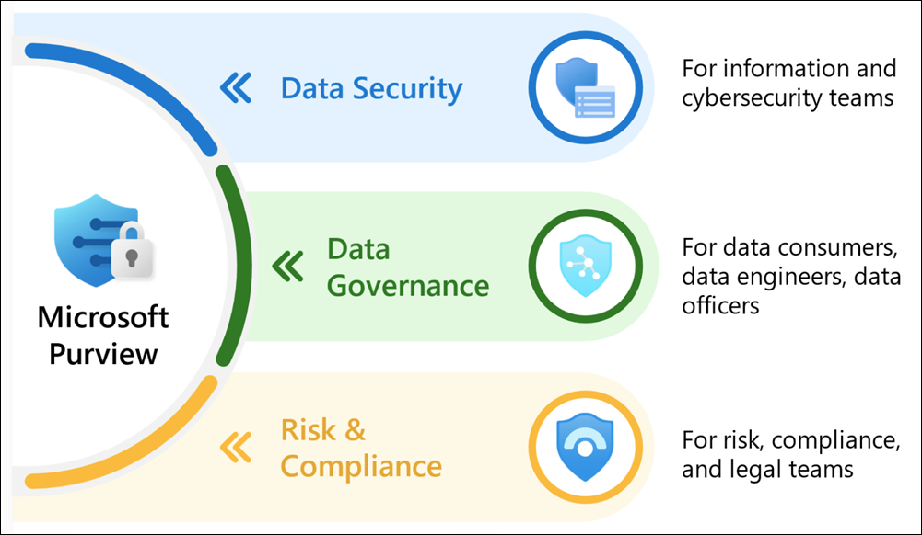

Slide 34
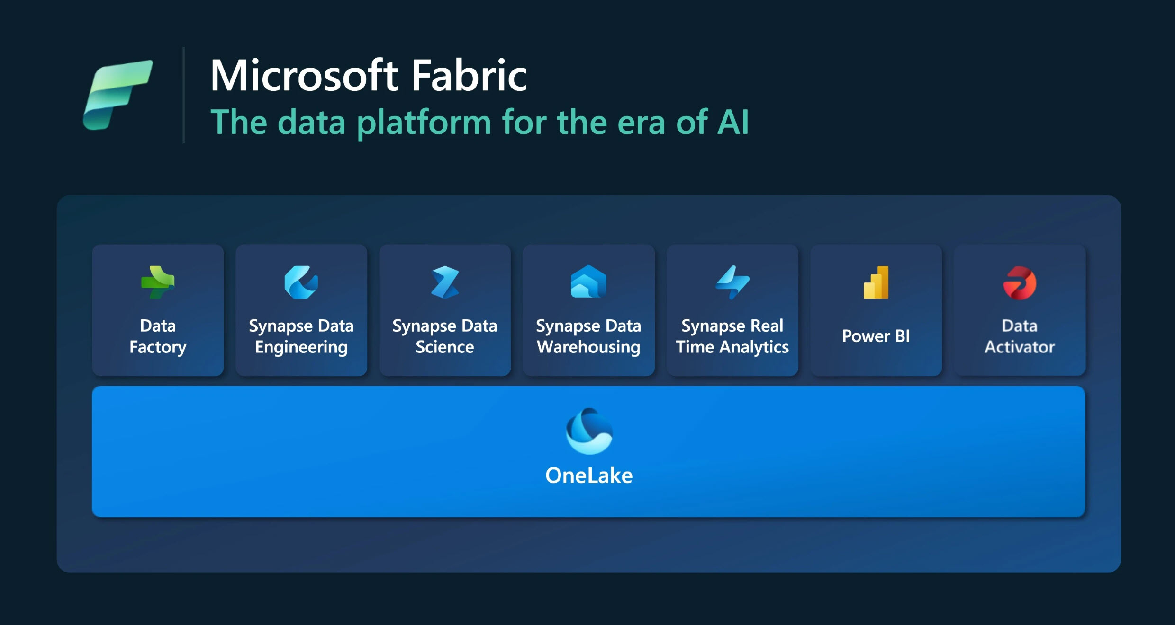
Microsoft Funding
Available

Slide 35
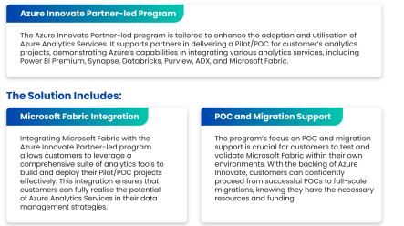
Microsoft Fabric
Microsoft Funding
Available

Slide 36
Microsoft Fabric POC
Microsoft Funding
Available

Slide 38


Questions?

Slide 39
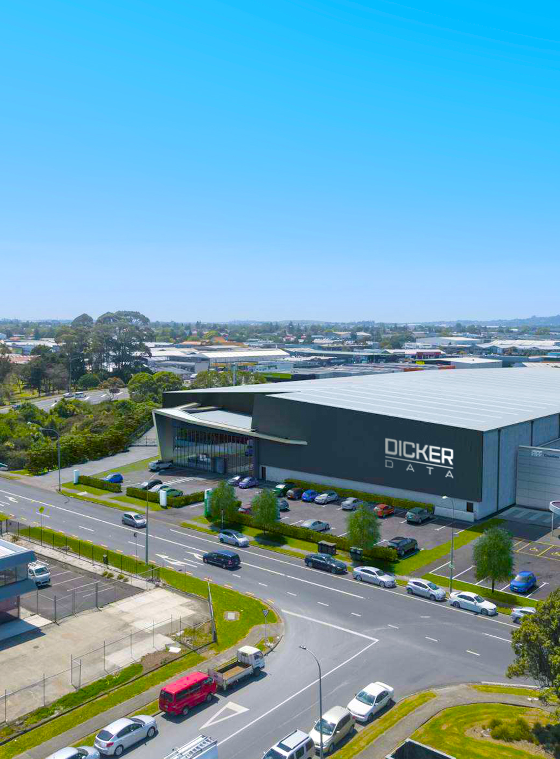


Thank you
for your time and participation today

