Slide 1


Azure Sales Playbooks
Essential cloud building
blocks for
AI Success
www.dickerdata.com.au/Microsoft
www.dickerdata.co.nz/Microsoft

Slide 2


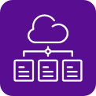

Your cloud and AI building blocks
These four sales plays create the intelligent cloud foundation your practice and customers need for AI success. Build systematically – each block strengthens the next.
Play 1:
Power Hybrid Work Azure Virtual Desktop
Play 2:
Build Your Foundation Infrastructure, Apps and Security
Move workloads to the cloud with confidence
Play 3:
Unify Your Data Analytics and Intelligence
Connect data silos and turn insight into action
Play 4:
Accelerate with AI Intelligent Automation
Secure, anywhere access to desktops and apps
Put AI to work across your business

Slide 3

Build Your Foundation with Infrastructure, Apps and Security
Play 2
This playbook focuses on Play 2 – migrating and modernising workloads to create a secure, scalable cloud foundation. Inside, you'll find all you need to identify migration opportunities, pitch confidently and close deals:
Market context and ready-to-buy prospects
Pitch guidance by customer segment
Objection handling and competitor comparisons
Revenue models, incentives and funding programs
Customer-facing assets – just add your branding
Plus, our expert Azure team is here to help you identify leads, win deals and scale your cloud migration practice.

Slide 4
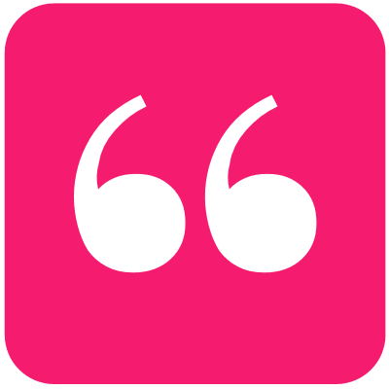
The opportunity is here and growing
Market drivers creating demand for cloud migration and modernisation
AI ambitions outpace readiness – Nearly half of SMBs face difficulties preparing data for AI workloads and 40%+ report persistent performance issues in computing, storage and networking¹
Another wave of cloud investment – Australian organisations are prioritising data security, scalability and cost optimisation as their top three cloud investment areas²
Customers buy on value – 56% choose partners based on overall business impact and value, seeking support to bridge the gap between today and their goals for 2030²
Some see AI as a magic bullet – With Australia lagging OECD peers in productivity for over a decade³, businesses see AI as both a productivity and compliance driver¹
AI could add $115 billion to Australia's GDP by 2030, with 70 per cent of that gain coming from greater productivity.”⁴
– Steven Worrall, former Managing Director, Microsoft ANZ
References:
1. Security Brief, AI and Cloud Growth demands smarter security for SMBs, 2025
2. Tech Research Asia, Dicker Data and Microsoft: The Strategic Partner Shift, 2025
3. AFR, Weak productivity bites businesses, but AI is helping close the gap, 2025
4. AFR, Economic summit can be AI's 'Team Australia' moment, 2025

Slide 5
7,577 customers are ready to start!
CloudAscent – Microsoft's tool that analyses data signals to identify buying patterns – reveals that 7,577 Australian organisations within Dicker Data's partner ecosystem are prepared to begin their cloud migration and modernisation journey. How many of those are your customers?
Plus, 55% are ready to ACT NOW based on their existing Microsoft usage investments, business needs and technical fit.
We can train you to use CloudAscent to identify opportunities in your own customer base, or we can help you find ready-to-go prospects.
Migrate and modernise readiness
Nuture
3,565
26%
Evaluate
2,578
19%
Act now
7,557
55%

Slide 6
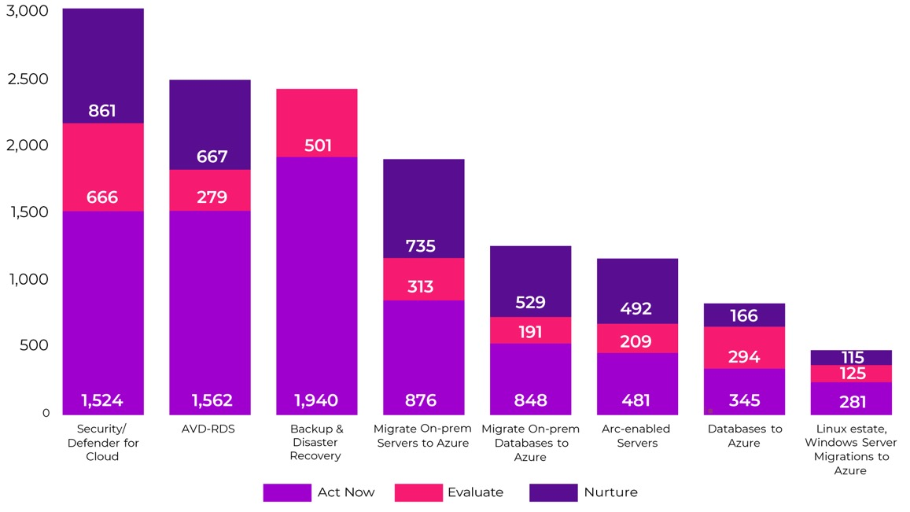
Build your sales hitlist
From quick wins to strategic plays, we can help you identify targets to suit your capabilities. There are thousands of fast-conversion opportunities across Security/Defender for Cloud and Backup & Disaster Recovery, and hundreds of deeper engagements on offer for on-prem server and database migrations with sustained revenue potential.

Slide 7
Identify your low-hanging fruit
Target customers with workloads ready for the cloud
Small (25-100 employees)
The opportunity: Lift-and-shift starter workloads, modernisation of 2-4 key applications, simple infrastructure consolidation
Annual consumption: Estimated USD $5K-$15K
Medium (100-300 employees)
The opportunity: Hybrid modernisation, SQL
re-platforming, app/API modernisation, identity and security uplift
Annual consumption: Estimated USD $15K-$50K
Large (300+ employees)
The opportunity: Multi-datacentre migration, DevOps adoption, industry workloads including SAP/ERP, high-scale applications
Annual consumption: Estimated USD $50K-$100K
Start with customers who already have Microsoft foundations in place and workloads ready to migrate.

Slide 8
How to pitch Azure migration and modernisation
Use these pitches to introduce the opportunity to customers.
Short version: Azure enables organisations to migrate and modernise workloads with enterprise-grade security, global scalability and cost efficiency. Move from legacy systems to a future-ready cloud platform without the complexity and risk of traditional infrastructure.
Longer: Microsoft Azure is a comprehensive cloud platform that helps businesses migrate, modernise and secure applications and workloads. It delivers advanced services like AI, automation and analytics while reducing infrastructure costs and technical debt. By leveraging Azure’s global network and built-in security, organisations can accelerate innovation, improve resilience and achieve measurable business outcomes – all with predictable costs and simplified management.
Three reasons customers choose to migrate and modernise with Azure:
Enterprise-grade security – Built-in security controls with Azure's scalable global network
Future-ready – Advanced AI, automation and analytics to accelerate innovation
Lower cost and complexity – Eliminate technical debt while reducing infrastructure costs

Slide 9
Pitch by customer segment
Segment | Small (25–100 staff) | Medium (100–300 staff) | Large (300+ staff)
Key pain points | Ageing servers Limited IT staff Basic DR needs Rising hardware costs | Performance issues Compliance requirements Hybrid complexity Legacy apps, slow innovation | Multi-site complexity Large data estates Security and risk exposure Scalability and global availability
Value proposition | Affordable starter cloud migration package designed for lightweight, low friction, simple and fast infrastructure consolidation/migration | Balanced migration + modernisation offering. Uplift security and governance, reduce technical debt and improve optimisation. Supports hybrid, SQL and app modernisation | Full-scale transformation program. End-to-end modernisation, AI-ready/AI-innovation, enterprise governance, security and high-capacity workloads. Ideal for multi-year modernisation journeys
Core Features | Cloud readiness assessment Basic landing zone setup Rehost/replatform workloads (2-4) Baseline/foundational identity and security | Cloud Discovery + Architecture Migration of up to 5 workloads SQL/DB modernisation App & API modernisation Security integration with Defender, Sentinel and Governance policies Monthly health checks | Cloud Adoption Framework (CAF) Full estate migration + modernisation (refactor/rearchitect) Multi-region landing zones/DR design AI-readiness and enhancements Security/compliance governance DevOps and FinOps enablement Well-Architected Framework (WAF) reviews 24/7 support options

Slide 10

Know your audience
Cloud migration decisions involve three key stakeholders with distinct priorities and concerns.
Persona | Top priorities | Top pain points | Why Azure?
CIO/CTO | • Cost optimisation • Scalability • Security | • Vendor lock-in • Migration complexity • Compliance risk | Azure delivers enterprise-grade security, global scalability and predictable costs with integrated compliance.
IT Manager | • Simplified management • Hybrid flexibility • Uptime | • Downtime risk • Integration issues • Skill gaps | Azure offers automated management, multi-region resiliency and hybrid capabilities via Azure Arc.
Finance Leader | • ROI • Cost predictability • Business continuity | • Budget overruns • Unclear TCO • Hidden costs | Azure's pay-as-you-go model and cost optimisation tools ensure transparency and faster ROI.

Slide 11



Modernisation in action: Industry applications
Healthcare: Regional clinic modernises patient care
Education: Regional private school delivers secure hybrid learning
Manufacturing:
Multi-site manufacturer unlocks predictive maintenance
Challenge: A regional clinic serving 5,000 patients annually was running its electronic medical records (EMR) system on ageing servers, limiting telehealth and struggling to meet privacy regulations.
Solution: Migrating the EMR and patient portal to Azure Virtual Machines and Azure SQL Database enabled secure cloud access from anywhere, with automated compliance reporting built in.
Results:
Telehealth enabled: Improved patient care through remote consultations
Compliance automated: Streamlined reporting under Australian Privacy Principles
Efficiency gained: Reduced IT overhead by 25%
Challenge: A school with 800 students was constrained by an outdated learning management system (LMS), limited remote learning and difficulty meeting data protection standards.
Solution: Migrating the LMS to Azure App Services and integrating Azure Active Directory delivered secure identity management for students and staff – enabling hybrid learning at scale.
Results:
Hybrid learning: Students and teachers access learning from anywhere
Security strengthened: Centralised ID management and data compliance
Reliability improved: Reduced downtime during peak enrolment periods
Challenge: A mid-sized manufacturer with plants across Australia had limited visibility into equipment performance, siloed production data across sites and ad-hoc reporting.
Solution: Azure IoT Hub, Azure Synapse Analytics and Azure Machine Learning connected operational data across plants, enabling predictive insights that identify issues before they cause downtime.
Results:
Less downtime: 30% fewer unplanned stoppages
Higher efficiency: Streamlined operations across sites
Real-time insights: Data-driven decision-making by plant managers

Slide 12
Common migration scenarios by industry
Industry | Use case | Business challenge | Azure benefits
Healthcare | Modernise electronic medical records (EMR) & patient portals | Compliance with HIPAA Secure patient data Ageing on-premises systems | Improved patient care Secure data exchange Compliance automation
Retail | E-commerce scalability & personalisation | Seasonal traffic spikes Legacy POS systems Lack of personalisation | Elastic scaling Global reach Personalised shopping experiences
Manufacturing | IoT & predictive maintenance | Equipment downtime Lack of real-time insights | Reduced downtime Predictive analytics Operational efficiency
Financial Services | Core banking modernisation & fraud detection | Regulatory compliance Fraud risk Outdated infrastructure | Real-time fraud detection Compliance adherence Improved customer trust
Education | Virtual learning platforms | Need for remote learning Secure student data | Scalable virtual classrooms Secure access Cost-effective delivery
Government | Citizen services modernisation | Legacy systems Data sovereignty Security mandates | Enhanced citizen engagement Compliance with local regulations
Energy & Utilities | Smart grid & energy optimisation | Ageing infrastructure Demand forecasting | Real-time monitoring Predictive demand management Sustainability

Slide 13
Common objections and how to respond
Objection | Concerns | Response
"Migration is too risky and complex" | Fear of downtime, lack of expertise | Microsoft provides funded assessments, deployment assistance and structured frameworks with dedicated partner support through the end-to-end migration process, reducing complexity, risk and cost.
"Costs are unpredictable and too expensive" | Budget overruns, unclear ROI | Azure Cost Management and Savings Plans ensure predictable spend. Hybrid Benefits, rightsizing and Reserved Instances typically reduce TCO by 20-40% vs on-premises. Success stories show measurable improvements with customers reporting up to 219% ROI post-migration.
"Security and compliance are a concern" | Regulatory risk, data breaches | Azure offers 90+ compliance certifications, Zero Trust architecture and integrated threat protection with built-in security tools like Defender for Cloud.
"Performance and uptime are critical" | SLA concerns, global reach | Azure guarantees 99.99% uptime with 60+ regions providing multi-regional resiliency for business continuity and disaster recovery. Automation, monitoring and managed services significantly reduce operational overhead vs on-premises.
"We already use AWS/GCP" | Vendor lock-in, multi-cloud strategy | Azure leads in hybrid capabilities, security integration, enterprise workloads and Microsoft ecosystem alignment. Azure Arc enables seamless multi-cloud management and integration with existing environments without disruption.
"We're heavily invested in VMware" | Vendor lock-in, multi-cloud strategy | Azure has a strong VMware on Azure story, ensuring low-friction migration.
"GCP is better for AI" | Future proofing and innovation | Azure delivers enterprise-ready AI with built-in compliance, governance and business app integration.
"We need proof before committing" | Risk aversion, stakeholder buy-in | Start with a funded Proof of Concept to validate performance, security and cost benefits.

Slide 14
Competitive comparison
Category | Microsoft Azure | AWS | GCP | VMware | On-Premises
Enterprise Integration​ | Strong hybrid capabilities with Microsoft stack (AVD, Arc, Defender, Entra, M365, Power Platform)​ | Strong enterprise, dev-first approach but limited productivity suite integration​ | Strong hybrid integration with Google Workspace, moderate enterprise penetration​ | Strong virtualisation layer, limited cloud-native integration without VMware Cloud​ | Tight integration with existing hardware and apps, limited agility for modern workloads not cloud-native​
Global Reach & Scale​ | 60+ regions & strong sovereign cloud footprint​ | Largest global footprint but fewer sovereign options​ | Smaller global presence​ | VMware Cloud on AWS or Azure extends reach but adds licensing cost and complexity​ | Limited to physical locations, requires high CapEx and long lead times, no global redundancy
Identity, ​ Security & Compliance​ | Best in class with Entra ID, ​ 90+ certifications, integrated security stack, Zero Trust​ | Robust portfolio but fragmented​ IAM strong, not enterprise-integrated​ | Identity strong but not enterprise-first.​ Good coverage, weaker enterprise posture​ | Strong virtualisation security, compliance depends on underlying infra,​ Relies on AD or third-party IAM, limited native identity innovation​ | Typically relies on AD/LDAP, lacks Zero Trust, high overhead, manual patching/ compliance/audits​
Data, AI & Automation​ | Copilot + OpenAI integrated across M365 & Azure AI​ | Extensive AI/ML but fragmented​ | Leading AI innovation, less enterprise integration​ | Automation via vRealize, limited AI unless integrated with cloud​ | Minimal automation, ​ AI adoption complexity, ​ high costs​
Microsoft Workloads​ | Lowest TCO for Windows/SQL workloads​ | Higher run cost​ | Limited optimisation​ | Good for Windows workloads, licensing complexity persists​ | Native support but high CapEx​
Migration Tools​ | Deep tooling (Migrate, Arc, SQL MI, App Service)​ | Solid but requires rewrites​ | Strong for containers, less for legacy​ | VMware HCX simplifies migration but adds cost​ | Manual migration processes, greater downtime risk, ​ resource-heavy
Cost Optimisation​ | Hybrid Benefits, Reserved Instances, predictive analytics​ | Reserved Instances, complex pricing​ | Sustained-use discounts, fewer enterprise benefits​ | VMware licensing + infra costs, limited elasticity​ | High upfront CapEx, ​ ongoing maintenance, unpredictable scaling costs​
Partner Ecosystem & Opportunity​ | Largest attach opportunity: Modern Work, Hybrid Cloud, Security, Data Platforms, App modernisation with AI​ | Good dev ecosystem, fewer enterprise adjacencies​ | Limited enterprise services demand​ | VMware partners focus on infra, fewer modernisation opportunities​ | Limited modernisation opportunities, ​mostly vendor support contracts only

Slide 15
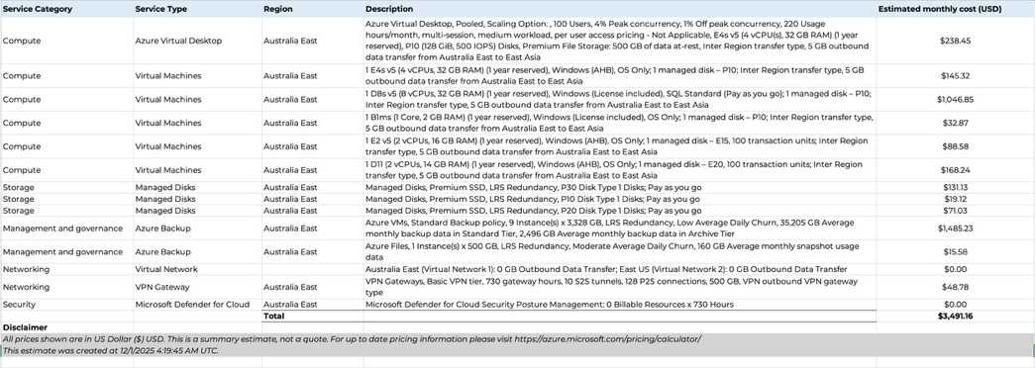
Azure costs
Example:
(based on 100 users)
Built using Azure’s pricing calculator, here's an example of a medium-sized organisation migrating to Azure. This design balances cost efficiency, user productivity and security compliance while supporting innovative growth with operational control.
What's included and why:
Azure Virtual Desktop: Cloud-hosted desktops for 100 users with pooled multi-session architecture and autoscaling for cost efficiency.
Virtual Machines: Right-sized
E-series and D-series VMs ensure performance for medium workloads, Azure Hybrid Benefit reduces licensing costs.
Premium SSD Storage: Guarantees low latency and predictable throughput for multi-user environments.
Backup & Governance: Daily snapshots protect infrastructure VMs and support compliance.
Networking: Virtual Network and VPN Gateway enable secure hybrid connectivity.
Security: Microsoft Defender for Cloud provides continuous posture management and threat protection.
Estimate only. Prices in USD and subject to change.

Slide 16
Modernising healthcare IT with Microsoft Azure
Case study:
The challenge:
A private Medical Centre with 100+ staff was struggling with outdated on-premises systems that were slow, costly to maintain and unable to scale for growing patient data or telehealth services. Frequent downtime disrupted operations, while security and compliance concerns added pressure.
The partner solution:
Working with Dicker Data and Microsoft, the CSP partner delivered:
Pre-sales assessment and clear migration planning
Secure Azure landing zone setup
EMR systems and application migration using rehost/replatform approach
Built-in security with Microsoft Defender
High availability through Locally Redundant Storage (LRS)
Cost optimisation with Reserved Instances
Access to Microsoft funding programs and partner incentives
Ongoing managed services including monitoring and staff training
The result:
IT costs dropped 25%, downtime during busy periods fell 30%, security and compliance were strengthened with automated reporting, and the centre gained flexibility to scale for future growth and telehealth services.
Annual revenue example for this scenario (100 users)
Partner Revenue/Cost | Year 1 Total
Azure Consumption Revenue USD (excl. Partner Services) | $42,000
Total Revenue/Cost (excl. Partner Services) | $42,000
Partner Profitability | Total
Profitability $ (excl. Partner Services) | $18,010
Profitability % (excl. Partner Services) | 43%
Partner Services (Managed & Support services)* | $8,400
Profitability $ (w Partner Services) | $26,410
Profitability % (w Partner Services) | 63%
* Eligibility & Approval subject to Terms & Conditions

Slide 17
Partner opportunity breakdown
Example:
(Based on 100 seats)
Here's how each component builds monthly recurring revenue per user, showing the value customers receive and your managed services opportunity.
Component | What’s included
Azure Consumption Cost (USD $35 pu/pm) | Compute (VMs) Storage (SQL, back-up, etc) Networking (bandwidth, VPN, etc) Licensing, Management and Governance (Windows, RDS CALs, etc)
Partner Services (USD $7 pu/pm) | Technical consulting Monthly health checks and optimisation services Ongoing managed and support services including extended hours + 24/7 critical support and 99.95% uptime SLA
$54,400
annual recurring revenue
Full stack offer together with your managed services @ $42 pu/pm
For 100 users: $4,200 USD/month | $50,400 USD annually

Slide 18
Complete earnings picture
Example:
(Based on 100 users, year 1)
 | Partner Revenue/Cost |  | Year 1 Total
 | Azure Consumption Revenue AUD | Azure Consumed Revenue (ACR) USD | $42,000
 | Total Revenue/Cost (excl. Partner Services) |  | $42,000
 | Partner Profitability |  | Total
 | Azure Funding Programs | Azure Credit Offer* | $4,200
 |  | Dicker Data Proof of Concept | $1,200
 |  | Azure Accelerate Program Funds (Post Deployment)* | $4,000
 | Azure CSP Incentives | CSP Standard Incentive @3% | $1,260
 |  | CSP Growth Incentive* @7.5% | $3,150
 | CSP Margin | Partner Earned Credits (PEC) | $4,200
 | Profitability $ (excl. Partner Services) | Partner Earning Potential $ | $18,010
 | Profitability % (excl. Partner Services) | Partner Earning Potential % | 43%
 | Partner Services (Managed & support services)* | Partner Services (Managed & support services)* @20% | $8,400
 | Profitability $ (incl. Partner Services) | Partner Earning Potential $ | $26,410
 | Profitability % (incl. Partner Services) | Partner Earning Potential % | 63%
In addition to your managed services revenue, Azure consumption generates ongoing revenue supported by Microsoft funding programs and CSP incentives.
63%
profitability
(including managed services)
* Eligibility & Approval subject to Terms & Conditions

Slide 19
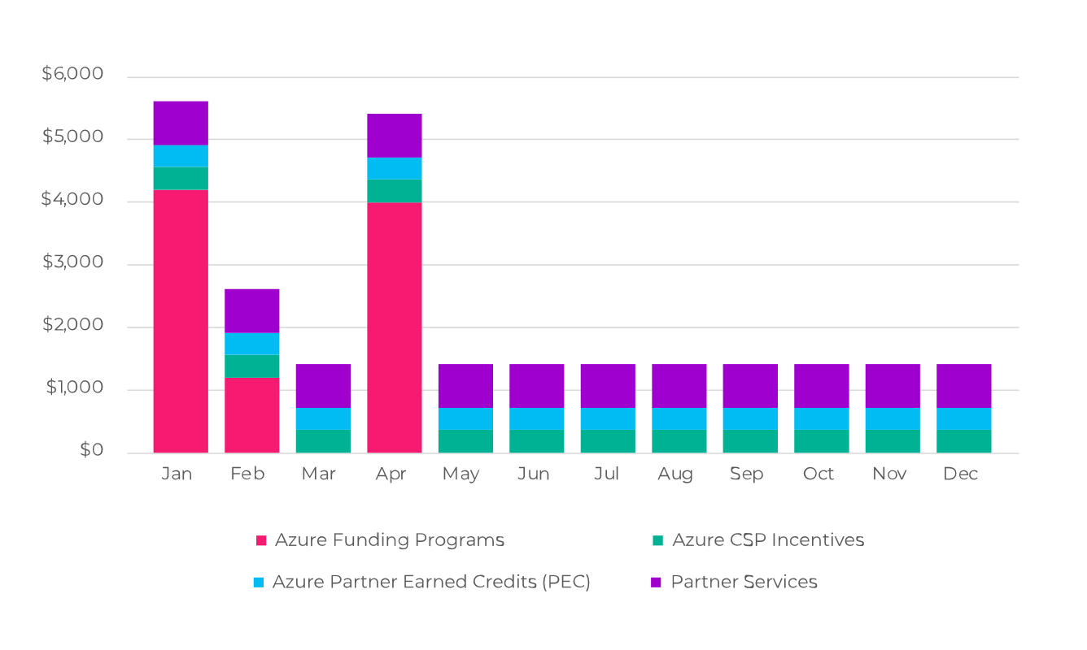
Complete earnings picture
Example:
Partner earning opportunity and profitability (including partner services)
This chart provides an example of your annual earnings when you combine your partner services with all the Azure incentives, funding programs and credits on offer.
Partner Earnings Opportunity & Profitability
(including Partner Services)

Slide 20
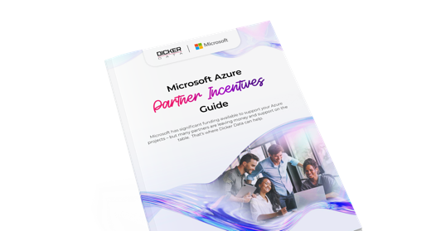
Funding and incentives at every stage
Pre-Sales
POC/Pilot
Post-Sales
Profitability
Business Case Development & Assessments
Build a solid foundation with expert assessment and planning.
Azure Credit Offer – 10% of annual forecasted spend Ease the budget for new SMB customers with a one-off credit.
Proof of Concept Funding – $1,000 to $2,500 AUD Validate your solution with funding during the testing phase.
Cloud Accelerate Factory – Zero-cost Access Microsoft experts to move customer workloads to Azure.
Azure Accelerate Post-Sales – $2,000-$12,000 USD per workload
Funding to support migration and deployment.
CSP Discounts & Incentives – Up to 7.5%
Earn partner credits and rebates based on consumption.
Download the complete
Microsoft Azure Incentives Guide

Slide 21
Start winning deals in three steps
1
Find your customers
Use CloudAscent yourself or ask for our help to identify ready-to-buy prospects within your customer base.
2
Qualify and convert
Use the pitch guides, objection handling and segment resources in this playbook to convert prospects.
3
Pitch Quick Start offers to customers
Pre-Sales Assessment
– Funded discovery to evaluate the current environment, map workloads to Azure and build the business case.
Funded Proof of Concept (POC) – Demonstrate value, validate business outcomes and build stakeholder confidence to secure buy-in.
Migration & Deployment
– Funded offer including environment setup, cost optimisation, security and compliance alignment
Ready to go?
Download the Build Your Foundations Selling Guide
for step-by-step support.

Slide 22





Meet your Azure specialists
Our Azure specialists help you build and scale your cloud practice. From migration strategy to solution architecture, we help you deliver Azure solutions to your customers.
Daniel Janicki, Practice Lead – Microsoft Azure (A/NZ)
Denham Williams, Cloud & AI Partner Solutions Specialist (AU)
Troy Stairmaid, Cloud & AI Partner Solutions Specialist (NZ)
Mikki Chopra,
Cloud Solution Architect
(A/NZ)
Saeed Nouri,
Cloud Solution Architect
(A/NZ)
Get in touch
Australia:
Sales support:
Microsoft.sales@dickerdata.com.au
Presales support:
microsoft.presales@dickerdata.com.au
Book a meeting with us
New Zealand:
Sales support:
microsoft.sales@dickerdata.co.nz
Presales Support: microsoft.presales@dickerdata.co.nz
Book a meeting with us

Slide 23
Build Your Foundation resources
Microsoft Resources
The Business Value of Migrating and Modernising IT Estate with Microsoft Azure​
The Total Economic Impact™ Of Migrating To Microsoft Azure For AI-Readiness​
2025 State of the Cloud Report | Flexera​
Azure Essentials resource kit​
Plan your migration – Cloud Adoption Framework​
Secure Overview – Cloud Adoption Framework​
Microsoft App Modernisation Guidance for Azure​
Microsoft Azure Well-Architected Framework​
FinOps on Azure | Microsoft Azure​
Azure Hybrid Benefit ​
Dicker Data Resources
Video Overviews (2-3 mins)​
Intent leads via CloudAscent​
Build Your Foundation pitch​
Understand incentives ​
Microsoft Azure vs. competitors​
Introduction to the selling guide​
​
Handy Guides​
Azure Partner Incentives Guide​
How to Sell Build Your Foundation
​
Go-to-Market Assets
Easily cobrand with your logo and company details
To Customer: Build Your Foundation Pitch Deck
Build Your Foundation Solution Brochure​
Azure vs. AWS cost savings ​
Microsoft Azure SQL Managed Instance benchmark vs. AWS RDS for SQL
Azure Virtual Machines Overview​
Azure Virtual Machine Scale Sets overview​
Azure Confidential Computing Overview​
Azure ExpressRoute​
Azure Storage Services Overview​
Azure Site Recovery ​
Azure Backup Recovery Services vault ​
Microsoft Defender for Cloud​
Azure AI Apps and AI Agents​

Slide 24


Let’s grow together
www.dickerdata.com.au/Microsoft
www.dickerdata.co.nz/Microsoft

