Slide 1


Azure Sales Playbooks
Essential cloud building
blocks for
AI Success
www.dickerdata.com.au/Microsoft
www.dickerdata.co.nz/Microsoft

Slide 2


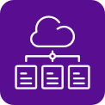

Your cloud and AI building blocks
These four sales plays create the intelligent cloud foundation your practice and customers need for AI success. Build systematically – each block strengthens the next.
Play 1:
Power Hybrid Work Azure Virtual Desktop
Play 2:
Build Your Foundation Infrastructure, Apps and Security
Move workloads to the cloud with confidence
Play 3:
Unify Your Data Analytics and Intelligence
Connect data silos and turn insight into action
Play 4:
Accelerate with AI Intelligent Automation
Secure, anywhere access to desktops and apps
Put AI to work across your business

Slide 3

Power your hybrid workforce with Azure Virtual Desktop
Play 1
This playbook focuses on Play 1 – enabling secure, flexible work from
anywhere. Inside, you'll find all you need to identify AVD opportunities,
pitch confidently and close deals:
Market context and ready-to-buy prospects
Pitch guidance by customer segment
Objection handling and competitor comparisons
Revenue models, incentives and funding programs
Customer-facing assets – just add your branding
Plus, our expert Azure team is here to help you identify leads, win deals and scale your AVD practice.

Slide 4
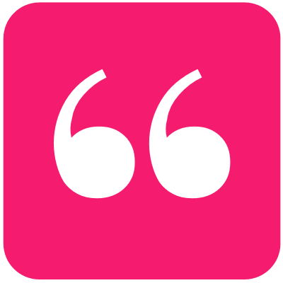
The opportunity is here and growing
Market drivers creating demand for AVD
Hybrid work is locked in – with 3 days a week in the office commonplace, 82% of employers expect it to remain or increase over the next two years¹
AI investment is surging – 88% of Australian companies and 90% in NZ plan to invest in AI in the coming year²
Cloud investment continues – Organisations are prioritising data security, scalability and cost optimisation²
Customers buy on value – 56% choose partners based on overall business impact, not just price²
AI could add $115 billion to Australia's GDP by 2030, with 70 per cent of that gain coming from greater productivity.”³
– Steven Worrall, former Managing Director, Microsoft ANZ
References:
1. Human Resources Director (HRD), 2025, Hybrid work enters 'stabilisation phase' in Australia
2. Tech Research Asia, Dicker Data & Microsoft, The Strategic Partner Shift, 2025
3. AFR, Economic summit can be AI’s ‘Team Australia’ moment, 2025

Slide 5
3,206 customers are ready to start!
CloudAscent – Microsoft’s tool that analyses data signals to identify buying patterns – reveals that 3,206 Australian organisations within Dicker Data’s partner ecosystem are prepared to begin their Azure journey by migrating their Remote Desktop Services (RDS) environments to Azure Virtual Desktop (AVD). How many of those are your customers?
Plus, 60% are ready to ACT NOW based on their existing Microsoft usage investments, business needs and technical fit.
We can train you to use CloudAscent to identify opportunities in your own customer base, or we can help you find ready-to-go prospects.
AVD Readiness

Slide 6
Identify your low-hanging fruit
Your customers are already primed for AVD
Here's where to focus based on their current Microsoft footprint:
Small (25–100 employees)
Customers with Microsoft 365 Business Premium ready to take their first step into Azure with secure remote work.
Medium (100–300 employees)
Businesses with mixed environments – Microsoft 365, E3 or E5 licenses – looking to modernise and simplify desktop delivery.
Large (300+ employees)
Organisations with E3/E5 plus legacy RDS, Citrix or VMware VDI ready to migrate and reduce infrastructure costs.
Start with customers who already trust you and have the Microsoft foundation in place.

Slide 7
What is AVD? Your elevator pitch
Short: Azure Virtual Desktop (AVD) delivers secure, flexible access to Windows desktops and apps from anywhere – without the complexity and cost of traditional desktop virtualisation.
Longer: Azure Virtual Desktop is Microsoft's cloud-based desktop virtualisation service. It lets teams access Windows desktops and apps securely from any device while reducing infrastructure costs, simplifying management and strengthening security. If you're already using Microsoft 365 or running legacy systems like Citrix, VMware or Remote Desktop Services, AVD is a natural next step — no additional licensing required.
Three reasons customers choose AVD:
Security built in – MFA, role-based access, Microsoft Defender and Zero Trust architecture
Lower costs – Multi-session Windows, autoscaling and use of existing M365 licenses
Faster deployment – Rapid setup, centralised control and easy remote access

Slide 8
Pitch by customer segment
Segment | Small (25–100 staff) Cloud-first SMBs using Microsoft 365 Business Premium. | Medium (100–300 staff) Mid-market businesses with hybrid environments. | Large (300+ staff) Organisations with Citrix / RDS / VMware legacy and/or complex compliance.
Pitch | Simple, secure and affordable virtual desktops. Save up to 40% vs on-prem VDI or unmanaged endpoints. | Hybrid flexibility with enterprise-grade security. Improve IT efficiency by 30%. | Full-scale modernisation for complex VDI environments. Reduce total VDI cost by 30-50% and improve uptime to 99.95%.
Core Benefits | Simplify IT management Enable secure remote work Lower infrastructure costs | Flexible, scalable desktops Security and compliance Better performance / uptime | Enterprise-grade scalability Multi-region resilience Legacy VDI modernisation
Core Features | AVD multi-session host pools FSLogix profiles M365 integration Managed patching 8x5 Support | Auto-scaling host pools Image & update management Intune integration 24x7 monitoring Monthly reporting | Custom AVD architecture App Attach Conditional Access & Defender integration Dedicated NOC/SOC support Quarterly strategy reviews

Slide 9

Know your audience
For AVD, the primary decision-makers will be IT leaders, including CIOs, IT managers and infrastructure architects.
What they need:
Scalable and secure infrastructure
Legacy system integration within budget
Cloud skills and capability
Other influencers to win over:
Business Leaders – Optimise operations and measure ROI. AVD delivers faster time-to-value, improved workforce efficiency and business resilience
Security & Compliance – Meet evolving regulations. AVD provides built-in security (MFA, RBAC), centralised policy control and compliance with ISO, HIPAA and GDPR standards
Workforce Managers – Support mobile and shift-based teams. AVD enables anywhere access, simplified provisioning and secure shared device usage
What AVD delivers:
Secure Windows 10 and 11 access from anywhere on Azure
Cost optimisation with multi-session capabilities and pay-as-you-go pricing
Built-in security and consistent management

Slide 10
Win over IT Leaders
What IT leaders need | How you can deliver with AVD
Secure access from anywhere Deliver Windows desktops and apps to any device while maintaining control | Familiar Windows 11, 10 and Server 2022 experiences Roaming user profiles for personalisation Full desktop or individual apps from any location Seamless M365 and Teams integration
Cost optimisation with flexibility Reduce infrastructure costs without long-term commitments | Use existing eligible M365 or Windows licenses Windows 10 and 11 multi-session capabilities Move from on-prem to cloud and reduce licensing costs Pay-as-you-go with no upfront payments
Built-in intelligent security Secure access across networks, devices, identities and data | Microsoft Entra ID and multi-factor authentication Single sign-on and passwordless options Private Link and RDP Shortpath for added security Screen capture protection and watermarking
Full management and control Configure and deliver working experiences with full control | Specify how and where desktops are distributed globally Azure Portal as a centralised management hub Easy scaling by adding hosts as needed Automate deployment with tooling that suits workflows Azure Virtual Desktop Insights for monitoring

Slide 11



AVD in action: Industry applications
Healthcare: Medical centre streamlines clinician access
Education: School supports diverse users securely
Manufacturing: Factory floor maximises uptime
Challenge: Permanent staff and visiting specialists struggled with complex login processes due to strict data security, wasting valuable patient care time.
Solution: AVD provides instant secure workstation access. With custom profiles, clinicians can log in from any device to access integrated patient systems within compliance guardrails.
Results:
Compliant: Meets HIPAA, ISO and PCI-DSS security standards
Speed: Clinicians log in quickly with roaming profiles
Integrated: Works with dictation systems, tap-to-login and EMR platforms
Challenge: A complex environment with teachers, relief staff, management, students and BYOD devices, requiring personalised access levels.
Solution: AVD creates secure profiles for every user type with appropriate access permissions, delivering a seamless experience across the entire school ecosystem.
Results:
Cost control: Multi-session Windows reduces infrastructure costs
Rapid deployment: IT provisions desktops in minutes without physical setup
Security: Protects sensitive data across all locations and devices
Challenge: Shared terminals accessed by different roles across multiple shifts needed flexible access while protecting sensitive operational data.
Solution: Role-based profiles mean any worker can use any terminal with pre-set access levels and functionality. Auto-logout protects unattended workstations.
Results:
Device consolidation: Reduces hardware footprint and costs
Secure access: Protects IP and operational data on shared endpoints
Scalability: Supports fluctuating workforce across shifts and sites

Slide 12
Common objections and how to respond
Objection | Response
“We don't want to manage more infrastructure.” | That's exactly why AVD works. It's a fully managed PaaS service with auto-scaling – Microsoft handles the infrastructure while you maintain control through Azure Portal.
“We have already deployed Remote Desktop Service (RDS).” | AVD reduces infrastructure overhead, improves security and supports modern work scenarios
“We currently use Citrix or VMware.” | AVD offers native M365 integration, Windows multi-session and lower total cost of ownership. Plus, AVD can coexist with your current infrastructure – you can start with a pilot.
“We're locked into VMware infrastructure.” | AVD can coexist with VMware. Start with hybrid deployments or pilot workloads, then migrate at your own pace. We offer funded assessments to map your path forward.
“Citrix has better performance.” | AVD now supports GPU workloads, auto-scaling and optimised Teams experience.
“AWS Workspaces is cheaper.” | AVD delivers richer features, seamless M365 integration and enterprise-grade security. For organisations already invested in Microsoft, AVD leverages existing licenses.

Slide 13



Competitive comparison
Feature / Benefit | Azure Virtual Desktop (AVD) | Citrix DaaS | VMware Horizon | AWS Workspaces
Native Microsoft 365 Integration | Full integration (Teams, OneDrive, Outlook) | Partial, add-ons required | Partial, add-ons required | Limited integration
Windows 11 Multi-Session | Included | Not available | Not available | Not available
Licensing Model | Included in M365 BP/E3/E5 | Separate Citrix licensing | Separate VMware licensing | Pay-as-you-go
Cloud Platform | Azure-native | Hybrid/cloud-agnostic | Hybrid/cloud-agnostic | AWS-native
Security & Compliance | Microsoft Entra ID, Defender, Conditional Access | Requires third-party tools | Requires third-party tools | AWS IAM, limited controls
Cost Efficiency | Consumption-based, multi-session | Higher infra & licensing cost | Higher infra & licensing cost | Simple pricing, but limited features
Management & Scalability | Azure Portal, Intune, Auto-scaling | Complex, requires Citrix Studio | Complex, requires Horizon Console | Simple, but less flexible
User Experience | Optimised for Teams, Office apps | Good, but requires tuning | Good, but requires tuning | Basic experience
Ideal Fit For | M365 customers, hybrid and remote work | Large enterprises with legacy VDI | Enterprises with a VMware stack | SMBs needing basic remote desktops

Slide 14
Infrastructure and licensing costs
Example:
(Based on 25 seats)
$1,400 USD per month
AVD solution (25 users)
2x Session Hosts
  8 vCPU (1-2 users per vCPU)
  64GB RAM
  Windows 11 Enterprise Multi-Session
  128GB OS Disk
15GB profile storage per user
15GB egress per user
Active Directory (IaaS)
2 vCPU
8GB RAM
Windows Server Standard
128GB OS Disk
Firewall
2 vCPU
  8GB RAM
  BYOL Third Party Vendor of Choice
  4GB OS Disk
  12.5Gb/s networking
General
Backup (Zone Redundant)
  30 day
  4 week
  6 month
  1 year
  1 instant
Application Server
4 vCPU
16GB RAM
Windows Server Standard
128GB OS Disk
Database Server
4 vCPU
16GB RAM
Windows Server Standard
SQL Server Standard
128GB OS Disk
256GB Data Disk

Slide 15
Empowering digital learning with AVD
Case study:
The challenge:
A regional school needed to replace its aging Remote Desktop Services (RDS) infrastructure with a more scalable, secure and cost-effective solution to support hybrid learning and administrative operations.
The partner solution:
Working with strategic services partner TechClick, Dicker Data supported the Microsoft partner to deliver:
Pre-sales technical consulting and environment assessment
Licensing alignment with existing Microsoft 365 Business Premium entitlements
Commercial strategy, business case and pricing guidance
Access to Microsoft funding programs and partner incentives
Funded AVD deployment support with minimal disruption
Ongoing managed services including monitoring, security and user training
The result
A seamless migration that gives educators and staff secure, anywhere access to school resources while reducing IT overhead and improving operational agility.
Annual revenue example for this scenario (25 users)
Component: | Annual Value (USD)
Microsoft 365 Business Premium Licensing | $8,250
AVD Infrastructure Revenue (Compute, storage, networking) | $16,500
Partner Services Revenue (Technical consulting, deployment, support) | $4,950
Total annual revenue | $29,700
Est. Profitability % excl partner services | 46%
Est. Profitability $ excl partner services | 11,408
Est. Profitability % incl partner services | 66%
Est. Profitability $ incl partner services | $16,358

Slide 16
Partner opportunity breakdown
Example:
(Based on 25 seats)
Here's how each component builds monthly recurring revenue per user, showing the value customers receive and your managed services opportunity.
Component | What’s included
Microsoft 365 Business Premium ($27.50 pu/pm) | Users & Devices Productivity Apps Email Calendar & scheduling Chat, Calling & Meetings AI Powered Assistance Insights & Analytics Identity & Access Management Device & App Management Cyber Threat Protection Data Security & Governance
AVD Infrastructure Costs ($55 pu/pm) | Compute (VMs) Storage (FSLogix profiles, OS disks) Networking (bandwidth, VPN, etc) Licensing (Windows, RDS CALs, etc.)
Partner Services ($16.50 pu/pm) | Technical consulting Professional Services Deployment Services Ongoing Managed & Support services
$29,700
annual recurring revenue
Full stack offer together with your managed services @ $99 pu/pm
For 25 users:
$2,475 USD/month | $29,700 USD annually

Slide 17
Complete earnings picture
Example:
(Based on 25 seats, Year 1)
 | Partner Revenue/Cost |  | Year 1 Total
 | Microsoft 365 Business Premium Licensing |  | $8,250
 | Revenue (from AVD) USD | Azure Consumed Revenue (ACR) USD | $16,500
 | Total Revenue/Cost (excl. Partner Services) |  | $24,750
 | Partner Profitability |  | Total
 | Microsoft 365 CSP Incentives | M365 CSP Core @3.75% | $309
 |  | M365 CSP Global Strategic Accelerator @3% | $248
 |  | M365 CSP Growth Accelerator @7.5% | $619
 | Azure Funding Programs | Azure Credit Offer* | $1,650
 |  | Dicker Data Proof of Concept | $1,200
 |  | Azure Accelerate Program Funds (Post Deployment)* | $4,000
 | Azure CSP Incentives | CSP Standard Incentive @3% | $495
 |  | CSP Growth Incentive* @7.5% | $1,238
 | CSP Margin | Partner Earned Credits (PEC) @10% | $1,650
 | Profitability $ (excl. Partner Services) | Partner Earning Potential $ | $11,408
 | Profitability % (excl. Partner Services) | Partner Earning Potential % | 46%
 | Partner Services (Managed & support services)* | Partner Services (Managed & support services)* @20% | $4,950
 | Profitability $ (incl. Partner Services) | Partner Earning Potential $ | $16,358
 | Profitability % (incl. Partner Services) | Partner Earning Potential % | 66%
In addition to your managed services revenue, Azure consumption generates ongoing revenue supported by Microsoft funding programs and CSP incentives.
66%
profitability
(including managed services)
* Eligibilty & Approval subject to Terms & Conditions

Slide 18
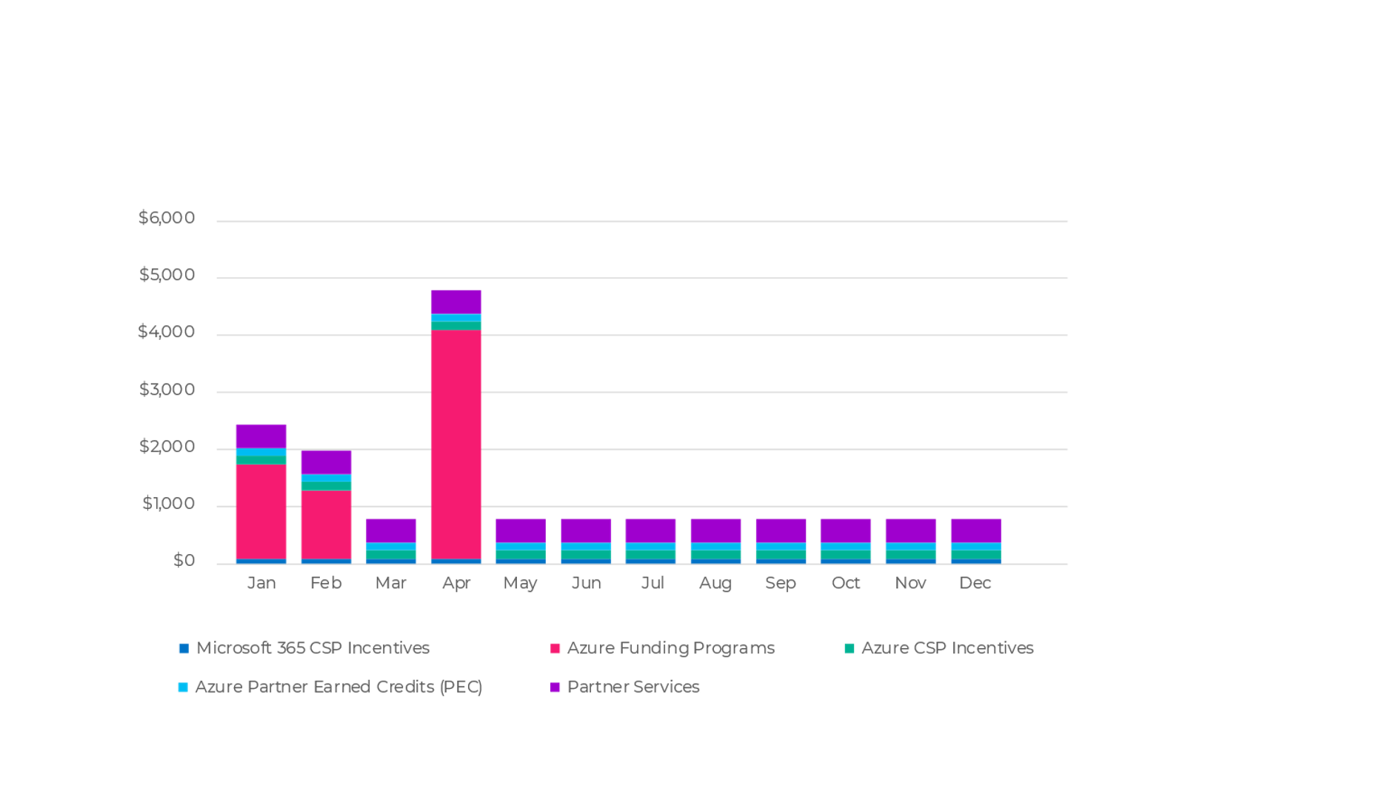
Complete earnings picture
Example:
Partner earning opportunity and profitability (including partner services)
This chart provides an example of your annual earnings when you combine your partner services with all the Azure incentives, funding programs and credits on offer.

Slide 19
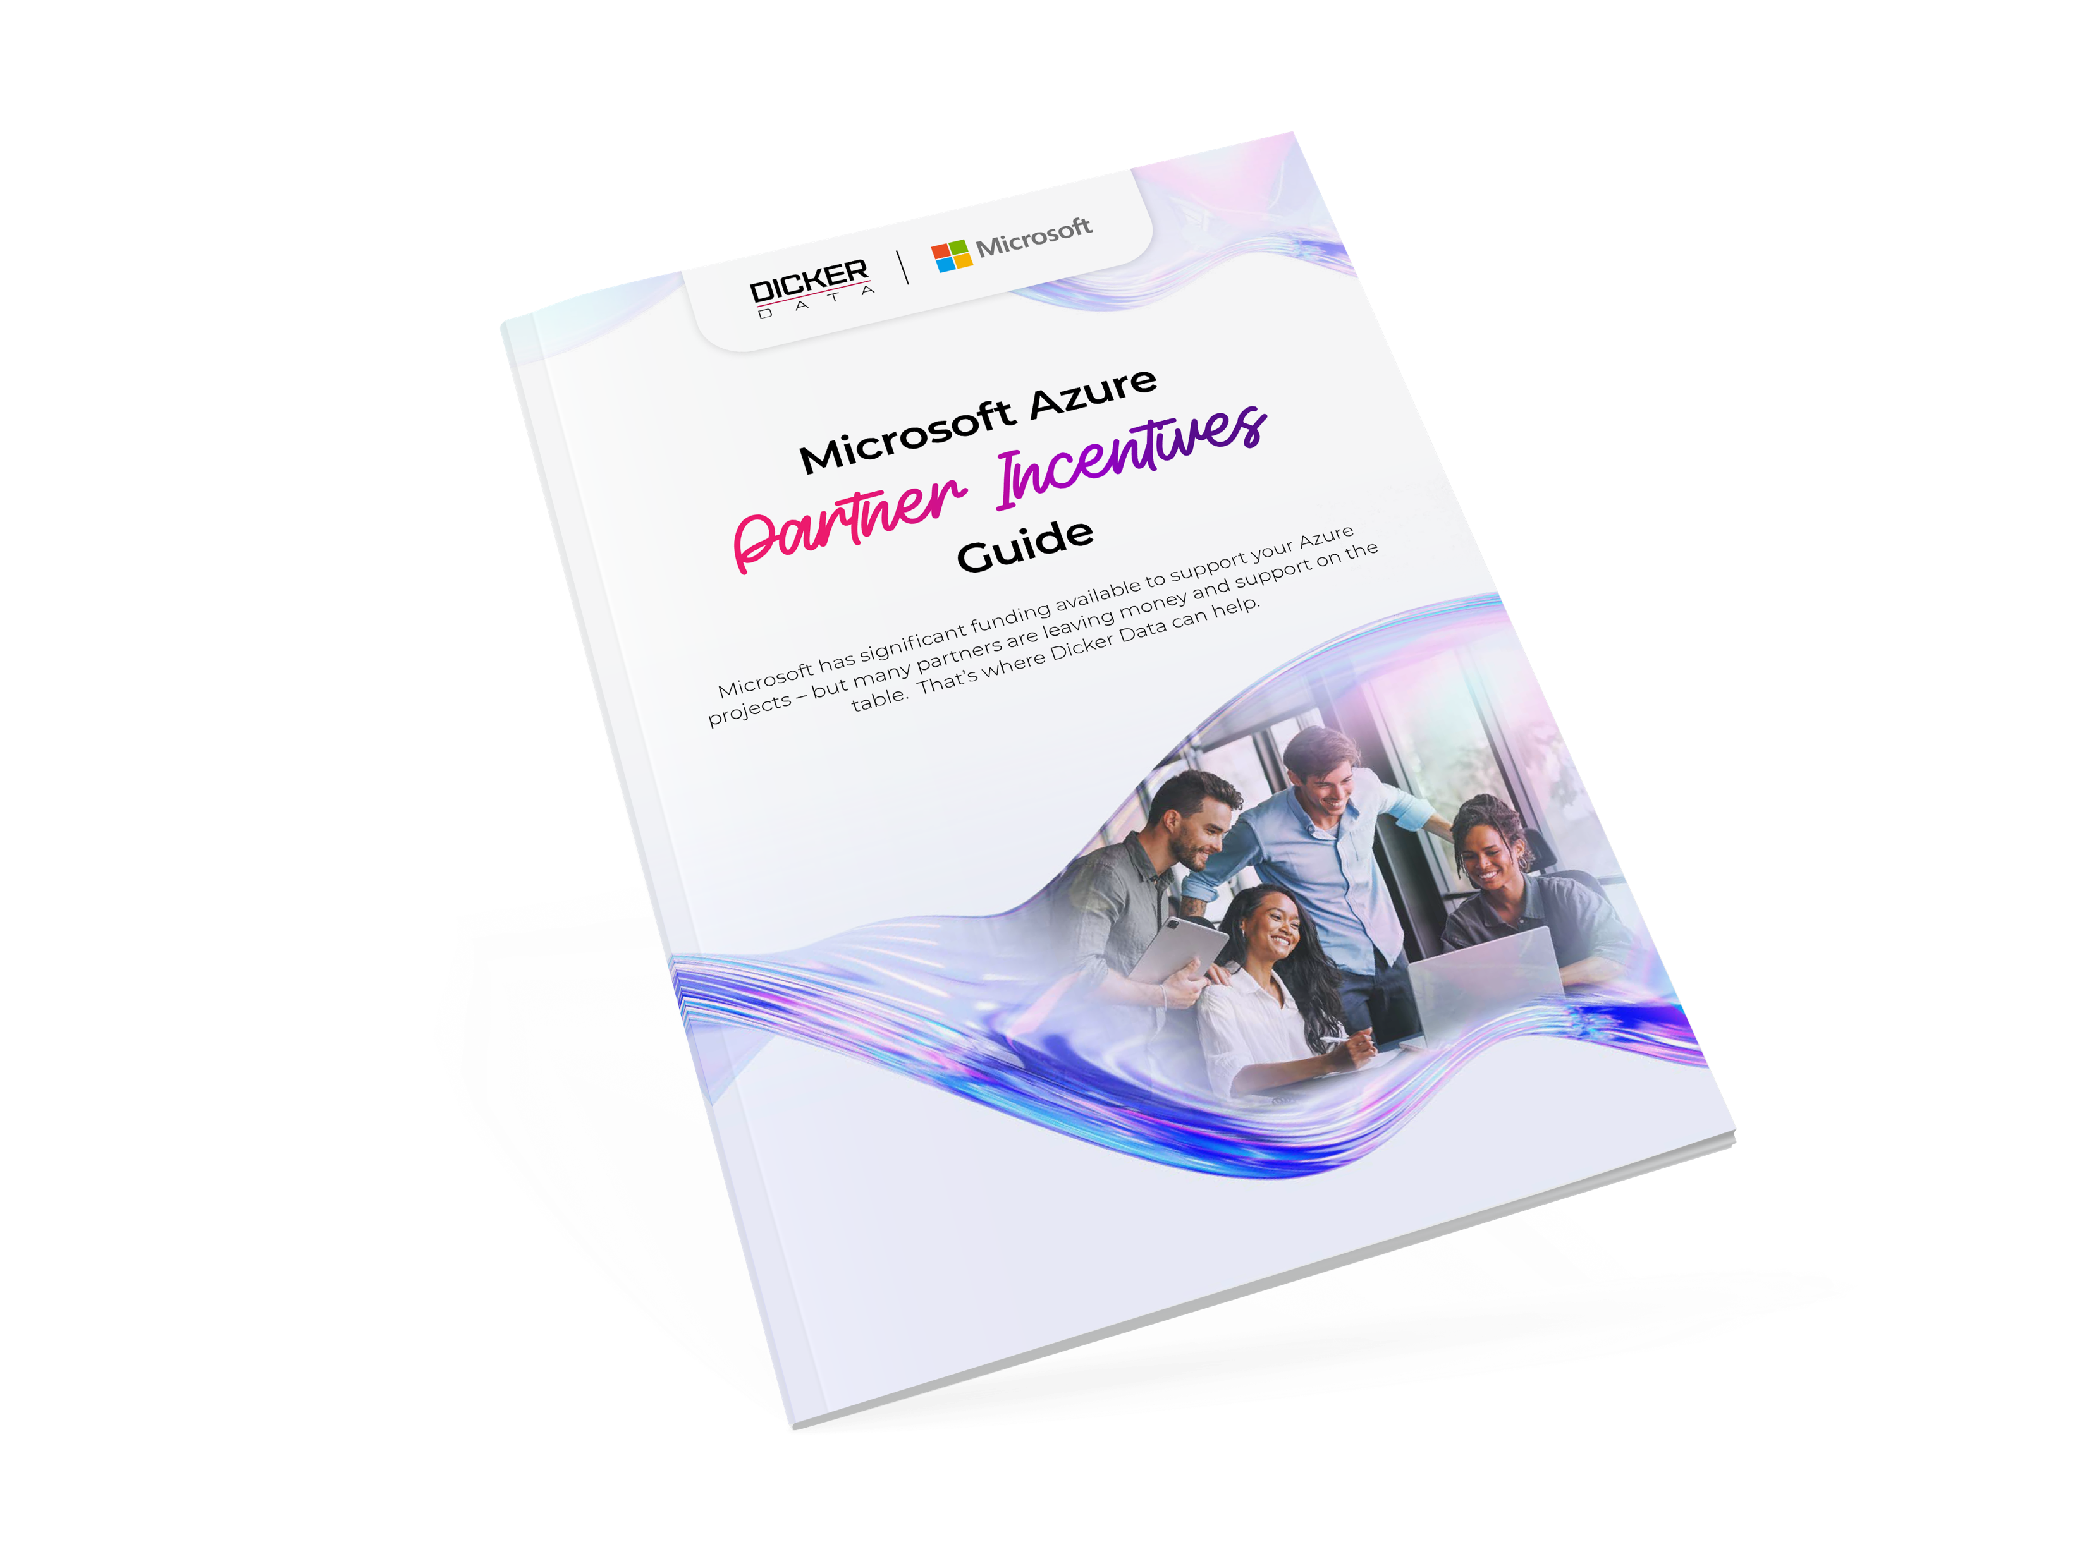
Funding and incentives at every stage
Pre-Sales
POC/Pilot
Post-Sales
Profitability
Business Case Development & Assessments
Build a solid foundation with expert assessment and planning.
Azure Credit Offer – 10% of annual forecasted spend Ease the budget for new SMB customers with a one-off credit.
Proof of Concept Funding – $1,000 to $2,500 AUD Validate your solution with funding during the testing phase.
Cloud Accelerate Factory – Zero-cost Access Microsoft experts to move customer workloads to Azure.
Azure Accelerate Post-Sales – $2,000-$12,000 USD per workload
Funding to support migration and deployment to AVD.
CSP Discounts & Incentives – Up to 7.5%
Earn partner credits and rebates based on consumption.
Download the complete
Microsoft Azure Incentives Guide

Slide 20

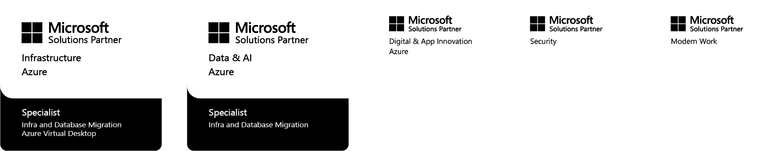
MSP-Ninja
Channel‑only AVD expertise
MSP-ninja.com/ContactUs
Sample Scenario for 25 typical knowledge workers
Self-Managed: | 25 users
AVD Self-Managed (AVD automation platform only) | $375
We leave the rest to you …
MSP-Ninja Managed: | 25 users
AVD Automation Platform | $2,375
Maintenance & Optimisation
IT-to-IT Support
Azure Compute & Storage
Bring your own licencing & add your standard services.
Need more help?
MSP-Ninja provides specialised Azure Virtual Desktop (AVD) services exclusively for MSPs. We work behind the scenes, white‑labelled to your brand, to accelerate your AVD practice and margin.
What you get
Pre‑sales support — technical consulting, environment assessment, and deal shaping
Commercial guidance — business case, pricing, and funding pathways
Funded deployment — expert build, onboarding, security alignment, cost optimisation
AVD automation platform — reduce operational overhead, improve consistency, maximise margin
Choose your operating model — self‑managed or fully managed (monitoring, security, training)
Start a conversation at
MSP-ninja.com/ContactUs

Slide 21
Start winning AVD deals in three steps
1
Find your customers
Use CloudAscent yourself or ask for our help to identify ready-to-buy prospects within your customer base.
2
Qualify and convert
Use the pitch guides, objection handling and segment resources in this playbook to convert prospects.
3
Pitch Quick Start offers to customers
Pre-Sales Assessment
Funded discovery to evaluate current environment, map workloads to AVD and build the business case.
Proof of Concept Demonstrate AVD's performance, security and cost benefits with real workloads to build stakeholder confidence.
Migration & Deployment Funded offer including environment setup, user onboarding, security alignment and cost optimisation.
Ready to go?
Download the
How to Sell AVD Guide
for step-by-step support.

Slide 22




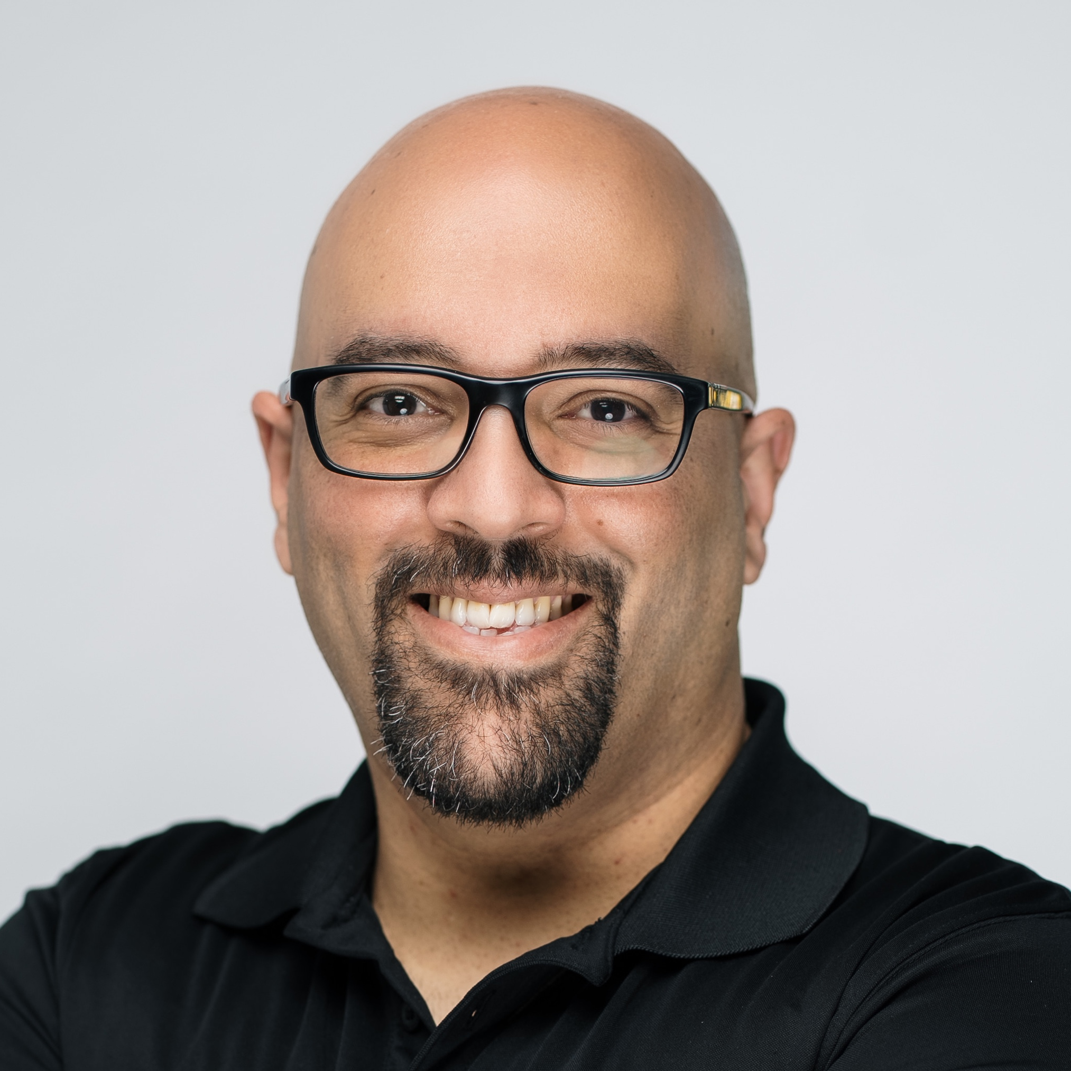
Meet your Azure specialists
Our Azure specialists help you build and scale your cloud practice. From migration strategy to solution architecture, we help you deliver Azure solutions to your customers.
Daniel Janicki, Practice Lead – Microsoft Azure (A/NZ)
Denham Williams, Cloud & AI Partner Solutions Specialist (AU)
Troy Stairmaid, Cloud & AI Partner Solutions Specialist (NZ)
Mikki Chopra,
Cloud Solution Architect
(A/NZ)
Saeed Nouri,
Cloud Solution Architect
(A/NZ)
Get in touch
Australia:
Sales support:
Microsoft.sales@dickerdata.com.au
Presales support:
microsoft.presales@dickerdata.com.au
Book a meeting with us
New Zealand:
Sales support:
microsoft.sales@dickerdata.co.nz
Presales Support: microsoft.presales@dickerdata.co.nz
Book a meeting with us

Slide 23
Comprehensive AVD resources
Microsoft Resources
Training & Enablement
Azure Virtual Desktop video intro / virtual tour
Microsoft Virtual Training Days
Azure Virtual Desktop Partner Resources
Azure Virtual Desktop Learning Paths
Azure Virtual Desktop Assessment
Marketing
Microsoft Commerce Incentive Resources
Grow Your AVD Business Slide Deck
Dicker Data Resources
Video Overviews (2-3 mins)
Intent Leads via CloudAscent
AVD Pitch
Understand AVD incentives
AVD vs. Competitors
Intro to How to Sell AVD pack
Handy Guides
AVD Incentives
How to Sell AVD
Go-to-Market Assets
Easily cobrand with your logo and company details
To Customer AVD Pitch Deck
AVD Solution Brochure

Slide 24


Let’s grow together
www.dickerdata.com.au/Microsoft
www.dickerdata.co.nz/Microsoft

