Slide 1

Azure Sales Playbooks
Essential cloud building
blocks for
AI Success
www.dickerdata.com.au/Microsoft
www.dickerdata.co.nz/Microsoft

Slide 2
Your cloud and AI building blocks
These sales plays create the intelligent cloud foundation your practice and customers need for AI success. Build systematically – each block strengthens the next.
Play 1:
Power Hybrid Work Azure Virtual Desktop
Play 2:
Build Your Foundation Infrastructure, Apps and Security
Move workloads to the cloud with confidence
Play 3:
Unify Your Data Analytics and Intelligence
Connect data silos and turn insight into action
Secure, anywhere access to desktops and apps

Slide 3

Unify Your Data with Analytics and Intelligence
Play 3
This playbook focuses on Play 3 – connecting data silos and building the unified analytics foundation your customers need to make faster decisions and prepare for AI. Inside, you'll find all you need to identify data analytics opportunities, pitch confidently and close deals:
Market context and ready-to-buy prospects
Pitch guidance by customer segment
Objection handling and competitor comparisons
Revenue models, incentives and funding programs
Customer-facing assets – just add your branding
Plus, our expert Azure team is here to help you identify leads, win deals and scale your data analytics practice.

Slide 4
The opportunity is here and growing
Market drivers creating demand for Microsoft’s Data Analytics Platform (DAP)
Data is a critical foundation for AI – 63% of organisations lack the right data management practices for AI, and 60% of AI projects without AI-ready data will be abandoned¹
Another wave of cloud investment – Australian organisations are prioritising data security, scalability and cost optimisation as their top three cloud investment areas²
Customers buy on value – 56% choose partners based on overall business impact and value, seeking support to bridge the gap between today and their goals for 2030²
Some see AI as a magic bullet – With Australia lagging behind OECD peers in productivity for over a decade3, businesses see AI as both a productivity and compliance driver
AI could add $115 billion to Australia's GDP by 2030, with 70 per cent of that gain coming from greater productivity.”⁴
– Steven Worrall, former Managing Director, Microsoft ANZ
References:
1. Technology Decisions, How to prepare your data for AI success, 2025
2. Tech Research Asia, Dicker Data and Microsoft: The Strategic Partner Shift, 2025
3. AFR, Weak productivity bites businesses, but AI is helping close the gap, 2025
4. AFR, Economic summit can be AI's 'Team Australia' moment, 2025

Slide 5
8,311 customers are ready to start!
CloudAscent – Microsoft's tool that analyses data signals to identify buying patterns – reveals that 8,311 Australian organisations within Dicker Data's partner ecosystem are prepared to begin their data analytics and intelligence journey. How many of those are your customers?
Plus, 47% are ready to ACT NOW based on their existing Microsoft usage investments, business needs and technical fit.
We can train you to use CloudAscent to identify opportunities in your own customer base, or we can help you find ready-to-go prospects.
Data Analytics Platform Services
– Customer Readiness

Slide 6
Identify your low-hanging fruit
Target customers who are primed for data analytics
A strong prospect meets three or more of these:
AUD $3,500+ per month in Azure Consumed Revenue (ACR)
Using Azure Data Services – Synapse, Azure Data Factory or competitor platforms such as Snowflake or Databricks
50+ seats of E5, E3, Business Premium, Dynamics 365 and/or Power BI
Heavy users of Excel, Power BI or Teams for reporting
Leadership asking for data-driven decision-making
Manually built reporting or dashboards
Already exploring GenAI tools such as Azure OpenAI
Keen on production AI, not just pilots
Medium (100-300 employees)
Fragmented analytics environment – strong candidates for Microsoft Fabric to unify data warehousing, integration and BI, reducing technical debt and improving self-service reporting.
Large (300+ employees)
Mature Microsoft investments alongside complex, siloed third-party platforms – primed for consolidation with Microsoft Fabric around platform rationalisation, cost optimisation and AI-ready analytics.

Slide 7
What is Microsoft DAP? Your elevator pitch
Use these pitches to introduce the opportunity to customers.
Short: Microsoft’s Data Analytics Platform (DAP) unifies data engineering, real-time analytics and business intelligence into a single, scalable ecosystem, so your customers can break down data silos and drive smarter decisions with the tools they already use.
Longer: Microsoft DAP extends the familiar tools your customers are already invested in – Microsoft 365, Power BI, Azure and Dynamics 365 – into a modern, end-to-end analytics solution. There’s no rip-and-replace. It lowers adoption risk, accelerates time-to-value and gives business users faster access to trusted insights while IT maintains control, security and compliance across the data estate.
Three reasons customers choose Microsoft DAP:
Builds on what they already own – adds modern analytics to Microsoft 365, Power BI, Azure and Dynamics 365 without forcing a platform change, and reduces the need for specialist skills
One unified platform – Microsoft Fabric and Azure Synapse unify data ingestion, storage, analytics and visualisation in one governed environment, reducing tool and data fragmentation
Scales to AI – from basic BI and dashboards to real-time insights, AI integration and Copilot-driven scenarios, customers can start small and grow confidently without re-architecting later

Slide 8
Pitch by customer segment
Segment | Medium (100–300 staff) Mid-market organisations with fragmented analytics environments. | Large (300+ staff) Enterprises with complex, siloed data platforms ready to modernise.
Pitch | Unify your data today and scale with confidence tomorrow. Consolidates Azure SQL, Data Factory, Power BI and analytics workloads Reduces technical debt and duplicated data pipelines Supports growth without re-architecting later | Simplify analytics and build a future-ready, AI-driven data platform. Simplifies Synapse, Data Lake, Power BI and Databricks-style architectures Improves governance, security and cost control at scale Aligns analytics strategy with AI and Copilot-driven initiatives
Core Benefits | Unified, governed analytics across multiple data sources Scales reporting and analytics as the business grows | Reduced platform complexity and operational cost AI-ready analytics foundation aligned to future innovation
Core Features | Microsoft Fabric or Azure Synapse for data integration, analytics and BI Azure Data Factory and Power BI for centralised self-service insights | Microsoft Fabric and Azure Synapse with Data Lake for large-scale analytics and governance Deep integration with Power BI, Azure ML and AI services for advanced analytics

Slide 9

Know your audience
User personas and key decision makers
Persona | Top priorities | Why Microsoft DAP?
Business Decision Maker CIO / CTO / Head of IT | Simplified, secure analytics platform that reduces tool sprawl Confidence the platform will scale and support AI Lower operational costs and risk | Unified analytics platform (Fabric / Synapse) reduces tool sprawl and operational overhead Built-in security, governance and Azure integration aligned to enterprise IT standards
Data & Analytics Leader CDO / Head of Data / Analytics Manager | Trusted, high-quality data available across the business Faster delivery of insights without constant re-engineering Better collaboration between data engineers, analysts and data scientists | OneLake provides a single logical data lake shared across all analytics workloads Persona-based experiences (Data Engineering, Data Science, Power BI) allow teams to work differently on the same data without duplication
Business Analyst / Power BI Lead | Easy self-service access to trusted data Minimal disruption to existing Power BI workflows Faster time from data to insight | Power BI is natively embedded in Fabric, preserving familiar tools and skills Direct access to governed data in OneLake enables fast, consistent insights without manual data preparation

Slide 10
Azure Data Services in action: Industry applications
Retail & Consumer Goods: Unifying data for real-time insights
Manufacturing & Industrial: Connecting OT and IT data to lift efficiency
Financial Services: Governed, AI-ready analytics at scale
Challenge: Retailers struggle
with fragmented data across POS,
e-commerce, loyalty, supply chain and marketing systems, resulting in delayed insights, poor demand forecasting and limited personalisation.
Solution: Microsoft Fabric with Real-Time Intelligence unifies transactional, behavioural and operational data into a single analytics environment, giving retailers near real-time visibility across sales, inventory, promotions and customer behaviour using OneLake, Power BI and streaming analytics.
Results:
Faster, data-driven decisions on pricing, promotions and inventory
Improved customer experience through personalised offers
Reduced stockouts and overstocking with real-time insights
Challenge: Manufacturers generate massive volumes of OT and IT data from sensors, machines, MES, ERP and supply chain systems, but most of it remains siloed and underutilised, limiting operational visibility and increasing downtime risk.
Solution: Microsoft Fabric, Azure Synapse and Azure Data Lake unify OT and IT data into a single source of truth for operational and enterprise analytics, supporting predictive maintenance, quality monitoring and production optimisation.
Results:
Reduced unplanned downtime through predictive insights
Improved operational efficiency and production quality
Faster decision-making across plant and corporate teams
Challenge: Financial services organisations face high regulatory pressure, fragmented data estates and growing demands for real-time risk, fraud and customer insights that legacy analytics platforms struggle to deliver.
Solution: Microsoft Fabric for Financial Services provides a governed, AI-ready analytics foundation that unifies data ingestion, real-time analytics, BI and compliance controls, supporting fraud detection, risk analytics and regulatory reporting.
Results:
Faster fraud detection and risk response using real-time analytics
Improved regulatory compliance with automated governance and lineage
Reduced operational cost through platform consolidation

Slide 11
Common objections and how to respond
Objection | Response
“We already use Databricks.” | Fabric complements or consolidates Databricks workloads, reducing overheads and simplifying your analytics architecture.
“We're concerned about migration.” | Microsoft and Dicker Data offer funded POCs, tools and services to support the end-to-end process.
“We need real-time insights.” | Fabric supports streaming analytics and real-time dashboards natively.
“This looks expensive compared to other tools.” | Fabric consolidates multiple analytics services into one platform, eliminating duplicated tools, storage and integration overhead – scale usage only when needed.
“We already use Power BI, why do we need more?” | Fabric extends Power BI by adding built-in data integration, engineering, real-time analytics and AI on the same data foundation, without changing how analysts work day to day.
“This seems too complex for our team.” | Fabric is a SaaS platform with role-based experiences, so business users, analysts and engineers each work in familiar interfaces while Microsoft manages the underlying infrastructure.
“We're worried about governance, security and compliance.” | Governance and security are built in through OneLake, Microsoft Purview and Azure security controls, providing consistent data access, lineage and compliance across all workloads.
“We don't want to migrate or duplicate all our data.” | Fabric supports mirroring and open data formats, so customers can analyse existing data in near real time without full migration or duplication.
“We're not ready for AI yet.” | Customers can start with BI and analytics immediately, while Fabric provides an AI-ready foundation for future Copilot and advanced analytics use cases without re-architecting later.

Slide 12
Competitive comparison
Key Feature​ | Microsoft Data Analytics (Fabric / Synapse / Power BI)​ | Snowflake​ | Databricks​ | Google BigQuery​ | Amazon Redshift​ | Tableau / Looker (BI‑only)​
End‑to‑end analytics platform​ | Unified BI, data engineering, warehousing, real‑time and AI in one SaaS platform​ | Data warehouse only (needs external tools)​ | Strong engineering and ML, BI requires integration​ | Primarily data warehouse​ | Data warehouse only​ | BI only​
Unified data storage layer​ | OneLake, single copy of data across workloads​ | Separate storage per workload​ | Delta Lake, often duplicated across tools​ | Warehouse centric storage​ | Warehouse centric storage​ | No native storage​
Native BI and self service analytics​ | Power BI embedded​ | Requires Power BI/Tableau/Looker​ | Requires BI tool​ | Looker integration​ | Quick Sight​ | Core strength​
Real‑time & streaming analytics​ | Built-in (Fabric RealTime Intelligence)​ | Limited, add‑ons required​ | Strong streaming​ | Supported​ | Limited​ | Not supported​
AI ready and Copilot experiences​ | Built-in Copilot and AI across analytics​ | Expanding AI features​ | Strong ML focus​ | SQL based ML​ | Limited​ | Limited / BI focused​
Governance and security​ | Unified governance via OneLake and Purview​ | Strong, but separate tooling​ | Unity Catalog​ | Google IAM​ | AWS IAM​ | BI layer governance only​
Microsoft ecosystem integration​ | Deep integration with Azure, M365, Dynamics​ | Platform agnostic​ | Azure integrated​ | Google centric​ | AWS centric​ | Tool level only​
Total cost and tool consolidation​ | Lower TCO via platform consolidation​ | Can become costly at scale​ | High compute costs​ | Query based pricing​ | Cluster based pricing​ | BI licensing adds cost​

Slide 13
Infrastructure and licensing costs
The Fabric SKU you select determines whether per-user Power BI licensing is required. Getting this right upfront avoids surprises when pricing a deal.
Infrastructure | Licensing (if using Power BI)​ | Other (optional but recommended)
F64 or greater SKU​ | No per-user Power BI licence needed* | Security and DR services
Anything less than F64​ | Per-user Power BI licence needed*
OneLake storage (PAYG)​ | N/A
* Report creation requires a per-user Power BI license

Slide 14
A logistics company with 100+ staff replaced manual reporting with real-time analytics in 6 weeks
EXAMPLE Case study:
The challenge:
A logistics company that had grown quickly still relied on Excel and manual reporting across disconnected systems – Xero, a SaaS logistics platform and ad-hoc spreadsheets. Monthly reporting took over a week, data was inconsistent and leadership lacked confidence in their numbers.
The solution:
The partner implemented Microsoft Fabric (F4 capacity) as a central analytics layer, ingesting data from all key systems using Fabric Data Factory. OneLake standardised core datasets and Power BI dashboards gave finance, operations and leadership self-service access to trusted, enterprise-grade insights – delivered in 6 weeks with minimal disruption and equipped to grow with the business.
The results
Monthly reporting reduced from one week to less than one day
Leadership gained a single, trusted view across finance and operations
Hidden margin leakage identified across customer routes, enabling pricing adjustments that improved profitability
Customer renewed licensing and managed services for year two
Annual revenue example for this scenario (100 users)
Revenue Stream | Description | Est. Revenue
Initial Implementation Services​ | Data ingestion, modelling, dashboards (6-week project)​ | $22,000​
Power BI Enablement & Training​ | User training + adoption support​ | $3,000​
Ongoing Managed Services​ | Platform support & enhancements ($1,200/month)​ | $14,400 (annual)​
Licence Resale / Margin​ | Power BI Pro + Fabric advisory margin​ | $2,500 (annual)​
Total Year‑1 Partner Revenue​ | ​ | $41,900​
Item | Amount
Delivery & Support Costs​ | ~$23,000​
Estimated Gross Profit​ | ~$18,900​
Estimated Gross Margin​ | ~45%​

Slide 15
Opportunity breakdown
Example:
(Based on a mid-market organisation)
Here's how a typical Microsoft DAP engagement breaks down – from platform costs to managed services – and what that means for total customer value and your recurring revenue.
Solution Component | Microsoft Product | What’s Included
Business Intelligence | Power BI Pro | Dashboards & reports, sharing & collaboration, Microsoft 365 & Teams integration
Unified Analytics Platform | Microsoft Fabric (F2 capacity) | Data ingestion (Fabric Data Factory), semantic models, scalable analytics foundation
Operational Data Store | OneLake (Data warehouse) | Central reporting database, managed backups, security, auto‑scaling
Data Integration & Automation | Fabric Data Factory | Scheduled ingestion from SaaS apps, transformations, monitoring (included with Fabric)
Total Microsoft Platform Cost (USD)
Ongoing Managed Services Scope
Total Customer Value (Platform + Partner)
Components | Monthly | Annual
Fabric F4 (Aus East) | $613.20 | $7,358.40
One Lake Storage (Aus East) | $4.25 | $51.00
Power BI Pro (100 users) | $1400.00 | $16,800.00
Total Microsoft Spend | $2,017.45 | $24,209.40
Fabric capacity monitoring & optimisation
Data pipeline health & failure remediation
Power BI model tuning & report enhancements
Security & access management
Monthly stakeholder reporting & roadmap planning
Light change requests (new fields, KPIs, sources)
Troubleshooting.
Category | Annual Cost
Microsoft licenses & capacity | $24,209.4
Partner managed services | $12,000.00
Total Annual Customer Value | $44,609.40
Example Managed Services Pricing | $1,000.00 (Per month) | $12,000.00 (Per year)
Around 33% of total value sits with partner‑led managed services, making it a highly attractive recurring‑revenue model.
Equivalent to ~8–10 hours/month at a blended partner rate
Conservative for ANZ SMB data & analytics services
Estimate only. Prices in USD and subject to change.

Slide 16
Complete earnings picture
Example:
(Based on 100 users, year 1)
 | Partner Revenue/Cost |  | Year 1 Total
 | Power BI Pro Licensing |  | $16,800
 | Fabric (USD) | Azure Consumed Revenue (ACR) USD | $7,358
 | One Lake Storage |  | $51.00
 | Total Revenue/Cost (excl. Partner Services) |  | $24,158
 | Partner Profitability |  | Total
 | Azure Funding Programs | Azure Credit Offer* | $741
 |  | Dicker Data Proof of Concept | $741
 |  | Azure Accelerate Program Funds (Post Deployment)* | $2,000
 | Azure CSP Incentives | CSP Standard Incentive @3% | $221
 |  | CSP Growth Incentive* @7.5% | $552
 | CSP Margin | Partner Earned Credits (PEC) @10% | $741
 | Profitability $ (excl. Partner Services) | Partner Earning Potential $ | $4,995
 | Profitability % (excl. Partner Services) | Partner Earning Potential % | 21%
 | Partner Services (Managed & support services)* | Partner Services (Managed & support services) | $12,000
 | Profitability $ (incl. Partner Services) | Partner Earning Potential $ | $16,995
 | Profitability % (incl. Partner Services) | Partner Earning Potential % | 70%
In addition to your managed services, Fabric, Power BI licensing and OneLake storage generate ongoing revenue, with Microsoft funding programs and CSP incentives boosting your overall profitability.
70%
profitability
(including managed services)
* Eligibility & Approval subject to Terms & Conditions

Slide 17
Complete earnings picture
Example:
Partner earning opportunity and profitability (including partner services)
This chart provides an example of your annual earnings when you combine your partner services with all the Azure incentives, funding programs and credits on offer.
Partner Earnings Opportunity & Profitability
(including Partner Services)

Slide 18
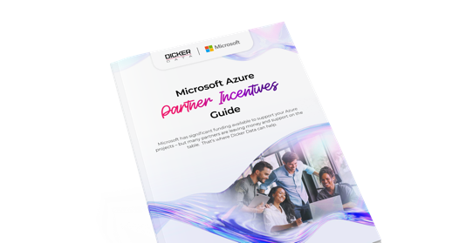
Funding and incentives at every stage
Pre-Sales
POC/Pilot
Post-Sales
Profitability
Business Case Development & Assessments
Build a solid foundation with expert assessment and planning.
Azure Credit Offer – 10% of annual forecasted spend Ease the budget for new SMB customers with a one-off credit.
Proof of Concept Funding – $1,000 to $2,500 AUD Validate your solution with funding during the testing phase.
Cloud Accelerate Factory – Zero-cost Access Microsoft experts to move customer workloads to Azure.
Azure Accelerate Post-Sales – $2,000-$12,000 USD per workload
Funding to support migration & deployment of Databases and Data Analytics Platform Services.
CSP Discounts & Incentives – Up to 7.5%
Earn partner credits and rebates based on consumption.
Download the complete
Microsoft Azure Incentives Guide

Slide 19
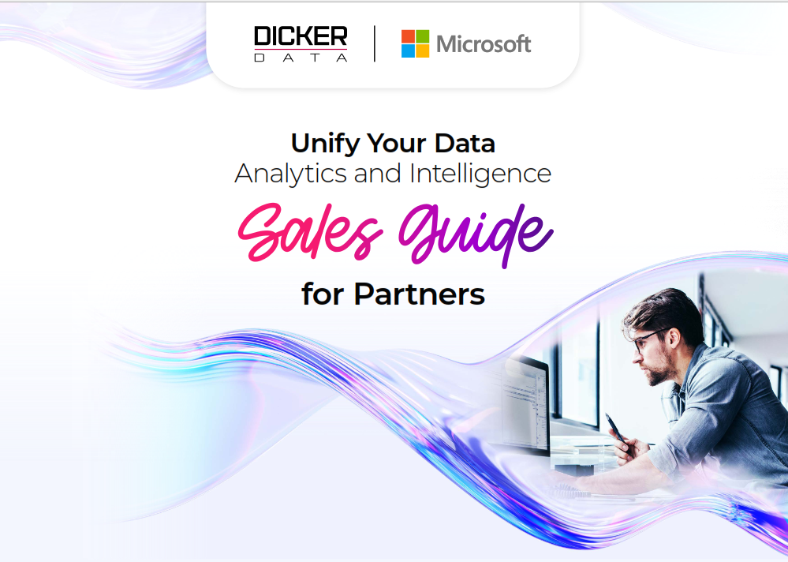
Start winning deals in three steps
1
Find your customers
Target organisations already using Azure data services – Synapse, Azure Data Factory, Power BI (50+ seats) or Microsoft 365 – with an active need for better reporting. Start conversations about where manual effort or data inconsistencies are slowing them down.
2
Lead with a quick win
Start with a small, fixed-scope offer such as one or two dashboards built on real customer data. Low risk, rapid ROI, easy to price and a natural entry point to deeper platform conversations about Fabric, governance and managed services.
3
Sell outcomes, not tools
Focus on business questions customers can't currently answer: profitability, growth drivers, operational performance. When analytics solves a real problem, the platform conversation follows naturally, price becomes less of an obstacle.
Ready to go?
Download the Unify Your Data Selling Guide for step-by-step support.

Slide 20




Meet your Azure specialists
Our Azure specialists help you build and scale your cloud practice. From migration strategy to solution architecture, we help you deliver Azure solutions to your customers.
Daniel Janicki, Practice Lead – Microsoft Azure (A/NZ)
Troy Stairmand, Cloud & AI Partner Solutions Specialist (NZ)
Mikki Chopra,
Cloud Solution Architect
(A/NZ)
Saeed Nouri,
Cloud Solution Architect
(A/NZ)
Get in touch
Australia:
Sales support:
Microsoft.sales@dickerdata.com.au
Presales support:
microsoft.presales@dickerdata.com.au
Book a meeting with us
New Zealand:
Sales support:
microsoft.sales@dickerdata.co.nz
Presales Support: microsoft.presales@dickerdata.co.nz
Book a meeting with us

Slide 21
Build Your Foundation resources
Microsoft Resources
Microsoft Fabric
Microsoft Fabric – Partners Page
Fabric Partner Resources (Marketing Centre)
Fabric Readiness & Enablement Resources
Fabric Catalyst Portal
Fabric Partner Community
Power BI
Power BI Documentation
Power BI Partners
Dicker Data Resources
Video Overviews (2-3 mins)​
Intent leads via CloudAscent​
Unify Your Data pitch​
Understand incentives ​
Microsoft Azure vs. competitors​
Introduction to the selling guide​
Handy Guides​
Incentives Guide​
Unify Your Data Selling Guide​
Go-to-Market Assets
Easily cobrand with your logo and company details
Unify Your Data Pitch Deck
Unify Your Data Solution Brochure​
Azure Analytics & Specialisations
Analytics on Microsoft Azure Specialisation
Azure Partner Directory
Incentives & Earnings
Partner Incentives Overview
Microsoft Commerce Incentives – Getting Started
MCI Engagements & Eligibility
Skilling & Enablement
Partner Skilling Hub
Microsoft Learn – Fabric & Power BI

Slide 22

Let’s grow together
www.dickerdata.com.au/Microsoft
www.dickerdata.co.nz/Microsoft

