Slide 1
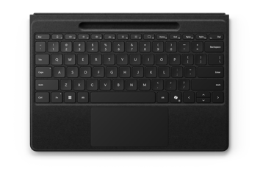
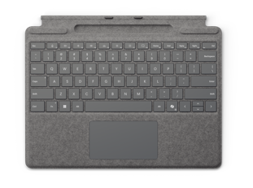
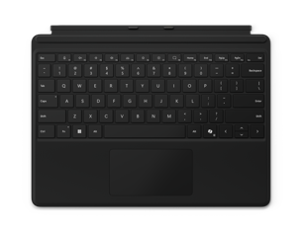
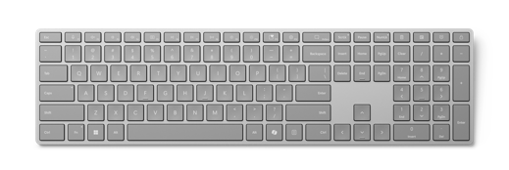
Designed for Surface Pro
Surface Keyboards
Give employees flexibility and control over how they engage with their Surface devices. Surface keyboards are precisely engineered for comfortable, accurate typing. Optimized key travel, shape, texture, and alignment support efficiency and focus throughout the workday.
These Surface keyboards feature:
Seamless connectivity and compatibility with select Surface Devices
Premium, modern design and durable construction
Full mechanical keyset with backlit keys and ideal spacing
Copilot key for one-touch Copilot access⁹
Improved productivity with dedicated keys for Call Mute,¹¹ Snip & Sketch, and more
Surface Keyboard
Sleek and modern design to match Surface devices and other accessories Built-in number pad Optimized feedback and return force to ensure a comfortable and responsive typing experience Reliable wireless connection through wireless Bluetooth 4.0 with a range of up to 16 feet Battery power lasting up to a full year¹⁰
Surface Pro Flex Keyboard | Surface Pro Keyboard with pen storage | Surface Pro Keyboard
Attached or detached use⁸ with up to 32.8 feet of connectivity in open air or 16.4 feet in a typical office environment and up to 41 hours of continuous battery life¹⁰ Secure storage, constant visibility, and wireless charging for Surface Slim Pen⁶ Stabilized with five layers of carbon fiber Optional bold keyset³⁶ with subtle accessibility features, including larger, bold font, high contrast, and brighter backlighting​ Wide, customizable precision haptic touchpad 128-bit encryption technology secures data between keyboard and device | Quick and secure attachment to Surface Pro Secure storage and wireless charging for Surface Slim Pen⁶ Alcantara® material for a warm, comfortable touch Optional bold keyset³⁶ with subtle accessibility features, including larger, bold font, high contrast, and brighter backlighting​ Large glass touchpad for precise control and navigation | Quick and secure attachment to Surface Pro Durable, stain-resistant material that easily wipes clean Large glass touchpad for precise control and navigation
⁶Sold separately. ⁸Detached use requires Windows 11. ⁹Copilot key feature availability varies by market, see aka.ms/keysupport. ¹⁰Requires Windows 11. Battery life varies significantly based on usage, network and feature configuration, signal strength, settings, and other factors. See Surface Battery Performance for details. ¹¹Call Mute and Widgets hot keys require Windows 11. ³⁶Surface Pro Keyboard with optional bold keyset version available only in US English.

