Slide 1


Surface Commercial Distributor Managed Partner (DMP)
Partner Center Onboarding Guide
Last updated: January 2025
Microsoft partner confidential

Slide 2






Surface Commercial DMP
Partner Center onboarding guide
High-level DMP onboarding flow
Onboarding: Prerequisites and callouts
Step-by-step onboarding guide
Topics covered
High-level DMP onboarding flow
Onboarding: Prerequisites and callouts
Step-by-step onboarding guide Additional information
Support
Objective
The purpose of this guide is to help companies navigate the new Surface Commercial DMP onboarding process in Partner Center.

Slide 3



Surface Commercial DMP
Partner Center onboarding guide
High-level DMP onboarding flow
Onboarding: Prerequisites and callouts
Step-by-step onboarding guide
High-level DMP onboarding flow ^{I}
High-level DMP onboarding flow

Slide 4

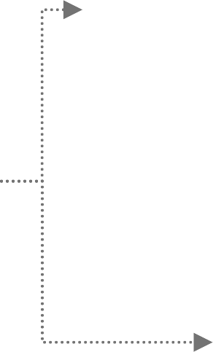

High-level DMP onboarding flow
Surface Commercial DMP
Partner Center onboarding guide
Onboarding: Prerequisites and callouts
Step-by-step onboarding guide
High-level DMP onboarding flow ^{I}
High-level DMP onboarding flow
Accept Surface Commercial DMP agreement
Partner development manager (PDM) reviews submission
Submission is approved
Sign in to Partner Center
Complete onboarding form
End
Submission is denied

Slide 5
Surface Commercial DMP
Partner Center onboarding guide
Onboarding: Prerequisites and callouts
High-level DMP onboarding flow
Onboarding: Important links and callouts
Step-by-step onboarding guide
Onboarding: Prerequisites and callouts

Slide 6
Surface Commercial DMP
Partner Center Onboarding Guide
Onboarding: Prerequisites and callouts
High-level DMP onboarding flow
Onboarding: Important links and callouts
Step-by-step onboarding guide
Prerequisites for Onboarding into Partner Center Surface Programs
1. Existing Microsoft AI Cloud Partner Program or Microsoft Partner Network (MPN) Account: You must have an active Microsoft AI Cloud Partner Program/MPN account in order to onboard into Partner Center. If you do not have an active tenant account or need to create an additional one, follow the link below:
Partner Center – Join a Program
2. Tenant ‘Global Admin’ is a required role: In order to complete the onboarding process, you will need to have the Global Admin for your Company’s Partner Center domain/tenant identified and available. If this role needs to be assigned, or if you would like to verify the role owner(s), refer to the links below.
Become a global admin for your company
What to do if the only admin for your Microsoft AI Cloud Partner Program has left the company
3. Mailbox Configuration: Ensure that your Mailbox preferences are configured correctly to receive Partner Center communications
Go to my preferences
Update the Contact Email field with your preferred email ID. Once you have entered the email address in this field, refresh the page and then click on Send
OTP (in this order).
You’ll receive a one-time password (OTP) to your specified email ID. Enter the password per the instructions to complete verification of your email address.

Slide 7
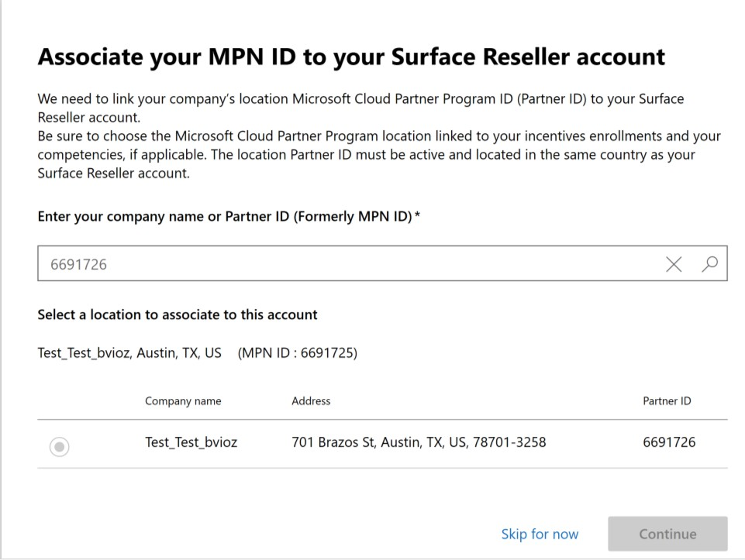
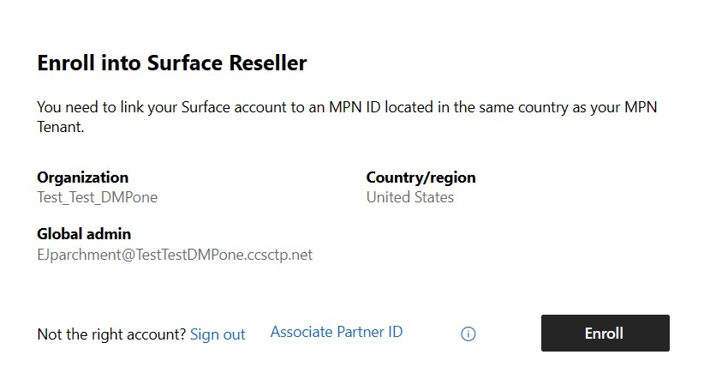
Surface Commercial DMP
Partner Center Onboarding Guide
Onboarding: Prerequisites and callouts
High-level DMP onboarding flow
Onboarding: Important links and callouts
Step-by-step onboarding guide
Additional Callouts
If you are an existing Cloud Solution Provider (CSP) Partner:
Please note that you cannot have a non-CSP Partner Location ID (PLA) under the same AAD tenant as a PLA associated to your CSP program.
If the PLA you are using to sign up for Surface is already enrolled in CSP, you will be able to use that PLA for your Surface programs with no issues. During Step 3 of the onboarding guide (Slide 12), be sure that you are selecting the same PLA as your CSP account when you see the prompt to Associate your MPN ID to your Surface Reseller account.
If the PLA you wish to enroll into Surface is not the PLA for your CSP account, It will need to be associated to Surface programs under a different tenant. In this scenario, select ‘Skip for now’ and sign-in using an eligible tenant. If you do not have an existing tenant that meets these requirements, you will need to create a new account as defined in Step 1a (slide 10). Then select Associate Partner ID using the new tenant to search for the required PLA.
Only One Surface enrollment per tenant is allowed
If you are managing multiple locations or subsidiaries, please note that only one Surface enrollment is allowed per tenant. You will need to associate each Surface enrollment to its respective PLA/tenant.
If you have more than one PLA that needs to be enrolled into Surface, refer to this resource on adding tenants to your Partner Center account.
If you can’t access Insights, refer to this resource on multi-tenant accounts to link the tenants.

Slide 8
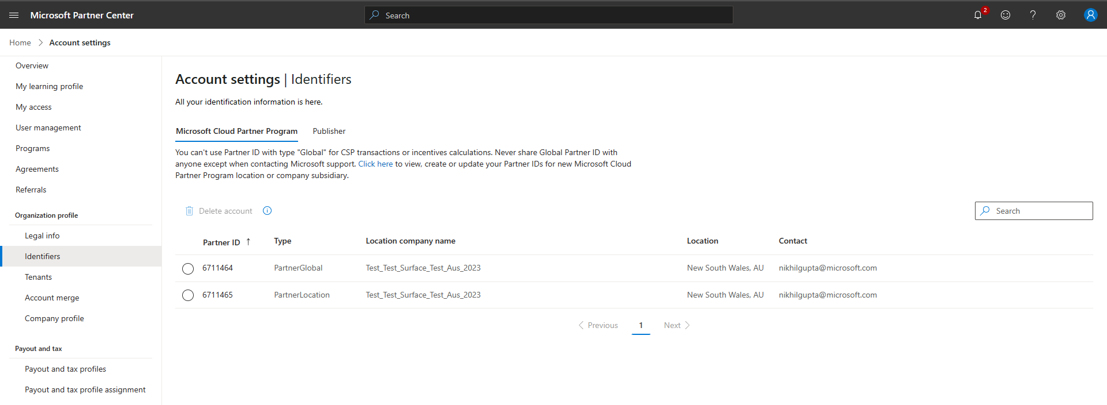
Surface Commercial DMP
Partner Center onboarding guide
Onboarding: Prerequisites and callouts
High-level DMP onboarding flow
Onboarding: Important links and callouts
Step-by-step onboarding guide
Additional Callouts
How to locate your Partner ID :
It may be necessary for a DMP Partner to locate their Partner Global ID (PGA) or Partner Location ID (PLA) in Partner Center in order to reference it with a Distributor.
In Partner Center, go to Account Settings - Identifiers - MCPP tab and you will find your account numbers in this location.

Slide 9
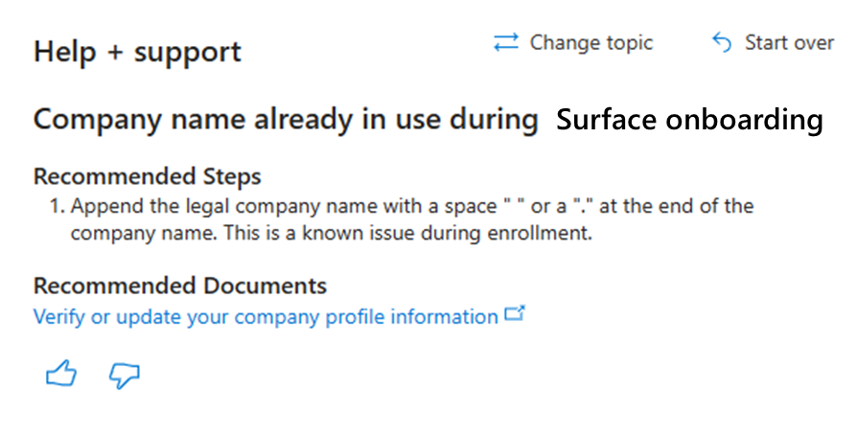
Surface Commercial DMP
Partner Center onboarding guide
Onboarding: Prerequisites and callouts
High-level ADR onboarding flow
Onboarding: Important links and callouts
Step-by-step onboarding guide
Additional Callouts
If "A relationship already exists with a different Legal Entity" error occurs, please follow the below step:
On the Company Information page, append your legal company name with a space " " or a period "." at the end of the company name. (ex. Change Contoso Inc to Contoso Inc.)
See Step 4 within the 'Step-by-step onboarding guide' section of this guide (slide 16) for the Company Information page.
This is a known issue during enrollment.
Please note that this is also provided under Help + Support for Surface Enrollment ​

Slide 10
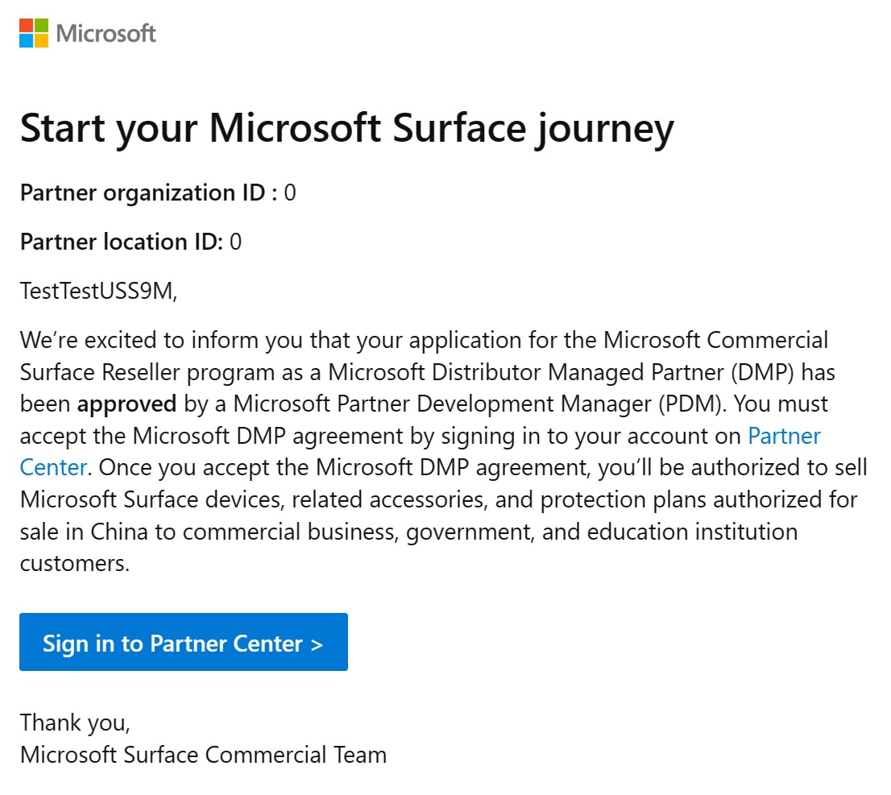
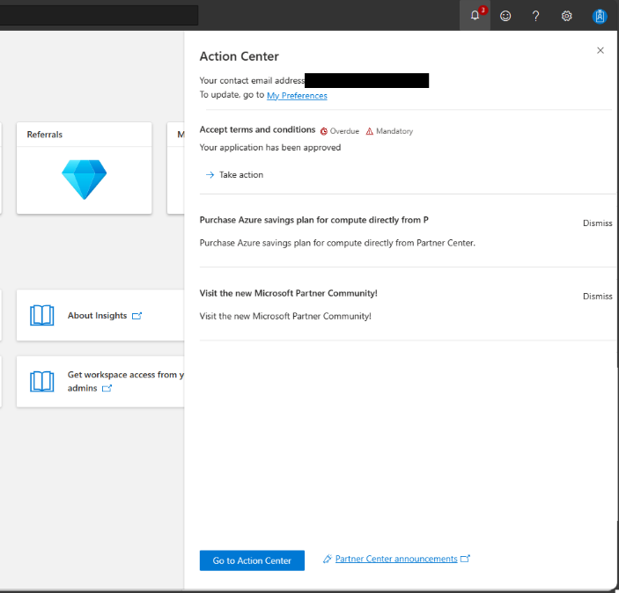
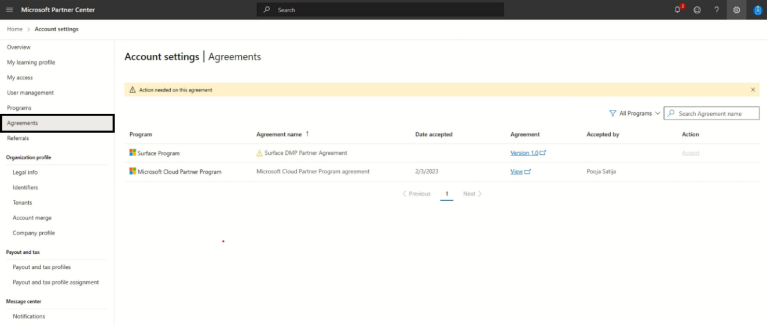
Surface Commercial DMP
Partner Center onboarding guide
Onboarding: Prerequisites and callouts
High-level ADR onboarding flow
Onboarding: Important links and callouts
Step-by-step onboarding guide
Additional Callouts
How to determine when you can Accept Program Terms?
Once the PDM approves, the partner Global Admin will receive an email from microsoft-noreply@microsoft.com with subject ‘Complete Microsoft Surface Distributor Managed Partner program enrollment’ to accept the terms.
2. Once the PDM approves, the Global Admin will see PC notification in Action Center to accept the terms.
3. The partner Global Admin can also navigate to the Agreements page and view/accept the agreement in Partner Center.

Slide 11
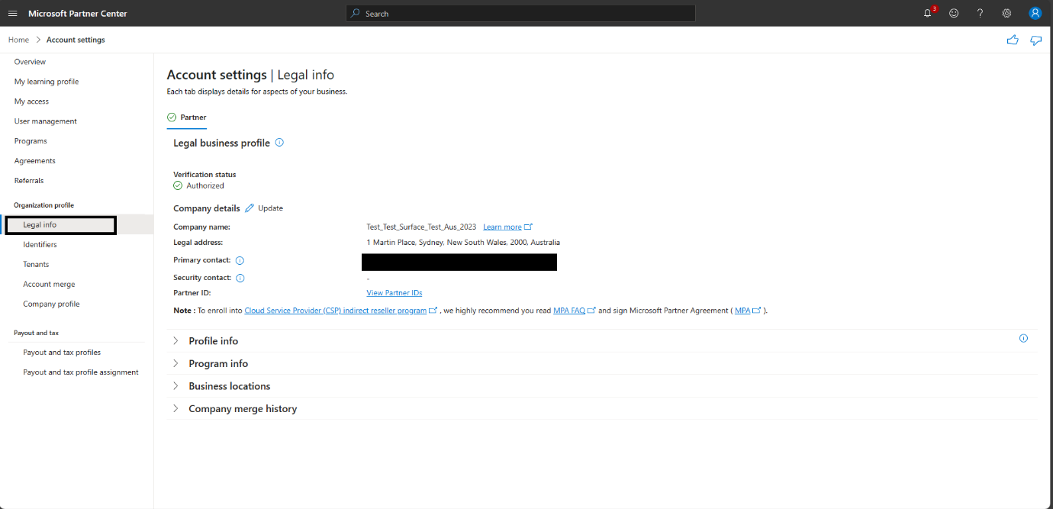
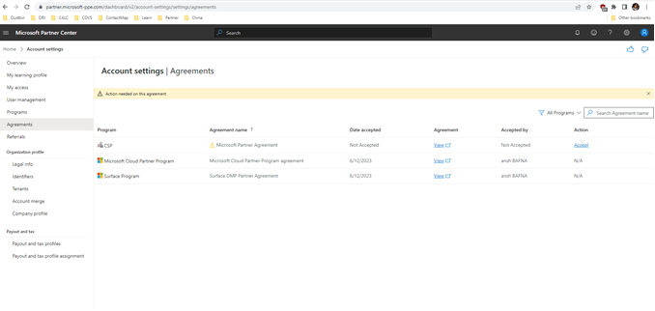
Surface Commercial DMP
Partner Center onboarding guide
Onboarding: Prerequisites and callouts
High-level ADR onboarding flow
Onboarding: Important links and callouts
Step-by-step onboarding guide
Additional Callouts
How to determine when you can Accept Program Terms?
In the case that you cannot see the communications to accept terms, it may be due to vetting being in progress
Once vetting is complete, you will be listed as Authorized in Partner tab of Legal Info page.
Accept the agreement to become active and receive the welcome email.

Slide 12

Surface Commercial DMP
Partner Center onboarding guide
Onboarding:
Step-by-step onboarding guide
Additional information
Prerequisites and
Step-by-step onboarding guide
callouts
Step-by-step onboarding guide

Slide 13
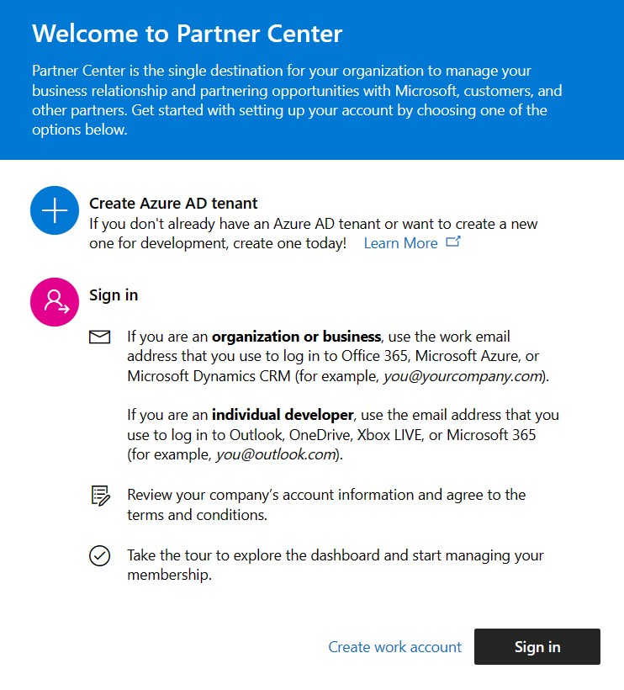
Step-by-step onboarding guide
Surface Commercial DMP
Partner Center onboarding guide
Onboarding:
Prerequisites and callouts
Step-by-step onboarding guide
Support
Step 1
Go to Partner Center: Surface DMP partner enrollment
If you are a net new partner, or need to create an additional Azure Active Directory (AAD) tenant to support your Surface program, select Create work account and follow instructions in Step 1a (slide 11) to create your new account.
If you already have an existing Azure AD tenant, select Sign in and complete the sign in using your existing username and password. From there, proceed to Step 2 (slide 12)
If you have multiple AAD logins, Be sure to sign in with the correct credentials for the Partner organization ID and Partner Location ID for the correct Company/Subsidiary and Country that you would like to be associated to your Surface account.
Please note again that the Global Admin role for the tenant will be required.

Slide 14
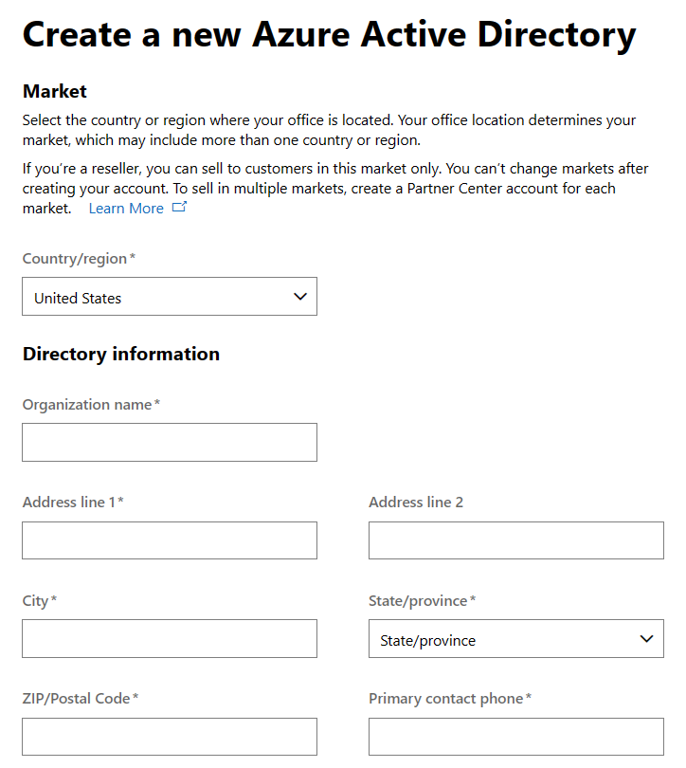
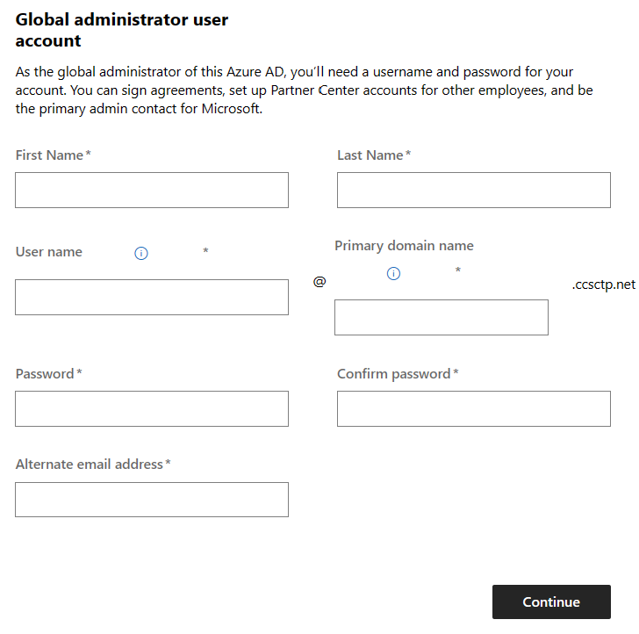
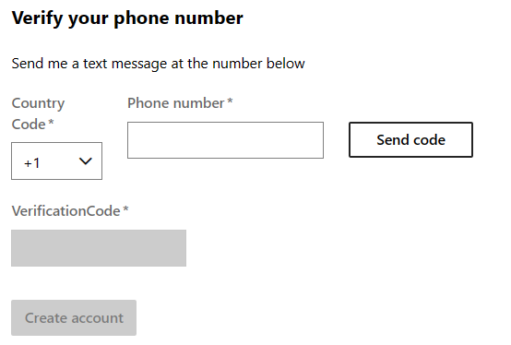

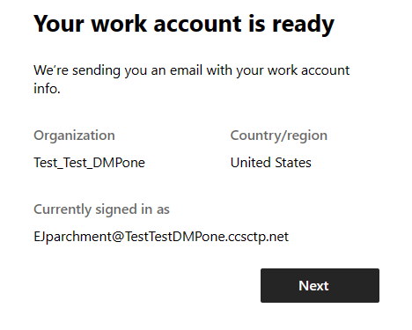
Step-by-step onboarding guide
Surface Commercial DMP
Partner Center onboarding guide
Onboarding:
Prerequisites and callouts
Step-by-step onboarding guide
Support
Step 1a (for net new accounts only)
To create a new Azure AD account, you’ll need to fill out the form with your company’s information and provide the contact details for the Global Administrator user account. Once you receive final notification that your account is ready, click Next and proceed to Step 2 (slide 12).
 | After you enter the ve select Create account will be created. (This mi minutes). | rification code and , your work account ght take up to two
After you enter the verification code and select Create account, your work account will be created. (This might take up to two minutes)
Once you select Continue, you’ll be asked to verify your phone number via text.

Slide 15
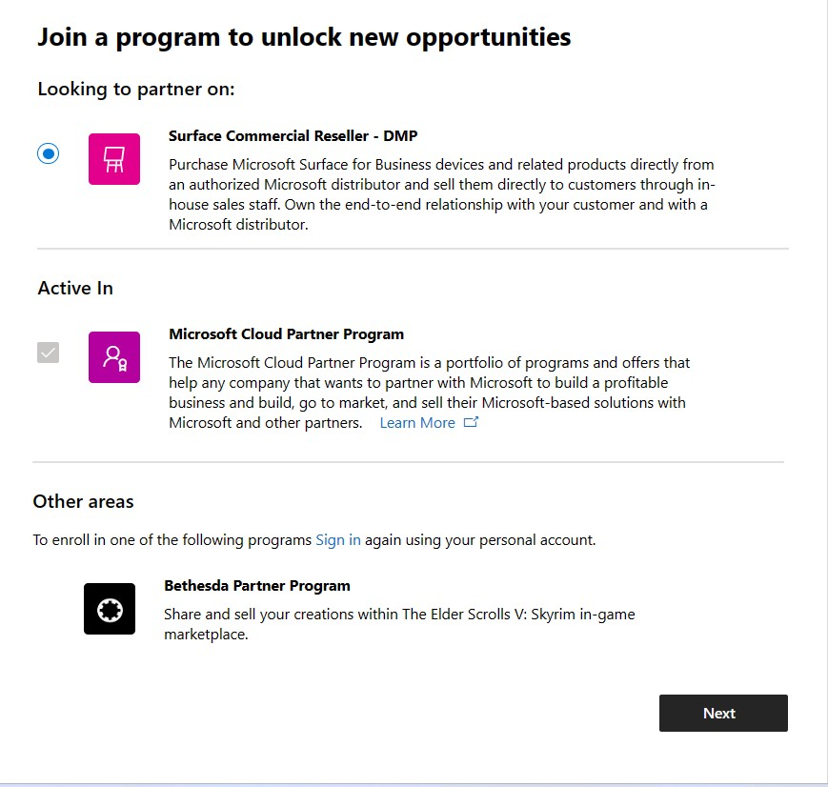
Step-by-step onboarding guide
Surface Commercial DMP
Partner Center onboarding guide
Onboarding:
Additional information
Prerequisites and
Step-by-step onboarding guide
callouts
Step 2 – Join the Surface DMP Program
After sign-in is completed with your new or existing account:
Select the Surface Commercial Reseller - DMP button > Next >
Surface Commercial Reseller - DMP.

Slide 16
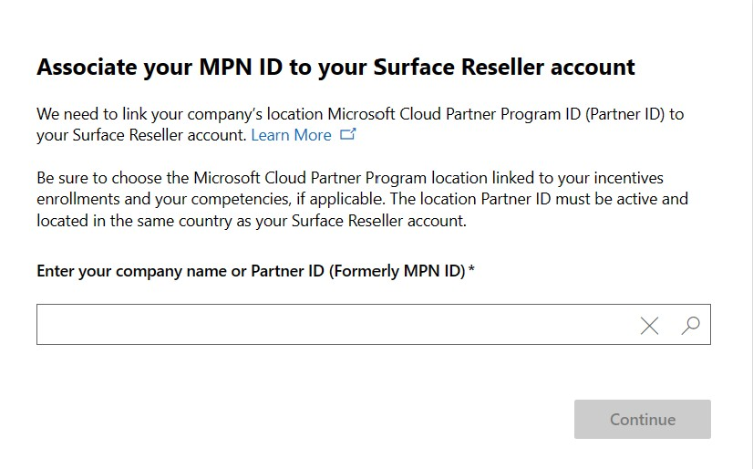
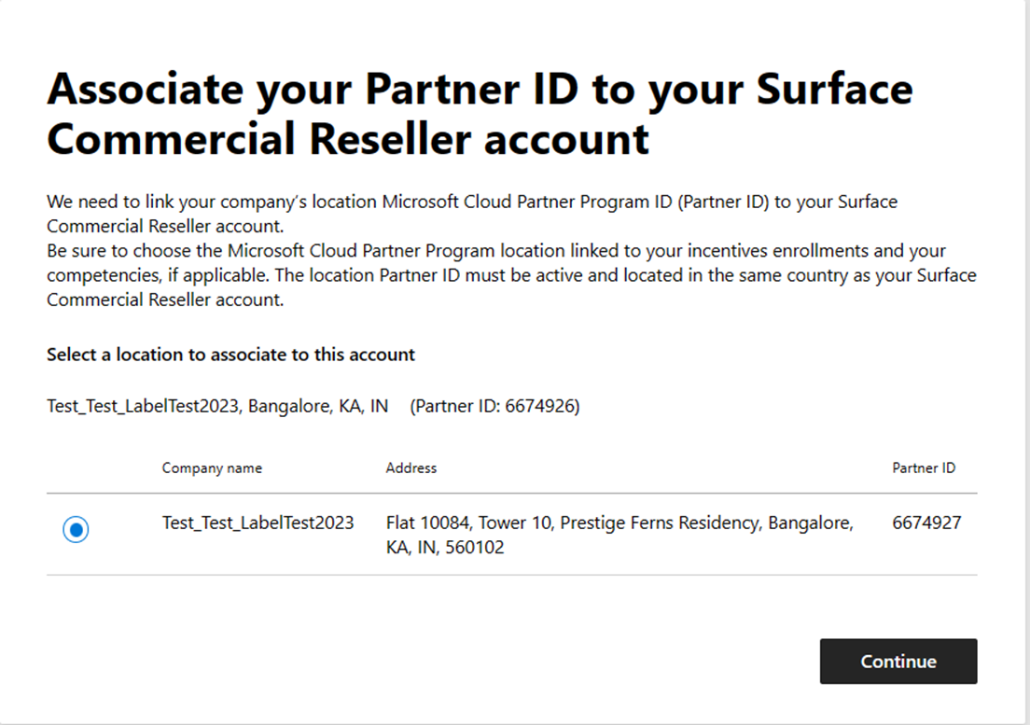
Step-by-step onboarding guide
Surface Commercial DMP
Partner Center onboarding guide
Onboarding:
Prerequisites and callouts
Step-by-step onboarding guide
Support
Step 3: Associate your PLA to your Surface Account
Verify your account information is correct. Click “Enroll”
If your account does not have any PLA associated, you will receive the “search” option to locate the PLA you would like to associate. Refer to Step 3a (Slide 14) for additional details
If your Account already has PLA(s) associated, you will receive the “select” option to select an available PLA from the list. If you are unable to find the desired PLA in this list, select ‘Associate Partner ID’ from the previous screen to enter the company name or Partner ID manually.
Once you’ve linked your Surface account to your partner ID, select Continue.

Slide 17
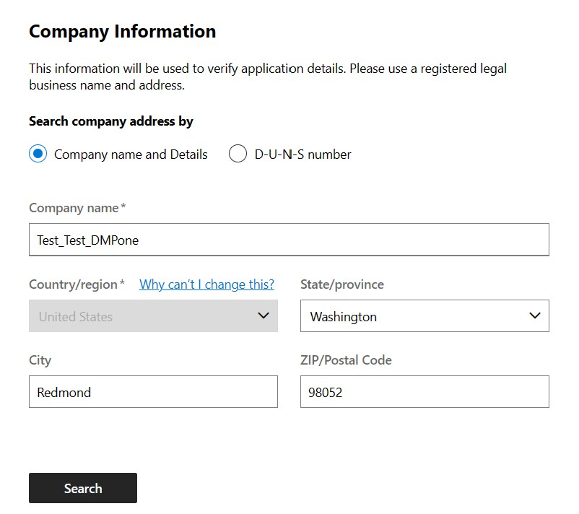
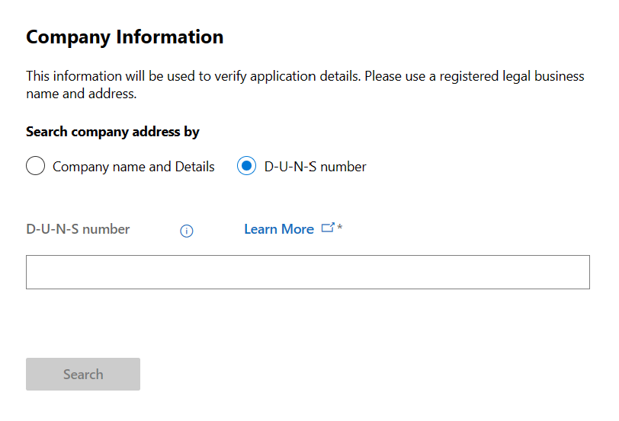
Step-by-step onboarding guide
Surface Commercial ADR
Partner Center onboarding guide
Onboarding:
Prerequisites
Step-by-step onboarding guide
Support
Step 3a
In case you are using a new account or are unable to find the required Partner Location ID (PLA), search for your company information either by company name and details or the Data Universal Numbering System (D-U-N-S) number, or by entering your information manually.

Slide 18
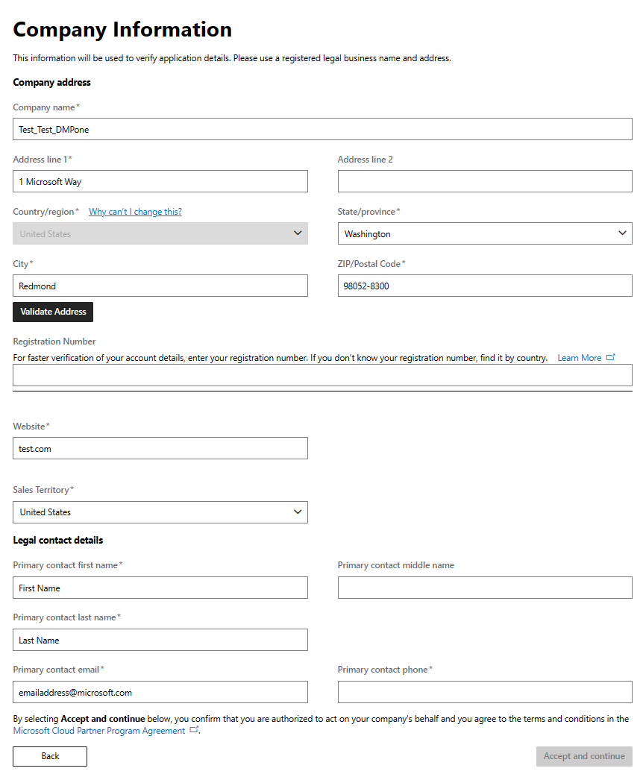
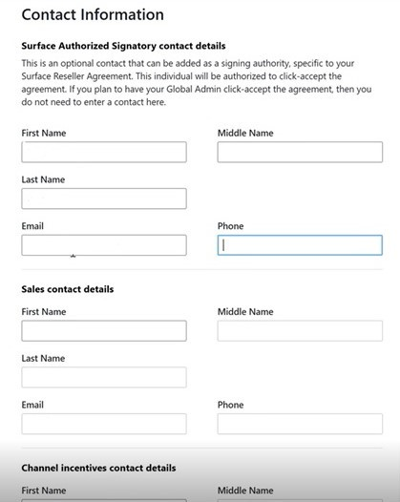
Step-by-step onboarding guide
Surface Commercial DMP
Partner Center onboarding guide
Onboarding:
Additional information
Prerequisites and
Step-by-step onboarding guide
callouts
Step 4 – Company Information
Continue with the form by validating your company information and then entering the details for the key contacts. Click Next when completed

Slide 19
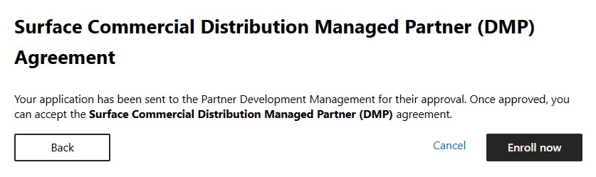
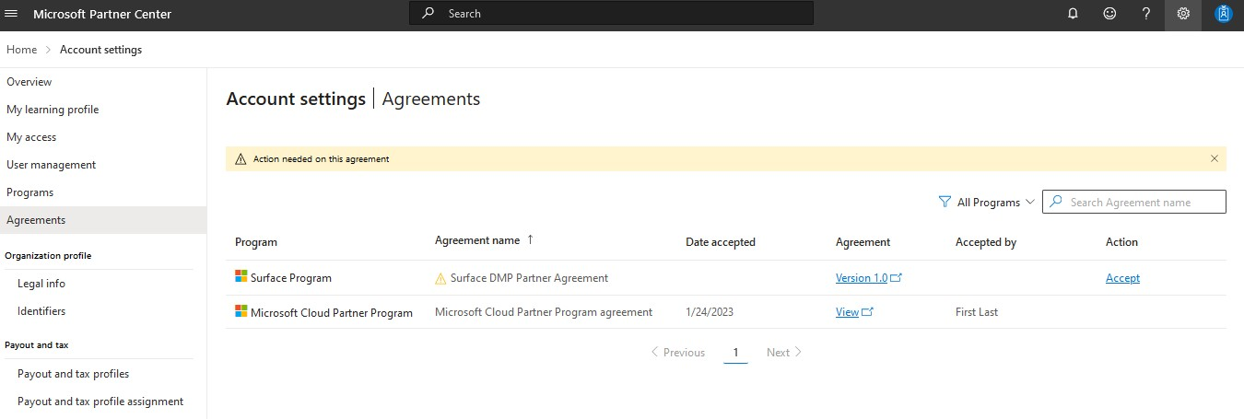

Step-by-step onboarding guide
Surface Commercial DMP
Partner Center onboarding guide
Onboarding:
Additional information
Prerequisites and
Step-by-step onboarding guide
callouts
Step 5 – Accept Program Terms
After submitting your key contacts, the form will be submitted to a Microsoft PDM for approval.
Once your form is approved by the PDM, the primary contact will receive an email to go back to Partner Center and accept the agreement.
Return to Partner Center and go to Account settings to review and accept the Surface Commercial DMP agreement.
To access your Account settings:
Select the gear icon on the upper-right corner.
Select Account settings from the dropdown menu.
3 Select Agreements on the left pane.
1
2

Slide 20
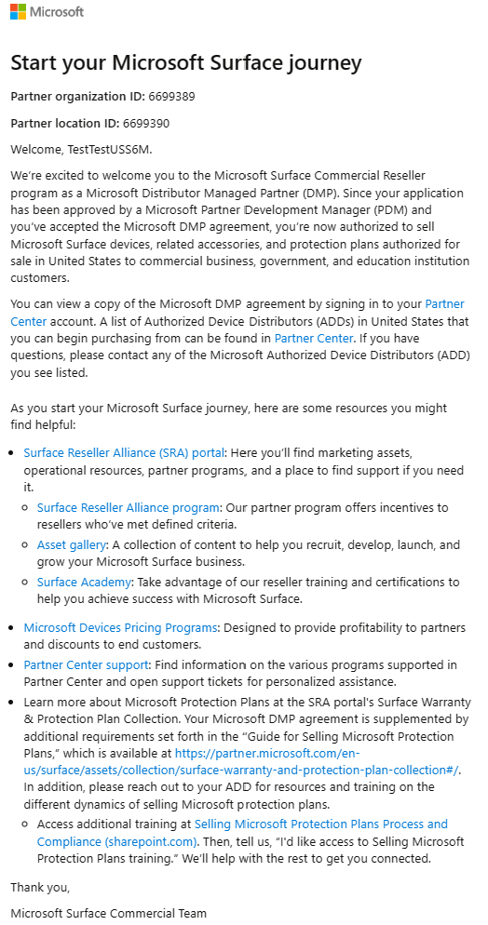
Step-by-step onboarding guide
Surface Commercial DMP
Partner Center onboarding guide
Onboarding:
Additional information
Prerequisites and
Step-by-step onboarding guide
callouts
Step 5 – Accept Program Terms
After you accept your agreement, you’ll receive a welcome email that contains multiple links to help get you started on your Surface journey.

Slide 21
Surface Commercial DMP
Partner Center onboarding guide
Step-by-step onboarding guide
Additional information
Additional information
Support
Additional information

Slide 22
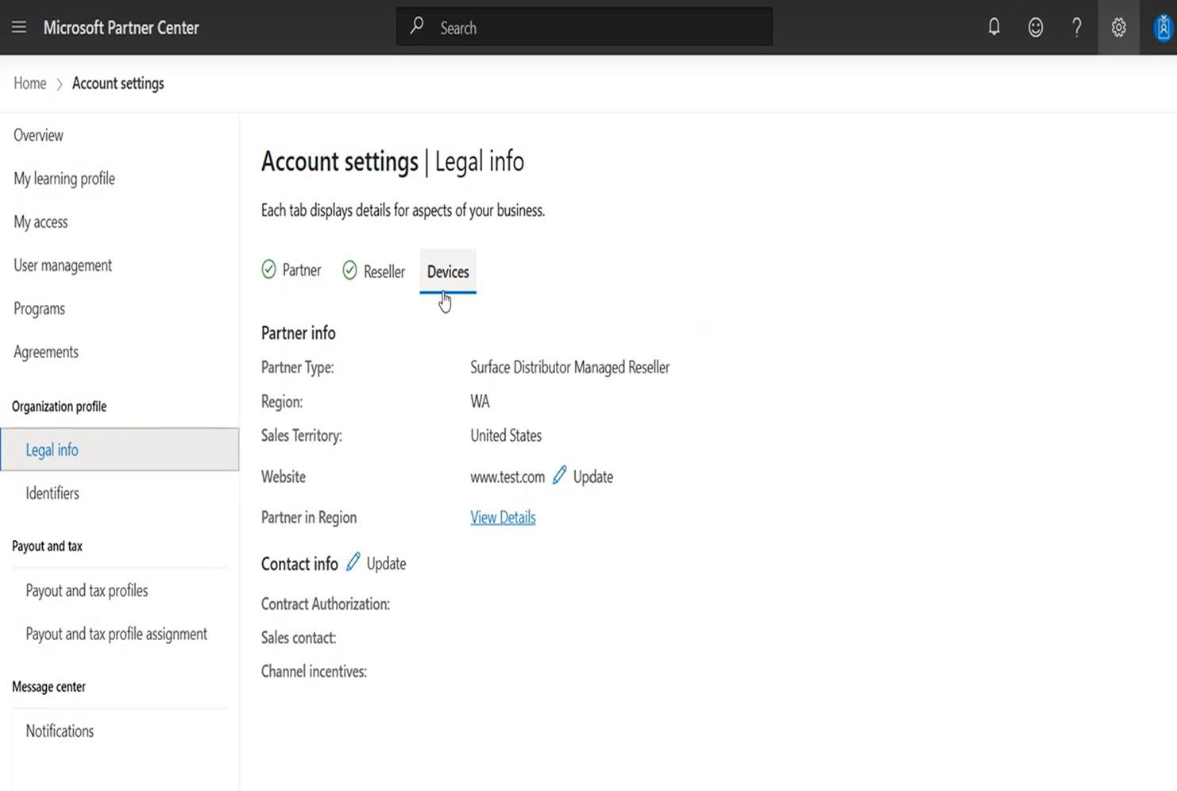

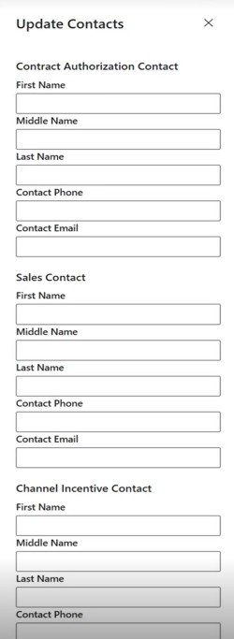

Surface Commercial DMP
Partner Center onboarding guide
Step-by-step onboarding guide
Additional information
Additional information
Support
Additional information
How to review and edit Surface contacts
1 Go to Account settings by selecting the gear icon on the upper right corner.
2 Select the Legal info tab under Organization profile.
3 Select Devices > Update (next to Contact info).
4 Either add or edit contacts on the right side.
Learn more about Partner Center:
What is Partner Center? Get around Partner Center Action Center overview
Manage your Partner Center account
Partner Center account structure
Find your workspaces, roles, and admins in Partner Center Verify your company profile

Slide 23
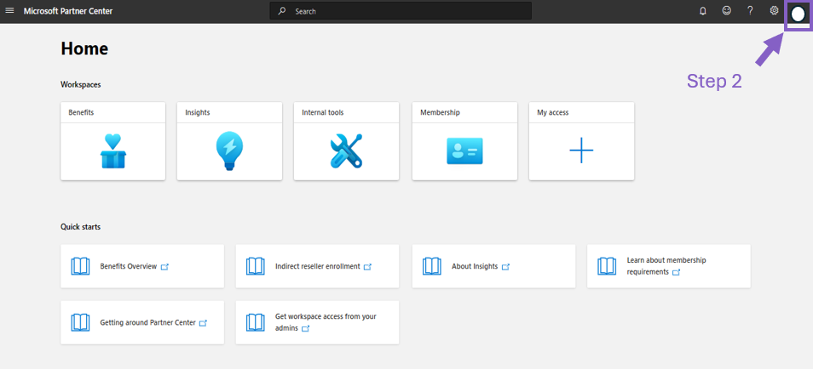
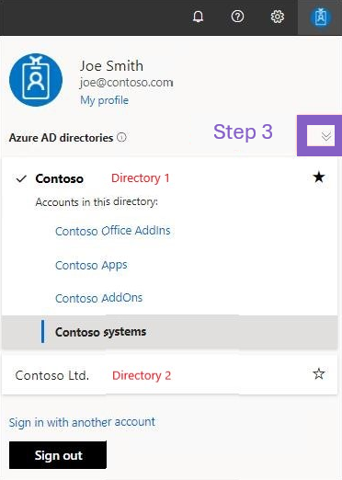
Surface Commercial DMP
Partner Center onboarding guide
Step-by-step onboarding guide
Additional information
Additional information
Support
FAQ
Steps to follow if you are unable to see your agreement
1 Visit Partner Center and login using your global admin email.
2 Select profile icon on top right.
3 Select expand option from the panel. All your Azure AD Directories will be listed here. Select the right AAD directory which was enrolled in the program.
4 Now visit the Agreements page to find the program agreement.

Slide 24
Surface Commercial DMP
Partner Center onboarding guide
Step-by-step onboarding guide
Additional informati
Support
on Support
Support

Slide 25
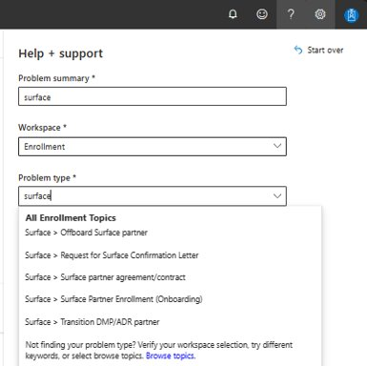
Surface Commercial DMP
Partner Center onboarding guide
Step-by-step onboarding guide
Additional informati
Support
on Support
Support
For any help or support needed during onboarding, use the link: Get support in Partner Center.
Select ? in Partner Center to open the Help + Support form, input the following:
Problem Summary = surface
Workspace = Enrollment
Problem type = Surface > Surface Partner Enrollment (Onboarding)
    Select appropriate topic - Surface Partner Enrollment (Onboarding) is frequently selected.
Support will be offered in English per the hours of operation. You will receive emails from support@mail.support.microsoft.com.
To update a partner account, either a global admin or an MPN partner admin role must be assigned. To learn how to assign roles, refer to Partner Center resource on assigning roles and permissions to users.

Slide 26

Thank you
© Copyright Microsoft Corporation. All rights reserved.

